Slide 1


SQL PROJECT
FINANCE & SUPPLY CHAIN ANALYTICS
AT ATLIQ HARDWARE
Presented by
Nagendra Vallepu

Slide 2
TABLE OF CONTENTS
  About AtliQ
  Business Model
  Problem Statement
  Project Overview
  Reports
  Conclusion
Presented by
Nagendra Vallepu

Slide 3
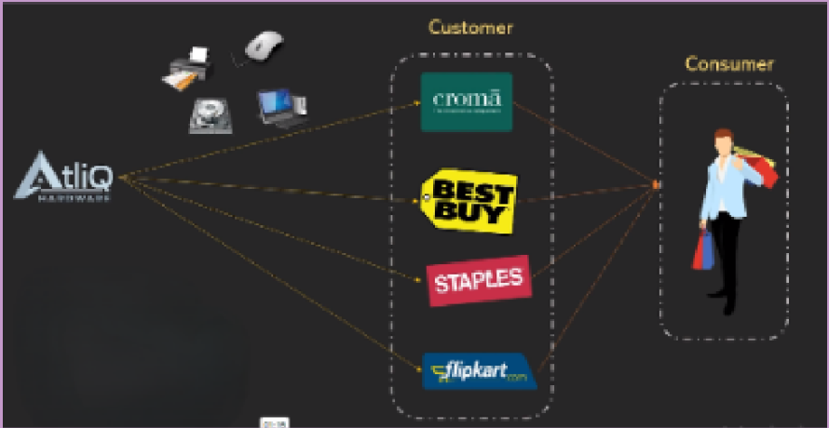
ATLIQ HARDWARE AND BUSINESS MODEL
AtliQ Hardware is a distinguished global leader in electronics manufacturing, specializing in the production and distribution of an extensive range of high-quality hardware products. Our offerings include personal computers, printers, mice and a variety of other computer peripherals, serving the diverse needs of customers worldwide.
Presented by
Nagendra Vallepu

Slide 4
PROBLEM STAMENT & PROBLEM OVERVIEW
AtliQ Hardware is is currently facing performance challenges due to the increasing size and complexity of its Excel files. To address this, the company has formed a dedicated team of data analysts to leverage MySQL for extracting valuable insights and enhancing operational efficiency
Problem Statement
The Scope of this project entails conduction an in-depth analysis of the dataset provided by AtliQ Hardware. The primary goal is to derive actionable insights regarding sales performance, market dynamics, customer behavior, and to forecast supply chain trends
Problem Overview
Presented by
Nagendra Vallepu

Slide 5
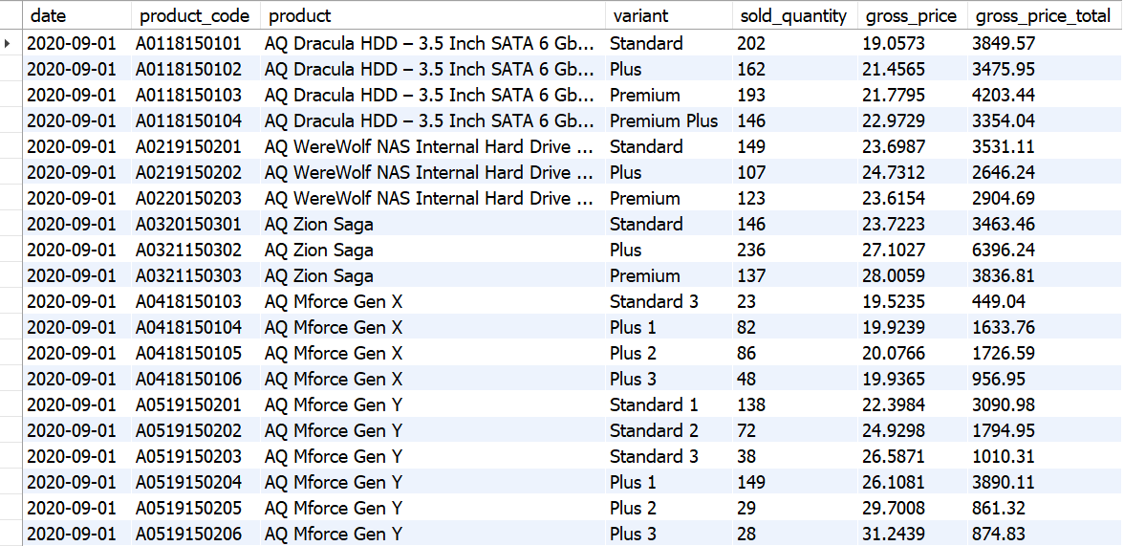
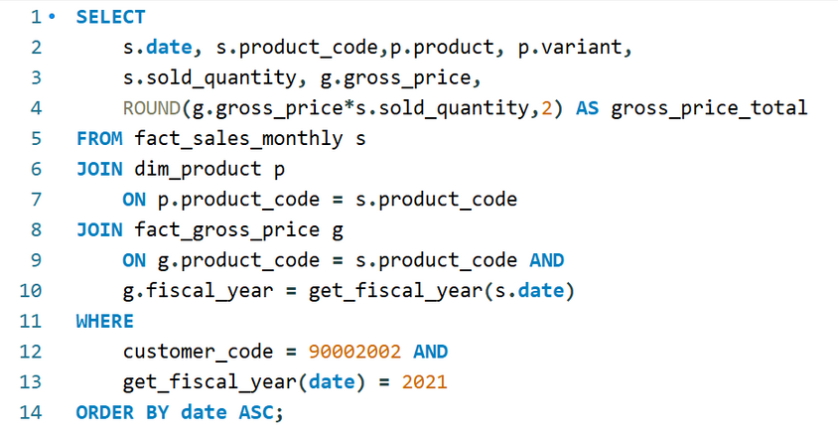
CROMA SALES REPORT
Generate a report detailing the individual product sales for Croma India customer throughout the fiscal year 2021
Presented by
Nagendra Vallepu

Slide 6
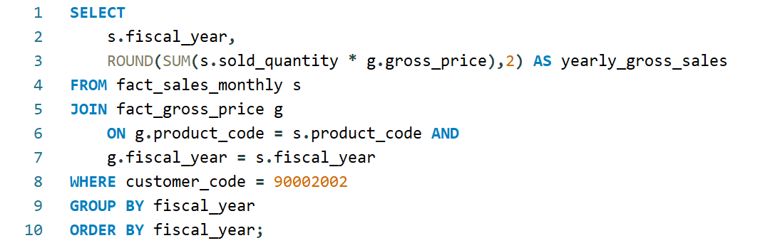
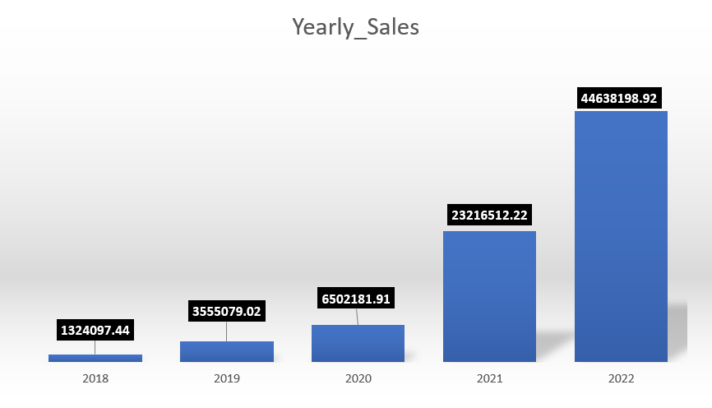
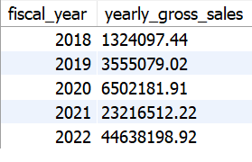
CROMA YEARLY GROSS SALES REPORT
Generate a yearly report for Croma India where there are two columns.
  Fiscal Year
  Total Gross Sales amount
in that year from Croma
Presented by
Nagendra Vallepu

Slide 7
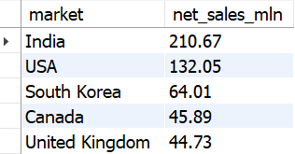
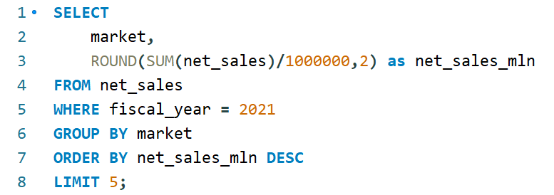
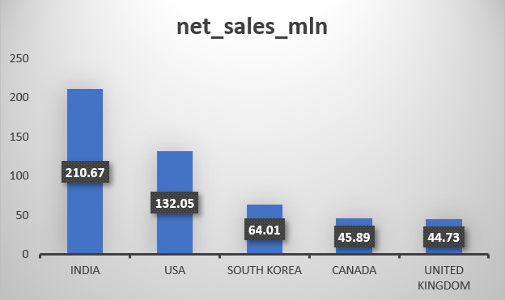
TOP 5 MARKETS
Generate a report getting Top 5 markets
by Net Sales in Fiscal Year 2021
Presented by
Nagendra Vallepu

Slide 8
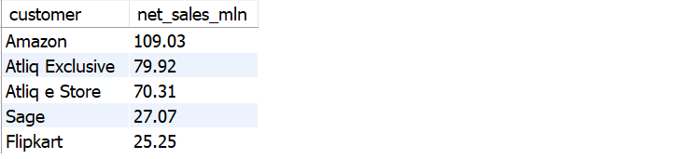
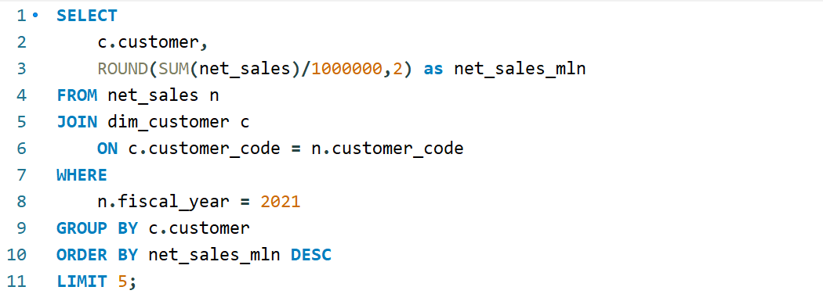
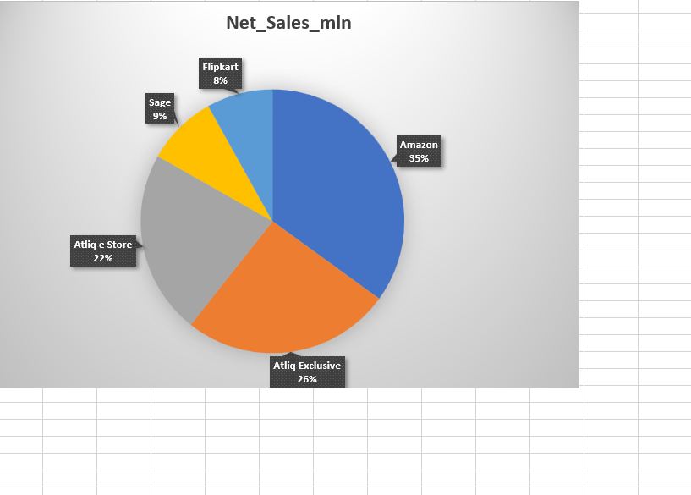
TOP 5 CUSTOMERS
Generate a report getting Top 5 Customers by Net Sales in Fiscal Year 2021
Presented by
Nagendra Vallepu

Slide 9
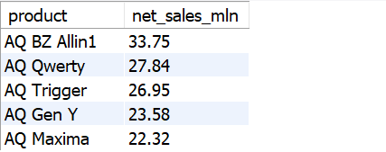
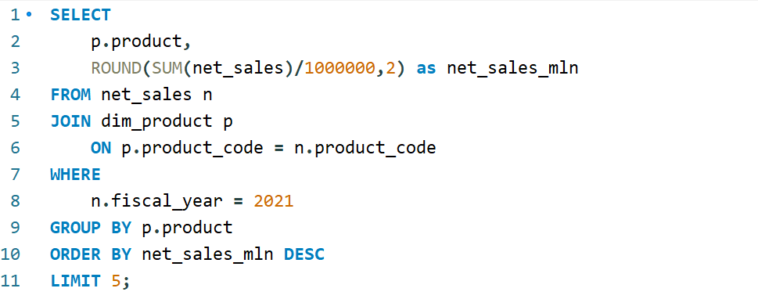
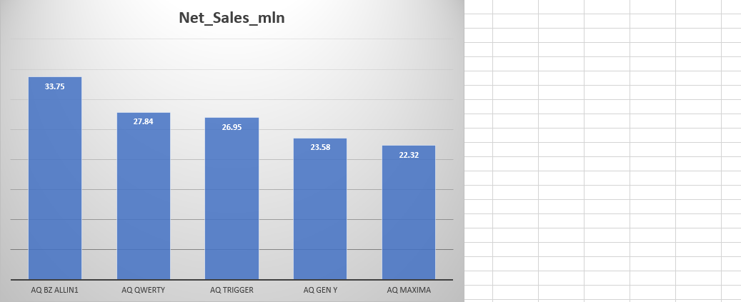
TOP 5 PRODUCTS
Generate a report getting Top 5 Products by Net Sales in Fiscal Year 2021
Presented by
Nagendra Vallepu

Slide 10
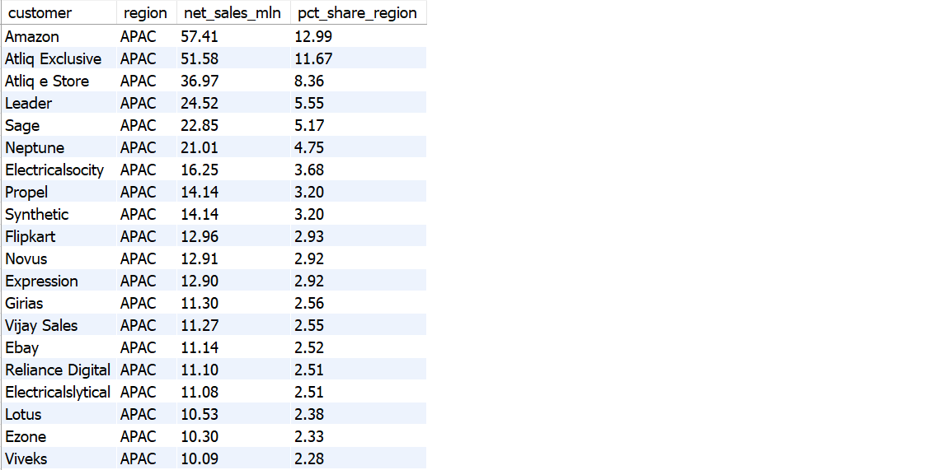
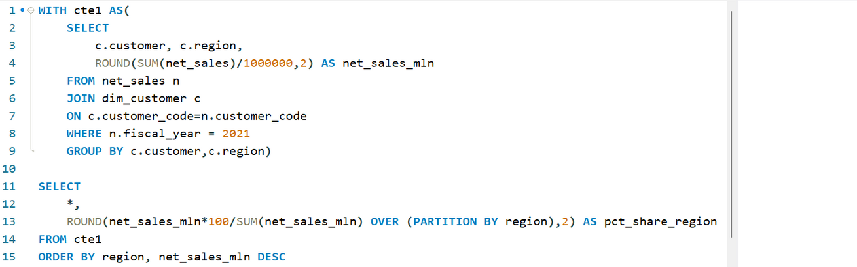
NET SALES% REPORT
Generate a Net Sales% report of Customers in different region
Presented by
Nagendra Vallepu

Slide 11
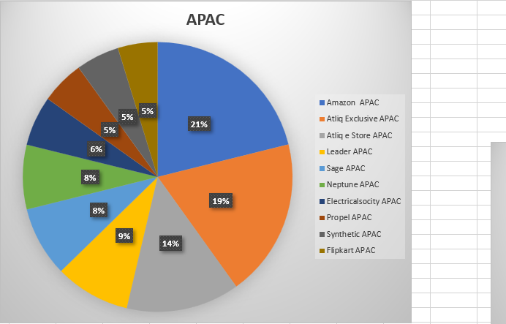
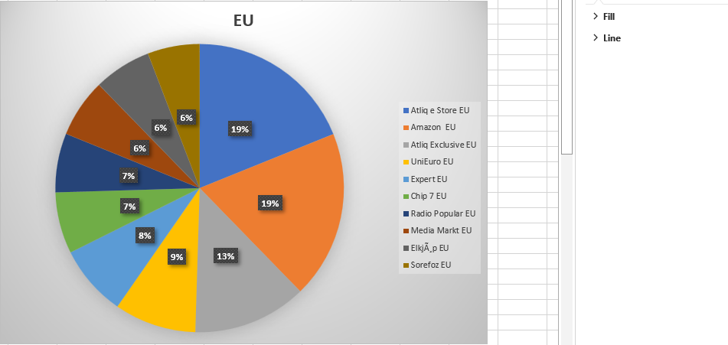
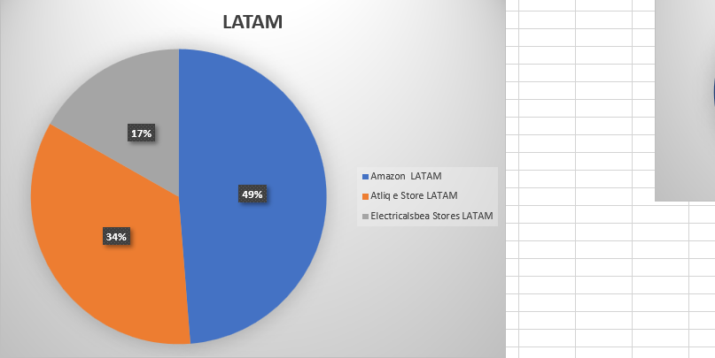
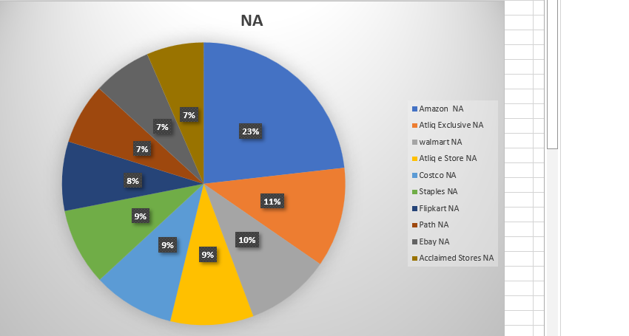
MARKET SHARE%
Top Customers in different Regions
Presented by
Nagendra Vallepu

Slide 12
CONCLUSION
  AtliQ Hardware achieved record sales in 2022
  India was the largest market in 2021 with sales of $210.67M
  Amazon generated the highest Net Sales in 2021 with $109.03M
  The AQ BZ All-in-One was the top-selling product in 2021 with the sales of $33.75M
  Amazon captures the top market share% in APAX, LATAM & NA regions.
  AtliQ estore topped the chart in EU region.
Presented by
Nagendra Vallepu

Slide 13
Thank you!
Presented by
Nagendra Vallepu

