Slide 1
Knowledge Sharing Session
AWS Static Content Migration

Slide 2
Contents
Introduction To AWS
Why AWS
What services are provided by AWS
AWS Migration Approach.

Slide 3
Introduction To AWS
AWS is basically Global cloud platform which host and manages services over Internet.
Advantages of Amazon Web Services
Scalability.
Reliable and secure infrastructure.
Provide wide range of services and tools.
offers a pay-as-you-go pricing model.

Slide 4
Why AWS?
7 reasons Why we need to choose AWS as your cloud platform
Location
Recovery System
Better Security
Multi-region Backups
Scalabilty Factor
Pricing Model
Flexibilty

Slide 5
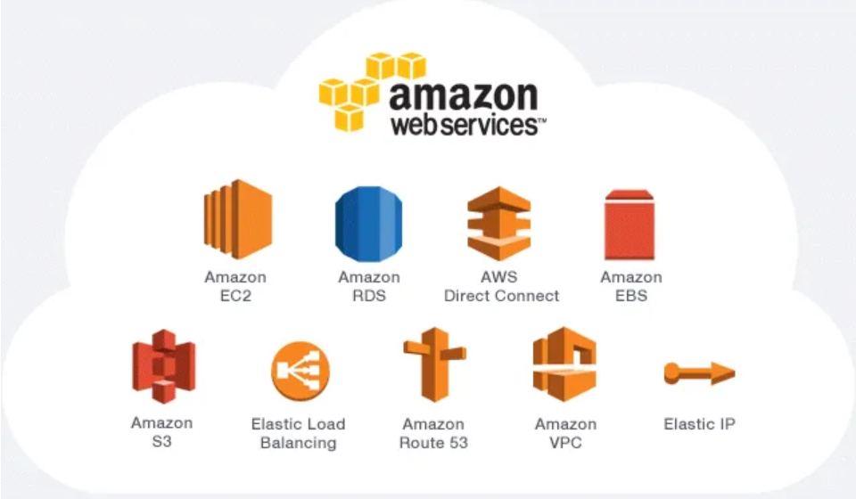
Services Provided By AWS

Slide 6
Services Provided by AWS
Amazon EC2 (Elastic Compute Cloud) : EC2 is a web service which aims to make life easier for developers by providing secure and resizable compute capacity in cloud.
Amazon S3 (Simple Storage Service) : It is a Public Cloud Storage resource available in AWS S3 platform. Amazon S3 buckets are similar to file folders and can be used to store, retrieve, back up and access objects.
Amazon Lambda : AWS Lambda is an Amazon serverless computing system that runs code and automatically manages the underlying computing resources like (EC2).
Amazon IAM(Identity and Access Management) : A web service that helps you securely control access to AWS resources.

Slide 7
Dynamo DB : A hosted NoSQL database offered by AWS.
Amazon CloudFront : Amazon CloudFront is a web service that speeds up distribution of your static and dynamic web content, such as .html, .css, .js, and image files, to your users.
Amazon Cloudwatch : Amazon CloudWatch monitors your AWS resources and the applications you run on AWS in real time. You can use CloudWatch to collect and track metrics, which are variables you can measure for your resources and applications.

Slide 8
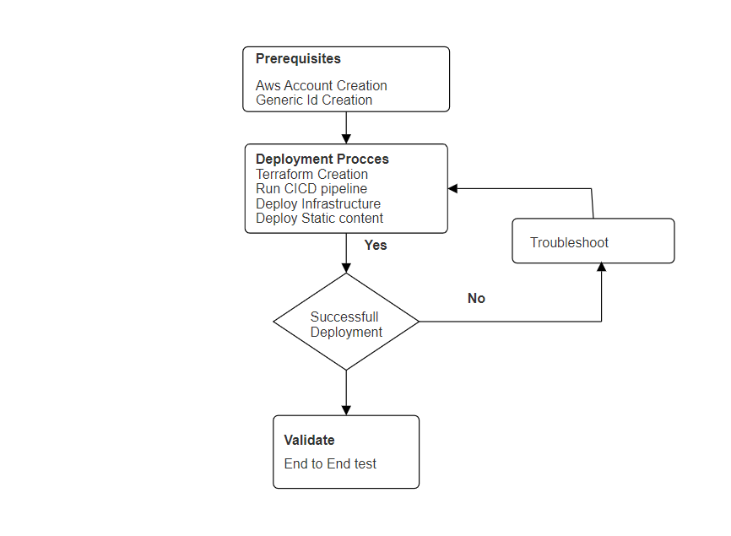
AWS migration Approach

Slide 9
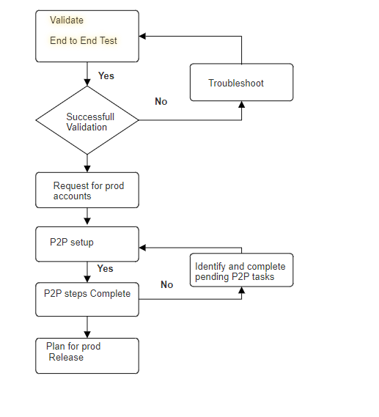

Slide 10
Prerequisites
AWS account creation
-> It should be created in Hermes.
-> AWS Deployer role creation Using RAAS.
-> Raising Access to AWS.
Generic Id creation
-> ID format
-> DAWS-HS-(Service Name)
-> TAWS-HS-(Service Name)
-> PAWS-HS-(Service Name)

Slide 11
Deployment Process
Creating S3 buckets with policies using Terraform
Create Terraform using the template below
>https://git.express-scripts.com/ExpressScripts/aws-static-content-terraform-template
Edit the application details with in the terraform file and Jenkins file.
> Dev, Dev-Candidate, Qa, Qa-candidate
Create the separate Jenkins Pipeline for Terraform Execution.
Run the Terraform.

Slide 12
Application Deployment
Create separate Feature branch with Jenkins file.
In Jenkins file fill the details like Generic ids and S3 buckets details.
Create the separate Jenkins file for application deployment.
After it successfully deployed login to aws and test the urls.

Slide 13


