Slide 1
Apache Hadoop Single Node Installation

Slide 2
Installation
Install Virtual Box
Create New VM and Install Ubuntu Desktop OS
Start VM and Open Terminal, run below commands
sudo apt-get update
sudo apt-get install openssh-server openssh-client
ssh-keygen and cd .ssh
Cat id_rsa.pub >> authorized_keys
ssh localhost
Download Hadoop from stable2 folder
Download JDK and Eclipse

Slide 3
Set Path in .bashrc
sudo gedit .bashrc
export JAVA_HOME=/home/osboxes/YARN/jdk1.8.0_65
export PATH=$PATH:$JAVA_HOME/bin
export HADOOP_HOME=/home/osboxes/YARN/hadoop-2.7.1
export PATH=$PATH:$HADOOP_HOME/bin
export PATH=$PATH:$HADOOP_HOME/sbin
export HADOOP_MAPRED_HOME=$HADOOP_HOME
export HADOOP_COMMON_HOME=$HADOOP_HOME
export HADOOP_HDFS_HOME=$HADOOP_HOME
export YARN_HOME=$HADOOP_HOME
export HADOOP_COMMON_LIB_NATIVE_DIR=$HADOOP_HOME/lib/native
export HADOOP_OPTS="-Djava.library.path=$HADOOP_HOME/lib"

Slide 4
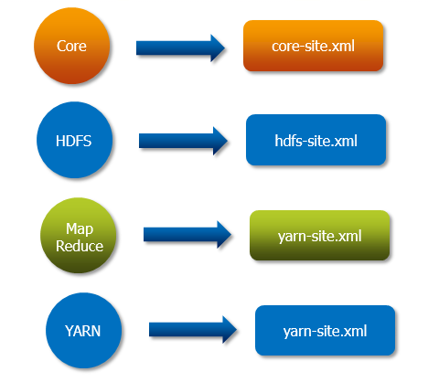
Configuration Files

Slide 5
Configuration Files – hadoop2.x/etc/hadoop/
hadoop-env.sh
export JAVA_HOME=/home/osboxes/YARN/jdk1.8.0_73
hdfs-site.xml
<property>
<name>dfs.replication</name>
<value>1</value>
</property>
<property>
<name>dfs.namenode.name.dir</name>
<value>file:///home/osboxes/YARN/hdp-data/dfs/name</value>
<description>Name node should store the name table(fsimage) </description>
</property>
<property>
<name>dfs.datanode.data.dir</name>
<value>file:///home/osboxes/YARN/hdp-data/dfs/data</value>
<description>data node
should store its blocks </description>
</property>

Slide 6
Configuration Files – hadoop2.x/etc/hadoop/
core-site.xml
<property>
<name>fs.default.name</name>
<value>hdfs://localhost:9000</value>
<description>The name of the default file system </description>
</property>
yarn-site.xml
<property>
<name>yarn.nodemanager.aux-services</name>
<value>mapreduce_shuffle</value>
</property>
mapred-site.xml
<property>
<name>mapreduce.framework.name</name>
<value>yarn</value>
<description>The runtime framework for executing MapReduce jobs. Can be one of local, classic or yarn.
</description>
</property>

Slide 7
Start Daemons
hadoop namenode –format
start-dfs.sh
start-yarn.sh
jps
NameNode
DataNode
SecondaryNameNode
ResourceManager
NodeManager

