Slide 1
Compression

Slide 2
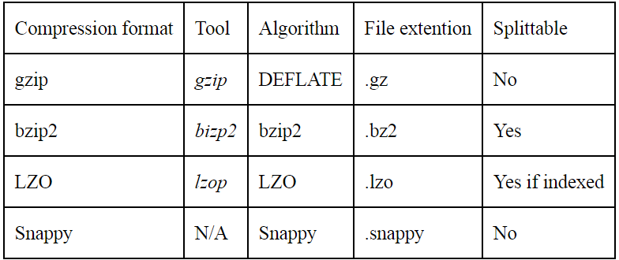
Hadoop - Compression
File Compression
Reduces space needed to store files and
Speeds up data transfer across the network
Speeds up data transfer to or from disk.
Compression Formats available to Hadoop are:

Slide 3
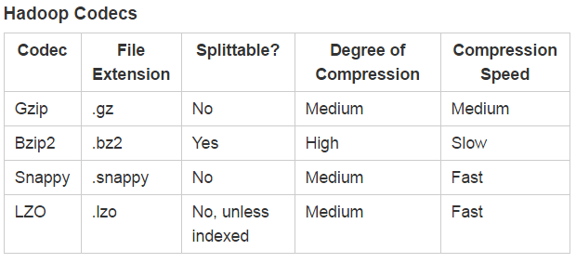

Slide 4
Hadoop – Compression Codecs
All comes with SPACE-TIME trade off
You can specify this trade off – 1 for optimized Speed, and -9 means Optimized Space
E.g. > gzip -1 file -> compresses file using fastest compression method
Splittable Compression means – you can seek to any point in the stream and start reading from some point.
Spillitable formats are best suited for MapReduce.
Codec – Compression – Decompression algorithm.
Hadoop compression codecs are available in
org.apache.Hadoop.io.compress package.
LZO – you must download separately due to license.

Slide 5
Compression and MapReduce
You should always use splittable compression with MR.[ for Input]
Because if you use non splittable compression then the Maps cannot read the file content arbitrarily, hence start of each block is not distinguished.
Hence Hadoop will launch only one map to process the entire file.
All the blocks now transfer to the node where that one map is running. So you lose the data locality.
And since it is only one map, the job will take longer time to run.

Slide 6



Compression and MapReduce

Slide 7
Compression and MapReduce
To compress the output of a MR job,
In Configuration XML files - In JOB configuration – set
mapreduce.output.fileoutputformat.compress.codec = class name of the compression codec, e.g Gzipcodec.class.
OR In Driver Class (in Java Code) - you can use the below two lines
FileOutputFormat.setCompressOutput(job,true);
FileOutputFormat.setOutputCompressorClass(job,GzipCodec.class);
The output Part file will be gzip compressed.
OR in CLI (Driver has to implement TOOL interface)
then you can pass any of the above properties to the program on the command line. This avoids hard coding of compression properties.

Slide 8
Compression and MapReduce
How to Compress MAP output?
If your MR application reads and writes uncompressed data, it is beneficial to compress the intermediate output of the map phase.
Map output is written to disk and transferred across the network to reducer nodes. So we should use FAST compressions like LZO,Snappy.
In Configuration XML files
mapreduce.map.output.compress to ture
mapreduce.map.output.compress.codec – to the compression codec.
OR In Driver Class (in Java Code) - you can use the below two lines
Configuration conf =new Configuration();
Conf.setBoolean(Job.MAP_OUTPUT_COMPRESS,true);
Conf.setClass(Job.MAP_OUTPUT_COMPRES_CODEC, GzipCodec.class, CompressionCodec.class);
Job job=new Job(conf);
OR in CLI (Driver has to implement TOOL interface)
Similar to configuration XML.

Slide 9
To See the output
Use –text option to see compressed files
Hadoop fs –text /out/*
DEMO:
Textinput format by default reads .gz as input.
Demo of –Reading compressed + compressing Map output + Writing compressed Output. [in GZ]
---------------------------------------------
Snappy there will be some issues
hadoop checknative -a | grep snappy
If it is true, then you can work with snappy.

