Slide 1
Counters

Slide 2
Counters:
There are 4 categories of counters in Hadoop: file system, job, framework, and custom.
You can use the built-in counters to validate that:
The correct number of bytes was read and written
The correct number of tasks was launched and successfully ran
The amount of CPU and memory consumed is appropriate for your job and cluster nodes
The correct number of records was read and written

Slide 3
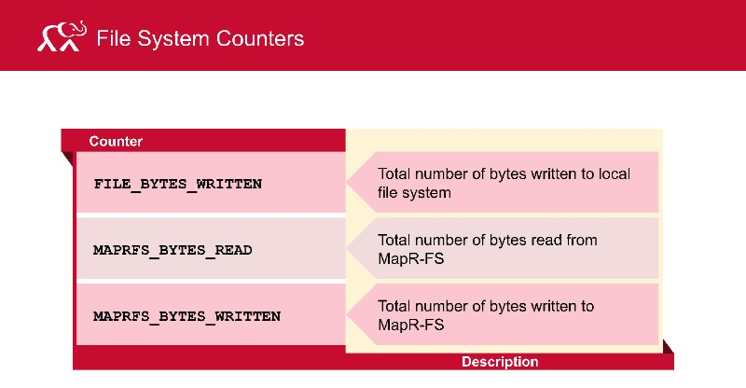

Slide 4
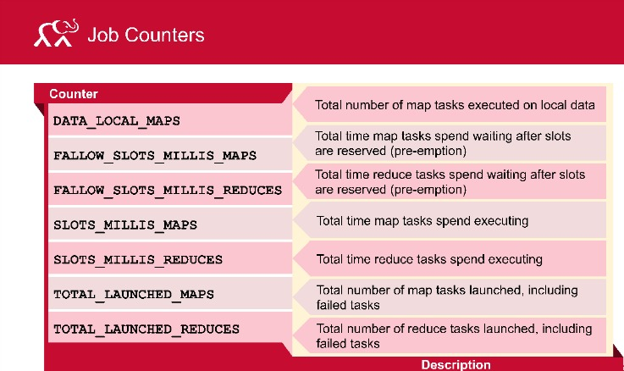

Slide 5
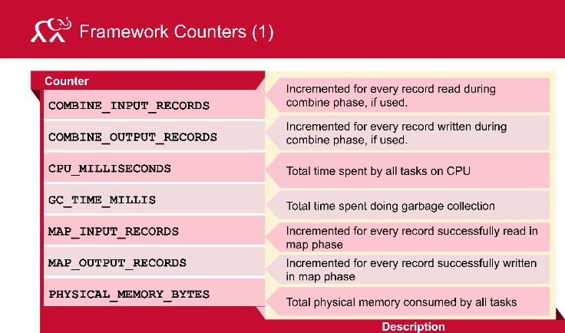

Slide 6
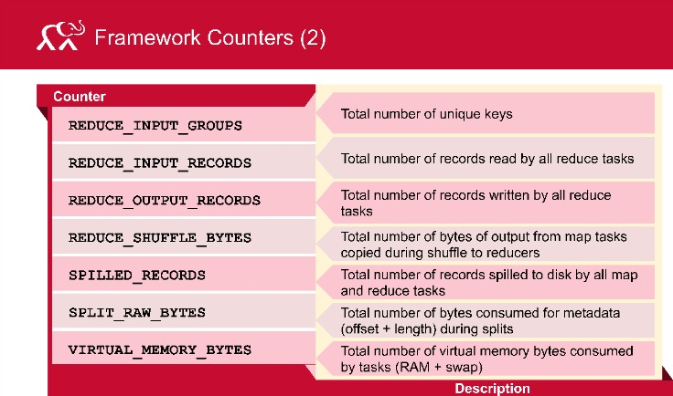

Slide 7
User Defined Counters
MR allows user code to define counters, which can be used some reports, like invalid records.
These can be incremented in Mapper or Reducer.
User-Defined Java Counters
For java counters, we need to define java enum, this serves as a Group for related counters.
Enum – java enum contains collection of constants.
Each enum can have any no of fields(counters) and
A job can contain any no of Enums( i.e any no of groups of counters and each group any no of counters)

Slide 8
User Defined Counters
Java Counters
Dynamic user defined counters
LAB – See the code

Slide 9
How to retrieve the counters
hadoop job -counter jobid groupname countername
mr-jobhistory-daemon.sh start historyserver

