Slide 1
Yarn Scheduling

Slide 2
MapReduce 1 vs MapReduce 2
MRv2 uses YARN, this is available in Hadoop 2 and later.
MRv1 – Hadoop 1 and earlier.
MRv1 – 2 daemons control the job execution – Job Tracker and Task Tracker.
Job Tracker – coordinates all jobs and schedule the tasks to run on task trackers.
TaskTrackers – run all tasks and send progress reports to job tracker.
Job Tracker keeps a record of overall progress of each job. If a Task fails, the job tracker can reschedule it on different tasktracker.

Slide 3
MRv1 – Job tracker takes care of both
Job scheduling – matching tasks with task trackers and
task progress monitoring( restarting failed or slow tasks, keeping track of tasks and maintains counters etc)
YARN – Resource manager handles the job scheduling and
Application Master (One per MR job) handles task monitoring.
Job Tracker also keeps job history, Yarn further separates this by Timeline Server
S.No | MapReduce v1 | YARN
1 | Job Tracker | RM, Application Master, Timeline Server
2 | Task Tracker | Node Manager
3 | Slot | Container

Slide 4
Advantages of YARN
Scalability: Yarn can run larger clusters than MRv1.
MRv1 – bottleneck is 4000 nodes and 40000 tasks
This is due to Job tracker has to manage both jobs and tasks
Yarn – 10000nodes and 100000 tasks
This is due to split – RM/Application Master architecture
Availability : High Availability cannot be achieved by Job tracker service due to SPOF.
YARN splits Job tracker into RM/AM. So HA is provided per cluster(RM) and per application(AM).
Multitenancy:
YARN can run MR and other distributed applications.
MRv1 can run only MR jobs.
YARN you can run different versions of MR on same cluster.

Slide 5
YARN - Scheduling
In a busy server, where resources are limited, an application need to wait for its execution.
YARN scheduler allocate resources to applications – according to some defined policy.
YARN provides a choice of schedulers and policies(which you can reconfigure a policy)
Schedulers available are – FIFO, CAPACITY, and FAIR SCHEDULER.

Slide 6
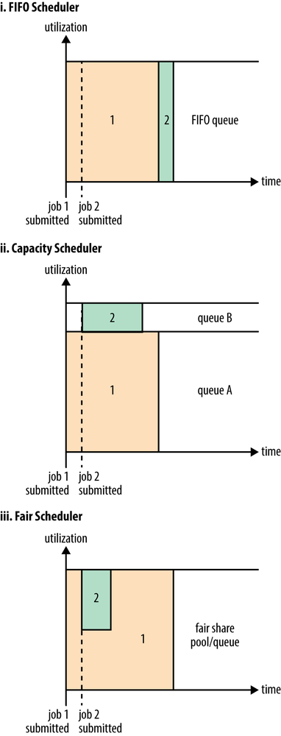
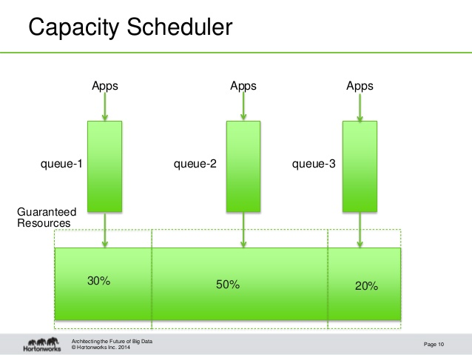

Slide 7
FIFO scheduler
FIFO Scheduler places the applications in a queue and runs them in the order of submission[first submitted is first executed]
When resources are limited, say first application requires all the resources, then the second application has to wait till the first one completes.
Even if the second job require very small amount of resources, it will be waiting till the first job completes.
I.e the small job is blocked until the large job completes.
FIFO is simple to understand, no configuration is required.
But not suitable for shared clusters. Because each application has to wait its turn.

Slide 8
Capacity and Fair Schedulers
For a Shared cluster , capacity or fair scheduler is preferred.
Both of these allows long running jobs to complete in a timely manner , while still allows users to run concurrent smaller adhoc queries to get results in a reasonable time.
Capacity scheduler, a separate dedicated queue allows small jobs to start as soon as the job is submitted. Here large jobs takes some more time to complete when compared to FIFO scheduler.
Fair scheduler, here no dedicated/reserved cluster capacity present.
When second job starts, Fair scheduler allocates half of the cluster resources(by freeing the containers used for first job[due to this second job has to wait for some time ]) so that each job uses its fair share of resources.

Slide 9
Capacity Scheduler configuration
Here we divide cluster resources into queues, each queue can be further divided in hierarchical fashion.
This division allows each organization to share its cluster allowance between different groups of users within the organization.
Note: within a queue – FIFO scheduling is used
E.g. queue hierarchy – root queue have two queues ‘prod’ and ‘dev’
Scheduler configuration file – Capacity-scheduler.xml
Each property of the form – yarn.scheduler.capacity.<queue name>.<sub-property> , here root.prod and root.dev

Slide 10
Capacity-scheduler.xml
<property> <name>yarn.scheduler.capacity.root.queues</name> <value>prod,dev</value> </property>
<property> <name>yarn.scheduler.capacity.root.dev.queues</name> <value>eng,science</value> </property>
<property> <name>yarn.scheduler.capacity.root.prod.capacity</name> <value>40</value> </property>
<property> <name>yarn.scheduler.capacity.root.dev.capacity</name> <value>60</value> </property>
<property> <name>yarn.scheduler.capacity.root.dev.maximum- capacity</name> <value>75</value> </property>

Slide 11
Capacity scheduler ..
We set the max-capacity so that at any point of time the queue won’t consume 100% of the cluster capacity , when the other queue is idle.
This way the other queue need not wait till the first queue containers to be get cleared.
Queue placement –
In Map reduce we specify - mapreduce.job.queuename
This will be name of the queue we want to use. If the queue name doesn’t exists, you will get error at submission time.
If no queue specified, application will be placed in ‘default’ named queue.

Slide 12
Fair Scheduler
It Attempts to allocate resources so that all running applicaitons get same share of resources.
How to enable Fair Scheduling? – Yarn-site.xml
Property name - yarn.resourcemanager.scheduler.class
Value – org.apache.hadoop.yarn.server.resourcemanager.scheduler.fair.FairScheduler.
CDH – Fair scheduler is default
Apache – Capacity scheduler is default
We can configure the Fair Scheduler – using fair-scheduler.xml

Slide 13
Each Node Manager in YARN cluster periodically sends heartbeat request to the Resource Manger.
Default is One heartbeat per second.
Heart beat contains info about –
Node manager’s running containers and
Resources available for new containers.
Hence you can schedule applications for every second, based on these Heartbeats.

