Slide 1
Map Reduce Programming Model

Slide 2
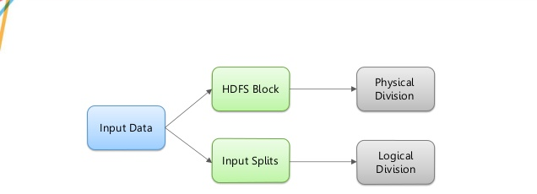
Splits vs Blocks

Slide 3
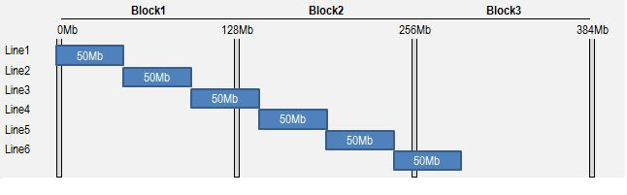
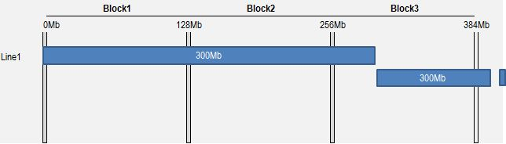
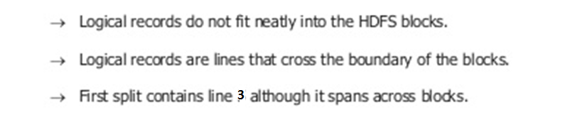
Splits vs Blocks

Slide 4
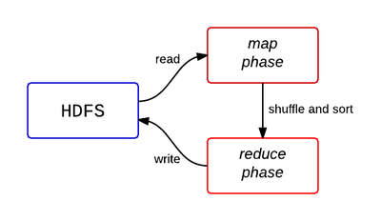
MR Programming Model

Slide 5
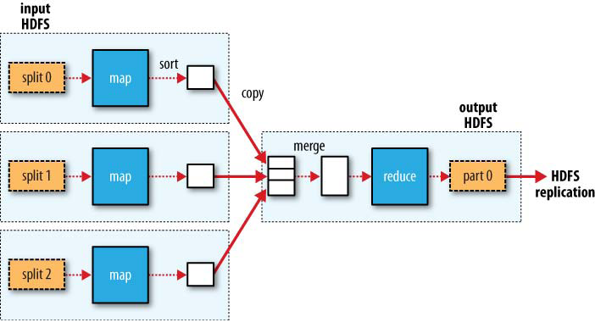
MR Programming Model

Slide 6
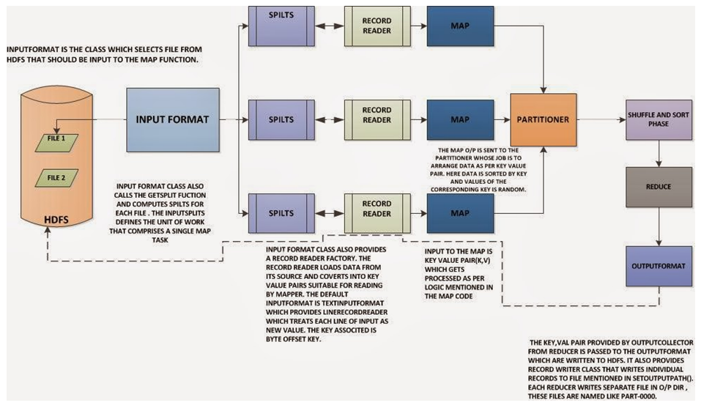
MR Programming Model

Slide 7
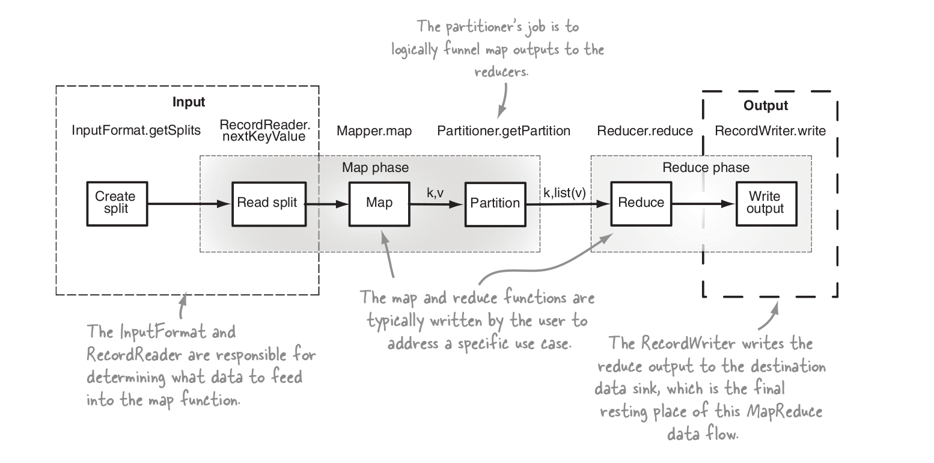
MR Programming Model

Slide 8
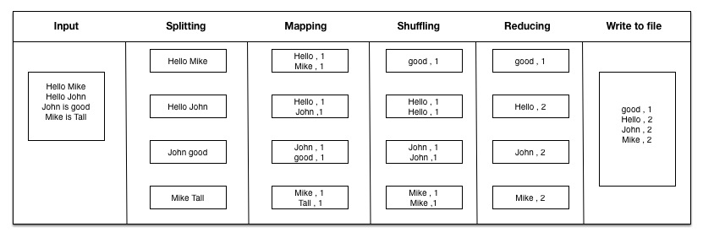
MR WC Program

Slide 9
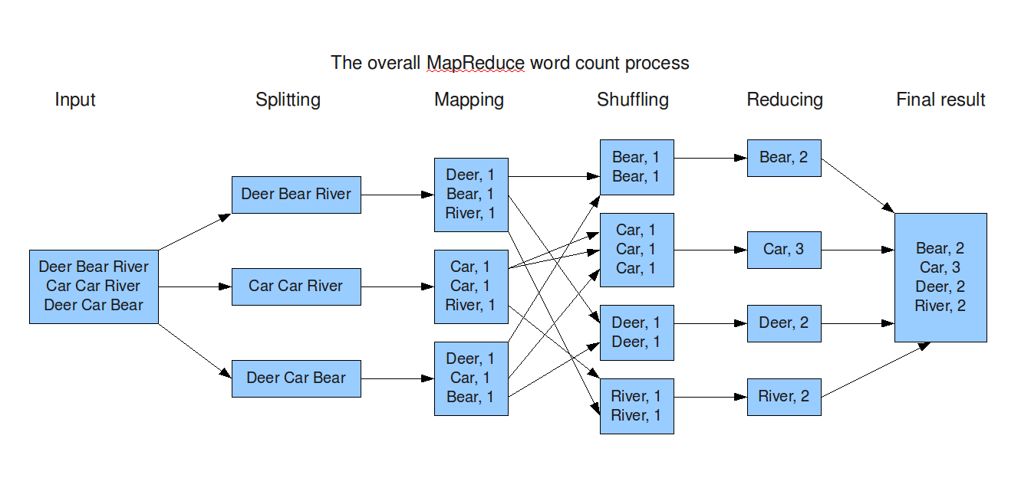
Map Reduce Job Flow

Slide 10
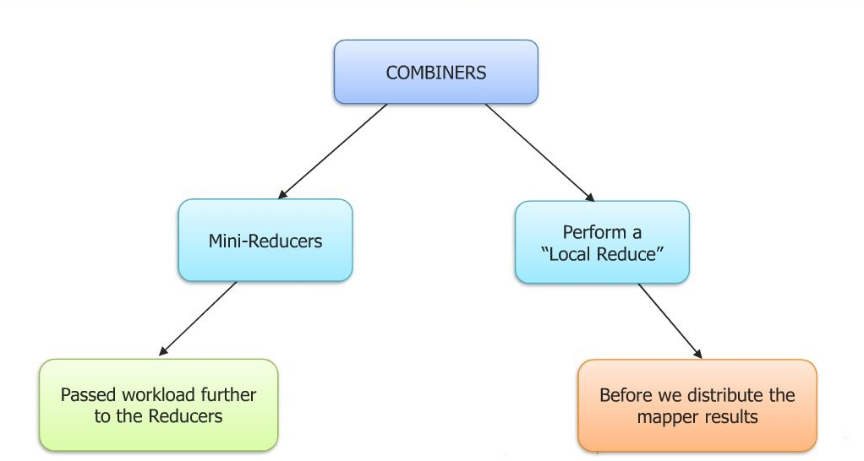
Map Reduce Combiner

Slide 11
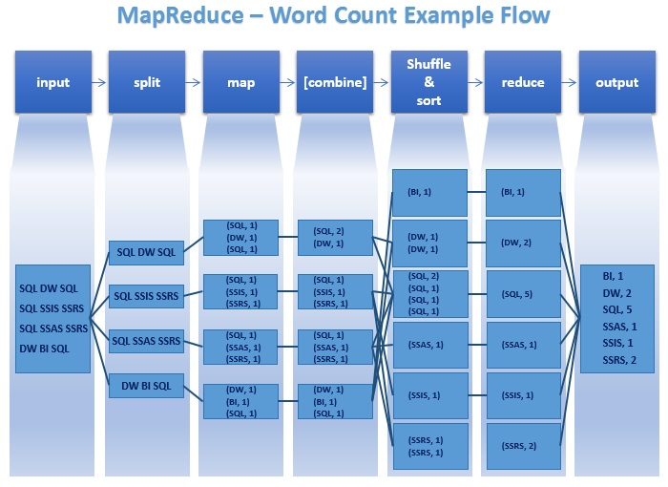
Map Reduce with Combiner

Slide 12
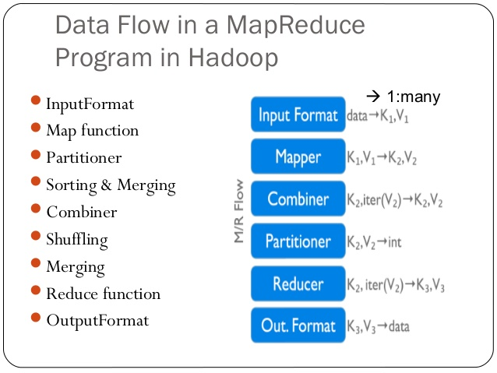
Map Reduce Complete Data flow

Slide 13
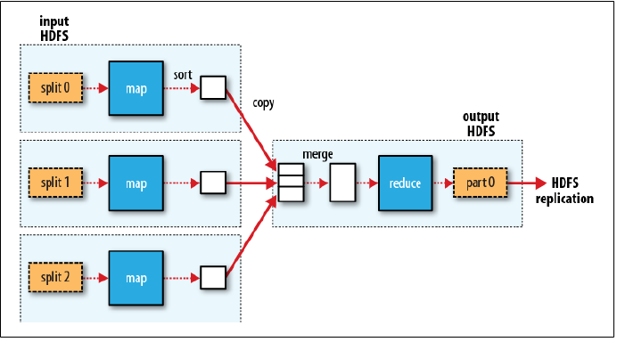
Map Reduce with Single Reducer

Slide 14
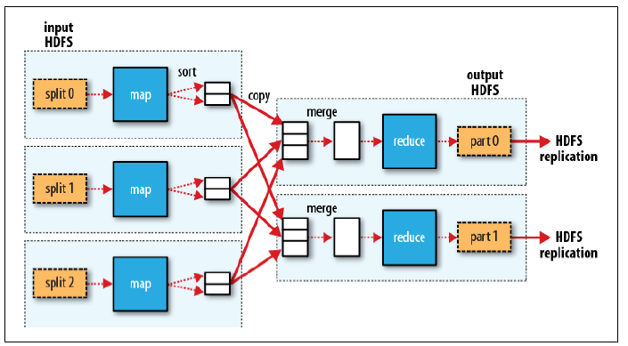
Map Reduce with Multiple Reducers

Slide 15
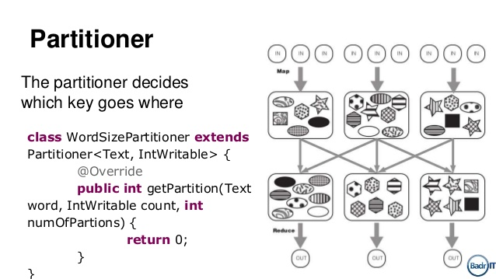
Map Reduce with Custom Partitioner

