Slide 1
Serialization - Writables

Slide 2
Serialization
Serialization is the process of turning structure objects into a byte stream for transmission over a network or for writing to persistent storage.
Deserialization is the reverse process of turning a byte stream back into a series of structure objects.
Serialization mainly used in two areas of distributed data processing:
For interprocess communication
And for persistent storage.
In Hadoop, interprocess communication between nodes in the cluster is implemented using RPC.
RPC remote procedure calls uses serialization to causes the message into a byte stream to be sent to the remote node. In the remote node the byte stream is desirialized into original message.

Slide 3
Hence the RPC serialization format should be compact, Fast, able to extend(extensible) for new requirements and interoperable between clients written in different languages.
Hadoop uses its own serialization format – it is writables.
This serialization format is compact and fast but not easy to extend other than java.
Writables are Core(central) to Hadoop, MR uses these as key values.
To overcome the limitations of writables, other serialization frameworks are supported by Hadoop. One example is AVRO.

Slide 4
Writable Interface
Writable Interface have two methods – one method is to read the sate from DataInput binary stream and other method is to write its state to DataOutput binary stream.
Public interface Writable{
Void write(DataOutput out) throws IOException
Void readFields(DataInput in) throws IOException.
https://hadoop.apache.org/docs/r2.6.3/api/org/apache/hadoop/io/Writable.html
E.g We use IntWritable, a wrapper for Java int.
Notes:
https://hadoop.apache.org/docs/r2.6.3/api/org/apache/hadoop/io/Writable.html
4

Slide 5
WritabeComparable and Comparators
We have another sub interface of Writable and java.lang.Comparable interfaces.
Public interface WritableComparable<T> extends Writable, Comparable<T>{}
Comparison is crucial for MR. In the sorting phase the keys are compared with one another. For Faster comparision, Hadoop provides “RawComparator” extension to Java’s Comparator.
Public interface RawComparator<T> extends Comparator<T> {
Public int compare(byte[] b1,int s1,int l1,byte[] b2,int s2,int l2);}
This interface lets us to compare records read from stream without deserializing them into Objects, this avoids overhead of Object creation. E.g RawComparator, byte arrays b1 and b2 are compared directly based on the given starting points s1 and s2 and lengths l1 and l2.

Slide 6
The Comparator(WritableComparator – which is general purpose implementation of RawComparator) provides two main functions.
One is, it provides implementation for Compare() method that deserializes objects to be compared from the stream and call the compare() method.
Second is – it provides RawComparator instances.

Slide 7
Hadoop Writable Classes
Hadoop comes with a large selection of Writable classes. All these are available in org.apache.Hadoop.io package.
https://hadoop.apache.org/docs/r2.6.3/api/org/apache/hadoop/io/package-summary.html
Below are the Writable Wrappers for Java Primitives. All of these have get() and set() methods for retrieving and storing the wrapped value.
Boolean – BooleanWritable, byte – ByteWritable, short – ShortWritable, int- IntWritable and VIntWritable, float – FloatWritable, long – LongWritable and VLongWritable.
Double – DoubleWritable.

Slide 8
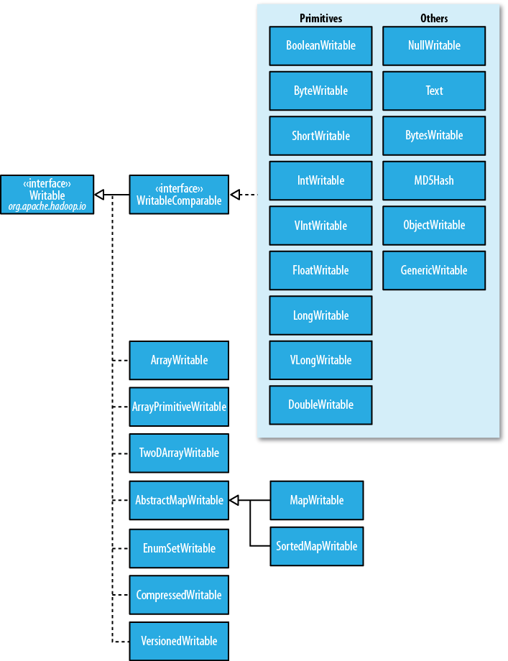

Slide 9
Writables for Java Object data types
Text – is the Writable equivalent to java.lang.String. Here the Text objects are mutable, i.e you can reuse the Text instance by calling one of the set() methods on it.
Text t=new Text(“abc”);
t.set(“def”); - here the same object value is changed.
See all the methods available in Text() class.
Text does not have rich API for manipulating strings as Java.lang.String. So in many cases we need to convert the TEXT objects to a STRING using toString() method on task.
BytesWritable – wrapper for an array of binary data.

Slide 10
NullWritable : it has zero length serialization. No bytes are written to or read from the stream. This is used as key in a SequenceFIle when you want to store a list of values as opposed to Key-Value pairs.
It is immutable singleton, and we can get an instance by calling NullWritable.get().
ObjectWritable and Generic Writable:
ObjectWritable is a general purpose wrapper for java primitives, string, enum, writable, null or arrays of any type. Used in Hadoop RPC.
ObjectWritable writes class name of the wrapped type every time it is serialized, hence wastes space.
Generic Writable: If we know the types of the object, we put them in a static array of types and use this to index to find the serialized reference type.
Generic Writable follows the approach, and it does not write the class name of the type in the object, saves space.

Slide 11
Writable Collections – 6 collection types
Hadoop.io package have 6 writable collection types.
ArrayWritable, for java object data types
ArrayPrimitiveWritable, for java primitive data types
TwoDArrayWritable, - arrays of arrays (object data types)
MapWritable, - implementation of java.util.Map<Writable, Writable>
SortedMapWritable – for java.util.SortedMap<WritableComparable, Writable>
EnumSetWritable – for sets of enum types.

Slide 12
Implementing a Custom Writable
Occasionally you may need to write your own custom implementation, where Hadoop’s writables fail to accommodate the need.
With custom Writable, you have full control over the
Binary representation and
Sort order.
Since Writables are the heart of the MR data path, tuning the binary representation can have a significant event on performance.
Hadoop’s Writables are well tuned, but to have complex structured data types, it is better to create a new Writable types rather than using Composite Stock of different types.
You can use Hadoop serialization( written in java) or try another serialization frameworks like AVRO.

Slide 13
Lab -
Write a custom writable data type that contains a pair of Text data types.
Steps:
Implement WritableComparable
Constructors – must have default constructor
Getters and Setters
And you must override – write() and readFileds() [for Writables]
Also Override compareTo() – for WritableComparator.
And hashCode(),equals(),toString() - for java object methods.
Note –do not allocate objects in wirte() and readFields() methods, MR framework uses writables which are mutables and these are reused.

Slide 14
Lab -
Write() method serializes each ‘Text’ object into output stream using the Text object’s write() method.
Similarly readFields() deserializes the bytes from the input stream by using Text object’s readFields() method.
This is because the DataOutput and DataInput interfaces have best implementations for serializing and deserializing Java primitives.
hashCode,equals() and toString() methods, you should override. These are from java.lang.Object.
hashCode() is used by the HashPartitioner to choose the reducer partition. So you should write a good hash function.
toString() method writes the two text data types in tab separated Strings.

Slide 15
Lab
CompareTo() is implemented for WritableComparable. You can implement your own ordering, in the way you expect.

Slide 16
Lab -
Write Custom comparator to order in descending order i.e Z-A
(default is ascending order) and implement Case insensitive comparator.

