Slide 1
YouTube-Video-Statistics

Slide 2
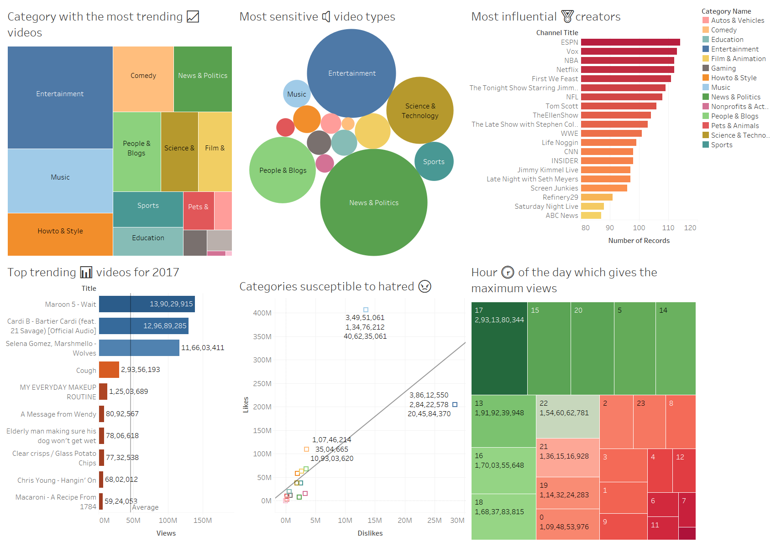

Slide 3
