Slide 1
Project Insurance Claim
Excel Project

Slide 2
Q1. Perform the basic Exploratory Data Analysis on the sample data. Q1.A. Identify the categorical and continuous variables
Categorical variables :
Sex
Smokers
Region
Continuous variables :
BMI
Charges

Slide 3
Q1.B. Make Histograms and box plots for continuous variables, do a correlation analysis.
Histogram tells us the Frequency of the numerical data, here are using Continuous Data .
Here continues variables are BMI, And Charges.
Box Plot are used to show the distribution of data points across a selected measure,
in this models we are getting any data points across the selected data.
Data variables are used for this model are BMI and Charges
Below I have given my output:

Slide 4
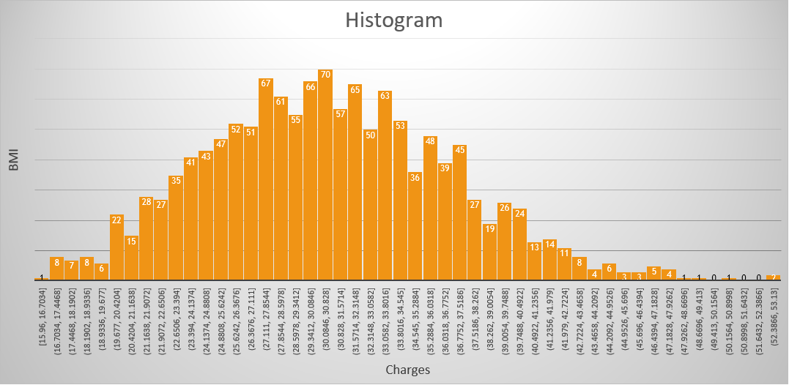
Histogram For : BMI and Charges

Slide 5
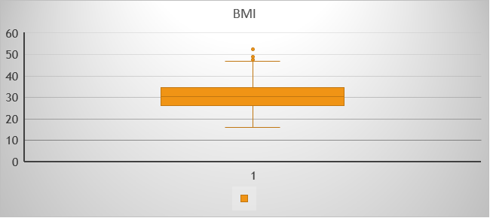
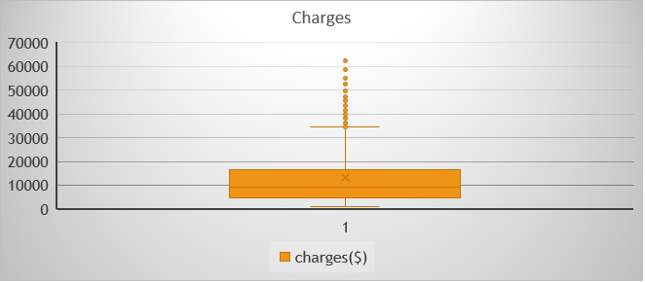
Box Plot For : BMI
There are some outliers In BMI Variable After 47.29 value
Box plot For : Charges
There are some outliers In charges Variable After 34489.4 value

Slide 6
Correlation Analysis For BMI and Charges
 | bmi | charges($)
bmi | 1
charges($) | 0.198341 | 1
There is a Positive Correlation between Variable BMI and Charges.
Changes in the BMI Variable will also Changes in Charges Variable
Positive Correlation of 0.198

Slide 7
Q.C. Make relevant Pivot table and charts for : Q.C.1) Male/Female ratio and which gender has more Smokers

Slide 8
Male / Female Ratio :
Famle = 662
Male = 676
Ratio : 331 : 338
Males Smokers are more Compared to Female Smokers

Slide 9
2) Charges vs Age

Slide 10
3) Charges vs BMI

Slide 11
4) Charges for Smokers vs Non-smokers
The average Charges for Smokers are more compared to Non-Smokers
79% of charges for Smokers
21% of Charges for Non-Smokers

Slide 12
Q1.D) Region-wise Smokers vs non-smokers analysis with one or more pivot table and charts

Slide 13
Region-Wise Smokers :
Northeast → 20.68%
Northwest → 17.85%
Southeast → 25.00%
Southwest → 17.85%
Region-Wise Non-Smokers :
Northeast → 79.32%
Northwest → 82.15%
Southeast → 75.00%
Southwest → 82.15%
Southeast Region have a greater number of smokers compared to another Region.
Equal number of people smoke in Northwest and Southwest which is 17.85%

Slide 14
Q1.E) Region-wise charges for smokers vs non-smokers

Slide 15
Region-Wise Charges for Smokers :
Only In Southeast region Charges for Smokers are more than Non-Smokers , 59.12% of Charges for southeast Region.
43.39% of Charges for smokers in Northwest Region, which is less compared to other Regions.
Region-Wise Charges for Non-Smokers :
56.61% of Charges for non-smokers in Northwest Region.
40.88% of charges for non-smokers in southeast region.

Slide 16
Q1.F) Has charges got something to do with no. of dependents ?
Number of dependents are children covered by health insurance
Yes, charges are related to number of dependents
Childrens | Sum of charges($)
0 | 7098070.00
1 | 4124899.67
2 | 3617655.30
3 | 2410784.98
4 | 346266.41
5 | 158148.63
Grand Total | 17755824.99

Slide 17
Q1.G) Do a similar dependents-charges analysis, Region-wise
Sum of charges($) | Region
Children | northeast | northwest | southeast | southwest
0 | 24.08% | 21.06% | 31.65% | 23.21%
1 | 30.45% | 18.35% | 31.52% | 19.68%
2 | 19.19% | 24.56% | 28.69% | 27.55%
3 | 23.31% | 33.94% | 26.79% | 15.97%
4 | 29.28% | 19.66% | 20.87% | 30.19%
5 | 13.24% | 5.67% | 38.38% | 42.72%

Slide 19
Q1.H) Do atleast one more pivot table and chart of your own choice, if needed

Slide 20
Q1.i )Give your understanding from the patterns observed in point (b)
Histogram :
highest Charges for BMI is in the middle value (median value)
lowest Charges for bmi within 15 -18 and 42 – 53
box plot :
BMI : There are some outliers In BMI Variable After 47.29 value
Charges : There are some outliers In charges Variable After 34489.4 value

Slide 21
Q1.J) Give your interpretation for observations made in point ( c )
which gender has more smokers :
we can observe that Male Smokers are more than Female smokers with a Ratio of ,
Female : Male -- 331 : 33.
Charges vs Age :
We can observe that , increasing in age will also increase the Charges .
Charges vs BMI :
We can observe that, increase in Body Mass Index will Also increase the Individual medical costs billed by health insurance.

Slide 22
Charges for Smokers vs Non-smokers :
The average Charges for Smokers are more compare to non Smokers.
79% of charges for Smokers .
21% of Charges for Non-Smokers

Slide 23
Q.2. Edit the data as following, to obtain dummy variables:
Sex : Replace all the “Males” with “1” and “Females” with “0”, creating numerical entries for gender this way will help you do analysis further. You can use Replace with “Match entire cell content option. Do a replace all to save time.
Smoker: Replace all the “Smokers” with “1” and “Non-smokers” with “0”.
Region: We always create one less category column for the dummy data w.r.t the categories available for that original variable. So, for Region, we will create three dummy columns, assuming “Northeast” as zero and omit the column for it. Now create three columns for “northwest”, “Southeast”, “Southwest”. Whichever row has “northwest” region as an entry will take “1” as an entry otherwise “0” in “northwest” column. Similarily in “Southeast” column, which ever row had “southeast” as an entry will take “1” as the new entry and “0” for the rest columns. Do a similar operation on “Southwest” column.

Slide 24
Sex : Replace all the “Males” with “1” and “Females” with “0”, creating numerical entries for gender this way will help you do analysis further. You can use Replace with “Match entire cell content option. Do a replace all to save time.
Sex :
female | 0
male | 1

Slide 25
Smoker: Replace all the “Smokers” with “1” and “Non-smokers” with “0”.
Smoker :
Smokers | 1
Non-Smokers | 0

Slide 26
Region: We always create one less category column for the dummy data w.r.t the categories available for that original variable. So for Region, we will create three dummy columns, assuming “Northeast” as zero and omit the column for it. Now create three columns for “northwest”, “Southeast”, “Southwest”. Whichever row has “northwest” region as an entry will take “1” as an entry otherwise “0” in “northwest” column. Similarily in “Southeast” column, which ever row had “southeast” as an entry will take “1” as the new entry and “0” for the rest columns. Do a similar operation on “Southwest” column.
Assuming Northeast as ZERO
Creating 3 columns
Northwest → 1 Other Entry will 0
Southeast → 1 Other Entry will 0
Southwest → 1 Other Entry will 0

Slide 27
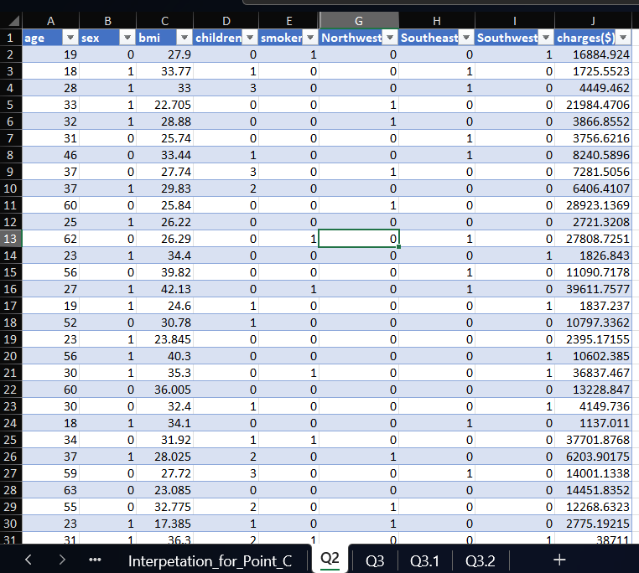

Slide 28
Q3. Do a descriptive summary analysis for the edited data. Perform a Multiple Linear Regression analysis to identify which variables decide the insurance charges/billed insurance claim. Give your interpretation for the above anslysis, do another set of regression analysis by dropping insignificant variables, if needed.
age |  |  | bmi |  |  | children |  |  | smoker |  |  | Southeast
Mean | 39.20703 |  | Mean | 30.6634 |  | Mean | 1.094918 |  | Mean | 0.204783 |  | Mean | 0.272048
Standard Error | 0.384102 |  | Standard Error | 0.166714 |  | Standard Error | 0.032956 |  | Standard Error | 0.011036 |  | Standard Error | 0.01217
Median | 39 |  | Median | 30.4 |  | Median | 1 |  | Median | 0 |  | Median | 0
Mode | 18 |  | Mode | 32.3 |  | Mode | 0 |  | Mode | 0 |  | Mode | 0
Standard Deviation | 14.04996 |  | Standard Deviation | 6.098187 |  | Standard Deviation | 1.205493 |  | Standard Deviation | 0.403694 |  | Standard Deviation | 0.445181
Sample Variance | 197.4014 |  | Sample Variance | 37.18788 |  | Sample Variance | 1.453213 |  | Sample Variance | 0.162969 |  | Sample Variance | 0.198186
Kurtosis | -1.24509 |  | Kurtosis | -0.05073 |  | Kurtosis | 0.202454 |  | Kurtosis | 0.145756 |  | Kurtosis | -0.94952
Skewness | 0.055673 |  | Skewness | 0.284047 |  | Skewness | 0.93838 |  | Skewness | 1.464766 |  | Skewness | 1.025621
Range | 46 |  | Range | 37.17 |  | Range | 5 |  | Range | 1 |  | Range | 1
Minimum | 18 |  | Minimum | 15.96 |  | Minimum | 0 |  | Minimum | 0 |  | Minimum | 0
Maximum | 64 |  | Maximum | 53.13 |  | Maximum | 5 |  | Maximum | 1 |  | Maximum | 1
Sum | 52459 |  | Sum | 41027.63 |  | Sum | 1465 |  | Sum | 274 |  | Sum | 364
Count | 1338 |  | Count | 1338 |  | Count | 1338 |  | Count | 1338 |  | Count | 1338

Slide 29
Southwest |  |  | charges($) |  |  | sex |  |  | Northwest
Mean | 0.2429 |  | Mean | 13270.42 |  | Mean | 0.505232 |  | Mean | 0.2429
Standard Error | 0.011728 |  | Standard Error | 331.0675 |  | Standard Error | 0.013674 |  | Standard Error | 0.011728
Median | 0 |  | Median | 9382.033 |  | Median | 1 |  | Median | 0
Mode | 0 |  | Mode | 1639.563 |  | Mode | 1 |  | Mode | 0
Standard Deviation | 0.428995 |  | Standard Deviation | 12110.01 |  | Standard Deviation | 0.50016 |  | Standard Deviation | 0.428995
Sample Variance | 0.184037 |  | Sample Variance | 1.47E+08 |  | Sample Variance | 0.25016 |  | Sample Variance | 0.184037
Kurtosis | -0.55986 |  | Kurtosis | 1.606299 |  | Kurtosis | -2.00256 |  | Kurtosis | -0.55986
Skewness | 1.200409 |  | Skewness | 1.51588 |  | Skewness | -0.02095 |  | Skewness | 1.200409
Range | 1 |  | Range | 62648.55 |  | Range | 1 |  | Range | 1
Minimum | 0 |  | Minimum | 1121.874 |  | Minimum | 0 |  | Minimum | 0
Maximum | 1 |  | Maximum | 63770.43 |  | Maximum | 1 |  | Maximum | 1
Sum | 325 |  | Sum | 17755825 |  | Sum | 676 |  | Sum | 325
Count | 1338 |  | Count | 1338 |  | Count | 1338 |  | Count | 1338

Slide 30
Multi Linear Regression
Before Removing Any Variables :
Regression Statistics
Multiple R | 0.866552
R Square | 0.750913
Adjusted R Square | 0.749414
Standard Error | 6062.102
Observations | 1338
 | Coefficients | P-value
Intercept | -11938.5 | 5.58E-32
age | 256.8564 | 7.78E-89
sex | -131.314 | 0.693348
bmi | 339.1935 | 6.5E-31
children | 475.5005 | 0.000577
smoker | 23848.53 | 0
Northwest | -352.964 | 0.458769
Southeast | -1035.02 | 0.030782
Southwest | -960.051 | 0.044765

Slide 31
Sex: p-value is more than 5% which for sex p-value is 69%, Failed to reject null hypothesis.
Northwest : p-value for Northwest is more than 5% which is 45%, Falied to reject null hypothesis.
therefore, sex and Northwest variables are insignificant for further analysis.
After removing Sex and Northwest Variable :
Regression Statistics
Multiple R | 0.866476
R Square | 0.750781
Adjusted R Square | 0.749658
Standard Error | 6059.146
Observations | 1338
 | Coefficients | P-value
Intercept | -12165.4 | 1.61E-35
age | 257.0064 | 4.62E-89
bmi | 338.6413 | 6.5E-31
children | 471.5441 | 0.000632
smoker | 23843.87 | 0
Southeast | -858.47 | 0.038873
Southwest | -782.745 | 0.058734
There is a slit difference between R-square.
Before removing insignificant variables, R-Square value is 75.0913%.
After removing insignificant variables, R-Square value is 75.0781%.

