Slide 1



| Tech Management, SRI-B
CLASH OF THE
CLAWS
The OpenClaw Hackathon
Team Members: Name USN
Kashish Pawar 1MS23EC054
Nagesh Pranad 1MS23EC082
Praveen C Koni 1MS23EC097
Varshini S 1MS24EC408

Slide 2



The Daily Commute Problem
What Goes Wrong Every Day
Manual Comparison Overload
Apps Don't Talk to Each Other
Last-Minute Chaos
Commuters manually compare fares, routes, and travel time before every single trip — a repetitive, exhausting process.
Calendar apps and transport apps exist in silos — no integration means no smart recommendations.
Rushed decisions lead to missed meetings, wasted money, and unnecessary daily stress.
The Cost of Inaction
45+
70%
Minutes Lost Daily
Avoidable Overspend
Wasted on travel decisions alone — time that could be spent on work or rest.
Taking the wrong transport choice consistently costs more than necessary.
Affects working professionals, students, and daily urban commuters across Bangalore and beyond.

Slide 3
Existing Tools Fall Short
Every popular app solves one piece of the puzzle — none connect your schedule to your commute.
Tool
Limitation
The Critical Gaps
Google Maps
Directions only — no decisions
No Calendar-Aware Transport
Zero tools read your calendar and suggest the best mode of travel automatically.
Ola / Uber
Books cabs — no calendar link
Metro App
Shows schedule — no comparison
No Side-by-Side Comparison
Calendar Apps
Shows events — no transport link
Metro vs Cab — fare, time, and availability in one unified view doesn't exist yet.
No "Leave By" Guidance
No app tells you exactly when to leave based on your next event — with offline fallback.

Slide 4
OUR SOLUTION
Introducing CommuteMate+
A Python-based intelligent system that reads your next calendar event and automatically recommends the best way to travel — Metro or Cab — with zero manual input.
Calendar-Aware
Smart Geocoding
Auto-reads next upcoming event from events.json
OpenStreetMap API with JSON fallback for 100% uptime
Haversine Distance
Auto-Decision Engine
Precise route distance calculated mathematically
Compares Metro vs Cab — selects by Time, then Cost
"Leave By" Alert
OTP Booking Sim
Tells you exactly when to head out — never be late again
Simulates booking with a generated confirmation code

Slide 5


How It Works — End to End
From your calendar event to a confirmed recommendation in seconds.
Compare Options
Pick Event
Geocode
Distance
Metro Check
Sample Output: Event: Standup @ Koramangala | Distance: 7.4 km | Metro: ₹30 | 22 mins ✅ RECOMMENDED | Cab: ₹120 | 28 mins | Leave By: 09:38 AM | OTP: 847362

Slide 6

Tech Stack & Architecture
Layer
Technology
Language
Python 3.x
Data
JSON (events + locations)
Geocoding
Fare → Decision
Geocoding
OpenStreetMap Nominatim API
Distance
Haversine Formula
Interface
Telegram Bot (optional)
events.json
Distance (Haversine)
Project Files
main.py · calendar_reader.py · bot.py · events.json · locations.json

Slide 7
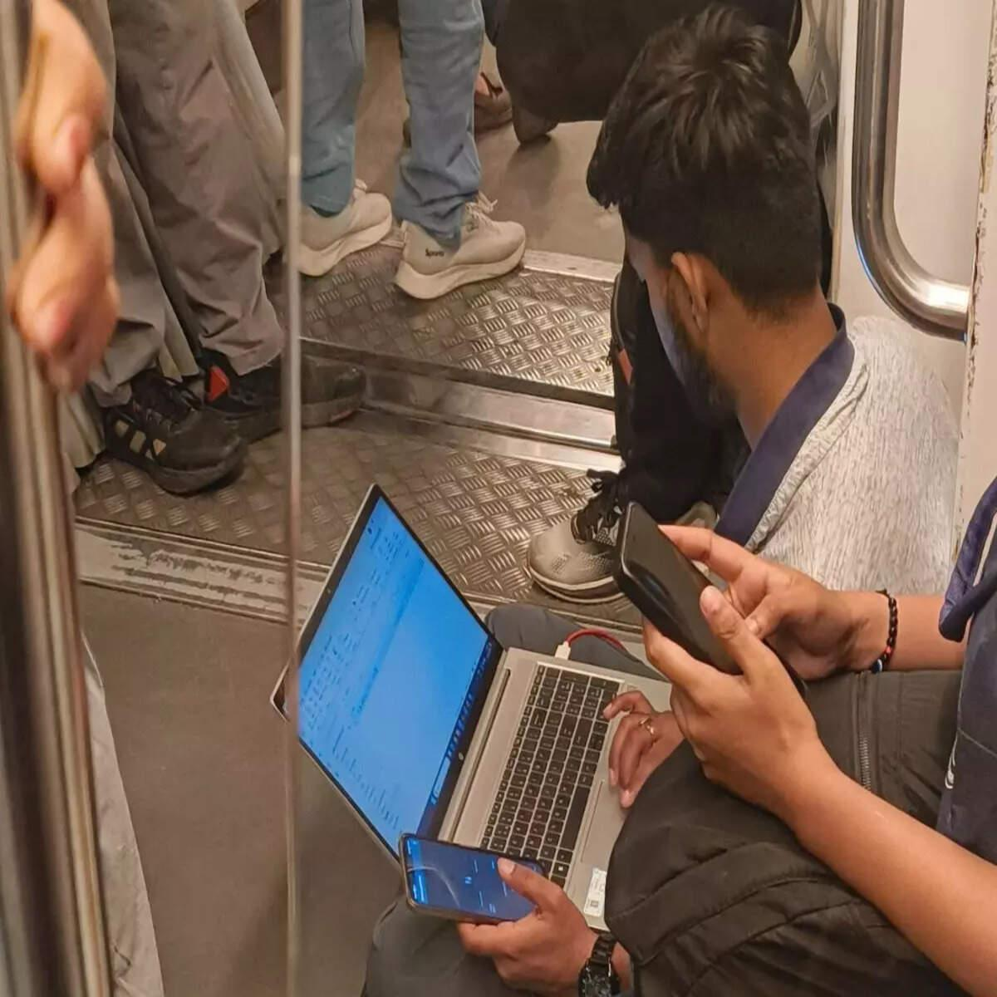


Real-World Impact
👔 Working Professional
🎓 Student Commuter
📱 Telegram User
Meeting at Whitefield — Metro picked automatically, saving ₹90 vs cab with a faster arrival time.
8 AM class detected — CommuteMate+ generates "Leave By 7:18 AM" and picks the cheapest route.
Recommendation pushed directly to phone — no app switching, no manual lookup, instant action.
10 min
70%
100%
Saved Per Trip
Cost Savings
API Uptime
On decision time alone
Metro vs Cab on eligible routes
Guaranteed via JSON fallback

Slide 8
Why CommuteMate+ Stands Out
Every competitor solves part of the problem. CommuteMate+ solves all of it — automatically.
Feature
Google Maps
Ola/Uber
CommuteMate+
The Key Advantage
CommuteMate+ doesn't just show options — it makes the decision for you, based on your real schedule, with zero manual input required.
Calendar Integration
❌
❌
✅
No competitor combines calendar awareness, transport comparison, and intelligent auto-selection in a single, offline-capable system.
Metro vs Cab Comparison
❌
❌
✅
Auto Best-Option Pick
❌
❌
✅
"Leave By" Time
❌
❌
✅
Offline JSON Fallback
❌
❌
✅

Slide 9
Project Resources
Access the Project
Submitted Files
🔗 GitHub Repository
🎥 Demo Video
File
Purpose
[YouTube / Drive Link]
main.py
Core engine
github.com/[username]/CommuteMate-Plus
calendar_reader.py
Event reader
events.json
Calendar data
To Run Locally
locations.json
Geocoding fallback
pip install requests
python main.py
README.md
Setup guide

Slide 10
WHAT'S NEXT
The Road Ahead for CommuteMate+
Live API Integration
1
Real Ola/Uber fares & live ETA data
2
Google Calendar Sync
Pull events directly — no JSON needed
ML Personalization
3
Learns your preferences over time
4
Multi-Stop Routing
Optimize back-to-back event commutes
Mobile App + Alerts
5
Push notifications & native mobile UI
6
National Expansion
Mumbai, Delhi & Chennai metro networks
"You focus on your day. CommuteMate+ handles the rest."

