Slide 1
Smart Number Plate Detection System
Mini Project
ON
Preparing by
AJAY RAMCHANDRA GOLE(138_C)
NAGESH SANTOSH LOHAR(161_C)

Slide 2
Introduction
Manual entry processes are not only time-consuming but also prone to errors, leading to inefficiencies and potential security risks. To address these challenges, the development of a smart number plate detection system emerges as a promising solution.
The primary objective of this project is to design and implement a robust system capable of accurately detecting and recognizing vehicle number plates in real-time. This system aims to automate the entry management process, enhancing efficiency, accuracy, and security.

Slide 3
EXISTING SYSTEM
Manual Entry Management System
Toll Collection Systems

Slide 4
NEED OF THE SYSTEM
Security: Keep unwanted or unauthorized vehicles out while letting in only those allowed.
Efficiency: Make entering places faster and easier by automating the process.
Record-keeping: Keep a good track of which vehicles come and go for safety and management.
4.Ease of Use: Make it simple for both users and security staff to manage entries and exits.

Slide 5
Project Objectives:
Automated Entry: Automatically open gates or barriers for recognized vehicles, reducing the need for manual checks.
Faster Entry Process: Speed up vehicle entry by eliminating the need for manual registration or checks.
Unauthorized Vehicle Alerts: Instantly notify security personnel when an unrecognized vehicle attempts to enter.
Improved Security: Enhance security by restricting access to authorized vehicles only.

Slide 6
Proposed System
In response to the limitations of traditional manual entry management systems, the proposed smart number plate detection system aims to revolutionize entry management processes by leveraging cutting-edge technologies in computer vision, image processing, and machine learning. This system offers a comprehensive solution for automated entry management in various domains such as parking lots, toll booths, and security checkpoints.
Number Plate Detection:
Preprocessing:
Entry Management:

Slide 7
Module Specification
Administration:
Manage user accounts, system settings, and security. Log and audit activities to ensure accountability.
Number Plate Detection:
Utilize advanced algorithms to capture and interpret vehicle license plates accurately, supporting real-time processing for efficient identification.
Database Storage:
Design and implement a structured database to store recognized number plates, timestamps, and metadata, enabling seamless data retrieval, analysis, and reporting for system functionality and performance

Slide 8
Operating Environment-Hardware and Software
Hardware requirements:
Processor: Intel i3 and above
Memory: Min 2 GB
Hard disk space:1GB
Web Camera
Software requirements:
Operating system: windows 7 or above.
IDE: Spyder/vs code
Server: MySQL Server

Slide 9
Technology Used
Frontend Technology: HTML, CSS, JavaScript
Backend Technology: Python, MySQL

Slide 10
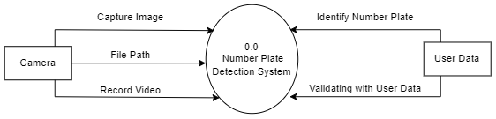
ANALYSIS & DESIGN
0th Level DFD

Slide 11
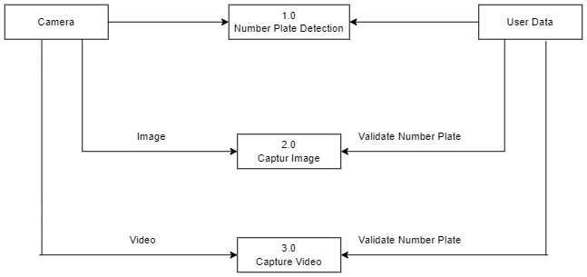
ANALYSIS & DESIGN
1st Level DFD

Slide 12
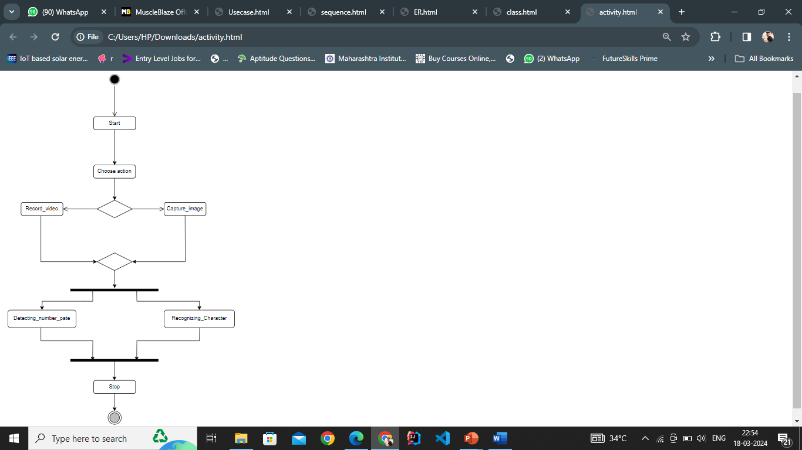
ANALYSIS & DESIGN
Activity Diagram

Slide 13
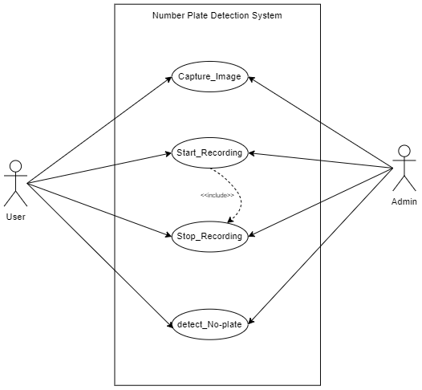
ANALYSIS & DESIGN
Use Case Diagram

Slide 14
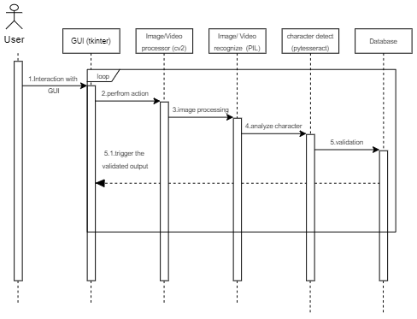
ANALYSIS & DESIGN
Sequence Diagram

Slide 15
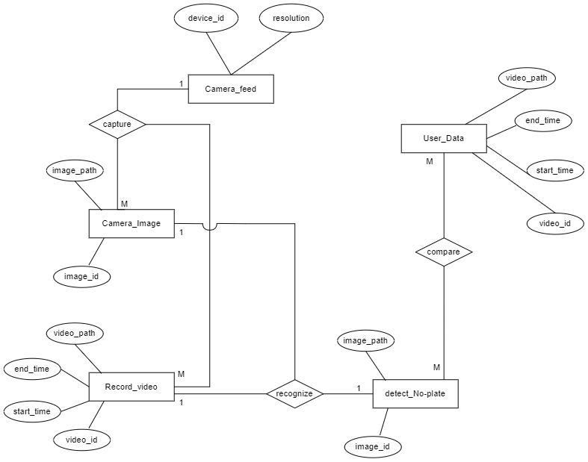
ANALYSIS & DESIGN
ER Diagram

Slide 16
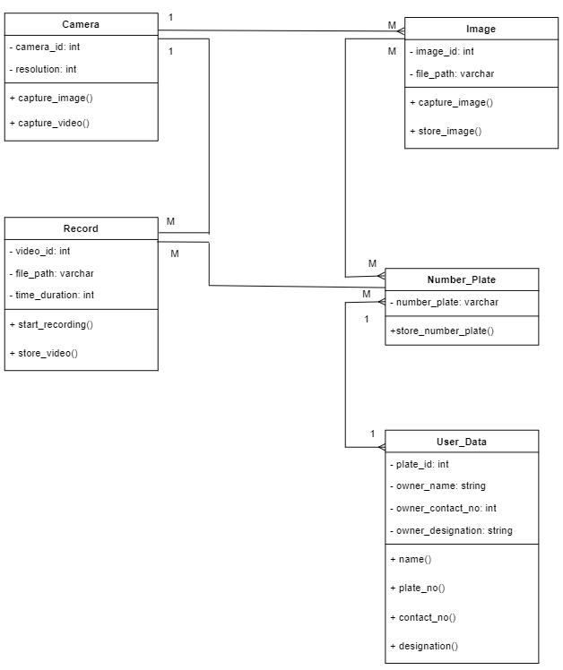
ANALYSIS & DESIGN
Class Diagram

Slide 17
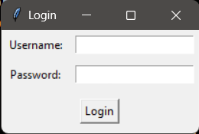
User Interface
1. Admin Login

Slide 18
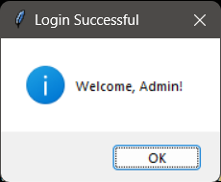
User Interface
2. Admin Login Successful Interface

Slide 19
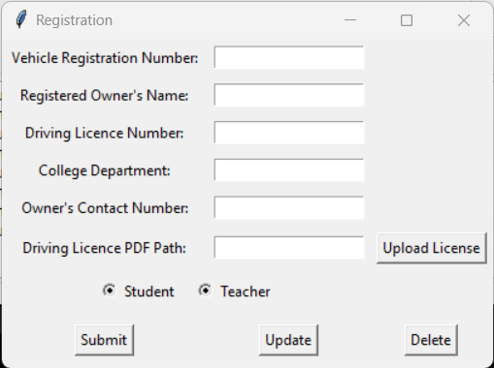
User Interface
3. User Registration Form

Slide 20
DATA DICTIONARY
1. User Data
Field | Data Type | Constraint | Description
Owner Name | Varchar(30) | None | Display Owner Name
Number Plate | Varchar(30) | Primary Key | Display Number Plate
Owner Contact No | Int(12 | Unique Key | Display Owner Contact Number
Owner Designation | Varchar(30) | None | Display Owner Designation
2. Camera
Field | Data Type | Constraint | Description
Camera Id | Int(20) | Primary Key | System Generated Camera ID
Resolution | Varchar(20) | None | Display camera resolution

Slide 21
DATA DICTIONARY
3. Record Video
Field | Data Type | Constraint | Description
Video Id | Int(20) | Primary Key | System Generated Camera ID
Video Duration | Int(20) | None | Display Video Time
File Path | Varchar(30) | None | Display File Path
Number Plate | Varchar(30) | Foreign Key | Display Number Plate
4. Capture Image
Field | Data Type | Constraint | Description
Image Id | Int(20) | Primary Key | System Generated Camera ID
File Path | Varchar(30)///////////08 | None | Display File Path
Number Plate | Varchar(30) | Foreign Key | Display Number Plate

Slide 22
THANK YOU

