Slide 1
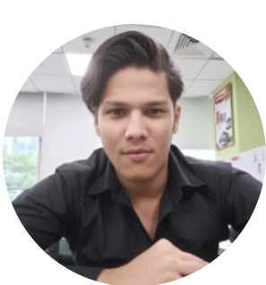

PROFILE
webMethods junior developer with 3 years of experience in webMethods intergration, working in sector retail.
Have analytical skills to identify the root causes of issues and develop efficient solutions.
Effiective Communication skills to interact with clients, understand their issues and develop efficient solutions.
Experience with debugging and resolving errors in webMethods applications.
Willing to learn new technologies, products and ability to adapt changing priorities,deadlines and requirements.
Dhuruv Rawat
Junior webMethods Developer
KEY PROJECTS AND ACHIEVEMENTS
webMethods Junior Developer
Avon Project - Retail– Junior. Developer
Tools: webMethods Designer,Integration server, Putty,WINSCP,JDBC Adapters, Enterpriseone Adapters,Broker
Analyzed Error emails and gave resolution as required
Supported numerous time for weekend outage activity.
Developed small enhancement as per client requirement and deployed code changes to production.
Developed one new interface for Gateway Orders.
Reprocessed EDI orders using MWS
Coordinated with other teams to resolve technical Connectivity issues.
Updated webMethod Flow for interfaces after analyzing the Code
MWS
JDBC Adapters
Broker
File Polling Ports
Java
QUALIFICATIONS
Sql
Academics
Btech – Applied Electronics and Instrumentation Engineering

