Slide 1
Speech Emotion Recognition using CNNs
Project ID: 153

Slide 2
Introduction
Convolutional Neural Networks (CNN) + Bidirectional Long Short-Term Memory (BLSTM) most state-of-the-art model for speech emotion recognition
Previous studies utilizing only amplitude spectrogram. Phase information ignored.
Study integrates phase information with amplitude information to get better results.
CNN used to extract features from spectrograms
BLSTM mainly used for training for the classifier

Slide 3

The Dataset: EmoDB

Slide 4
EmoDB
Berlin Database of Emotional Speech
535 audio files of spoken German conveying seven different types of emotions:
Fear (A): 69
Disgust (E): 46
Happiness (F): 71
Boredom (L): 81
Neutral (N): 79
Sadness (T): 62
Anger (W): 127
Files about 2-3 seconds long

Slide 5
EmoDB
Every utterance named with 7 characters
Reading the filename: Eg: 03a01Fa.wav refers to Speaker 03 speaking text a01 with emotion F (Freude) or Happiness. a denotes one version of such an utterance
6th character in the filename used for matching file with emotion during classification.

Slide 6

Extraction of information
Spectrograms using STFTs

Slide 7
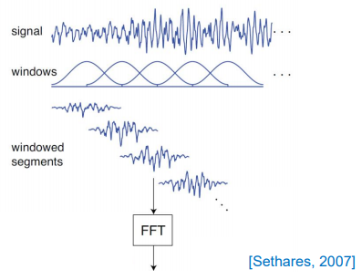
STFT
Window type: Hamming
Length: 256 samples
Overlap: 50%
Generate windowed signal
Apply 256 point FFT to each windowed signal
Amplitude spectrograms generated using MATLAB
Phase information of signal derived from group delay

Slide 8
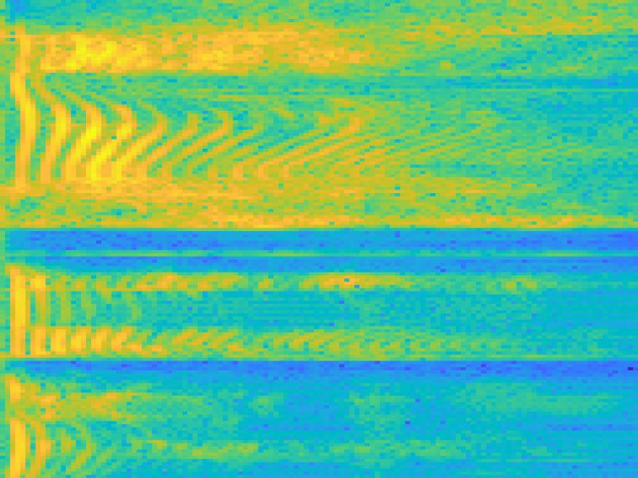
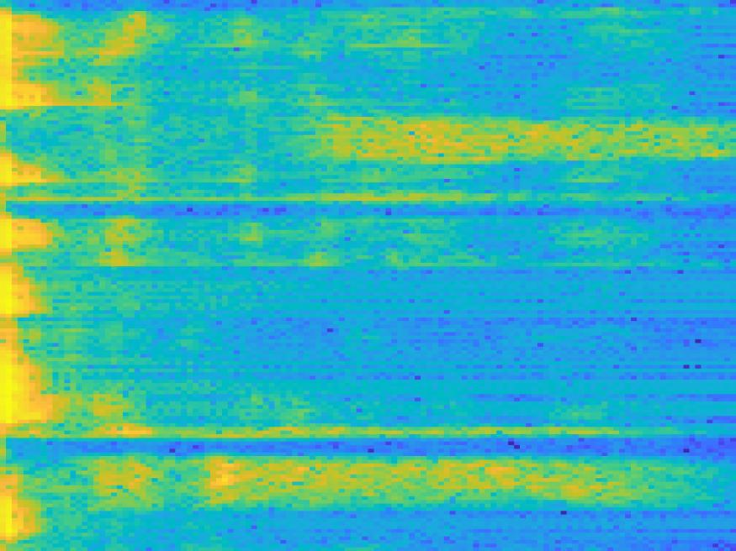
Amplitude Spectrogram
08b09Wc : Emotion Anger
11a07Ta : Emotion Sad
X-axis: Frequency (0 to 8 kHz)
Y-axis: Time (0 to 1,2s)

Slide 9


Phase Spectrogram
08b09Wc : Emotion Anger
11a07Ta : Emotion Sad
X-axis: Frequency (0 to 8 kHz)
Y-axis: Time (0 to 1,2s)

Slide 10
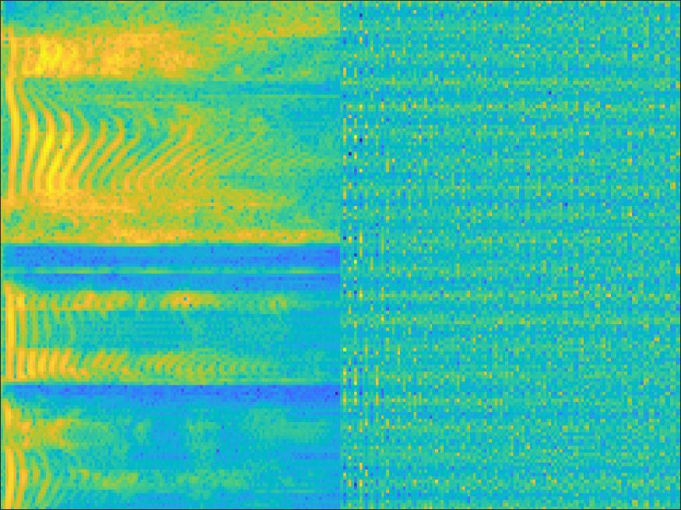
Amplitude+Phase Spectrogram
08b09Wc : Emotion Anger
X-axis: Frequency (0 to 8 kHz)
Y-axis: Time (0 to 1,2s)

Slide 11
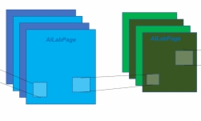
The Network
CNN + BLSTM

Slide 12
Methodology
All spectrograms generated using MATLAB
Three spectrograms of all audio files compiled and stored in three separate folders
Neural network created using Keras library
Network trained over 10 epochs with a batch size of 50

Slide 13
Network Architecture
Audio Signal
Spectrogram
CNN
BLSTM
Features extracted
Decision

Slide 14
CNN and BLSTM Specifications
Conv1_2D: 32 filters, 5x5
Conv2_2D: 64 filters, 5x5
Max pooling (after both layers): s=2, 2x2
Conv3_2D: 1 filter, 1x1 (used to reduce the third dimension)
Flatten layer
Dropout layer: size of 0.5
FC Layer: 50 nodes
BLSTM: 200 units
Batch Normalization after every convolution layer

Slide 15
Experiments
Designed network was experimented with 3 types of spectrogram
Only amplitude spectrogram
Only phase spectrogram
Amplitude+Phase spectrogram
Accuracy, Precision, Recall, F1-score were used to analyse performance of the network
It was observed that Amplitude+Phase spectrogram approach gives better results compared to only amplitude and only phase approach

Slide 16
Results
After running the model for 10 epochs with batch size of 20 following results were obtained.
 | Accuracy (%) | Precision (%) | Recall (%) | f1-score (%)
Amplitude | Training = 92.74 Testing = 83.08 | Training = 88.04 Testing = 32.90 | Training = 57.14 Testing = 18.47 | Training = 68.75 Testing = 23.59
Group Delay | Training = 89.71 Testing = 78.00 | Training = 76.86 Testing = 22.99 | Training = 40.17 Testing = 22.99 | Training = 51.70 Testing = 22.99
Amplitude+Group Delay | Training = 94.11 Testing = 84.40 | Training = 85.45 Testing = 39.60 | Training = 70.76 Testing = 20.39 | Training = 77.25 Testing = 26.72

Slide 17
Conclusions
Amplitude+Group Delay gives best results. Good to integrate phase component.
Overfitting observed in training and testing data comparisons.
Suggested methods to overcome: increase size of dataset, decrease number of hyperparameters

Slide 18
Thank you!
-NAGESH SAMANE 2017A8PS0612P
-MAINAK MANDAL 2017A3PS0259P
-PARTH GOVIL 2017A8PS0533P

