Slide 1

Lending Club Case Study
Presented by:
Nagesh Kumar Vashist
Mayank Aditya

Slide 2
Agenda
Problem Statement
Data Load and Cleanup
Univariate Analysis
Bivariate Analysis
Multivariate Analysis
Conclusion

Slide 3
Problem Statement
Lending Club is a consumer finance company which specialises in lending various types of loans to urban customers. When the company receives a loan application, the company has to make a decision for loan approval based on the applicant’s profile. Two types of risks are associated with the bank’s decision:
If the applicant is likely to repay the loan, then not approving the loan results in a loss of business to the company
If the applicant is not likely to repay the loan, i.e. he/she is likely to default, then approving the loan may lead to a financial loss for the company
As a data analyst we need to identify patterns which indicate if a person is likely to default, which may be used for taking actions such as denying the loan, reducing the amount of loan, lending at a higher interest rate

Slide 4
Data load and cleanup
Data Cleanup is a process to remove unwanted data or noise in the data and convert the data to the desired format so that data analysis can be done on the dataset.
Below are the steps we have done for data cleanup:
Loaded loan.csv file with 39717 rows and 111 columns
Removed all the empty columns
Removed all the columns that are empty more then 70%
Converted the column values to the expected format and data type
Validated duplicate rows based on id column
Created new columns for further analysis

Slide 5
Univariate Analysis
Done the analysis for important features as follows:
Investor Funded Amount
Interest Rate
Annual Income
Employment Tenure
Loan Status
Grades
Verification Status
Purpose of loan
Home Ownership

Slide 6
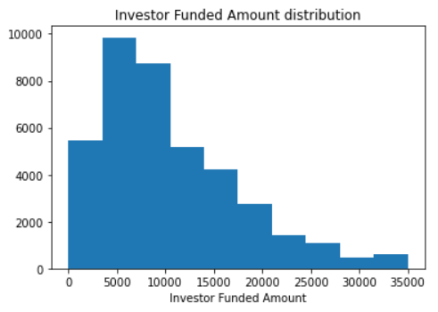
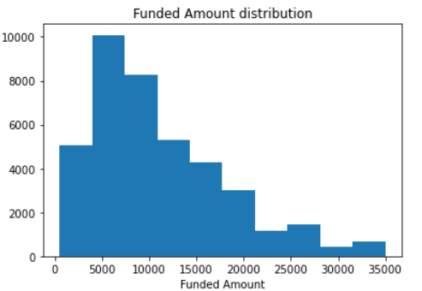
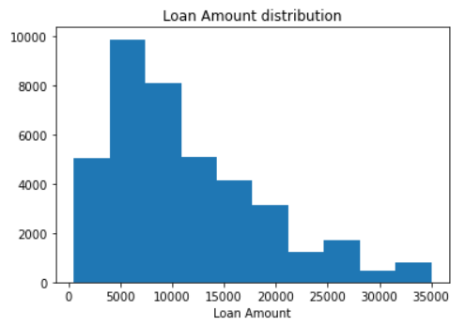
Univariate Analysis of Loan amt
We can see that with above distribution plots Investor Funded Amount, Funded Amount and Loan Amount has similar distribution. For further analysis we will consider Investor Funded Amount

Slide 7
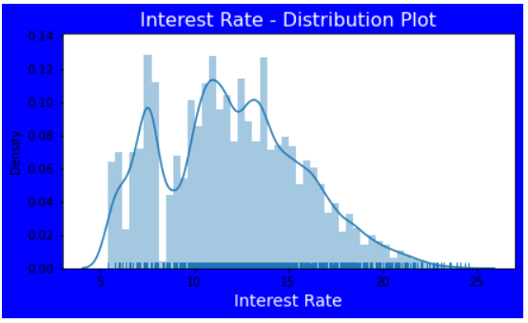
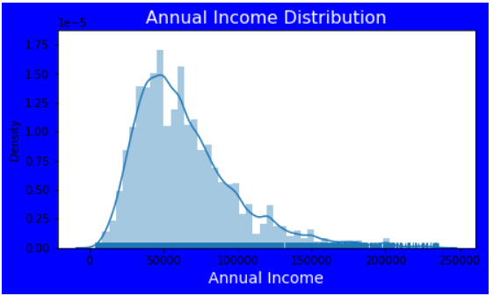
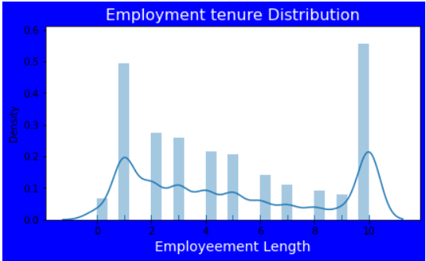
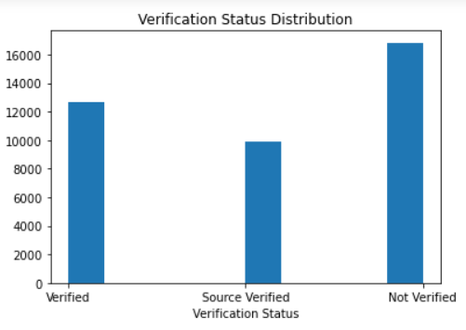
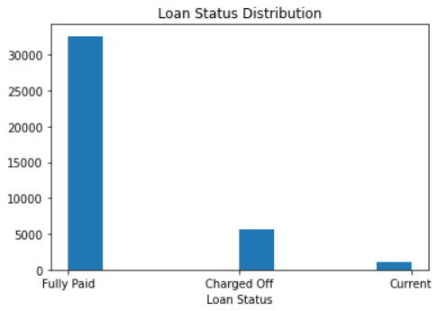
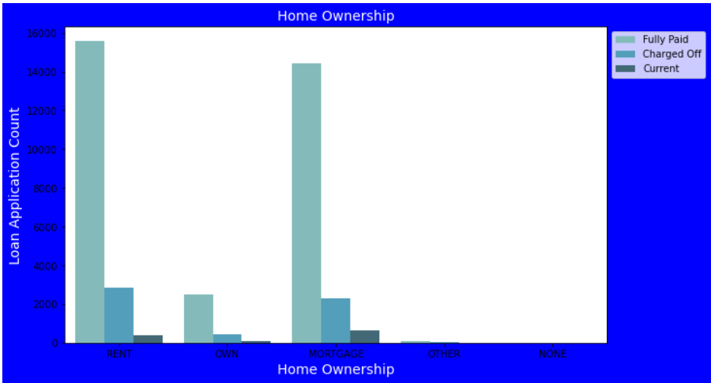
Few of the univariate plots

Slide 8
Bivariate Analysis
Done the analysis for important features as follows:
Annual income and charged off proportion
Purpose of loan and charged off proportion
Grades and charged off proportion
Interest rate and charged off proportion
Employment length and charged off proportion
State and charged off proportion
Bankruptcies and charged off proportion

Slide 9
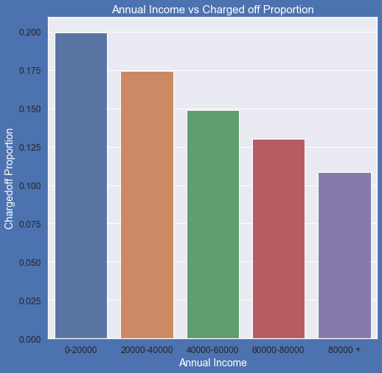
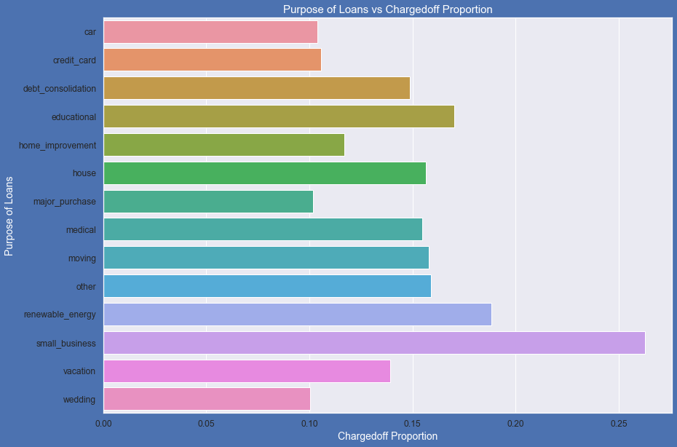
Few of the Bivariate plots

Slide 10
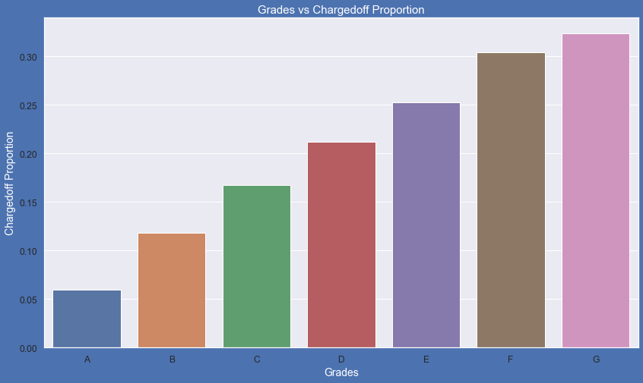
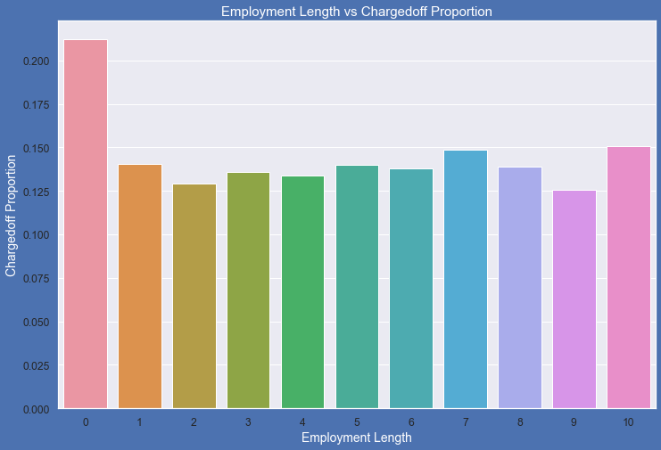
Few of the Bivariate plots

Slide 11
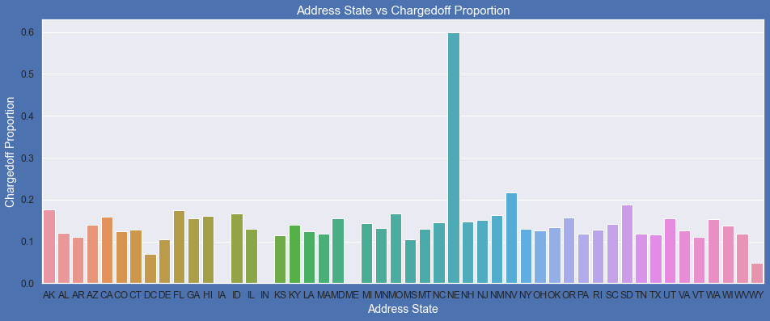
Few of the Bivariate plots

Slide 12
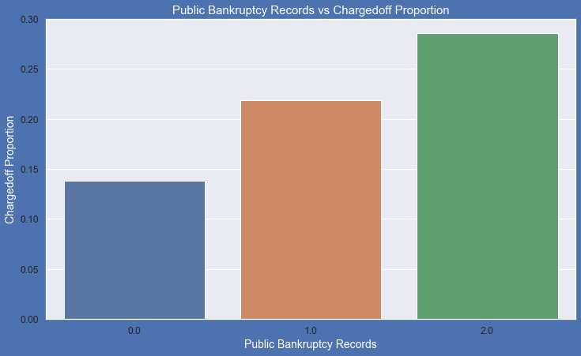
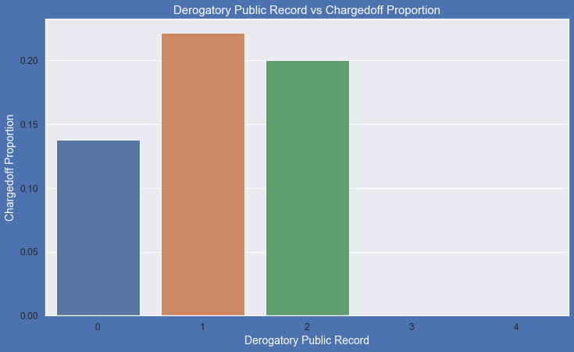
Few of the Bivariate plots

Slide 13
Multivariate Analysis
Plot following features differentiating with loan status
loan_amnt
annual_inc
Year
int_rate

Slide 14
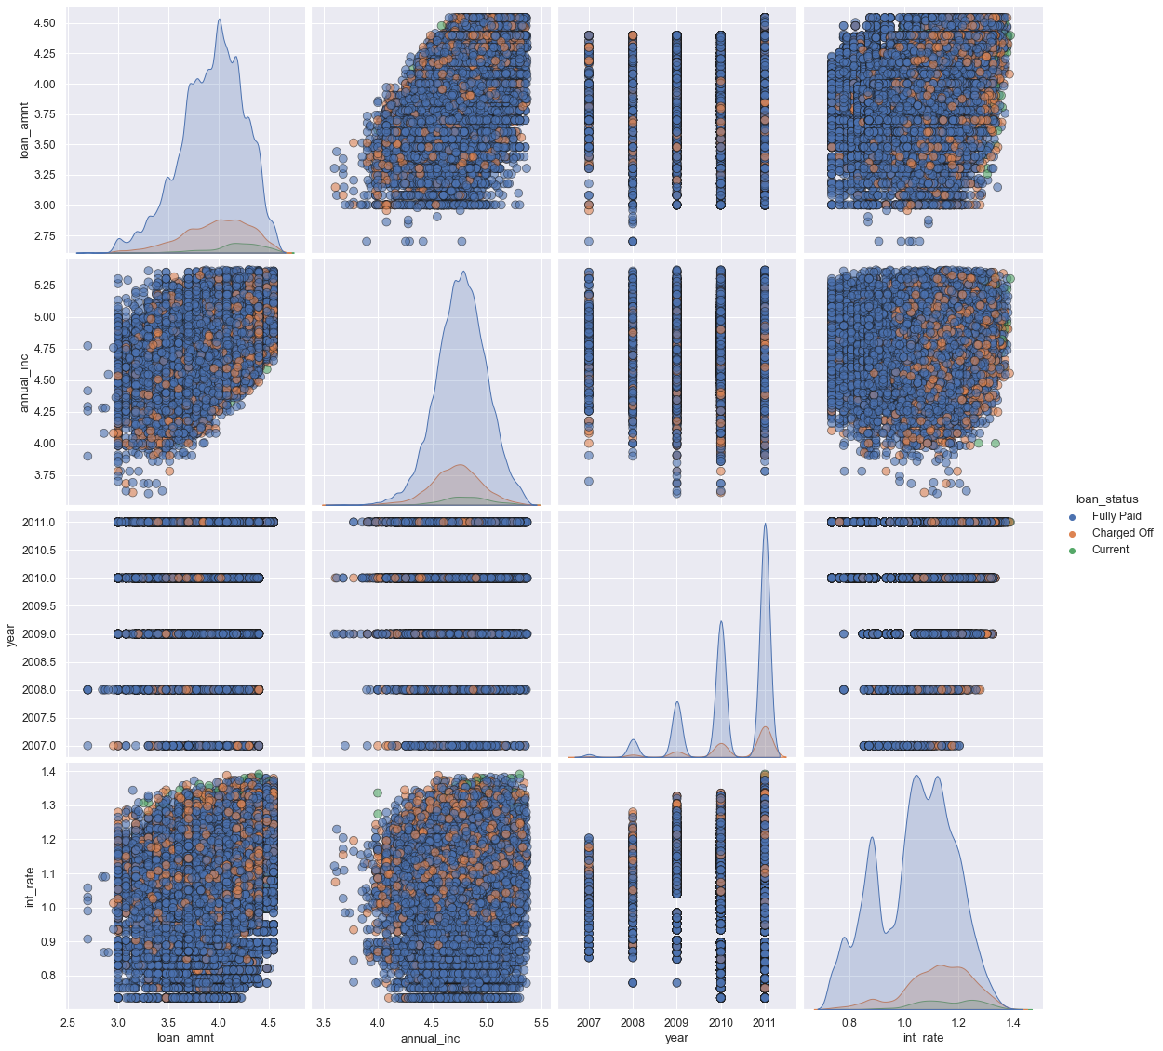

Slide 15
Conclusion
Higher the interest rate higher charged off ratio
Higher the annual income higher the loan amount slightly
Interest rate is increasing with loan amount increase this results in high charged off.
Median,95th percentile,75th percentile of loan amount is highest for loan taken for small business purpose among all purposes.
Debt consolidation is second and Credit card comes 3rd.
Most of the loans issued for longer term had higher interest rates for repayment.
Loans taken for small business purposes had to repay the loan with more interest rate as compared to other.
Those who already have pub_rec_bankruptcies value 1, have charged off proportion higher than who have no pub_rec_bankruptcies.
pub_rec_bankruptcies count 2 has even higher charged off proportion but those numbers are not significant to decide.
states NE has very high chances of charged off but number of applications are too low to make any decisions.
Those who are not working or have less than 1 year of work experience have high chances of getting charged off.
sub Grades of "A" has very less chances of charged off.- sub Grades of "F" and "G" have very high chances of charged off.

Slide 16


