Slide 1
INVENTORY MANAGEMENT ANALYSIS
By:
Nagesha S

Slide 2
Project Objective
Perform SQL-based data analysis on an inventory management system
Demonstrate proficiency in:
Data cleaning
Aggregation
Joins, Subqueries, and CTEs
Window functions
Derive insights for business intelligence and inventory optimization

Slide 3
About the Dataset
Source: Kaggle – Inventory Management Analysis (SQL-Based Project)
Dataset Features:
Product.csv: Includes product names, categories, standard costs, and list prices.
Orders.csv: Contains order details such as quantities, unit prices, and order statuses.
Customer.csv: Customer information, including names, contact details, and credit limits.
Warehouse.csv: Data on warehouse locations and inventory distribution.
Employee.csv: Employee records linked to warehouse operations.
Region.csv: Geographic data, including country, state, city, and postal codes.
OrderDetails.csv: Transaction-level data connecting products and orders, detailing sales volume and revenue.

Slide 4
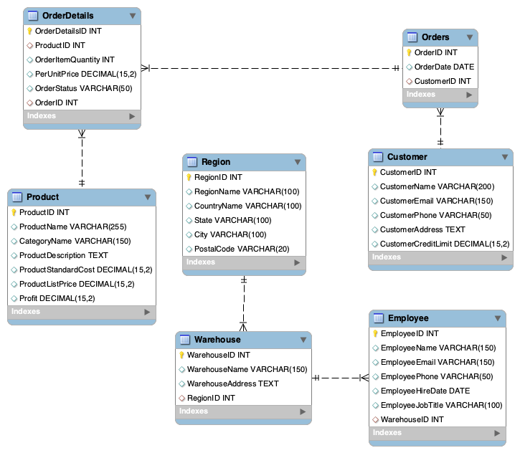
Schema Design
Key Relationships:
Orders link Customers and OrderDetails
Products linked via OrderDetails
Warehouses mapped to Regions

Slide 5
Data Import & Setup
Sample Code Snippet:
CREATE DATABASE IF NOT EXISTS inventory_db;
USE inventory_db;
LOAD DATA LOCAL INFILE 'data/Customer.csv'
INTO TABLE Customer
FIELDS TERMINATED BY ','
IGNORE 1 ROWS;
Created schema: inventory_db
Imported 7 CSVs using LOAD DATA LOCAL INFILE
Ensured referential integrity with FOREIGN KEYS
Verified using DESCRIBE and SHOW TABLES

Slide 6
Descriptive Statistics
Findings:
Total Customers: 400
Total Revenue: ₹30520090.71
Average Product Price: ₹2002.398800 (per total Products 400)
SELECT COUNT(*) AS total_customers FROM Customer;
SELECT SUM(OrderItemQuantity * PerUnitPrice) AS total_revenue FROM OrderDetails;
SELECT COUNT(*) AS total_products, AVG(ProductListPrice) AS avg_price FROM Product;

Slide 7
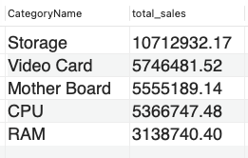
Aggregation & Grouping
SELECT CategoryName,
SUM(OrderItemQuantity * PerUnitPrice) AS total_sales
FROM OrderDetails
JOIN Product USING(ProductID)
GROUP BY CategoryName
ORDER BY total_sales DESC;
Insights:
Top Categories: Storage, Video Card

Slide 8
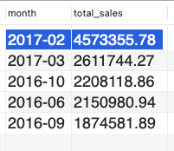
Subqueries & CTEs
Result:
Month with highest total sales identified for trend analysis is 2017-02 with total sales 4573355.78
WITH MonthlySales AS (
SELECT DATE_FORMAT(OrderDate, '%Y-%m') AS month,
SUM(OrderItemQuantity * PerUnitPrice) AS total_sales
FROM Orders
JOIN OrderDetails USING(OrderID)
GROUP BY month
)
SELECT month, total_sales
FROM MonthlySales
ORDER BY total_sales DESC
LIMIT 5;

Slide 9
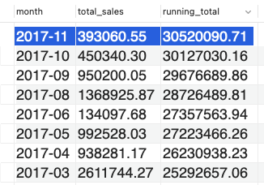
Window Functions
Insights:
Displays running total of revenue — useful for tracking cumulative growth.
2017-11 shows highest running total (30520090.71) along with total sales(393060.55)
2013-06 shows lowest running total.
WITH MonthlySales AS (
SELECT DATE_FORMAT(OrderDate, '%Y-%m') AS month,
SUM(OrderItemQuantity * PerUnitPrice) AS total_sales
FROM Orders
JOIN OrderDetails USING(OrderID)
GROUP BY month
)
SELECT month, total_sales,
SUM(total_sales) OVER (ORDER BY month) AS running_total
FROM MonthlySales;

Slide 10
Insights & Conclusion
Key Findings:
Top-performing product categories & regions identified
Monthly revenue growth and trends visualized
Data cleanliness and constraints validated
Demonstrated use of CTEs, Subqueries, and Window Functions
Future Enhancements:
Integrate Power BI or Tableau for visualization
Automate ETL and reporting pipelines

Slide 11
Thank you!

