Slide 1
MLLP PROJECT
Indian Food
Recognition &
Recipe Generation
A prototype combining computer vision, curated food knowledge, and text generation
Nageshwar Kumhar • Roll No. 2330422 • Group - 18
B.Tech Electronics & Computer Science Engineering
KIIT, Bhubaneswar | 12 November 2026
MLLP • Indian Food Recognition and Recipe Generation
01

Slide 2
Problem & motivation
Why connect food-image classification with contextual information?
THE USER PROBLEM
PROJECT IDEA
A user sees a dish in a photo but may not know its name, regional association, or typical preparation.
Predict a supported food label, retrieve curated food facts, and optionally generate a short guide.
MLLP • Indian Food Recognition and Recipe Generation
02

Slide 3
Objectives & scope
What the current prototype demonstrates
01
Image input
02
Classification
Upload a JPG or PNG in a browser interface.
Predict a label from the pretrained model's fixed class set.
03
Knowledge lookup
04
Text generation
Show regional association, description, and typical recipe.
Use FLAN-T5-small as an experimental generation component.
MLLP • Indian Food Recognition and Recipe Generation
03

Slide 4
System architecture
Separate stages: vision model, knowledge base, and language model
1
2
3
4
Upload image
Vision model
FOOD_INFO
FLAN-T5
JPG / PNG
Food label + score
Region + facts + recipe
Optional generated text
Regional association comes from curated data; it is not predicted directly from pixels.
MLLP • Indian Food Recognition and Recipe Generation
04

Slide 5
Technology stack
Libraries and pretrained models used
Streamlit
Web interface and interactive controls
Subhash5/indian-food-classifier
Pretrained image-classification model
google/flan-t5-small
Small text-generation model
Transformers + PyTorch
Model loading and inference
Pillow + Python
Image handling and application logic
MLLP • Indian Food Recognition and Recipe Generation
05

Slide 6
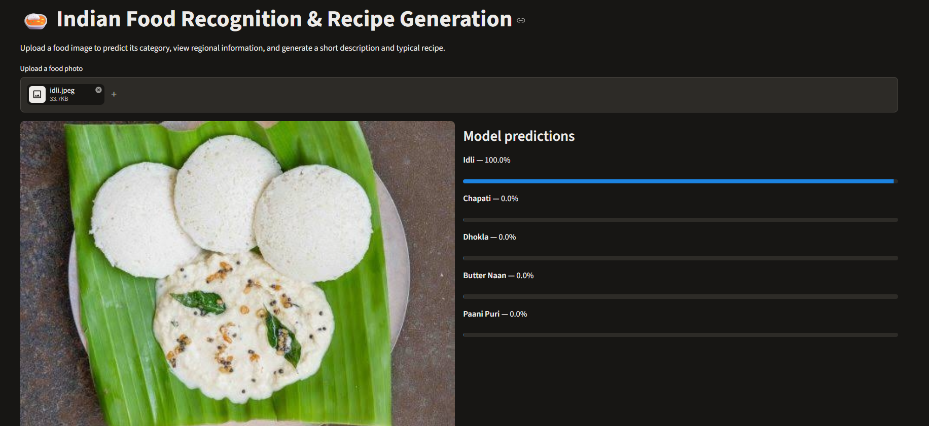
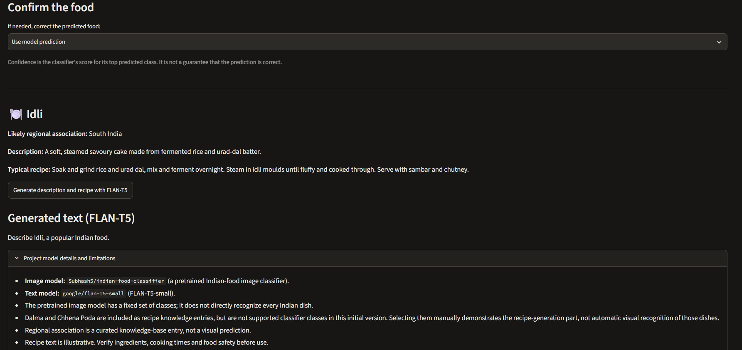
Home Page and Image Upload
Application Screenshots and Output results
Indian Food Image Classification
AI-Generated Description and Recipe

Slide 7
Application walkthrough
Replace the mock panel with actual screenshots from the final app
INSERT ACTUAL APP SCREENSHOT
DEMO SCRIPT
Predicted label: Idli
Regional association: South India
Reference description + recipe
Generated output (if validated)
• Open the local Streamlit app.
• Upload an idli image.
• Show the predicted class and score.
• Show curated regional and recipe fields.
• Click generation and show actual output.
Insert actual
food image
Replace this mock panel before submission.
MLLP • Indian Food Recognition and Recipe Generation
06

Slide 8
Observed results
Manual demonstration observations — not a formal benchmark
IMAGE UPLOAD
TOP LABEL
DISPLAYED SCORE
KNOWLEDGE LOOKUP
Worked for the tested idli image
Idli
100.0% on one example only
South India + reference recipe
The 100% score is one displayed prediction score—not measured overall accuracy.
MLLP • Indian Food Recognition and Recipe Generation
07

Slide 9
Text generation: status
FLAN-T5-small is integrated, but output quality needs validation
WHAT WORKED
KNOWN ISSUE
• Model files downloaded successfully.
• Direct sequence-to-sequence loading was implemented.
• The model produced text in a test run.
• One observed output was short and incomplete.
• Do not claim consistent recipe generation yet.
• Use curated recipe text as a reference fallback.
MLLP • Indian Food Recognition and Recipe Generation
08

Slide 10
Limitations & responsible reporting
Clear boundaries make the evaluation credible
• Fixed label set: not every Indian dish can be recognised.
• A dictionary entry adds information, not a new vision class.
• Regional association is curated knowledge, not a visual prediction.
• No held-out dataset or formal accuracy metrics have been measured.
• Recipe text is illustrative; check ingredients and food-safety guidance.
MLLP • Indian Food Recognition and Recipe Generation
09

Slide 11
Future improvements
A realistic roadmap beyond the initial prototype
01
Broader dataset
Label and evaluate a wider range of Indian dishes.
02
Formal evaluation
Use held-out tests, per-class metrics, and a confusion matrix.
03
Robust fallback
Handle unknown labels and empty generated output gracefully.
04
Grounded recipes
Cite reliable recipe sources and verify generated instructions.
MLLP • Indian Food Recognition and Recipe Generation
10

Slide 12
Conclusion & references
A compact integration prototype with clear next steps
REFERENCES
TAKEAWAY
• Subhash5/indian-food-classifier
huggingface.co/Subhash5/indian-food-classifier
• google/flan-t5-small
huggingface.co/google/flan-t5-small
• Transformers: huggingface.co/docs/transformers
• Streamlit: docs.streamlit.io
The prototype connects image classification, curated domain knowledge, and a small language model in a simple web app.
Current scope: prototype, not a fully evaluated production system.
MLLP • Indian Food Recognition and Recipe Generation
11

