Slide 1
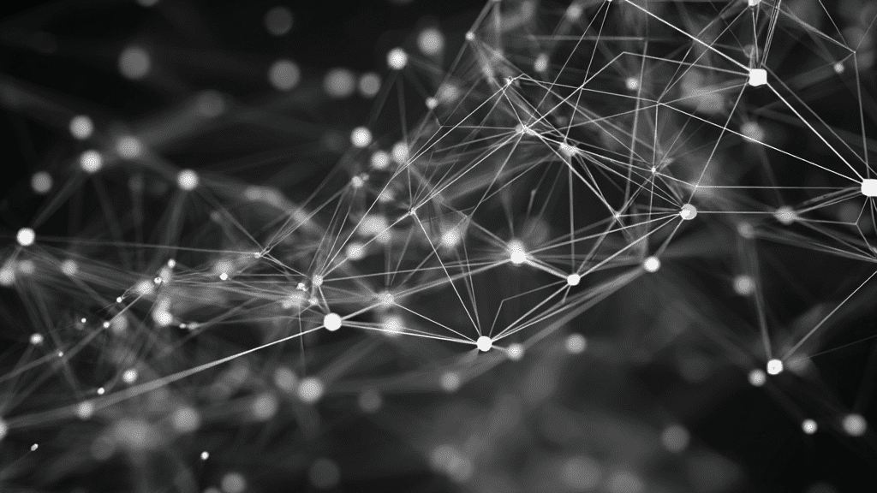
Image Blur vs. Sharp
Classification
Using Traditional Neural Networks
A Multi-Layer Perceptron Approach with Handcrafted Feature Extraction
Prepared By
Supervisor
Institution
Nagham Zidiah
Dr. Mohamed Alsheakhali
220221787
University College of
Applied Sciences

Slide 2
Presentation Overview
A comprehensive journey through our blur detection methodology
01
Introduction
02
Theoretical Background
Problem statement and project objectives in blur detection
Neural networks, MLP architecture, and optimization methods
03
Methodology
04
Experiments & Results
Dataset, preprocessing, feature extraction, and model architecture
Performance metrics and optimizer comparison analysis
05
Discussion
06
Conclusion
Analysis of results, error sources, and model behavior
Summary of findings and key takeaways

Slide 3
01 / Introduction
The Blur Detection Challenge
Problem Statement
Types of Image Blur
Detecting blur in images is a critical problem in computer vision, especially for systems that assess and enhance image quality. Images may become blurred due to motion or focus issues, which reduces edge clarity and fine details.
Motion Blur
Caused by camera or object movement during exposure, creating streaking effects along the motion direction.
Project Objective
Design a neural network to classify images into sharp and blurred categories. Instead of using raw pixel values, we extract meaningful handcrafted features such as edge strength, gradient magnitude, contrast, and high-frequency energy.
Defocus Blur
Results from incorrect focus, causing uniform blurring across the entire image with loss of fine details.
Research Goal
Sharp Image
Evaluate how effectively neural networks combined with handcrafted features can classify blurred images, providing insights into the synergy between traditional image processing and machine learning.
Clear, well-focused image with distinct edges and preserved fine details throughout.

Slide 4
02 / Theoretical Background
Neural Network Foundations
Artificial Neural Networks
Activation Functions
ANNs are computational models inspired by the human brain's information processing. They consist of layers of connected neurons where each neuron receives inputs, applies weights, and produces an output.
Activation functions introduce non-linearity into the network, enabling it to learn complex decision boundaries.
ReLU (Rectified Linear Unit)
Neural networks learn patterns from data through training, making them ideal for classification tasks.
f(x) = max(0, x) — Used in hidden layers for efficient training
Training & Optimization
Multi-Layer Perceptron (MLP)
MLP is a feedforward neural network with an input layer, one or more hidden layers, and an output layer. Each neuron applies a weighted sum followed by an activation function.
Loss Function
Cross-Entropy Loss measures the difference between predicted and true labels.
Optimizers
Input
Hidden
Output
Adam and SGD update weights iteratively to minimize loss.
Features
Processing
Classes

Slide 5
03 / Methodology
Dataset & Preprocessing
Dataset Composition
Preprocessing Pipeline
The dataset contains three categories of images: sharp, motion blurred, and defocused blurred images.
1
Grayscale Conversion
All images converted to grayscale to reduce computational complexity and focus on structural features.
Total Images
900
Sharp Images
300
2
Image Resizing
Each image resized to 256 × 256 pixels to ensure consistency across the dataset.
Motion Blur
300
Defocus Blur
300
Label Assignment
3
Sharp images → 0, Blurred images → 1
For classification, motion and defocus blur were combined into a single Blur class (600 images).

Slide 6
03 / Methodology
Feature Extraction
Instead of using raw pixel values, we extract handcrafted features from each image to represent its structural and frequency characteristics. These features form a numerical representation used as input to the neural network.
1
Variance of Laplacian
3
Image Contrast
Measures edge sharpness based on edge intensity. The Laplacian operator detects edges by computing the second derivative of image intensity.
Measures intensity variation within an image. Blurred images smooth intensity transitions, reducing contrast variation.
cv2.Laplacian(image, cv2.CV_64F).var()
np.std(image)
Sharp images → Higher variance | Blurred → Lower variance
Higher std → Higher contrast → Sharper image
2
Tenengrad (Sobel Gradient)
4
High-Frequency Energy (FFT)
Measures image sharpness based on gradient magnitude. Uses the Sobel operator to detect edge strength in horizontal and vertical directions.
Captures frequency-domain sharpness using Fast Fourier Transform. Sharp images contain strong high-frequency components (edges and fine details).
np.sqrt(sobel_x² + sobel_y²)
np.fft.fft2(image)
Captures edge strength in both directions
Blur suppresses high-frequency components
Feature Vector: Each image is represented as a 4-dimensional vector [Laplacian, Tenengrad, Contrast, FFT] → Input to MLP classifier

Slide 7
03 / Methodology
Model Architecture & Training
MLP Architecture
Training Configuration
Loss Function
Input Layer
Shape
Binary Cross-Entropy
4 handcrafted features
(4,)
Optimizers Tested
Adam, SGD
Hidden Layer 1
Shape
32 neurons, ReLU activation
(32,)
Max Iterations
300 epochs
Random State
Hidden Layer 2
Shape
42 (for reproducibility)
16 neurons, ReLU activation
(16,)
Data Splitting
Training Set
70%
Output Layer
Shape
2 neurons (Sharp / Blur)
(2,)
630 samples
Testing Set
30%
Normalization: StandardScaler applied to features before training for improved convergence.
270 samples

Slide 8
04 / Experiments & Results
Adam Optimizer Performance
94.8%
Confusion Matrix
Overall Accuracy
Test Set Performance
Predicted: Sharp
Predicted: Blur
The model achieved excellent classification performance using the Adam optimizer. The confusion matrix shows that most blurred images were correctly classified, with only a small number of sharp images misclassified as blur.
Actual: Sharp
83
7
True Negative
False Positive
Actual: Blur
7
173
False Negative
True Positive
Classification Report
Class | Precision | Recall | F1-Score | Support
Sharp (0) | 0.92 | 0.92 | 0.92 | 90
Blur (1) | 0.96 | 0.96 | 0.96 | 180
Accuracy | — | — | 0.95 | 270
Macro Avg | 0.94 | 0.94 | 0.94 | 270
Key Insights
Stable Convergence: Adam provided consistent training with minimal oscillation.
High Precision: 96% precision for blur class indicates low false positives.
Balanced Performance: Similar precision and recall across both classes.

Slide 9
04 / Experiments & Results
Optimizer Comparison: Adam vs SGD
To evaluate the impact of different optimization algorithms, we compared Adam and Stochastic Gradient Descent (SGD) using the same network architecture. This experiment helps analyze convergence behavior and classification performance differences.
Adam Optimizer
94.8%
SGD Optimizer
90.0%
Adaptive Moment Estimation
WINNER
Stochastic Gradient Descent
Metric | Sharp | Blur
Precision | 0.92 | 0.96
Recall | 0.92 | 0.96
F1-Score | 0.92 | 0.96
Metric | Sharp | Blur
Precision | 0.90 | 0.90
Recall | 0.79 | 0.96
F1-Score | 0.84 | 0.93
Advantage: Adam adapts the learning rate using first and second moment estimates, which improves stability and convergence speed.
Observation: SGD showed more misclassification in the sharp class (recall: 0.79 vs 0.92), indicating less stable convergence.
Conclusion: Adam optimizer was more effective for this problem, achieving higher accuracy (94.8% vs 90.0%) and better convergence compared to SGD.

Slide 10
05 / Live Demo
Testing New Images
To demonstrate the model performance, we implemented a prediction pipeline that processes new images through the same preprocessing and feature extraction steps used during training.
Prediction Pipeline
Example Predictions
1
Load new image from file path
110_IPHONE-7_S.jpeg
SHARP
Sharp Test Image
98.19%
2
Apply preprocessing (grayscale, resize)
BLUR
105_IPHONE-SE_M.jpg
Motion Blur Test Image
98.17%
3
Extract handcrafted features (4 features)
4
Normalize using trained StandardScaler
5
Predict Sharp or Blur with confidence score
probability = model.predict_proba(features_scaled)

Slide 11
06 / Discussion
Analysis & Insights
Key Findings
Why Adam Outperformed SGD
Effective Classification: The extracted features combined with an MLP model can effectively classify sharp and blurred images with high accuracy.
Adaptive Learning Rate
Adam adapts the learning rate for each parameter individually, allowing faster convergence on sparse gradients.
Feature Engineering Success: Handcrafted features (Laplacian, Tenengrad, Contrast, FFT) capture essential blur characteristics without requiring raw pixel data.
Moment Estimates
Uses first and second moment estimates (mean and variance) of gradients to stabilize updates.
Adam Superiority: Adam optimizer achieved better performance than SGD due to adaptive learning rates and moment estimates.
Bias Correction
Corrects bias in moment estimates during early training steps, improving stability.
Error Analysis
Performance Summary
Best Accuracy
Blur Precision
Sharp Image Misclassification
94.8%
96%
Most errors occurred in sharp images with weaker edge information, causing them to be classified as blur.
Adam Optimizer
Low False Positives
Sharp Recall
F1-Score
Dataset Imbalance
0.95
The slight imbalance (300 sharp vs 600 blur) may have influenced predictions, though the impact was minimal.
92%
Balanced Metric
Good Detection

Slide 12

07 / Conclusion
Project Summary
Achievements
Key Takeaways
Successfully developed a neural network model that classifies images as sharp or blurred using handcrafted spatial and frequency features.
Feature Engineering: Handcrafted features effectively capture blur characteristics.
MLP Suitability: Traditional neural networks work well for this classification task.
Achieved 94.8% accuracy with the Adam optimizer, demonstrating the effectiveness of feature engineering combined with traditional neural networks.
Optimizer Choice: Adam outperforms SGD for this problem.
Practical Application: Model can be deployed for real-time blur detection.
Feature engineering combined with neural networks is an effective approach for blur detection, offering a lightweight and interpretable solution compared to deep learning methods.
Prepared By
Supervisor
Institution
Nagham Zidiah (220221787)
Dr. Mohamed Alsheakhali
University College of Applied Sciences

