Slide 1
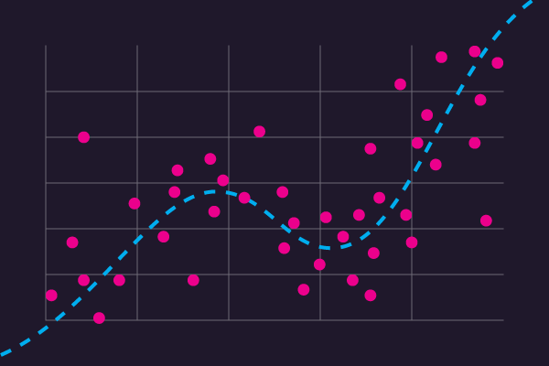
Regression Model

Slide 2
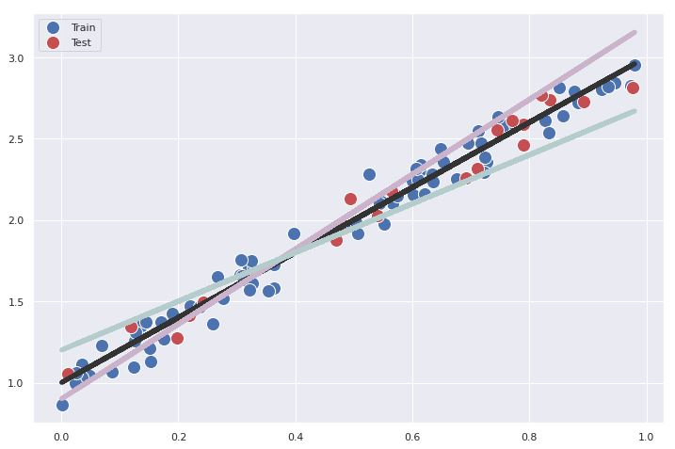
Definition of regression
Regression is a model of a machine learning, predict a dependent variable on the basis of one or more independent variables, we actually want to go from x to y and find the relationship between inputs and outputs. In fact, the goal is to find the best possible answer for the function
A linear regression diagram is actually the shortest input distance from all data, In the form of a black line it is more balanced than the other lines

Slide 3
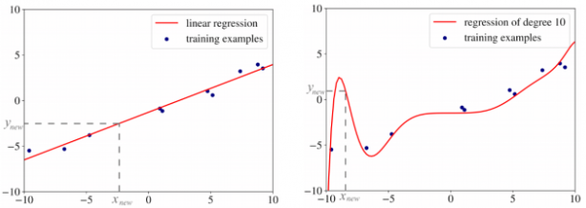
Types of Regression
Linear:
A linear regression is a model where the assumption is that the relationship between inputs and output is linear
Non-linear:
A non-linear regression is a model where the assumption is that the relationship between inputs and output is non-linear

Slide 4
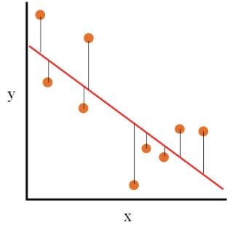
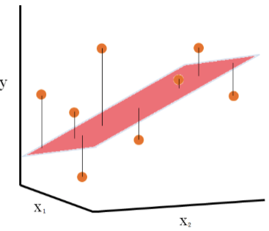
Types of linear Regression
Simple linear regression: The following represents the simple linear regression where there is just one independent variable, X, which is used to predict the dependent variable Y.
Multiple linear regression: The following represents the multiple linear regression where there are two or more independent variables (X1, X2) that are used for predicting the dependent variable Y.

Slide 5
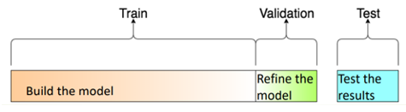
Data collection, Data training:
more than 80% of artificial intelligence (AI) project time is spent on data labeling and preparing phases
Training data is the dataset you use to train your algorithm or model so it can accurately predict your outcome.
Validation data is used to evaluate the parameters during training procedure
Test data is used to see how well it can predict new answers based on its training.

Slide 6
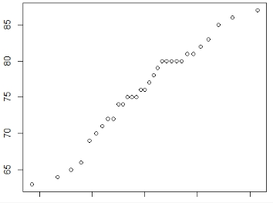
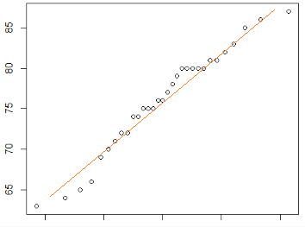
Simple Linear Regression
The following mathematical formula represents the regression model:
Y = b*X + b0
We consider the problem of predicting the marks of a student based on the number of hours he/she put into the preparation. Although at the outset, it may look like a simple linear regression, it could turn out to be a multiple linear regression problem depending on multiple input features or it may also turn out to be a non-linear problem. However, in this case we consider as a simple linear regression problem.
However, let’s assume for the sake of understanding that the marks of a student (M) do depend on the number of hours (H) he/she put up for preparation. The following formula can represent the model:
Marks = function (No. of hours) => Marks = m*Hours + c
The data represented in the first plot would be used to find out a line such as the second plot which represents a best-fit line. The slope of the best-fit line would be the value of “m”.

Slide 7
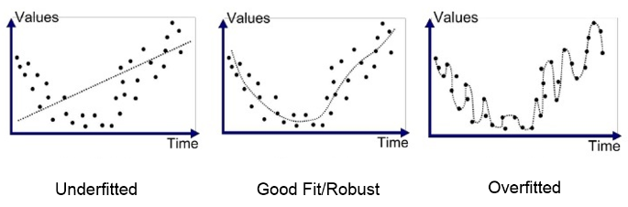
Overfitting vs Underfitting
Your model may be underfitting because it is not complex enough to capture patterns in the data.
overfitting is a modelling error in statistics that occurs when a function is too closely aligned to a limited set of data points, as a result , the model is useful in reference only to its initial data set , and not to any other data sets
The image below illustrates underfitted - good fit- overfitted

Slide 8

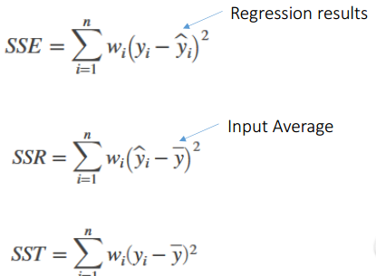
R-Squared and Evaluating the goodness of fit
R-Squared : It is the square of the correlation between the response values and the predicted response values, this statistic measures how successful the fit is in explaining the variation of the data.
Evaluating the goodness of fit: The sum of squares due to error(SSE) this statistic measures that total deviation of the response values from the fit to the response values. It is also called the summed square of residuals and is usually labeled as SSE.
A value closer to 0 indicates that the model has a smaller random error component, and that the fit will be more useful for prediction.

Slide 9

Real-world examples of linear regression models
For example, we consider a wind turbine, we use regression to estimate the voltage is produced electricity based on the wind speed or even the wind direction, it means how much electricity is produced in one day with the current wind speed.

