Slide 1


Medical Pump Simulator Safety critical system
Instructor: Professor Matthias Wagner
Group E’s presentation responsibilities:
Pham Nhat Nam: Project Overall Introduction.
Tomusange Brian: Hazard Analysis.
Mohamed Omar Zayan: Simulator.
Thomas Tena Nigussie: Testing.
Lam Phuoc Huy: Safety Plan + Conclusion.

Slide 2
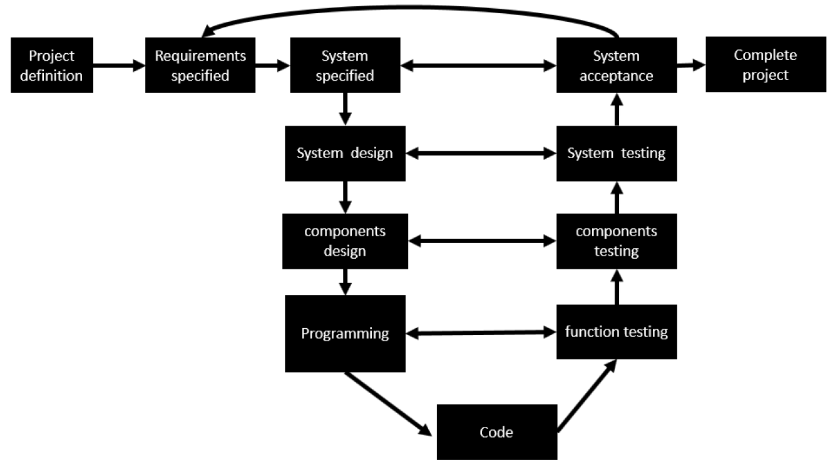
Project overall Introduction Management (Pham)
Meeting on Tuesday & Thursday.
Whatapps for communication.
Github for programming management

Slide 3
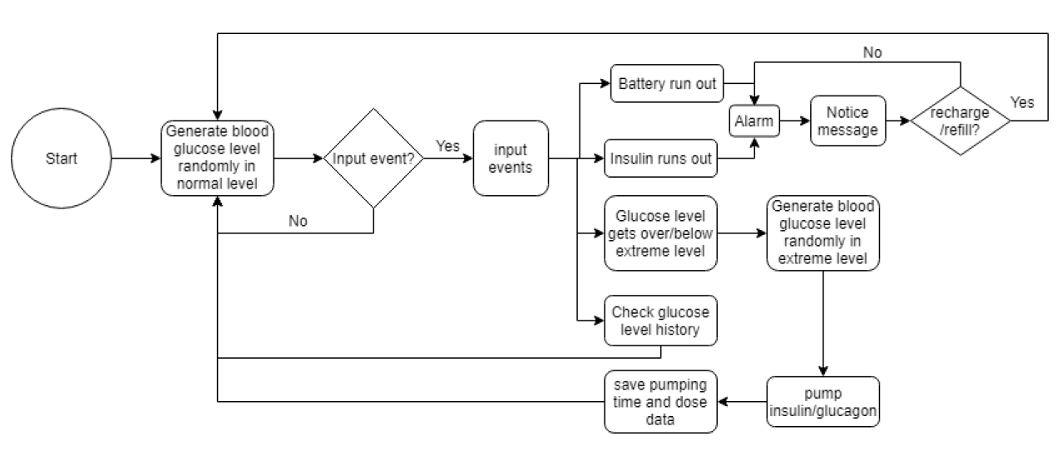
Project overall Introduction Coverage
Use cases in the simulator:
Doctor: Checking pumping log and glucose level data.
Patient: Glucose level, remaining dosage, battery level can be observed.
Emergency: Alarm and notification work in cases that glucose level overcome extreme level, Insulin dosage or battery level run out.
Tester: Inputting events, changing clock speed.

Slide 4
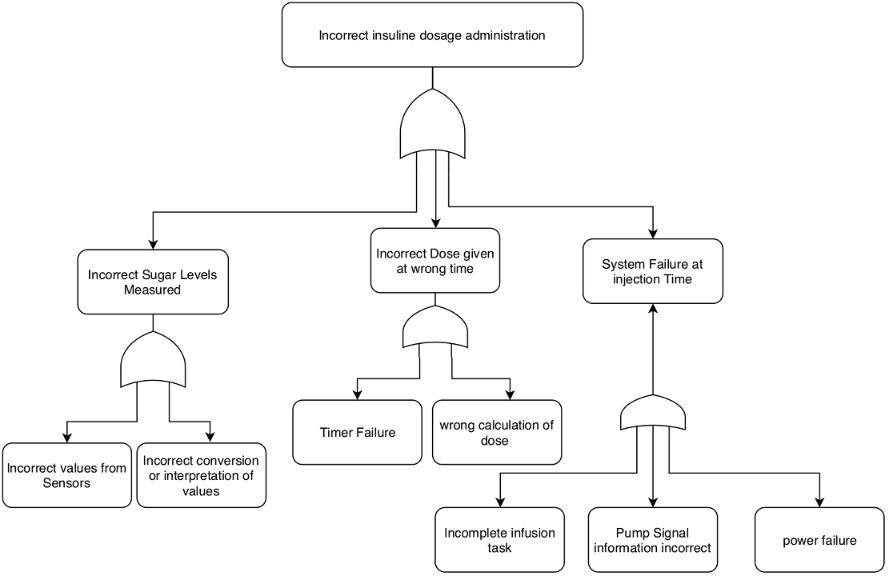
Hazard Analysis Fault Tree Analysis (Brian)
CHAIN OF EVENT METHODS
(FTA = 7 CAUSES OF FAULTS)
H1: INCORRECT INSULINE DOSAGE ADMINISTRATION

Slide 5
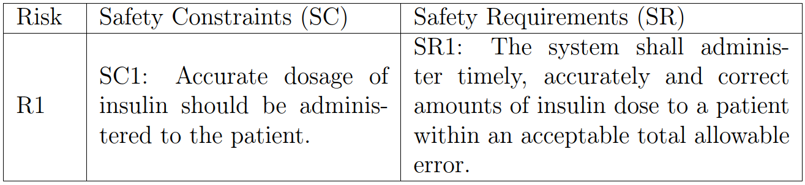
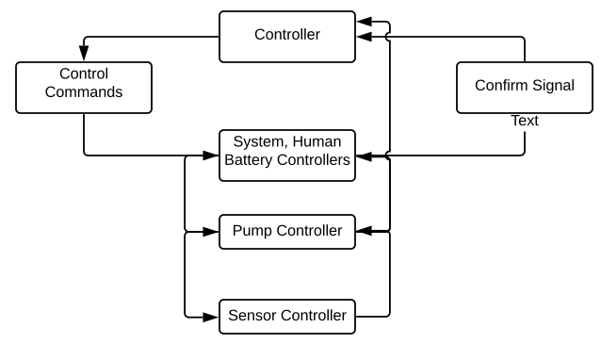
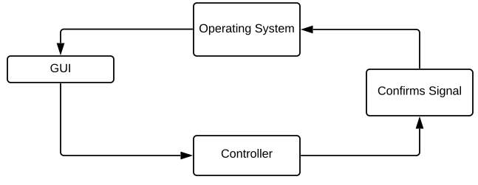
Hazard Analysis STAMP APPROACH TO HARZARD ANALYSIS OF INSULINE INFUSION PUMP
STEP 1: Identified system objectives, system Hazard , Hazard and safety constraint.
STEP 2: Creating the Hierarchical control structure.

Slide 6
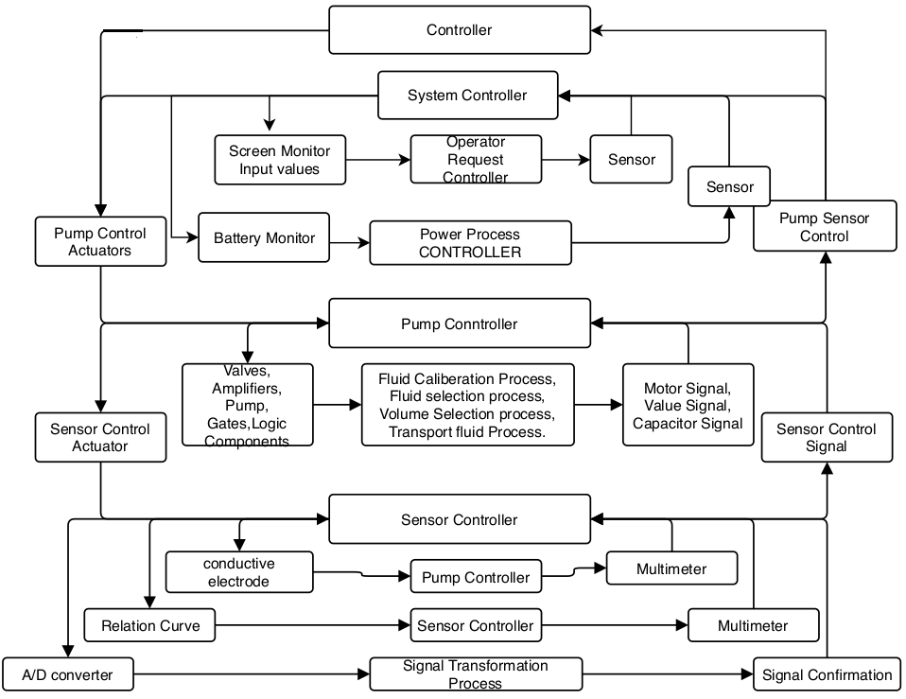
STEP 3: Defining control actions
Hazard Analysis
STAMP APPROACH TO HARZARD ANALYSIS OF INSULINE INFUSION PUMP

Slide 7
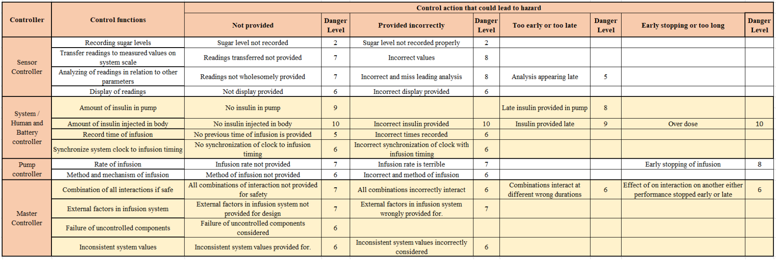
STEP 4: Control structure under normal condition STEP 5: Identifying potential unsafe actions STEP 6: Using unidentified safe control to create safety requirements STEP 7: Determining how each potentially hazardous control action could occur to enable mitigation action.
Hazard Analysis
STAMP APPROACH TO HARZARD ANALYSIS OF INSULINE INFUSION PUMP

Slide 8

Simulator Mathematical formula (Zayan)
Changes in blood glucose were determined by a mathematical formula [1]:
A0 is the initial amount of carbohydrates
G0 is the initial concentration of blood glucose
K1 is the glycemic index
K2 is the rate at which insulin is released

Slide 9
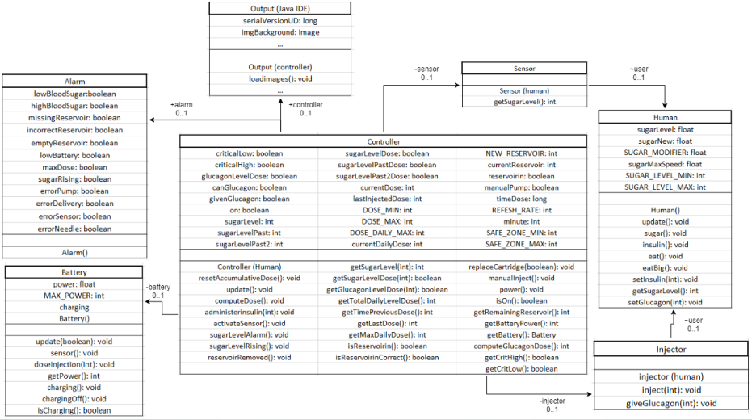
Simulator Class Diagram(Zayan)

Slide 10
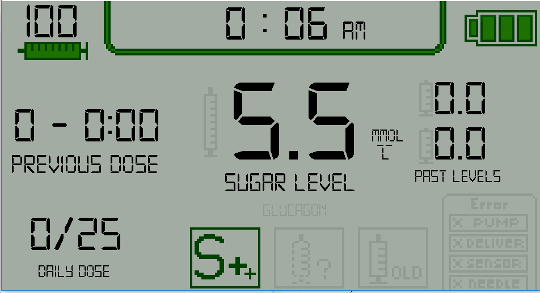
Simulator Graphical User Interface

Slide 11
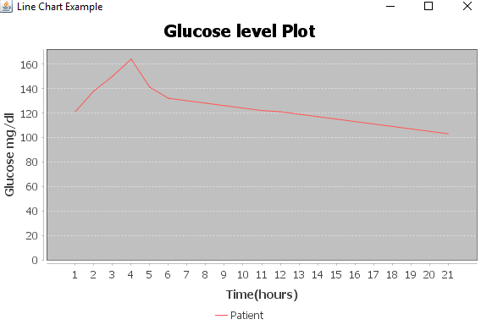
Simulator Graphical User Interface

Slide 12
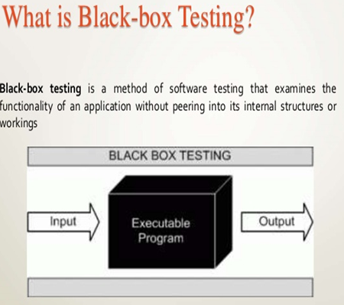
Testing Blackbox Testing (Nigussie)
Test Case | Input | Expected Output | Actual Output | Test Result
1 | Needle ON | No error Message | No error Message Displayed | Pass
2 | Needle OFF | Warning Message | Warning Message Displayed | Pass
3 | Sensor ON | No error Message | No error Message Displayed | Pass
4 | Senson OFF | Warning Message | Warning Message Displayed | Pass
5 | Reservior is ON | No error Message | No error Message Displayed | Pass
6 | Reservior is OFF | Warning Message | Warning Message Displayed | Pass
7 | Pump is Working ON | No error Message | No error Message Displayed | Pass
8 | Pump is Working OFF | Warning Message | Warning Message Displayed | Pass
9 | Drain Battery | Battery Empty | Battery is Drained | Pass
10 | Drain Insulin | Insulin Level Empty | Insulin is Drained | Pass
11 | Recharge Battery | Battery Must Start Recharging | Battery is being Recharged | Pass
12 | Refill Insulin | Insulin level must increase | Insulin level Raised | Pass
13 | AutoMode | Sugar level is calculated, accordingly Insulin is injected automatically | Sugar level is calculated, accordingly Insulin is injected automatically | Pass
14 | Manual Mode - Add Sugar | Sugar Level is raised in the monitor | Sugar level increases in the monitor | Pass
15 | Manual Mode - Add Excess Sugar | Maximum Insulin Dosage must be reached | Maximum Insulin Dosage Reached | Pass
16 | Manual Mode - Set Insulin Dosage | Insulin Dosage level is set Manually | Insulin Dosage level is adjusted by patient | Pass
17 | Clock Reading | Current Time | Real Time Displayed | Pass
18 | Auto Mode OFF | Switch to Manual Mode | Switched to Manual Mode | Pass
19 | Turn OFF the System | Data is reset | Reset the data | Pass
20 | Auto Mode - Red Zone | Goes into Red Zone | Goes into Red Zone | Pass
21 | Auto Mode - Yellow Zone | Goes into Yellow Zone | Goes into Yellow Zone | Pass
22 | Auto Mode - Green Zone | Goes into Green Zone | Goes into Green Zone | Pass

Slide 13
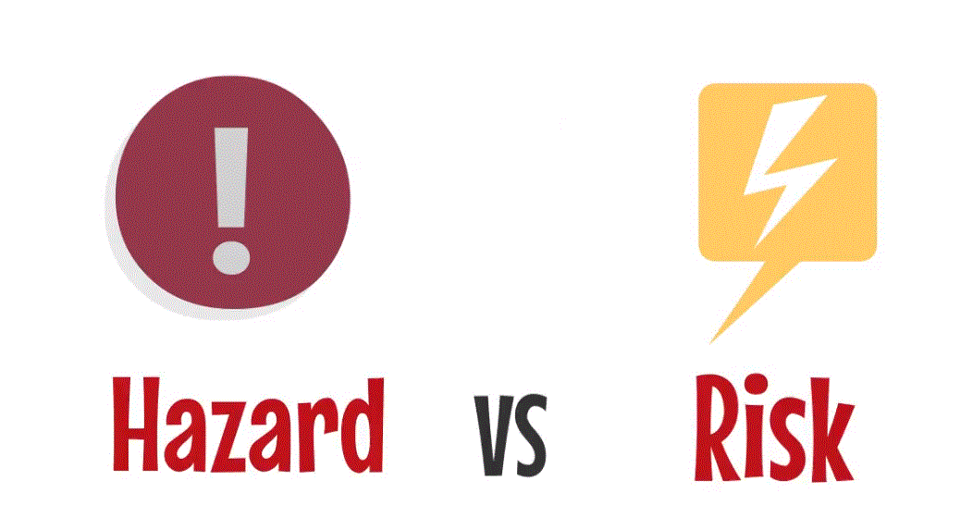
Testing Hazard vs Risk
Risk=Hazard+Exposure.
Risk
The risk is concerned about analyzing the likelihood that a hazard will occur and what the potential consequences are.
Hazard
A hazard is a situation that can endanger the life or health of a patient.
# | Risks | Impact | Mitigation
1 | Not enough time to implement all ideas | High | Prioritize ideas and implement them by priority.
2 | Less time for testing | Medium | Focus on testing the critical parts, but mention that further testing is recommended..
3 | Finding of design errors in a late phase | Medium | Adjust the design, try to change the project accordingly and focus on high priority tasks. If design error occurs in low priority task, think about skip this task.
4 | Finding critical bugs during final tests | Low (as long as every part is tested after implementation) | Try to fix the most critical parts of the software first before continue.
5 | Implementation not satisfying specifications | Low | Regular checks and apply changes immediately if necessary.
Identified Hazard | Occurrence probability | Hazard severity | Estimated risk | Acceptability
Insulin/Glucagon wrong pumping dosage | Low | High | High | Intolerable
Incorrect infusion time record | Medium | Low | Low | Acceptable
Glucose level history | Low | Medium | Medium | Noticeable
System stops working | High | High | High | Intolerable
VS

Slide 14
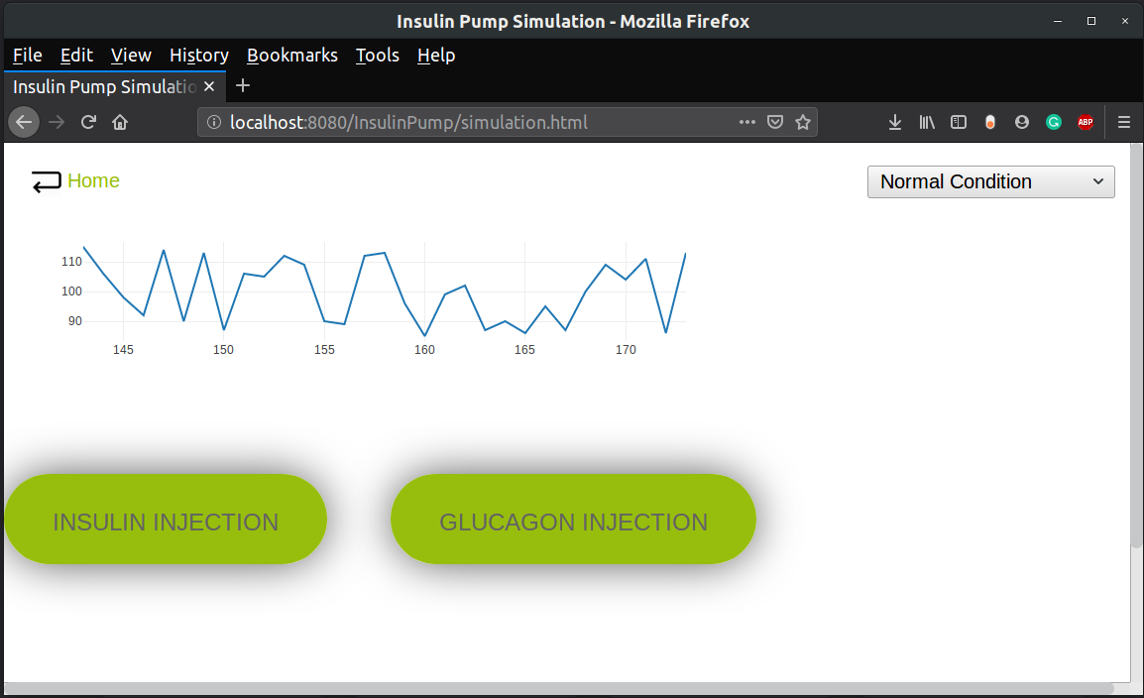
Safety Plan (Lam)
Manual to guide user how to use
Improve the glucagon function
HMI design need some revision (The graphical display change when glucose level outside of safety range)
Developed a backup web-based version in case the main system not working correctly

Slide 15
Conclusion
Even though there are still many shortcomings in our simulator, we can say that our final product satisfies all basic use cases initially planned.
Future works:
Improve the HMI design, glucagon function and implement a database to store patient information.
Because the medical information of the patient is considered private & sensitive, it will be great if we have a login function with 2 phase authorization.

Slide 16

Thank you for your listening

Slide 17
Reference
[1] C. Estela, “Blood glucose levels,” Undergraduate Journal of Mathematical Modeling: One+ Two, vol. 3, no. 2, p. 12, 2011.
[2] N. Leveson and J. Thomas, “Stpa handbook,” NANCY LEVESON AND JOHN THOMAS, vol. 3, 2018.

