Slide 1
Analyzing Human Activities Using Internet of Things Technology
Lam Phuoc Huy
Frankfurt University of Applied Sciences
Nibelungenplatz 1, D-60318 Frankfurt am Main, Germany
Email: hphuoc@stud.fra-uas.de

Slide 2
Overview
IoT Introduction
GPS Technology
Methods to Analyzing Human Activities Using GPS
Challenges and Open Issues
Conclusion

Slide 3
What is Internet of Things (IoT) ?
The IoT is the network of common devices or industrial equipment embedded with electronics, software and network connectivity, which enable these objects to collect and exchange data.

Slide 4
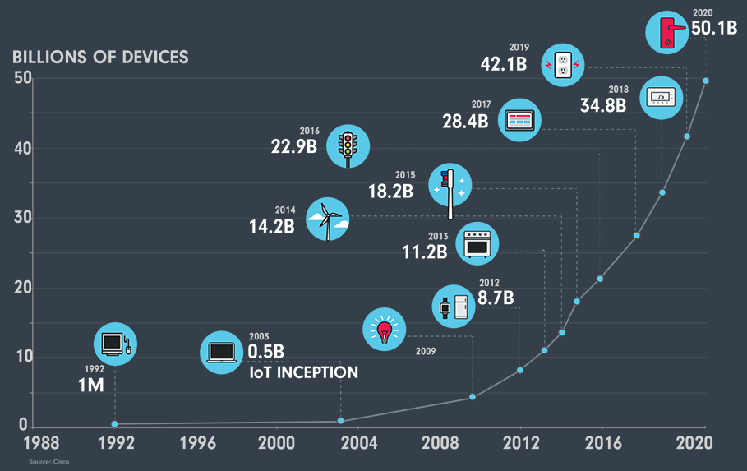
What is Internet of Things (IoT) ? cont.
Growth of the IoT devices [2].

Slide 5
GPS Technology
The GPS system is a satellite-based radio navigation system initially developed and currently maintained and operated by the U.S. Department of Defense (DoD).
It consists of three segments: space, control, and user [2].

Slide 6
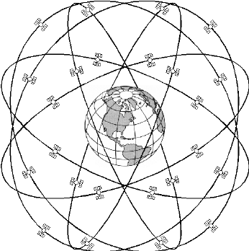
Space Segment
A constellation of at least 24 operational satellites in six equally-spaced orbital planes at an altitude of 20,200 km above the Earth make up the space segment.
GPS satellite constellation [3].

Slide 7
Control Segment and User Segment
The control segment consists of a master control station, a substitute master control station, and 16 monitoring sites located throughout the world.
The last segment consists of processors, receivers, and antennas that allow users to pick up the GPS satellite signals.

Slide 8
Analyzing Human Activities Using GPS
The study of human activities is not new in the
literature. Although the accuracy of GPS data collected from IoT devices are improving, the same can not be said for their quality in terms of semantic richness.
To solve this problem, Spaccapietra et al. [4] proposed a conceptual model for semantic trajectories.

Slide 9
Spinsanti et al. Approach
A novelty approach to enriching people’s movements was introduced by Spinsanti et al. [5].
The basic assumption is that the person stopped in a place because he or she is interested in visiting that place. The geographical objects that could represent the goal of the stop are called Place of Interest (POI).

Slide 10
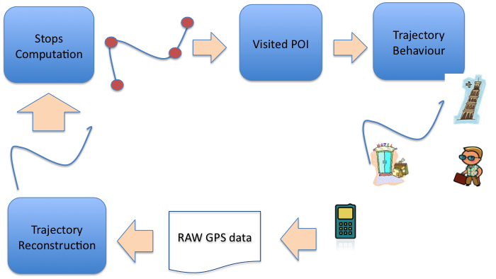
Spinsanti et al. Approach cont.
The schema of Spinsanti et al. approach [5].

Slide 11
Challenges and Open Issues
Even though there is huge potential in using IoT technologies to study human behaviors, most researchers agree that the field is still in its infancy and faces many challenges.

Slide 12
Standardization
Machine to Machine (M2M) communication technologies that require no human involvement have been considered as the foundation of IoT.
We need to deal with a massive number of M2M devices whose capabilities vary widely, ranging from tiny sensors with low resources to powerful storage and computation servers.

Slide 13
Security and Privacy
Since most of the communications are transfer through wireless networks, it very hard to avoid eavesdropping.
Furthermore, because most of the IoT components are designed with low capabilities in terms of both energy and computing resources, it is not possible to implement complex security tactics.

Slide 14
Conclusion
In the last few years, IoT technology has become a real game-changer in many domains from traffic management to tourist monitoring and urban planning.
We believe that given the interest shown by industries and governments, IoT will become one of the leading research topics in the near future.

Slide 15
Thank you for your listening

Slide 16
References
[1] K. Ashton et al., “That ‘internet of things’ thing,” RFID journal, vol. 22, no. 7, pp. 97–114, 2009.
[2] The Internet and Television Association, “Internet of Things.” https: //www.ncta.com/positions/internet-of-things. [Online; Accessed 10-June-2020].
[3] Official U.S. government information about the Global Positioning System, “What is GPS?” https://www.gps.gov/systems/gps/. [Online; Accessed 10-June-2020].
[4] C. Rizos, “Trends in gps technology & applications,” in 2nd International LBS Workshop, Citeseer, 2003.
[5] S. Spaccapietra, C. Parent, M. L. Damiani, J. A. de Macedo, F. Porto, and C. Vangenot, “A conceptual view on trajectories,” Data & knowledge engineering, vol. 65, no. 1, pp. 126–146, 2008.
[6] L. Spinsanti, F. Celli, and C. Renso, “Where you stop is who you are: understanding people’s activities by places visited,” EPFL, Lausanne, Switzerland b KDDLab, ISTI, CNR, Pisa, Italy, 2010.

Slide 17
References cont.
[7] J. Qi, P. Yang, D. Fan, and Z. Deng, “A survey of physical activity monitoring and assessment using internet of things technology,” in 2015 IEEE International Conference on Computer and Information Technology; Ubiquitous Computing and Communications; Dependable, Autonomic and Secure Computing; Pervasive Intelligence and Computing, pp. 2353–2358, IEEE, 2015.

