Slide 1
Gesture Recognition using MS Kinect in Real-time
Real-Time System Project
Group 4
Pham Nhat Nam
Lam Phuoc Huy
Tran Anh Khoa
Instructor: Prof. Matthias Deegener

Slide 2
Division of works
Tran Khoa: main programmer, working directly with MS Kinect.
Lam Phuoc Huy: secondary programmer, searching for support materials.
Pham Nhat Nam: tester, plan management, working with documents, reports and support in work.

Slide 3
Contents
Introduction
Features
Kinect v1 vs v2
Algorithm
Demo
Conclusion

Slide 4
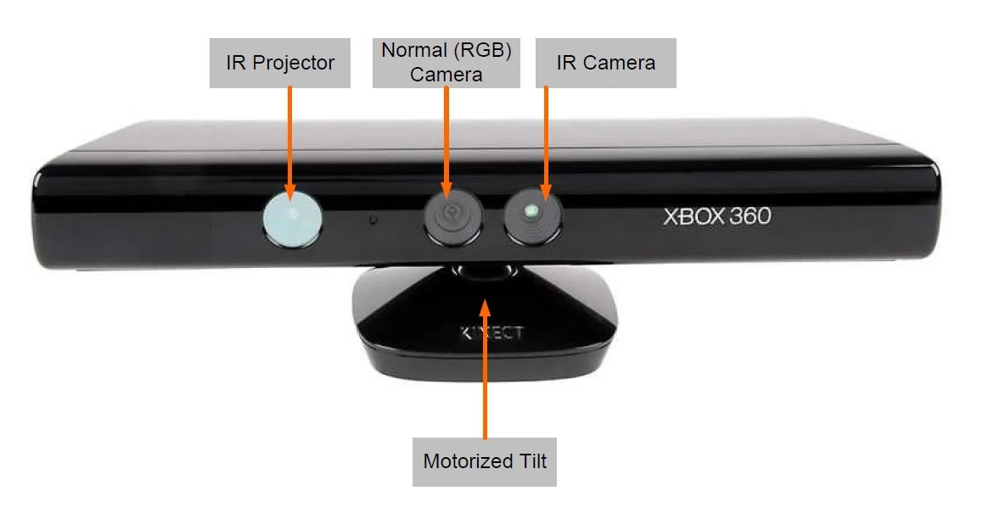
Introduction: Features
Identify 20 separate spots of articulation at the same time on a human’s body.
Recognizing the sense of depth to build up the 3D environment.
=> Applicable in gesture recognition.
Gesture to recognize in this project: swipe hand left/right, raise hand up to a direction.
Notes:
As mentioned before, MS Kinect xbox 360 is the main device for this project. Kinect is a line of motion sensing input devices produced by Microsoft and first released in 2010. It contains of 3 camera as shown on the image. A normal camera for image capture and 2 IR components for depth sensing. The reason it can be used in gesture recognition is in its feature: tracking upto 20 separate spot at the same time on human’s body and can build up the 3D environment by the help of depth sensing. It also include a microphone array, along with software and artificial intelligence from Microsoft to allow the device to perform real-time speech recognition.

Slide 5
Introduction: Features
System Requirement:
USB 3.0 connection for Windows 10 (Windows 8.1/8/7, Linux require only USB 2.0 connection).
Microsoft .NET Framework 4.5.
Microsoft Kinect for Windows Runtime v1.8/1.7.
Microsoft Kinect for Windows SDK v1.8/1.7.

Slide 6
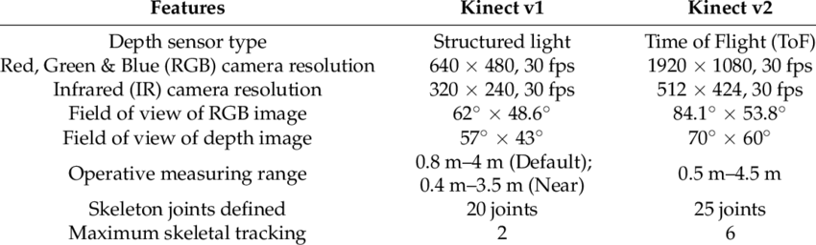
Introduction: Kinect v1 vs Kinect v2
Notes:
The biggest notable difference is the higher resolution capability of the Kinect 2 camera. Though the Kinect 1 device is a vast improvement over regular webcams at the time, the Kinect 1 is restricted by it’s lower resolution output. The Kinect v2 face recognition, motion tracking, and resolution are much more precise than the Kinect v1. Kinect v2 can process 2 gigabytes of data per second, USB 3 provides almost 10x faster broadband for the data transfer, 60% wider field of vision, and can detect and track 20 joints from 6 people’s bodies including thumbs. In comparison, the Kinect v1 could only track 20 joints from 2 people. On top of this, when using Kinect v2 we are capable of detecting heart rates, facial expressions and weights on limbs, along with much more extremely valuable biometric data.

Slide 7
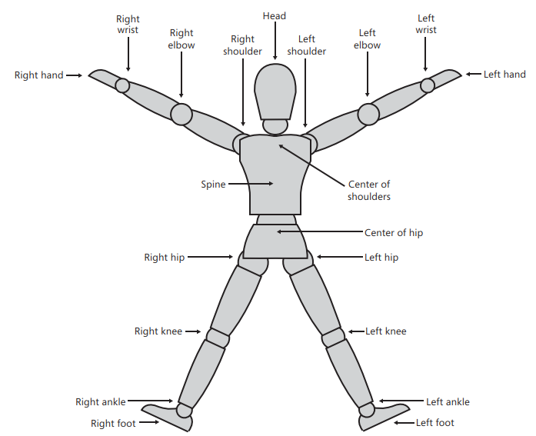
Algorithm
The Kinect for Windows SDK provides us with a set of APIs that allow easy access to the skeleton joints. [2]
HelixToolkit is applied to handle 3D problem. [5]
20 control points of a skeleton [1]
Notes:
Now I will take part in explain the core of our work. So how can we make the program to recognize the gesture and control the VLC application?
First of all, in order to extract the input from Kinect, we use the API from WIndow software development kit. It help us extract info about environment and important point of joint on human’s skeleton. As you can see on the image, there are 20 points the Kinect can monitor on human’s body.
Next, to handle the environment and problem of 3D, HelixToolkit is the library provided to solve this.

Slide 8

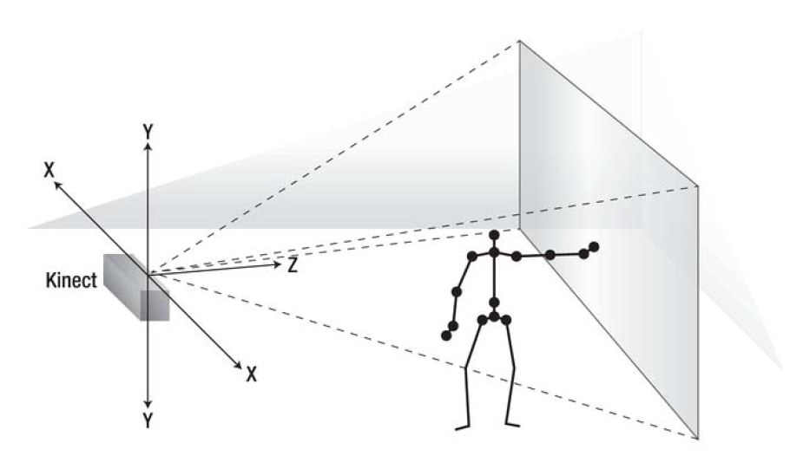
Algorithm
The Kinect sensor has a practical ranging limit of 1.2–3.5 m [4] in z axis.
Based on the change of coordination of joint to decide the gesture.
Each gesture will be set corresponding to an area of coordinates.
Depending on the application to be applied, the output of each gesture will be set appropriately.
Skeleton space [3] uses a right-handed coordinate space in meter unit
Sensor is default at (0,0,0)
Notes:
In order to make it work well, distance between kinect and user should be in the limit from 1.2 to 3.5 meters.
Since this is just a simple project, we use a simple solution based on the the of coordination of joint to decide the gesture. We đont apply any complex algorithm or machine learning into this.
As shown in the image, sensor can track the position of detecting user and important point on the body compared to the position of itself. So for example, if I swept right, the x coordinate of my right hand will increase and vice versa. If I raise hand, the y unit increase.
However, to avoid mistake in distinguishing since swept action can also increase the y unit, we set a limit range of coordination for each action. So if we want to swept right, we should only swept inside the swept right area.
Since we want to make a program with ability to control many application, the output can be changed depending on the applied program.

Slide 9
Demo

Slide 10
Conclusion
Mostly based on the Microsoft Kinect SDK APIs
Gesture to recognize is still simple.
Can control basic features of applications like VLC.

Slide 11
Reference
[1] Catuhe, D., 2012. Programming With The Kinect For Windows Software Development Kit. Redmond: Microsoft Press.
[2] Jana, A., 2012. Kinect For Windows SDK Programming Guide (Community Experience Distilled). Packt Publishing.
[3] Webb, J. and Ashley, J., 2012. Beginning Kinect Programming With The Microsoft Kinect SDK. [New York]: Apress, page 114.
[4] https://en.wikipedia.org/wiki/Kinect#Kinect_for_Xbox_360_(2010)
[5] https://github.com/helix-toolkit/helix-toolkit

