Slide 1
COLLEGE PROJECT
Campus Minimum Network Designer
using Kruskal’s Algorithm
A
B
D
Connecting every campus building at the lowest possible cable cost
TEAM:
G Manikanta(25MVCSDR0019)
Nagi Reddy(25MVCSDR0012)
Upendar(25MVCSDR0024)
Manasa(25MVCSDR0060)
C
E
Notes:
Introduce the project: a tool that designs the cheapest network connecting all campus buildings, using Kruskal's algorithm. Replace the bracketed placeholders with your details.

Slide 2





Problem Statement & Objective
Problem
Objective
Connect all campus buildings with the minimum total cable / network cost.
Find the Minimum Spanning Tree (MST): every building connected, no extra cable.
Why minimize cost?
Saves cable & setup cost
Less maintenance
Efficient, loop-free design
Notes:
Problem: laying cable between every pair of buildings is wasteful. Objective: find the MST - the cheapest set of connections that still links every building. Lower cost, less maintenance, no redundant loops.

Slide 3


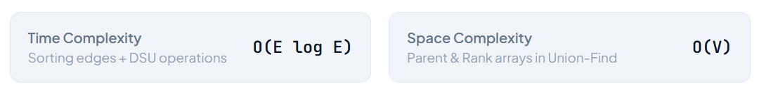
Proposed Solution
Kruskal’s Algorithm
Example: campus graph
Greedy: always pick the cheapest cable that doesn’t form a loop.
Library
Admin
A
4
B
3
D
Lab
Union-Find (DSU)
2
5
Quickly checks whether two buildings are already connected.
6
1
C
E
7
Hostel
Canteen
V buildings need exactly V − 1 cables
5 buildings · 7 possible cables (numbers = cost)
Notes:
Kruskal's is greedy: sort all possible cables by cost and keep adding the cheapest one that does not create a cycle. Union-Find tells us in near-constant time whether two buildings are already connected. The graph on the right is the example used in the rest of the deck.

Slide 4



Technology & Architecture
React.js
User enters buildings & costs
Python Backend
Receives graph via API
Kruskal +
Union-Find
Sort edges, avoid cycles
MST Result
Chosen edges + total cost
React.js
Highlights MST in green
Frontend: React.js
Backend: Python
Interactive network canvas, buttons and live visualization
API that runs Kruskal’s Algorithm with Union-Find
Notes:
Flow: the React frontend sends the buildings and connection costs to the Python backend. The backend runs Kruskal's algorithm with Union-Find and returns the MST edges and total cost. React then highlights the MST in green.

Slide 5
How the Algorithm Works
3
1
2
Forms cycle?
4
Sort edges by cost
Pick the cheapest edge
Add edge to the MST
No
Yes
Example run
5
Skip the edge
Repeat until V − 1 edges
Sorted costs: 1, 2, 3, 4, 5, 6, 7
Add: D–E, A–C, B–D, A–B
Skip: B–C, C–D, C–E (cycles)
Total cost = 1 + 2 + 3 + 4 = 10
Notes:
Walk through the flow: sort edges, take the cheapest, ask Union-Find whether its two ends are already connected. If not, add it; if yes, skip it. Stop after V-1 edges. On the example, edges D-E, A-C, B-D, A-B are chosen for a total cost of 10.

Slide 6
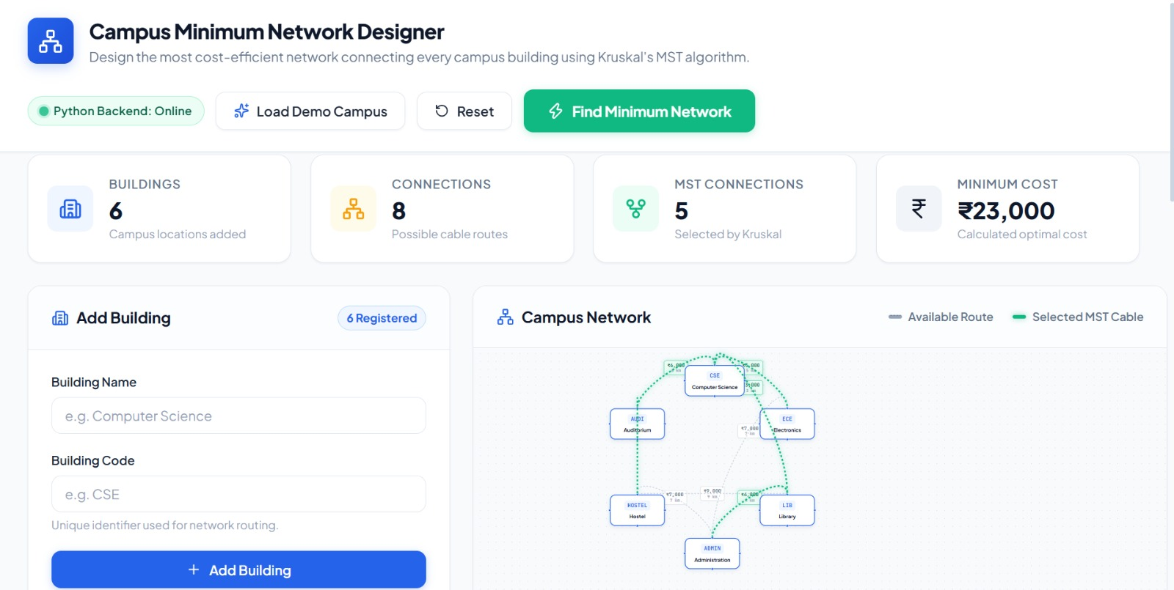
Website & Results
Campus Network Designer
Add Building
Library
Admin
MINIMUM TOTAL COST
e.g. Library
+ Add
A
B
10
4
Add Connection
3
D
Lab
Library → Admin
2
5
Cost: 4
+ Add
4 cables selected
6
1
C
Chosen edges
Find Minimum Network
7
E
D–E · 1
A–C · 2
B–D · 3
A–B · 4
Hostel
Canteen
5 buildings · 7 connections
MST (selected)
Not used
Notes:
Mock-up of the dashboard: the sidebar adds buildings and connections, the canvas draws the network, and 'Find Minimum Network' sends it to the backend. The MST comes back highlighted in green with the minimum total cost (10 for this example). Swap in a real screenshot of your app if you have one.

Slide 7
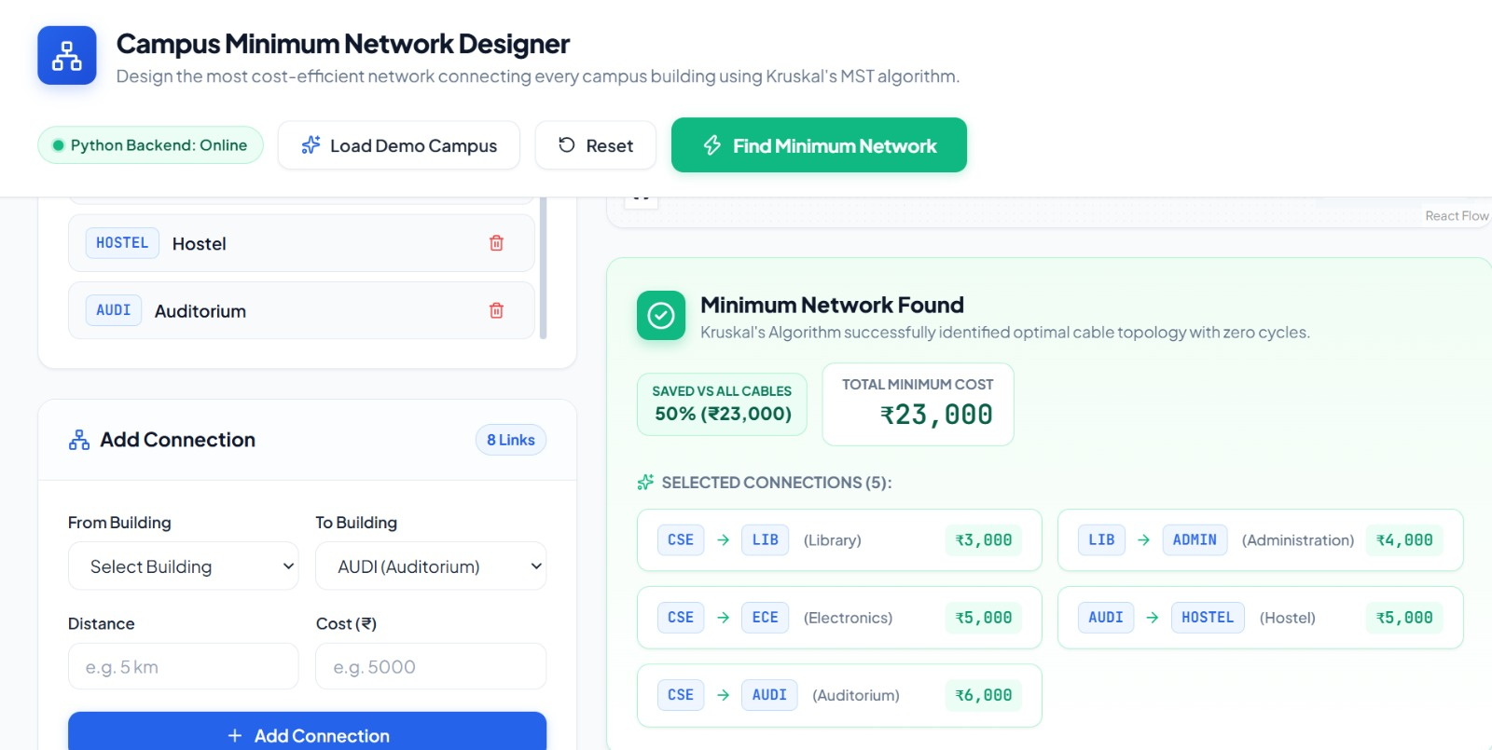

Slide 8




Conclusion & Future Scope
Conclusion
Future Scope
Successfully finds a minimum-cost campus network
Real campus maps
Larger networks
Demonstrates Kruskal’s Algorithm with Union-Find
Live data
Cost analysis
Notes:
Wrap up: the project meets its goal of finding a minimum-cost network and shows Kruskal's with Union-Find in action. Future work: load real campus maps, scale to larger networks, use live data, and add deeper cost analysis.

