Slide 1


Lean Six Sigma as a tool for
Operational Risk Management
Facoltà di Economia
Dipartamento Metodi e Modelli per L’Economia, Il Territorio e la Finanza.
Corso di laurea Finanza e Assicurazione.
A.A 2021/2022
Relatore.
Valentina Lagasio
Studente.
Nagib Stefano Souki
1793926.

Slide 2
Operational Risk
Refers to the risk of loss resulting from inadequate or failed internal processes, systems, human errors, or external events. It is the risk of loss that occurs from the day-to-day operations of an organization. It involves a wide range of risks, from data breaches to natural disasters, that can threaten an organization's assets, income, and reputation.
It has been always in Banking and non-banking organizations, but the relevance has been increasing with the complexing and globalization of the financial system.
Lean Six Sigma as a tool for
Operational Risk Management
19/01/2022
Pagina <number>

Slide 3
Banking
Perspective
Through the publication of its guidelines and regulatory technical standards on operational risk, the EBA aims at promoting and enhancing the effectiveness of operational risk management and supervision throughout the banking system.
Operational risk is a relatively young field: it became an independent discipline only in the past 20 years. While banks have been aware of risks associated with operations or employee activities for a long while.
Lean Six Sigma as a tool for
Operational Risk Management
19/01/2023
Pagina <number>

Slide 4
Limits of the
operational risk management
in banking
The quantity of diverse risk that we can find on this category
The operational risk requires oversight and transparency off almost all the organizational process and business activities.
Operational risk was
less easily measured and managed through data and recognized limits than financial risk
Lean Six Sigma as a tool for
Operational Risk Management
19/01/2023
Pagina <number>

Slide 5
Operational risk in banking
New instruments
New instruments and frameworks are needed to evaluate the resiliency of the business processes, challenge business management and prioritize interventions. These frameworks should support the following types of actions:
Map the processes
Identify supporting technology
Monitor
risk and controls
Link resource planning to processes
Reinforce needed behaviour
Enable feedback
Establish change management
Lean Six Sigma as a tool for
Operational Risk Management
19/01/2023
Pagina <number>

Slide 6
Lean Six
Sigma
Is a methodology that apply a collaborative team effort to improve the performance by limiting the waste and variation. It’s a combination of Lean Management and Six Sigma that aim to eliminate the wastes, called Muda.
Fujio Cho defined the waste (Muda) as “anything other than the minimum amount of equipment, materials, parts, space, and workers time, which are absolutely essential to add value to the product"
Different types of waste have been defined in the form of a mnemonic of "downtime”
Defects:
Over-production:
Waiting:
Non-Used Talent
Transportation
Inventory
Motion
Extra-processing
Lean Six Sigma as a tool for
Operational Risk Management
19/01/2023
Pagina 7

Slide 7
Lean
Methodology
Six
Sigma
Is a way of management for the companies that helps on a process of continuous improvement, it’s a long-term methodology that aims to achieve small and incremental improvements in the process, particularly on the efficiency and quality. The main objective of Lean Management is to create value for the final costumer through the optimization of the resources and elaborate a stable workflow respecting the costumers’ requirements, it do it eliminating all the wastes and the unnecessary efforts of the process by an identification of each step of the business process and reviewing and eliminating the steps that do not add a value.
Six Sigma aim to improve manufacturing quality by identifying and removing the causes of defects and reducing the variability in the process. This is done by applying empirical and statistical method and by working with Six Sigma experts. Each Six Sigma project follows a defined methodology and has specific value targets.
Lean Six Sigma as a tool for
Operational Risk Management
19/01/2023
Pagina <number>

Slide 8
DMAIC PROCESS
Define: this step aims to clarify the business problem, goal, resources,
scope, and timeline. This phase is normally used on the project chapter creation
Measure: this step represents the measurement of the specification
of the problem and goal. Here the data is collected.
Analyse: the aim of this step is identified, validate, and select the root cause of the elimination. Most of the potential root causes are identified through a root cause analysis (e.g., Fishbone diagram).
Improve: the aim of this step is to identify, test and apply a solution to the issues,
partial or full, depending on the situation.
Control: the aim of this step is to insert the changes and guarantee sustainability.
Lean Six Sigma as a tool for
Operational Risk Management
19/01/2023
Pagina <number>

Slide 9
RBC IT&S
AND LEAN
SIX SIGMA
RBC IT&S, is applying the Lean Six Sigma philosophy to upgrade the processes to achieve a lean organization and reducing all the wastes on the process.
During the application some issues were identified on the processes that are creating a more exhaustive and expensive workflow. Between the issues we have:
The SRO report was built incrementally by adding the sponsor’s (Chief Financial Officer, CFO) requirements.
It is necessary to add comments to be able to monitor the adjustments
We depend on the business partners collaboration to be able to create a forecast of the SRO figures thar are accurate.
Lean Six Sigma as a tool for
Operational Risk Management
19/01/2023
Pagina 9

Slide 10
RBC IT&S
AND LEAN
SIX SIGMA
The goal that RBC IT&S Luxembourg wants to achieve through Lean Six Sigma application is to:
The Lean Six Sigma tools that have being applied inside of the bank’s management and analysis is the DMAIC process to stablish the interventions and identify the issues, The Fishbone scheme to have a complete view of the process and applying the Kanban strategy to organize the daily task between the team members.
Clean up the report
Create a tracker to discuss the variances
Explain the objective of the exercise and implement SLA or clear instructions
Lean Six Sigma as a tool for
Operational Risk Management
19/01/2023
Pagina <number>

Slide 11
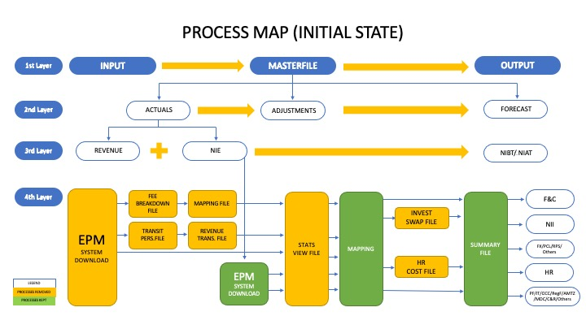
Lean Six Sigma as a tool for
Operational Risk Management
19/01/2023
Pagina <number>

Slide 12
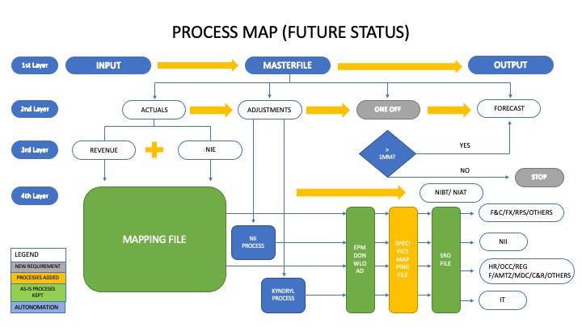
Lean Six Sigma as a tool for
Operational Risk Management
19/01/2023
Pagina <number>

Slide 13
Result
How Lean Six Sigma will help RBC IT&S Luxembourg to reduce operational risk:
On the 2 schemes explained before, we can understand the changes in the process of RBC IT&S Luxembourg, there we can find 3 main changes related to operational risk management :
Addition of the phase called “ONE OFF”, that represent an additional analysis on the events that affect the bank having a monetary value of over 1.000.000€.
The further development of the adjustments, to understand properly the reason of the necessary adjustment from the plan.
The autonomation, that reduce the intervention of the employees on the process, creating a more autonomous and developed system.
Lean Six Sigma as a tool for
Operational Risk Management
19/01/2023
Pagina 7

Slide 14
Thanks for your attention
Lean Six Sigma as a tool for
Operational Risk Management
19/01/2023
Pagina 14

