Slide 1

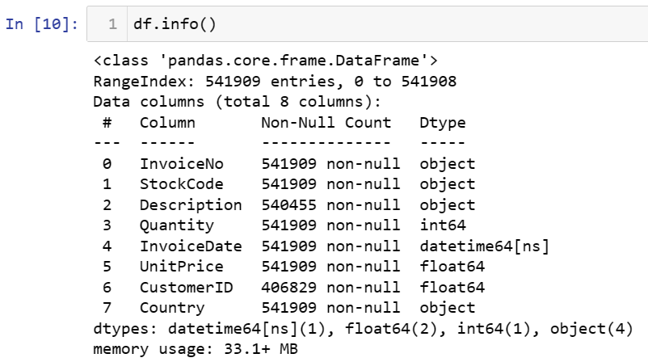
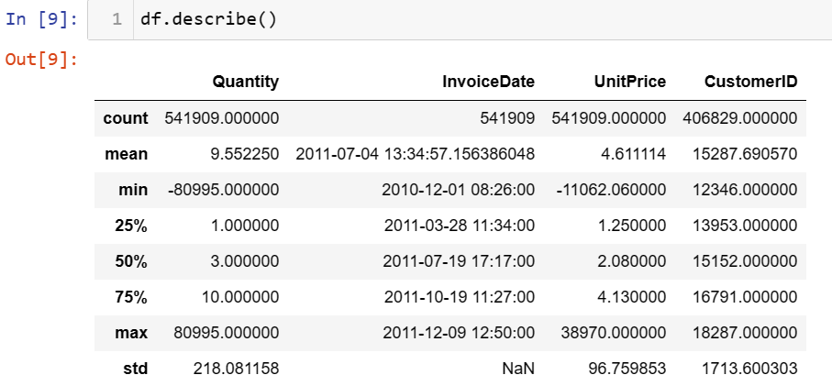
USE CASE-3.1: CUSTOMER SEGMENTATION
PROCESS:
Loading the dataset
Data cleaning
Feature Engineering
Building the Model
Box plot to visualize Cluster Id vs Recency
Libraries:
Seaborn
Plotly
Openpyxl
Missingno
matplotlib
Dataset:
The dataset contains 5.4Lakh Samples of the online purchase history of 2.4k customers.

Slide 2
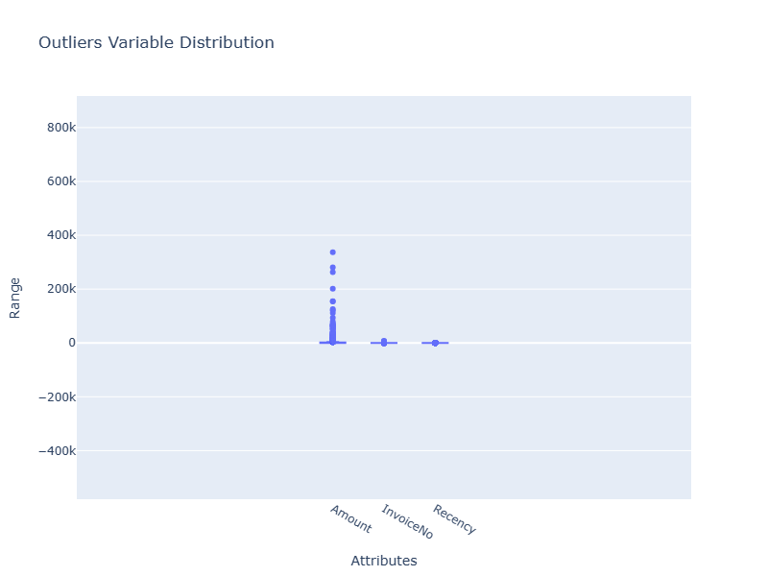
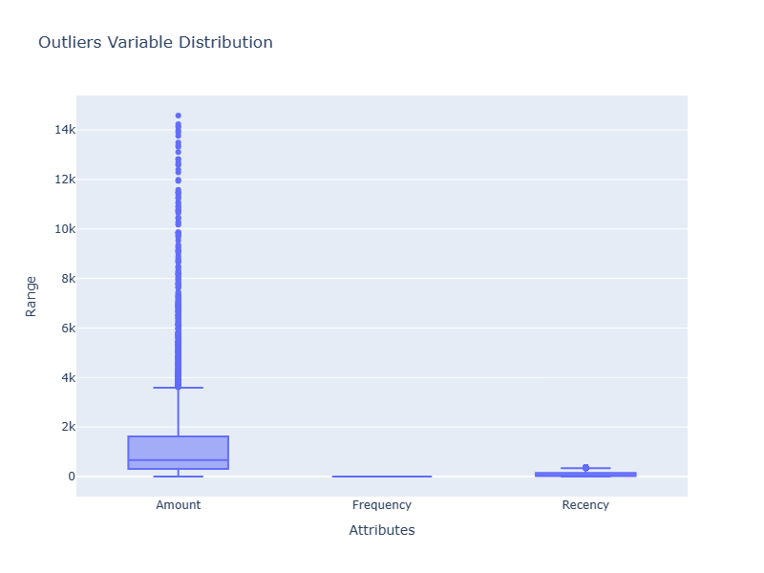
There are 2 types of outliers and we will treat outliers as it can skew our dataset
Statistical
Domain specific
Outliers can distort statistical analyses and models by introducing noise and skewing results.
Removing outliers helps in obtaining a more representative view of the dataset and its underlying patterns.

Slide 3
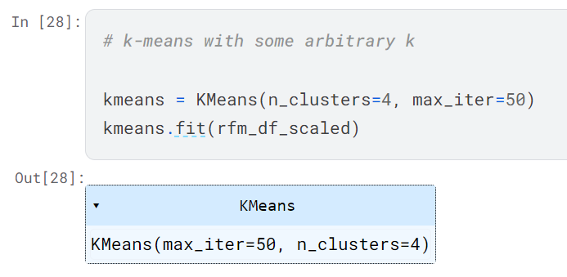
Rescaling the Attributes:
It is extremely important to rescale the variables so that they have a comparable scale.| There are two common ways of rescaling:
1-Min-Max scaling
2-Standardisation (mean-0, sigma-1)
Building the Model:
K-Means Clustering:
K-means clustering is one of the simplest and popular unsupervised machine learning algorithms.

Slide 4
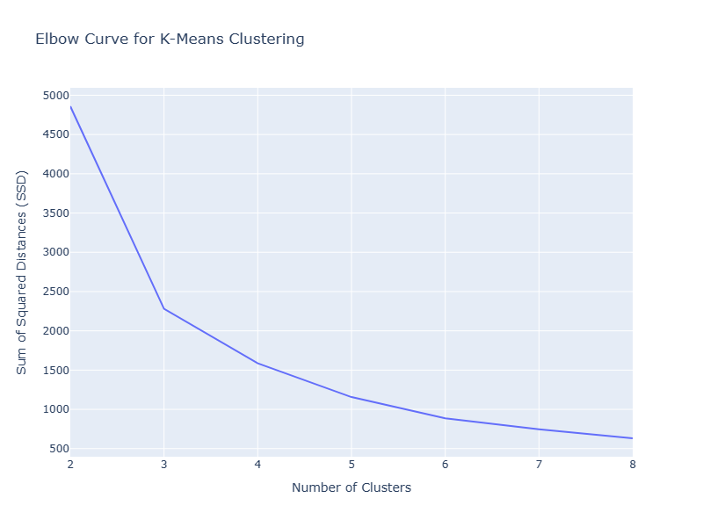
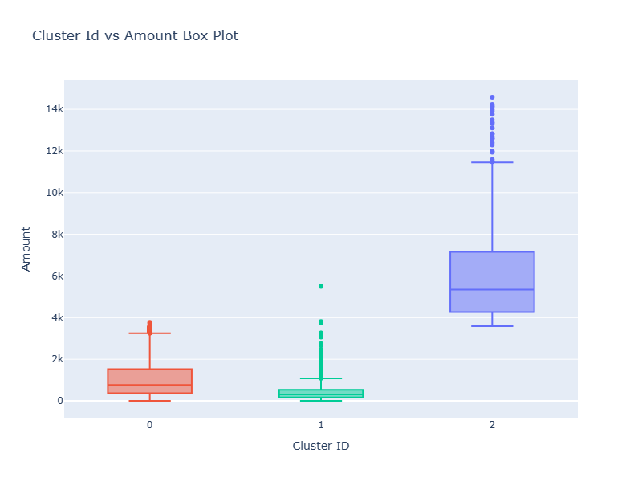
Finding the Optimal Number of Clusters
The Elbow Method is one of the most popular methods to determine this optimal value of k.
BOX PLOT

Slide 5
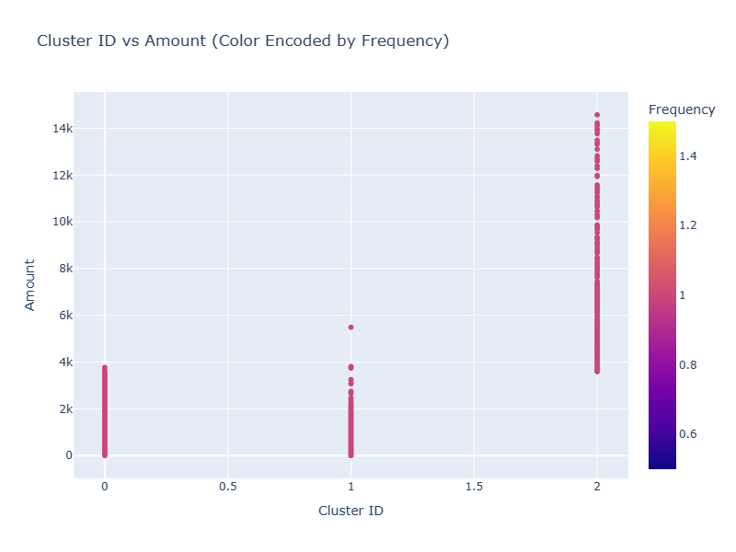
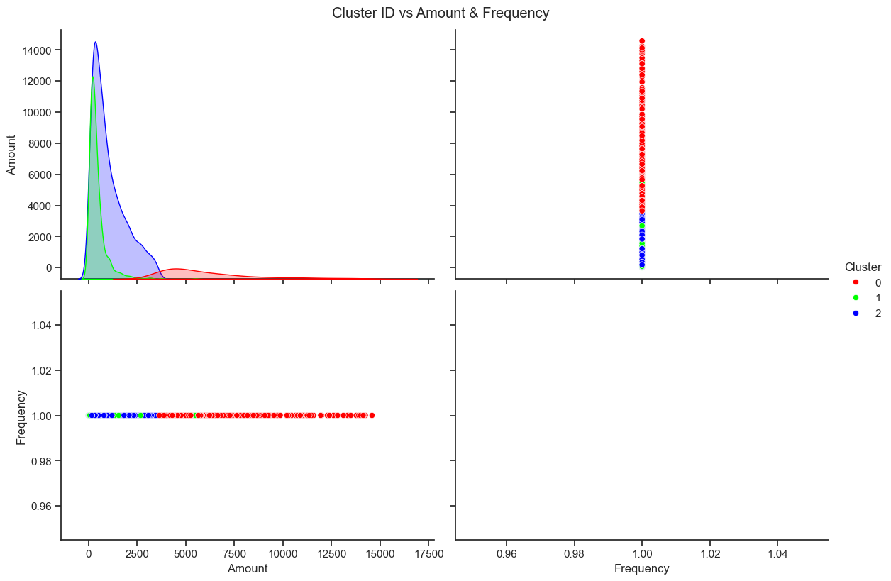
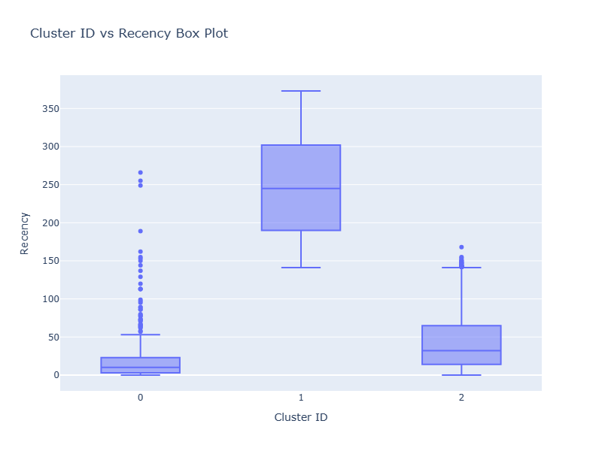
Color Encoded by Frequency
Scatter plot
Box plot

Slide 6
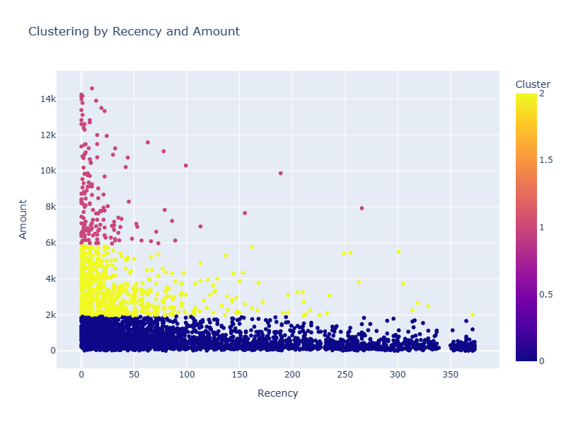
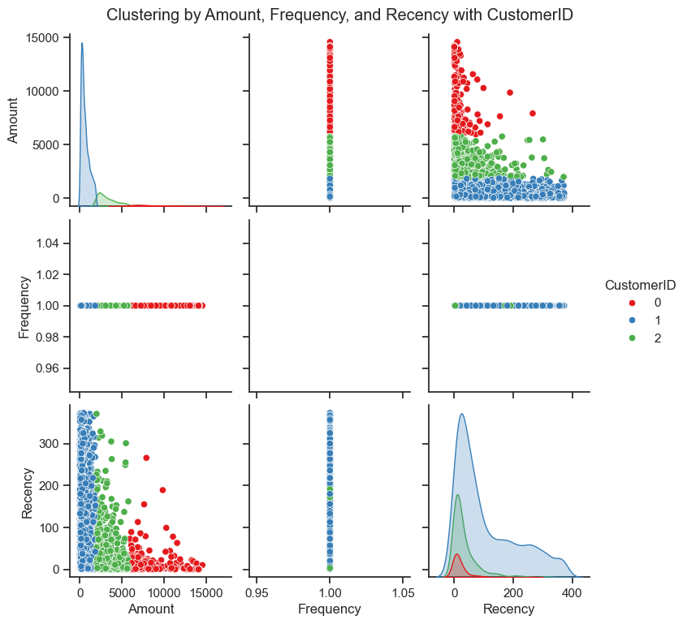
Selecting the two features for clustering
Create a scatter plot with Plotly
Scatter plot matrix

Slide 7
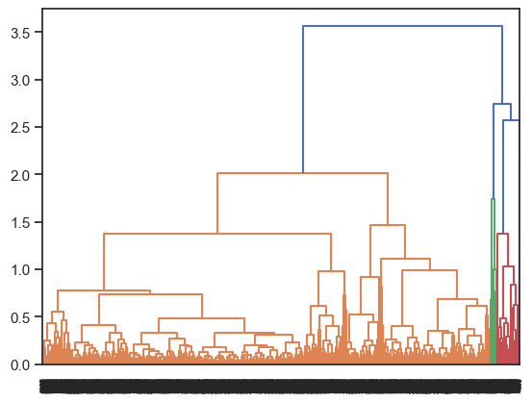
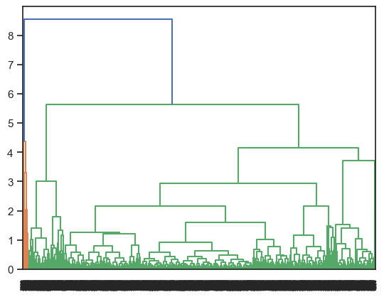
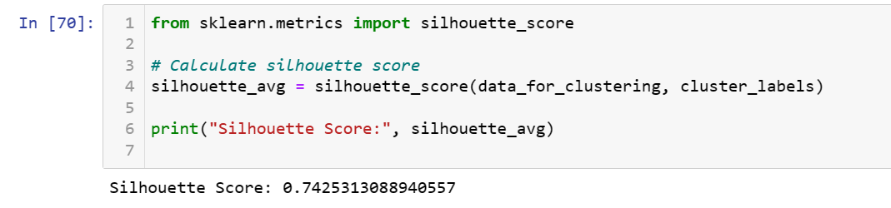
Average linkage
In average linkage hierarchical clustering, the distance between two clusters is defined as the average distance between each point in one cluster to every point in the other cluster.
Complete Linkage
In complete linkage hierarchical clustering, the distance between two clusters is defined as the longest distance between two points in each cluster.
Model accuracy: 74%

