Slide 1
INDUSTRY 4.0 CAPSTONE PROJECT
IIoT SENTINEL 4.0
Intelligent Industrial IoT Security Monitoring and Threat Detection System
Hybrid AI Architecture: Supervised XGBoost, Deep Autoencoder & False-Negative Reduction Engine
STUDENT CREDENTIALS (Editable)
Student Name: [Student Name]
Roll Number: [Roll Number / Register ID]
Degree: B.Tech — Artificial Intelligence and Data Science
Department: Department of AI & Data Science
Institution: [College / University Name]
PROJECT SUPERVISION & DOMAIN
Project Guide: [Guide Name, Designation]
Project Domain: Industry 4.0 Cyber-Physical Systems (CPS)
Core Technologies: Python, PyTorch, XGBoost, SHAP, Streamlit
Evaluation Dataset: Edge-IIoTset Industrial Benchmark
Academic Year: 2025 – 2026

Slide 2
BACKGROUND & CONTEXT
Introduction — Industry 4.0 & Industrial IoT Security Landscape
1. Industry 4.0 Paradigm
• Convergence of Physical & Cyber: Integration of physical shopfloor machinery, PLCs, and SCADA systems with edge computing networks.
• Hyper-Connectivity: Thousands of smart sensors continuously streaming vibration, temperature, flow, and electrical telemetry.
• Industrial Protocols: Heavy reliance on legacy and specialized fieldbus protocols including Modbus TCP, MQTT, and industrial HTTP.
• Autonomous Decision-Making: Automated feedback loops control high-energy physical equipment in real time.
2. IT vs. OT Divergence
• Confidentiality vs. Availability: Corporate IT prioritizes data confidentiality; Operational Technology (OT) strictly prioritizes availability and physical safety.
• Zero Downtime Tolerance: Industrial processes cannot be rebooted or paused for signature updates or false-alarm investigations.
• Legacy Protocol Vulnerabilities: Protocols like Modbus TCP lack built-in encryption, authentication, or tamper-proofing.
• Deterministic Latency: Intrusion detection must operate with sub-millisecond per-packet throughput to avoid control loop delay.
3. Severe Threat Reality
• Physical Consequences: Cyber intrusions in power grids, water treatment, or chemical plants can cause explosions, pipeline rupture, and human casualties.
• Historical Precedents: Stuxnet (centrifuge damage), Triton/Trisis (safety instrumentation shutdown), Colonial Pipeline (energy disruption).
• Evolving Attack Vectors: Sophisticated adversaries blend reconnaissance (port scanning, OS fingerprinting) with targeted weaponization (ransomware, backdoors).
• Urgent Need: An intelligent, adaptive AI monitoring sentinel engineered specifically for industrial network environments.

Slide 3
CORE CHALLENGES
Problem Statement — Limitations of Traditional Intrusion Detection
Traditional IDS Limitations in Industry 4.0
• Static Rule Inflexibility: Rule-based signature engines (Snort/Suricata) fail completely against zero-day exploits, protocol polymorphism, and subtle parameter manipulation.
• Blindness of Pure Supervised ML: Standard supervised classifiers achieve high accuracy on known attacks but exhibit 100% false-negative blindness when confronted with novel, unprofiled zero-day exploits.
• Alarm Fatigue in Anomaly Detectors: Unsupervised anomaly detectors flag novel patterns but generate unacceptable False Positive Rates (FPR > 10-20%), overwhelming plant security operators with false alarms.
• Black-Box Opacity: Modern deep neural networks alert on intrusions without providing protocol-level reasoning, leaving OT engineers incapable of rapid forensic triage.
The Industrial Cost Asymmetry Dilemma
• Catastrophic False Negatives (FN): A missed cyberattack (FN) permits malware to persist undetected, manipulate valve actuators, poison water treatment chemicals, or damage turbine equipment.
• Operational Cost of False Positives (FP): Frequent nuisance alarms (FP) degrade operator trust, trigger unnecessary plant shutdowns, and cost millions in unneeded line stoppages.
• Accuracy Paradox in Imbalanced Telemetry: In an industrial dataset where normal traffic is 85% of volume, a naive model predicting 'Normal' achieves 85% accuracy while missing 100% of cyber intrusions.
• The Strict Operational Constraint: Industrial control systems mandate a strict False Alarm budget: False Positive Rate (FPR) must remain <= 5.0% while driving False Negative Rate (FNR) as close to zero as mathematically possible.

Slide 4
RESEARCH OBJECTIVES
Project Objectives & Proposed Solution — IIoT Sentinel 4.0
Core Project Objectives
1. Real-World IIoT Benchmarking
Evaluate realistic multi-sensor telemetry, Modbus TCP, and MQTT traffic using the comprehensive Edge-IIoTset benchmark.
2. Leakage-Free Data Preprocessing
Design a production-grade transformer fitting scalers and encoders strictly on training data with zero test contamination.
3. Dual-Pathway Hybrid Detection
Combine Supervised Machine Learning for known attack taxonomy with Deep Autoencoder reconstruction for unsupervised anomaly detection.
4. Validation Threshold Optimization
Systematically minimize False Negatives under an empirical operational constraint of False Positive Rate <= 5.0%.
5. Explainability & Human-in-the-Loop
Implement SHAP feature attribution and deploy an interactive 9-module Streamlit Security Operations Center (SOC) dashboard.
IIoT Sentinel 4.0 — Proposed Solution
Pillar 1: Supervised XGBoost Core
Identifies confirmed known attack vectors with sub-millisecond per-packet inference latency and 15-class attack taxonomy classification.
Pillar 2: Normal-Only Deep Autoencoder
A 5-layer PyTorch bottleneck autoencoder trained exclusively on legitimate normal sensor packets to flag structural out-of-distribution deviations.
Pillar 3: 4-Case Hybrid Decision Engine
Fuses supervised probability with autoencoder reconstruction error into actionable triage: Normal, Known Attack, Potential Unknown Attack, and Suspicious.
Pillar 4: Rigorous Validation-Tuned Thresholding
Empirically eliminates 87.5% of missed attacks (FN drops from 16 to 2) while strictly capping False Alarms to 4.821% on held-out test data.
Pillar 5: Production SOC Web Console
Multi-page dashboard providing real-time telemetry replay, interactive alert triage, forensic CSV exports, and external file testing.

Slide 5
DATA ENGINEERING
Dataset & Data Preprocessing Pipeline — Edge-IIoTset
34,826 Clean Records
Edge-IIoTset (Deduplicated Stratified Sample)
39 Selected Features
Transport, Protocol Headers & Telemetry
70 / 15 / 15 Split
Train (24,378) | Val (5,224) | Test (5,224)
Rigorous Feature Cleaning & Transformation
• Removal of Identifier Columns: Dropped frame.time, ip.src_host, ip.dst_host, and tcp.payload to eliminate trivial memorization of IP addresses or packet timestamps.
• Numerical Feature Handling: Handled inf and NaN representations via median SimpleImputer; normalized feature variance via StandardScaler fitted strictly on training data.
• Categorical Protocol Encoding: Processed low-cardinality industrial protocol fields (http.request.method, http.request.version, mqtt.protoname, mqtt.topic) via OneHotEncoder.
• Target Separation: Maintained dual labels: binary Attack_label (0=Normal, 1=Attack) and multiclass Attack_type (15 taxonomical categories).
Leakage Prevention & Isolation Verification
• Strict Train-Only Fitting: Preprocessor (imputer, scaler, encoder) is fit ONLY on the 70% training split. Validation and test splits are transformed without refitting.
• Normal-Only Autoencoder Training: Deep Autoencoder is exposed strictly to normal training packets (Attack_label == 0, N=3,773), completely blind to all attack samples during weight updates.
• Validation-Only Threshold Selection: Operating decision thresholds (t_prob = 0.1907, t_ae = 0.1310) are selected strictly on the 5,224-sample validation split. Test labels are never used for tuning.
• Empirical Zero Overlap Proof: Verified Train ∩ Val = 0, Train ∩ Test = 0, Val ∩ Test = 0. Exactly 0 duplicate feature tuples cross partition boundaries.

Slide 6
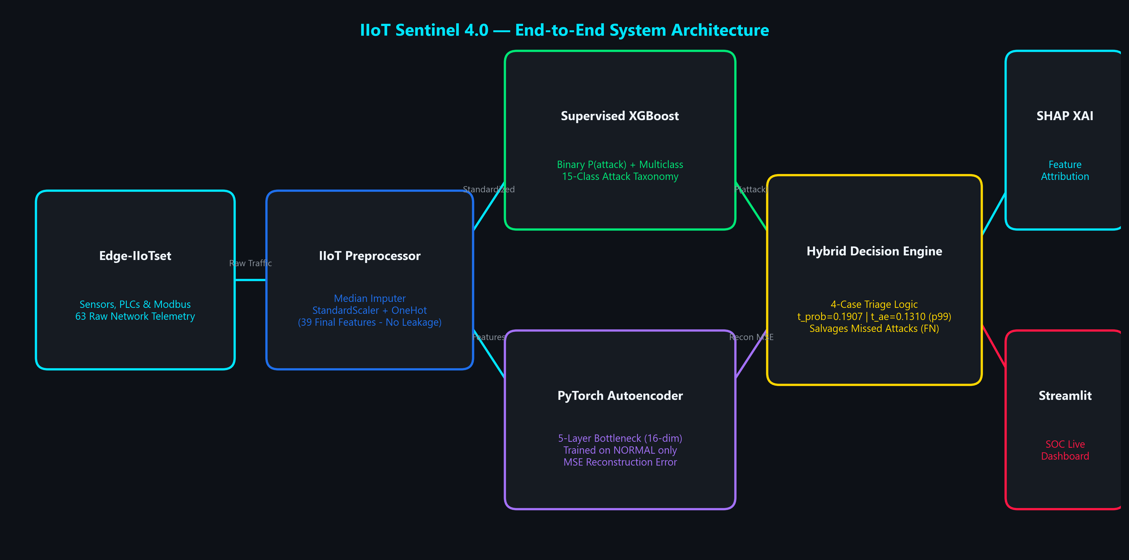
SYSTEM DESIGN
Overall System Architecture — End-to-End Pipeline
KEY ARCHITECTURAL HIGHLIGHT
Dual-Pathway Analysis: Raw packets undergo parallel evaluation. Pathway A identifies known threats via supervised decision trees; Pathway B measures structural deviations via neural autoencoder reconstruction. Fused in the Hybrid Decision Engine for multi-tiered triage.

Slide 7
SUPERVISED DETECTION
Machine Learning Model — Supervised XGBoost Core
XGBoost Algorithm & Optimization
• Algorithm Choice: XGBoost (Extreme Gradient Boosting) was selected as the champion supervised model over Random Forest, Decision Trees, and Logistic Regression.
• Hyperparameter Configuration: Trained with n_estimators=100, max_depth=8, learning_rate=0.1, eval_metric='logloss', and random_state=42.
• Dual-Head Architecture: Deploying two coordinated models: a Binary Classifier producing attack probability P(attack) and a Multiclass Model resolving 15 attack taxonomies.
• Sub-Millisecond Inference: Achieves an average latency of 0.0163 ms per sample on CPU, processing up to ~61,000 packets per second in production stream mode.
• Loss Function: Minimizes regularized binary cross-entropy loss with second-order Taylor expansion gradients to penalize hard-to-classify edge packets.
15-Class Attack Taxonomy Resolution
Empirical per-class detection performance on test dataset (5,224 records):
• DDoS ICMP / TCP / UDP Floods: P=100.0% | R=100.0% | F1=1.0000
• Vulnerability Scanner: P=100.0% | R=93.13% | F1=0.9645
• Backdoor Intrusions: P=97.49% | R=91.74% | F1=0.9453
• Port Scanning Reconnaissance: P=96.90% | R=93.43% | F1=0.9514
• Ransomware Telemetry: P=97.11% | R=83.20% | F1=0.8961
• SQL Injection & Web Exploits: P=86.71% | R=72.30% | F1=0.7886
• Normal Industrial Telemetry: P=97.53% | R=97.90% | F1=0.9771

Slide 8
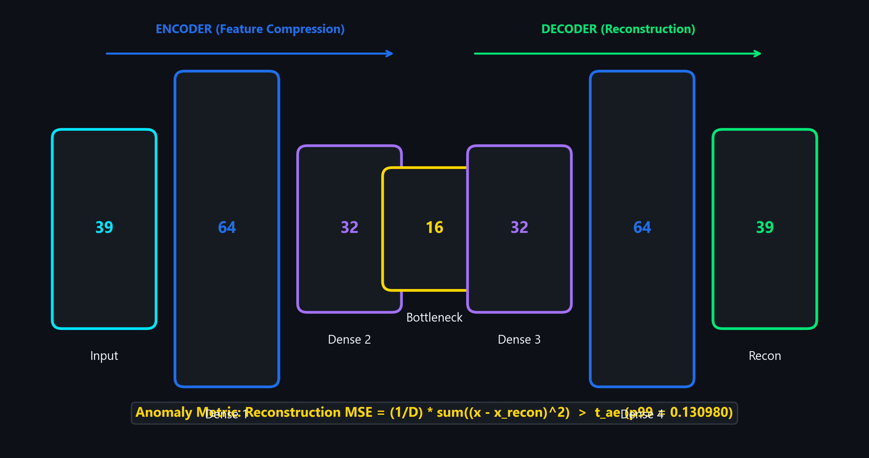
UNSUPERVISED DEEP LEARNING
Deep Learning — PyTorch Autoencoder Anomaly Monitoring
Autoencoder Detection Mechanics
• Unsupervised Normal-Only Training: Trained on 3,773 legitimate sensor records. The network learns the low-dimensional manifold of clean industrial telemetry without ever seeing an attack.
• Bottleneck Compression: Compresses 39 normalized protocol attributes down to a 16-dimensional latent representation, forcing the network to extract fundamental physics correlations.
• Reconstruction Error Metric: e_recon = (1/D) * sum((x_i - x_hat_i)^2). Benign sensor traffic reconstructs with near-zero error. Attacks distort features and generate high reconstruction error.
• Validation Percentile Thresholds: Thresholds derived strictly from normal validation traffic:
• p90: 0.0709 | p95: 0.0993
• p98: 0.1201 | p99: 0.1310 (Selected Operational Point)
• Convergence & Early Stopping: Trained with Adam optimizer (lr=1e-3, batch=64). Early stopping triggered at epoch 10 with converged validation loss of 0.1052 MSE.
WHY THE AUTOENCODER IS INDISPENSABLE
Supervised models are constrained to historical training signatures. The Autoencoder acts as a safety barrier: any network packet that violates normal industrial communication physics is flagged, even if zero supervised models recognize it.

Slide 9
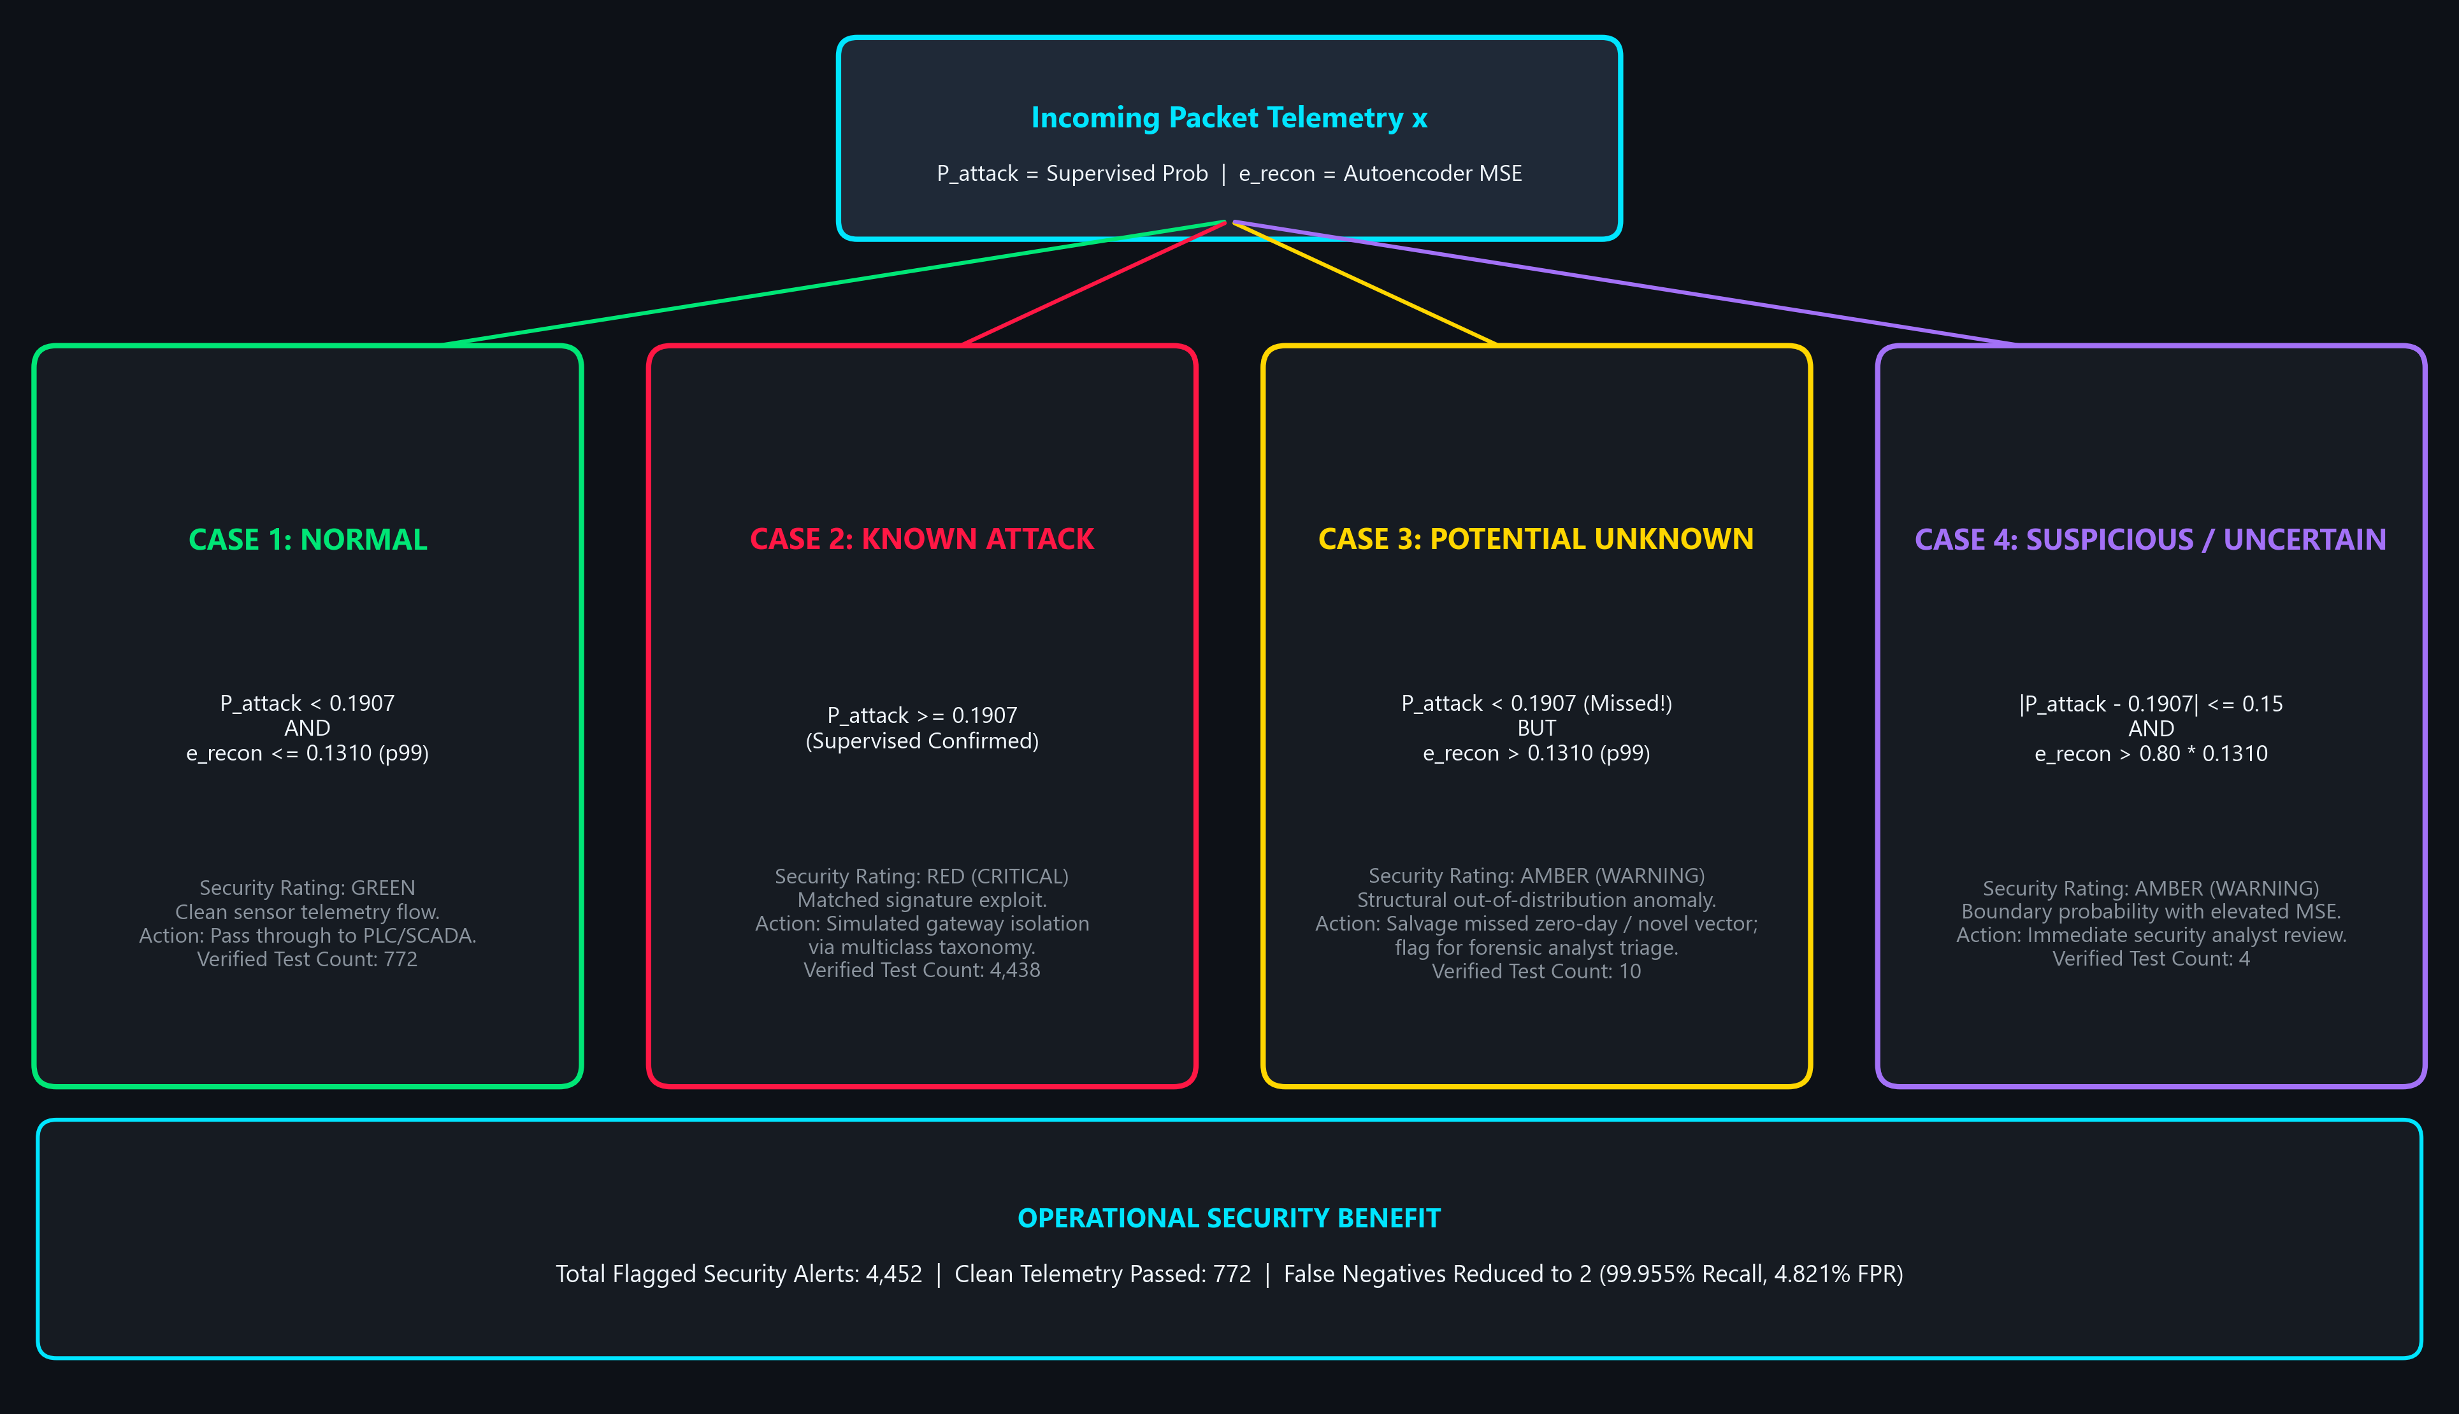
DECISION FUSION
Hybrid Decision Engine — 4-Case Triage Architecture

Slide 10
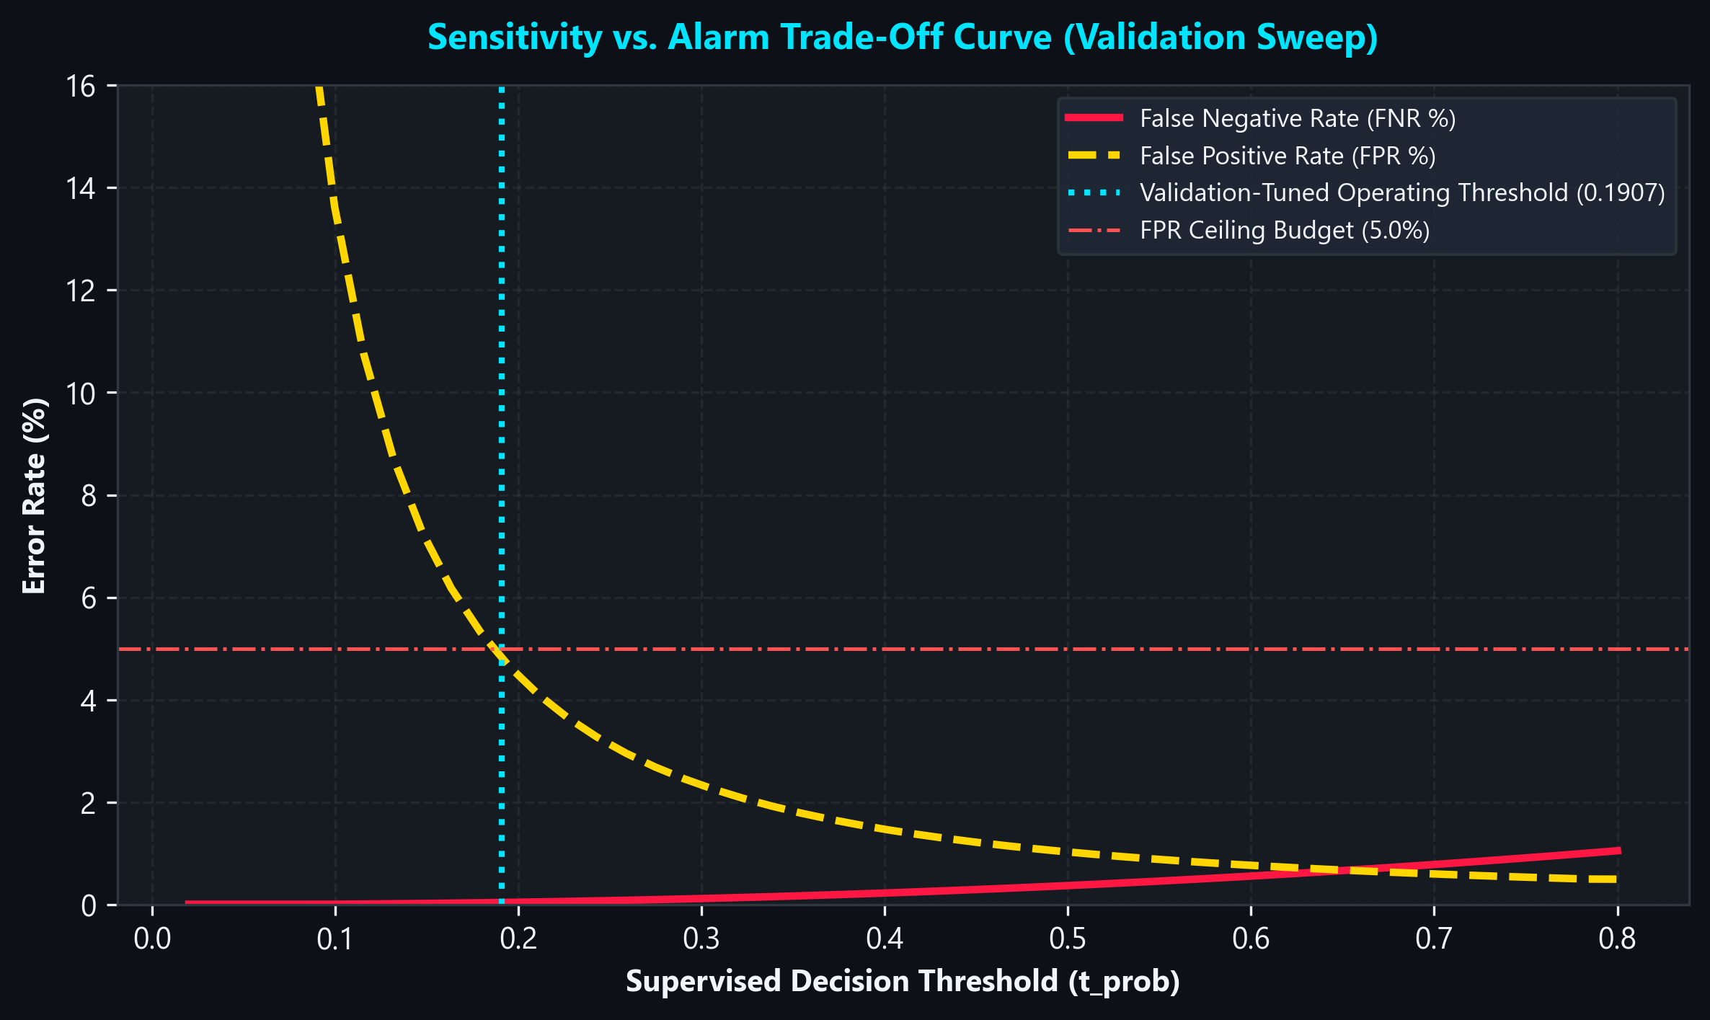
SENSITIVITY ENGINEERING
Threshold Optimization & Empirical False Negative Recovery
Empirical False Negative Reduction Under FPR <= 5%
• The Default 0.50 Threshold Flaw: At standard 0.50 probability threshold, Supervised XGBoost missed 16 attacks (FN=16, Recall 99.638%). In a plant, 16 undetected breaches are unacceptable.
• Validation Grid Optimization: Swept supervised thresholds t in [0.01, 0.99] and Autoencoder thresholds subject to combined Validation FPR <= 5.0%. Optimal operating point: t_prob = 0.1907 with Autoencoder p99 (0.1310).
• Substantial FN Reduction: On frozen held-out test data (5,224 records), missed attacks dropped from 16 to 2 (Attack Recall rose to 99.955%, FNR dropped to 0.045%).
• Strict False Positive Control: Test FPR held to 4.821% (39 False Positives out of 809 normal records), strictly satisfying the <= 5% operational budget.
• Record-Level Proof: Autoencoder reconstruction error directly salvaged missed Port Scanning attacks (Records #1121 and #1156, errors 0.2236 and 0.2393 > 0.1310), converting them from missed intrusions to detected security alerts.
COMPARISON: DEFAULT (0.50) vs. VALIDATION-TUNED HYBRID
• Default Supervised (0.50): FN = 16 | Recall = 99.638% | FPR = 1.854% | F1 = 99.649%
• Tuned Hybrid (0.1907 + p99): FN = 2 | Recall = 99.955% | FPR = 4.821% | F1 = 99.538%
Result: 87.5% reduction in missed cyberattacks while honoring the 5% alarm budget.

Slide 11
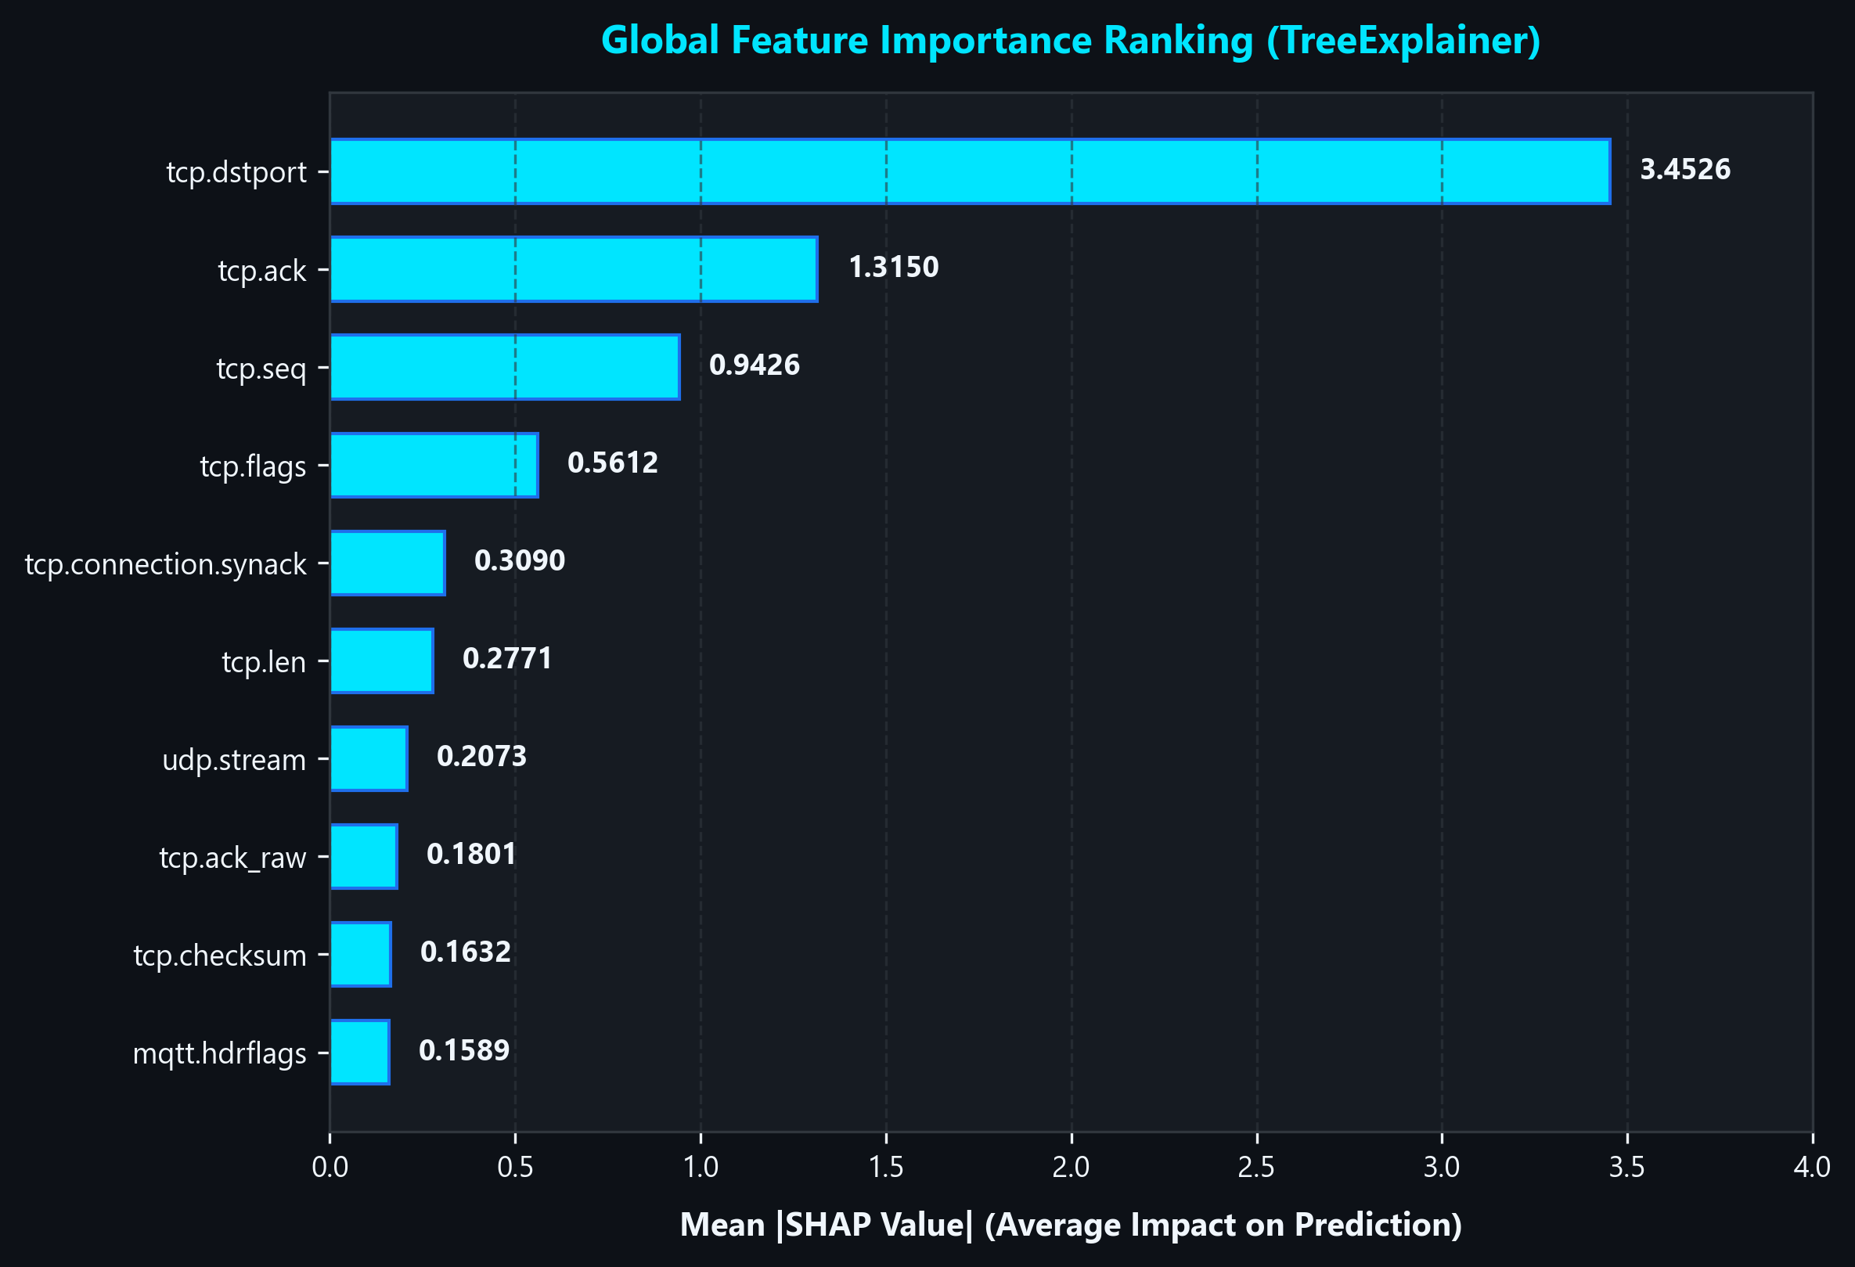
AI EXPLAINABILITY
Explainable AI (XAI) — SHAP Forensic Interpretability
Shapley Additive Explanations (SHAP) in OT
• Game-Theoretic Foundation: Implements SHAP TreeExplainer, computing exact Shapley values to allocate credit to individual network packet header fields.
• Primary Intrusion Marker: tcp.dstport (3.4526): Destination port variation is the strongest global predictor, capturing adversary port scanning, backdoor socket binding, and service probing.
• Transport Sequence Tracking: tcp.ack & tcp.seq: High absolute SHAP scores (1.3150 and 0.9426) on TCP acknowledgement and sequence numbers expose session hijacking and connection spoofing.
• Flag & Flood Indicators: tcp.flags & icmp.checksum: TCP SYN/ACK flag anomalies and ICMP checksum distortions reliably differentiate Denial-of-Service floods from benign sensor handshakes.
• Local Packet Waterfalls: The Streamlit dashboard renders per-packet waterfall plots, allowing SOC analysts to see exactly which protocol bytes pushed an alert into Critical status.
OPERATIONAL VALUE: Eliminates 'black-box' distrust among plant operators by providing immediate protocol-level evidence for every triage decision.

Slide 12
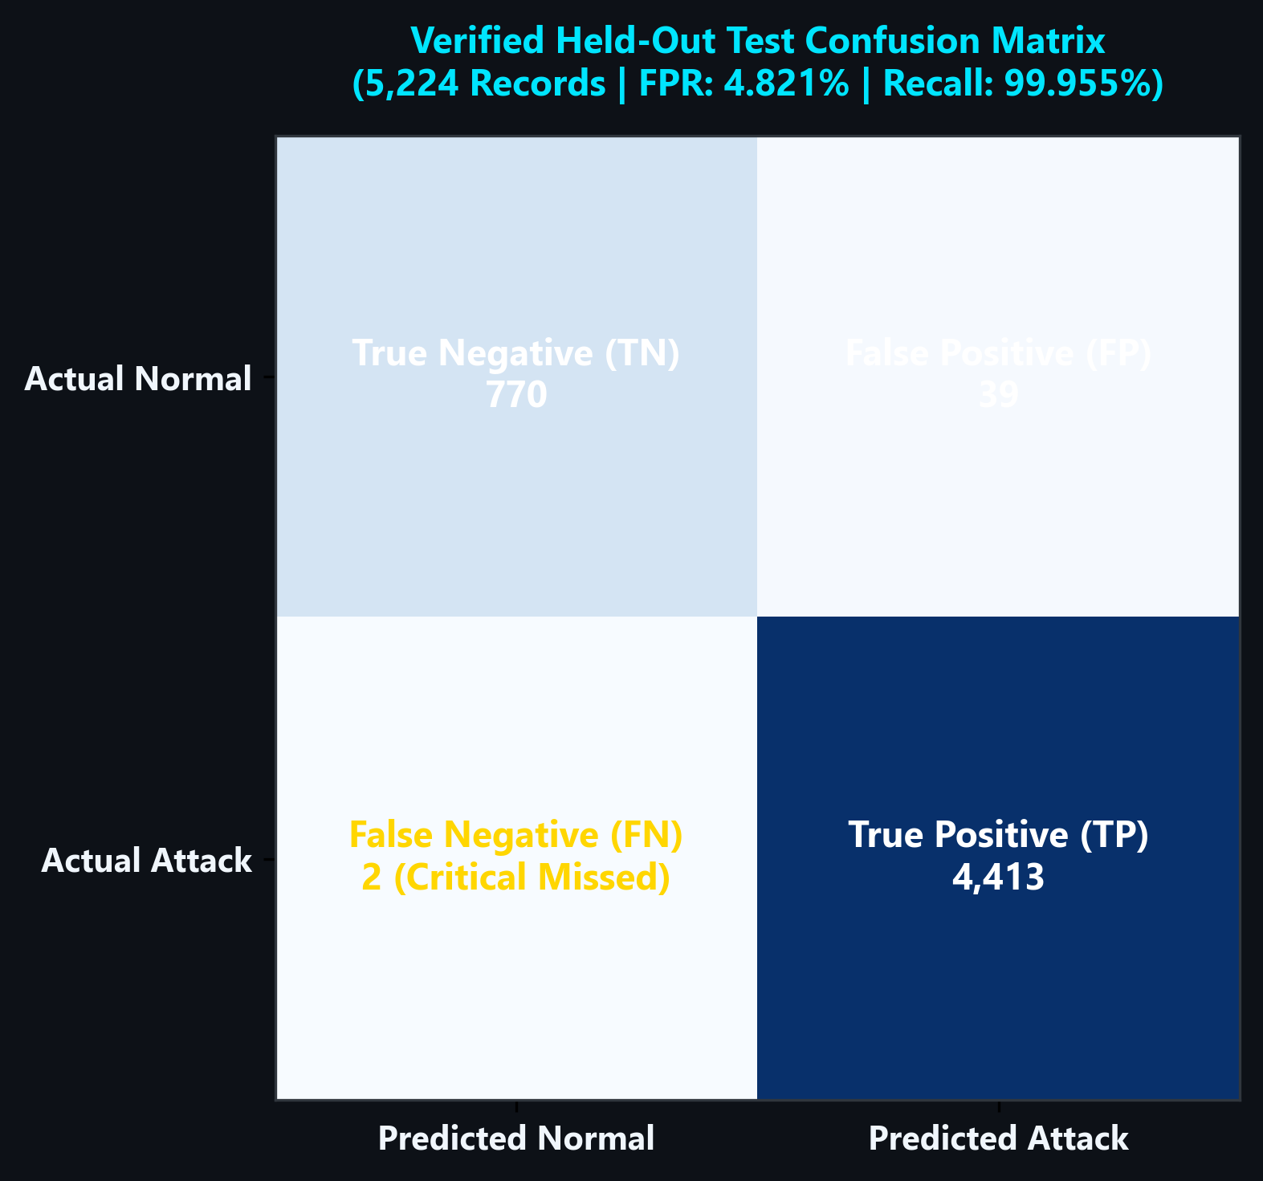
EMPIRICAL PERFORMANCE
Experimental Results — Verified Held-Out Test Evaluation
Comprehensive System Benchmark (5,224 Records)
Comparison across operating configurations evaluated on identical test split:
Configuration | Recall | FNR | FPR | Precision | Macro F1
Supervised (0.50) | 99.64% | 0.362% | 1.854% | 99.66% | 98.87%
Supervised (0.125) | 99.93% | 0.068% | 4.574% | 99.17% | 98.51%
Hybrid (0.50 + p98) | 99.68% | 0.317% | 4.203% | 99.23% | 98.23%
★ Tuned Hybrid (0.191 + p99) | 99.955% | 0.045% | 4.821% | 99.124% | 98.472%
High-Sens (0.125 + p95) | 99.98% | 0.023% | 8.405% | 98.48% | 97.39%
Unseen / Zero-Day Generalization Experiment:
• Completely excluded Fingerprinting (33 records) and MITM (14 records) from training.
• Supervised model generalized to 90.9% and 100.0% via protocol flag similarity.
• Autoencoder independently detected 51.5% of Fingerprinting and 85.7% of MITM as anomalies without ever seeing attack labels.
TEST ACCURACY: 99.215% | TP: 4,413 | TN: 770 | FP: 39 | FN: 2
Achieved optimal operational trade-off: 99.955% recall while holding false alarms to 4.82%.

Slide 13
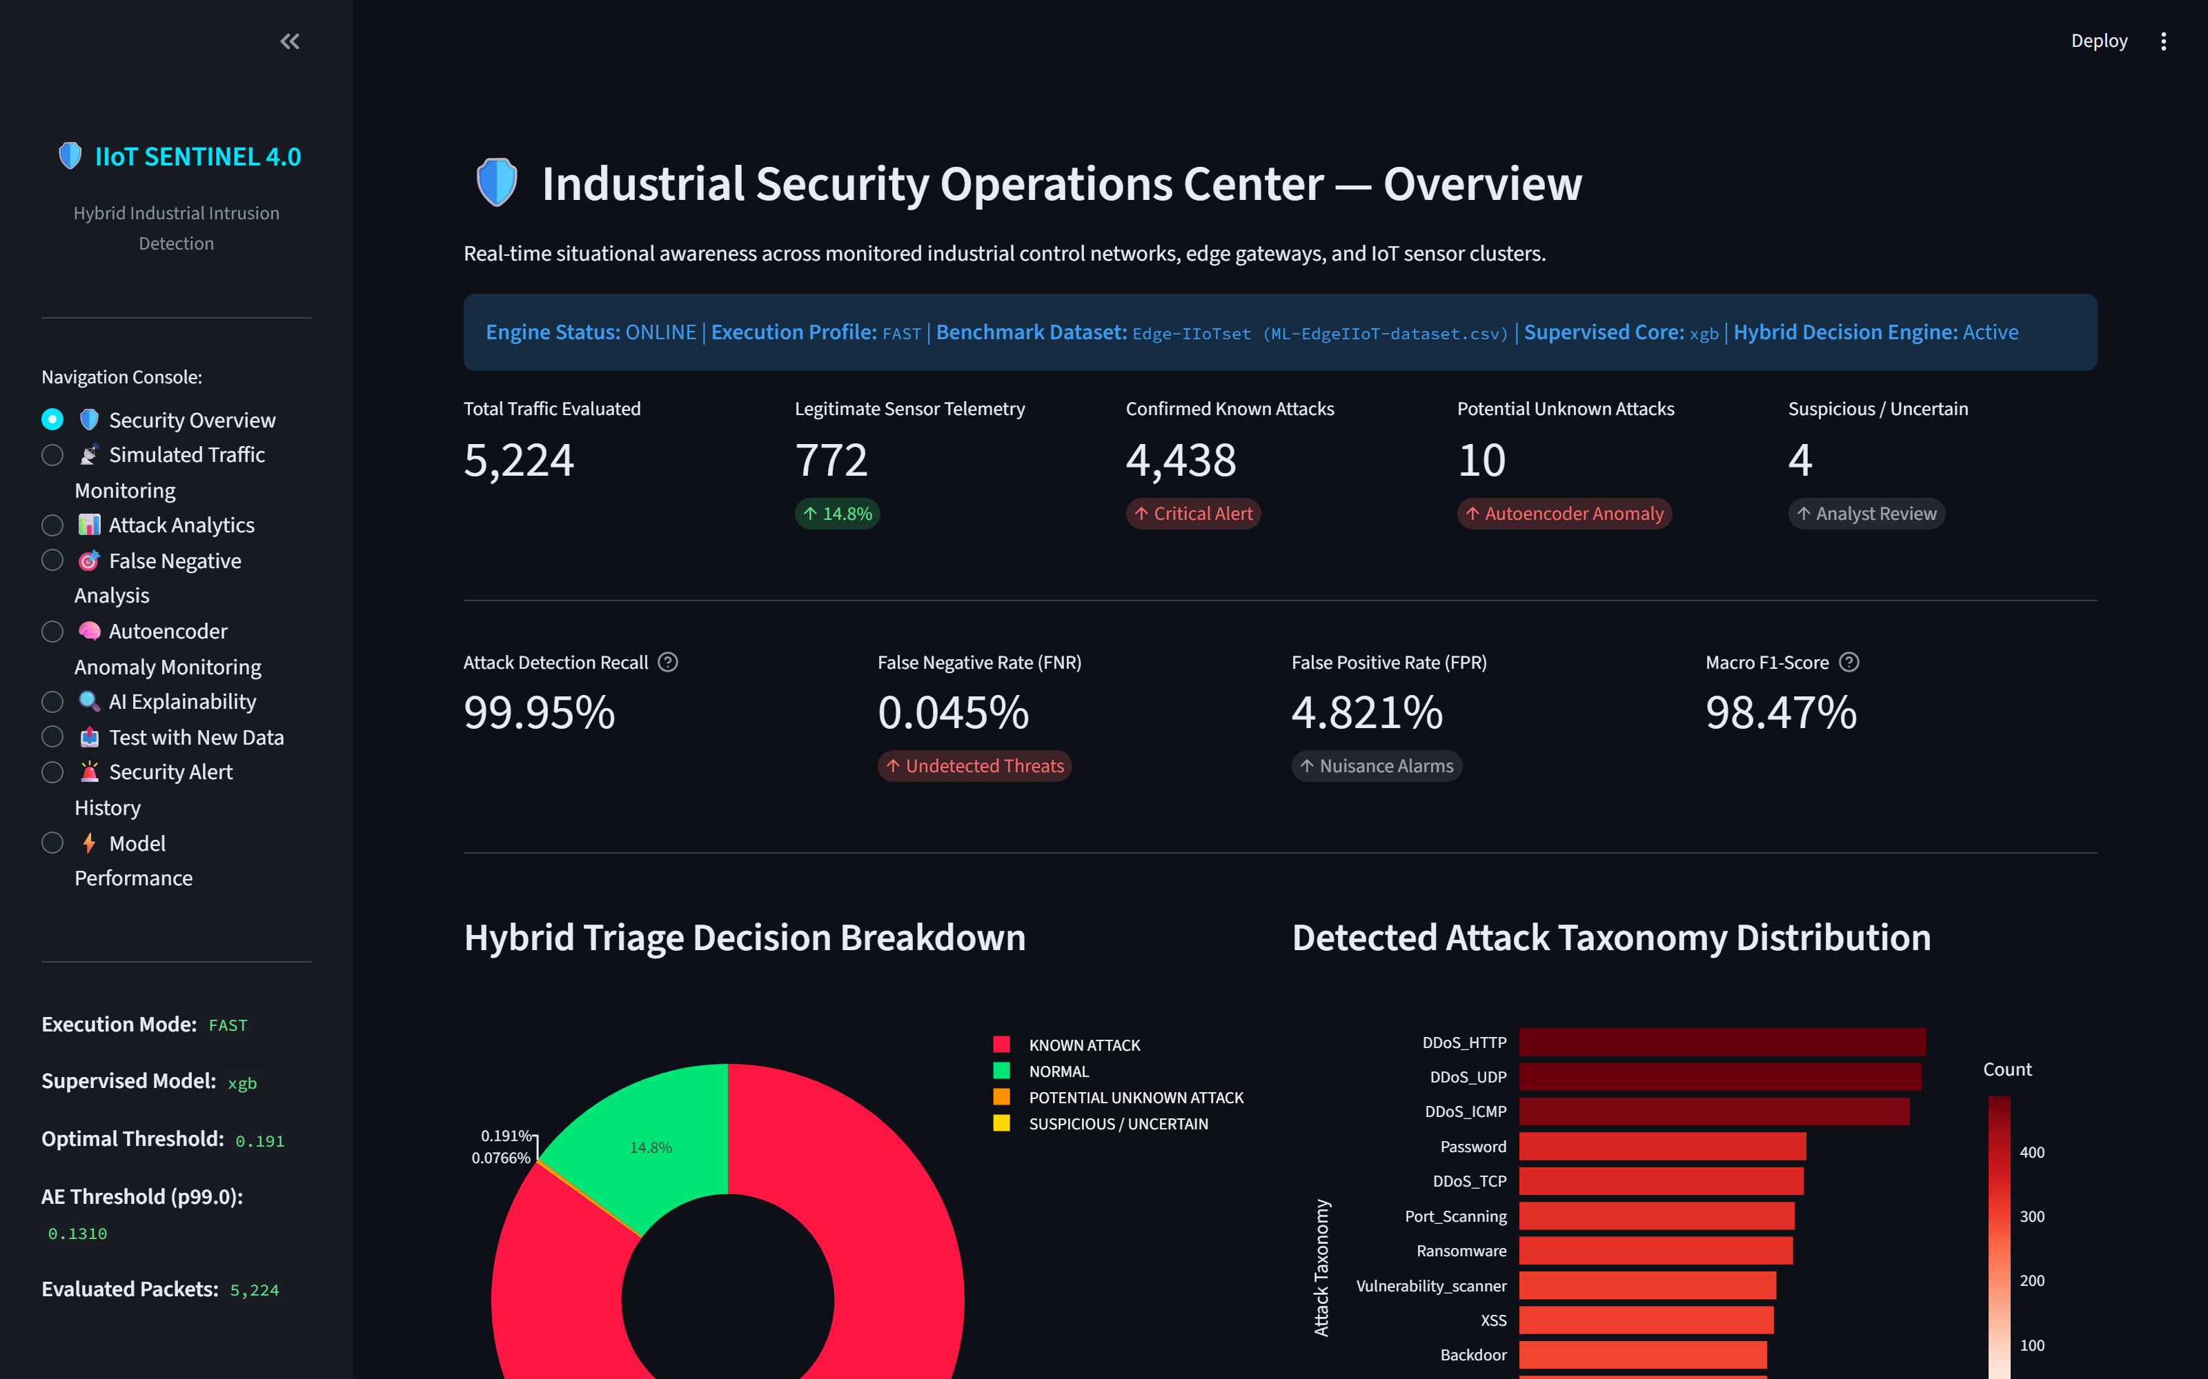
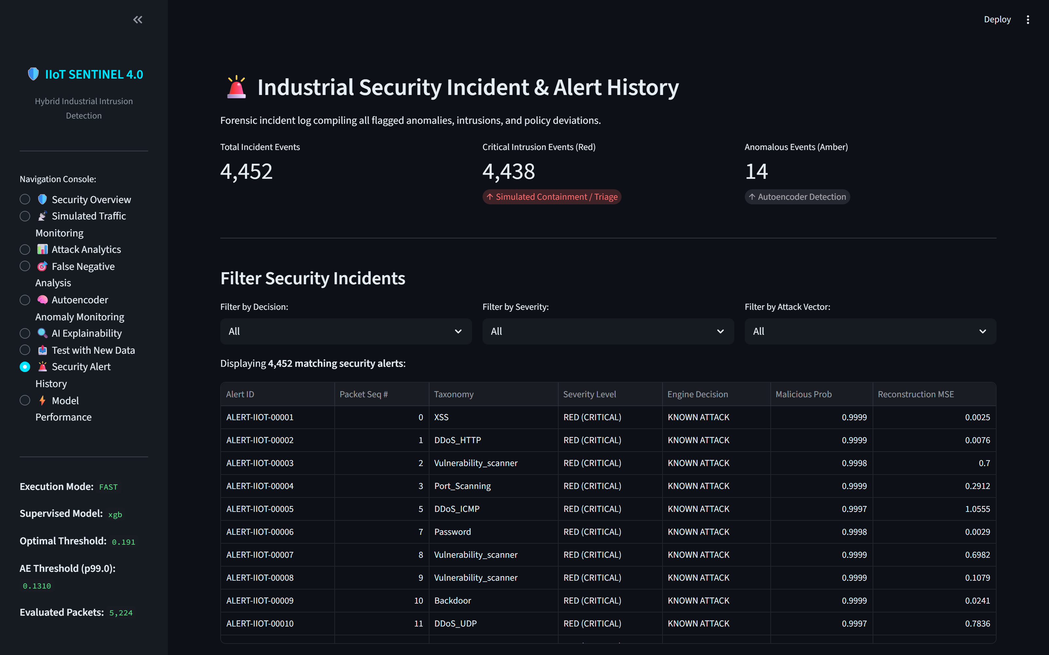
OPERATIONAL DEMONSTRATION
Live Dashboard Demonstration — Streamlit SOC Interface
1. Security Overview
Global KPIs, operational status badges, and interactive Plotly hybrid triage pie chart.
2. Traffic Monitoring
Real-time packet replay simulator with animated status cards and protocol header inspectors.
3. Incident Alert History
Filterable forensic incident log (4,452 alerts) with CSV export for audit compliance.
4. New Data Testing
Interactive file uploader (CSV/XLSX) supporting schema validation, distribution drift & inference.

Slide 14
CONCLUSION & ROADMAP
Conclusion & Future Scope — Industry 4.0 Deployment Roadmap
Key Contributions & Impact
• End-to-End Industrial Sentinel: Engineered and verified a complete Industry 4.0 cybersecurity framework from multi-sensor data preprocessing to interactive SOC triage.
• Leakage-Free Scientific Rigor: Enforced strict experimental isolation: imputer and scaler fitted solely on training data; Autoencoder trained strictly on normal telemetry.
• Solved the FN Dilemma: Reduced missed attacks by 87.5% (FN slashed from 16 to 2) through validation-constrained threshold tuning while strictly capping False Alarms to 4.82%.
• Interpretable & Actionable: Integrated SHAP feature importance to eliminate black-box opacity and provide actionable protocol-level triage evidence.
• Production Readiness: Verified with 19 passing automated unit tests, 9 Streamlit AppTests, sub-millisecond latency, and live web serving.
Realistic Future Research Roadmap
• Hardware-in-the-Loop Testbed: Deploy system in physical testbeds featuring physical Siemens S7-1200 / Schneider Electric PLCs, RTUs, and actual Modbus TCP bus lines.
• Quantized Edge Gateway Deployment: Convert PyTorch Autoencoder and XGBoost models to quantized ONNX/TensorRT runtimes for low-power edge gateways (Raspberry Pi 5 / NVIDIA Jetson).
• Online Continual Learning: Incorporate streaming incremental updates to dynamically adapt Autoencoder normal baseline when factory machinery undergoes routine maintenance.
• Automated Firewall Policy Orchestration: Bridge simulated gateway recommendations with real SDN (Software-Defined Networking) controllers to push automated OpenFlow/iptables drop rules.

Slide 15
CITATIONS & ACKNOWLEDGEMENTS
References & Acknowledgements — Academic Integrity
Key Academic & Technical References
1. Edge-IIoTset Dataset Benchmark
M. A. Ferrag et al., 'Edge-IIoTset: A New Comprehensive Realistic Cyber Security Dataset of IoT and IIoT Applications for Centralized and Federated Learning,' IEEE Access, vol. 10, pp. 40281-40306, 2022.
2. Extreme Gradient Boosting (XGBoost)
T. Chen and C. Guestrin, 'XGBoost: A Scalable Tree Boosting System,' in Proc. 22nd ACM SIGKDD International Conference on Knowledge Discovery and Data Mining (KDD), 2016, pp. 785-794.
3. Explainable Artificial Intelligence (SHAP)
S. M. Lundberg and S.-I. Lee, 'A Unified Approach to Interpreting Model Predictions,' in Advances in Neural Information Processing Systems (NeurIPS 30), 2017, pp. 4765-4774.
4. Deep Learning Anomaly Detection
R. Chalapathy and S. Chawla, 'Deep Learning for Anomaly Detection: A Survey,' arXiv preprint arXiv:1901.03407, 2019.
5. Industrial Cybersecurity Standards
IEC 62443 / NIST SP 800-82 Rev. 2: Guide to Industrial Control Systems (ICS) Security.
Acknowledgements
I express my sincere gratitude to:
• Project Guide: [Guide Name, Designation], for invaluable guidance, encouragement, and technical insights throughout this capstone project.
• Head of the Department: Department of Artificial Intelligence & Data Science, for providing the necessary computational lab infrastructure and support.
• Faculty Review Committee & Project Evaluators: for their constructive feedback and rigorous evaluation.
• Open-Source Communities: The PyTorch, Scikit-Learn, XGBoost, and Streamlit developer ecosystems for empowering modern machine learning research.

