Slide 1
PROJECT TITLE
CAPSTONE PROJECT
Presented By:
Student name-VARSHITHA NAGIREDDY
College name-AUDISANKARA COLLEGE OF ENGINEERING & TECHNOLOGY
Department-COMPUTER SCIENCE ENGINEERING(ARTIFICIAL INTELLIGENCE)

Slide 2
OUTLINE
Problem Statement (Should not include solution)
Proposed System/Solution
System Development Approach (Technology Used)
Algorithm & Deployment
Result (Output Image)
Conclusion
Future Scope
References

Slide 3
Problem Statement
Small-scale farmers in rural areas face challenges in accessing timely and accurate agricultural information. Limited exposure to advanced farming techniques, lack of awareness of real-time market trends, unpredictable weather, and inadequate pest control measures hinder optimal crop production. Language barriers further isolate these communities from accessing vital resources. The need for hyper-localized, easily understandable agricultural advice remains unmet for many farmers, reducing productivity and income levels.

Slide 4
Proposed Solution
We propose an AI-powered assistant for smart farming advice using Retrieval-Augmented Generation (RAG) integrated with IBM Cloud Lite and IBM Granite. This virtual agent retrieves data from trusted sources such as meteorological APIs, agricultural departments, and market databases to offer localized, real-time guidance in the user's native language. It provides recommendations on crop selection, pest control, soil health, weather updates, and mandi (market) prices. The system bridges the knowledge gap by offering data-driven, contextual answers for better decision-making.

Slide 5
System Approach
IBM Granite Models: Used for multilingual natural language understanding and generation.
IBM Watson Assistant (Lite): For building the conversational interface.
RAG Architecture: Combines document retrieval with LLM-based response generation.
IBM Cloud Object Storage: For storing knowledge base documents (weather, market data, crop reports).

Slide 6
Algorithm & Deployment
User Query Input: User asks a question in their local language (e.g., “What crop is best for this soil?”).
Retriever Module: Fetches relevant documents (from cloud storage, APIs).
Generator Module: Uses IBM Granite to form a contextual and natural response.
Response Translation (if needed): Translated back to the local language for display.
Deployment:
Hosted on IBM Cloud Lite
Connected via Watson Assistant, exposed through a web/mobile interface.

Slide 7
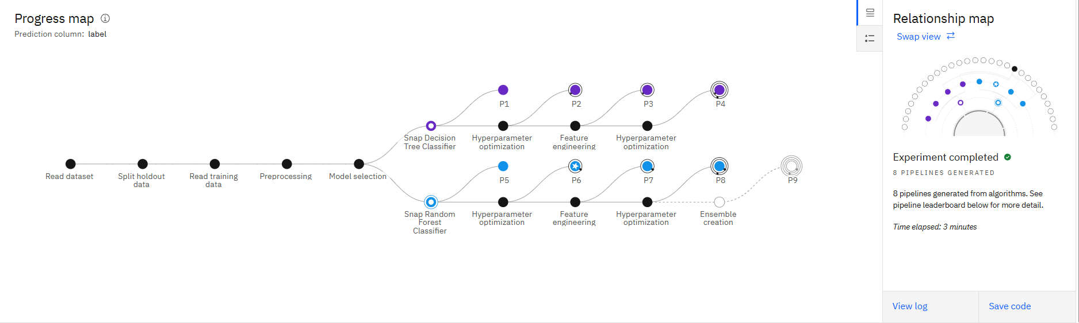
Result

Slide 8
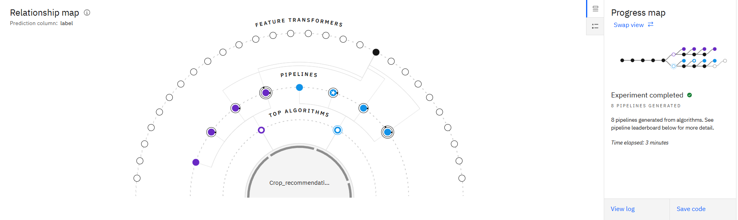
Result

Slide 9
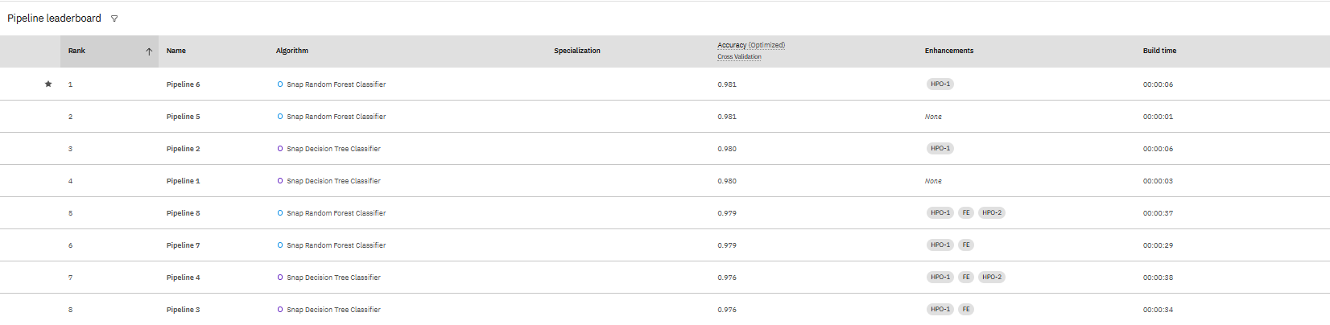
Result

Slide 10
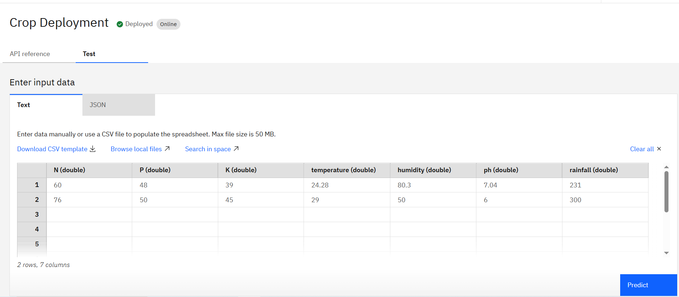
Result

Slide 11
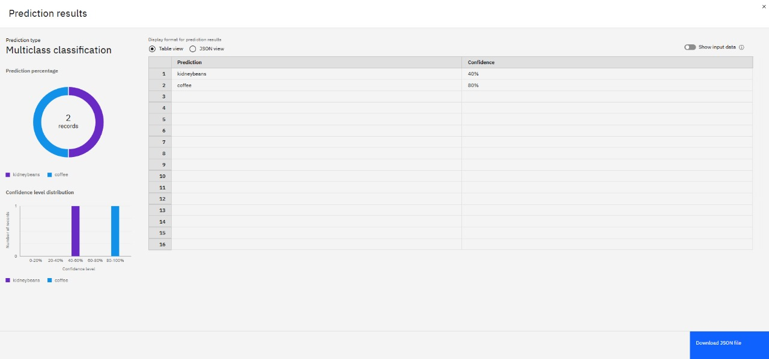
Result

Slide 12
Conclusion
The AI agent effectively empowers small-scale farmers by delivering smart, localized agricultural advice in real time. Through the use of IBM’s powerful AI and cloud technologies, farmers can make data-driven decisions on crop planning, market timing, and pest management. The assistant enhances accessibility with multilingual interaction, offering an intuitive and impactful solution. This project showcases how RAG models combined with cloud services can address grassroots-level challenges in agriculture.

Slide 13
Future scope
Voice Assistant Integration for accessibility among non-literate farmers.
IoT Integration to collect real-time soil and weather data from sensors.
Offline Mode with Syncing for areas with limited internet.
Drone Surveillance Support for pest monitoring and precision agriculture.
Blockchain Integration for supply chain traceability and secure farmer payments.

Slide 14
References
IBM Granite Documentation – https://www.ibm.com/products/granite
IBM Watson Assistant – https://cloud.ibm.com/catalog/services/watson-assistant
IBM Cloud Lite – https://cloud.ibm.com
4.Indian Meteorological Department APIs
5.Dataset: Crop_recommendation.csv

Slide 15
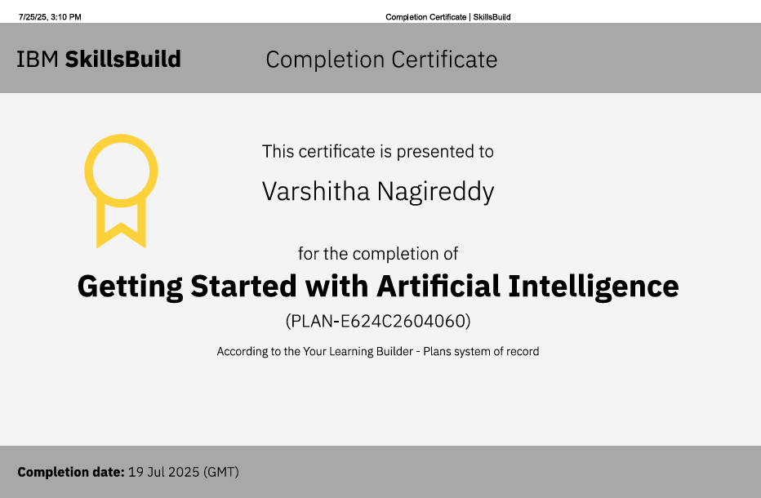
IBM Certifications
Screenshot/ credly certificate( getting started with AI)

Slide 16
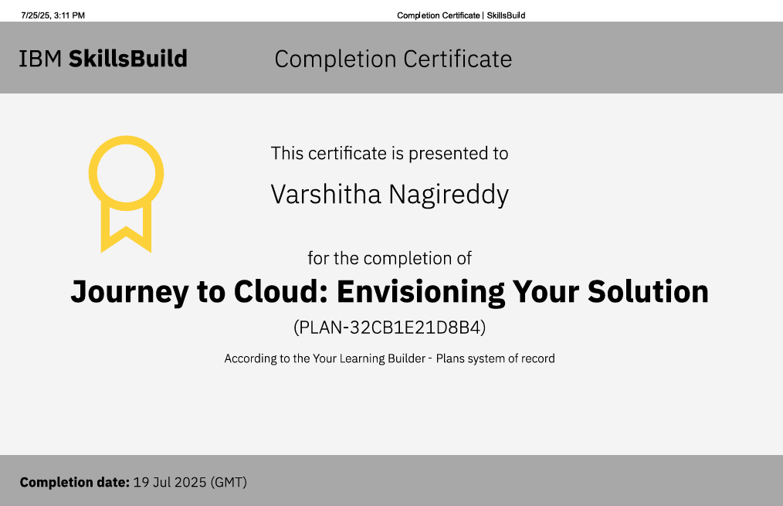
IBM Certifications
Screenshot/ credly certificate( Journey to Cloud)

Slide 17
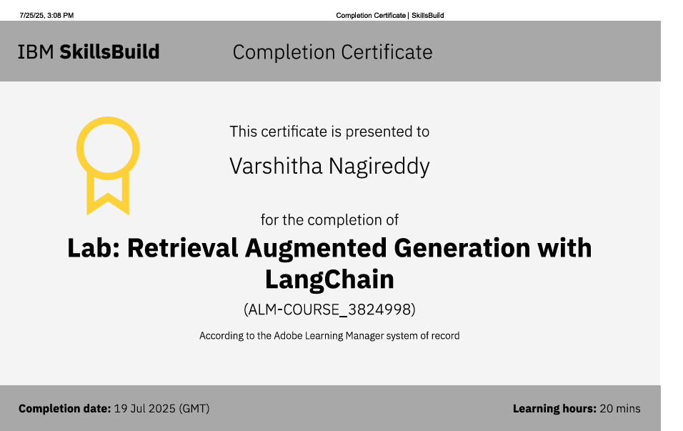
IBM Certifications
Screenshot/ credly certificate( RAG Lab)

Slide 18
THANK YOU

