Slide 1
Category Intelligence
Retail Product Performance EDA
Calibo AI Academy • Phase 1 — Mini Use Case 01
Team: Varshitha • Chandu • Lohitha • Varshini
1

Slide 2
Business Context
Retail / E-commerce • Six months of transaction data
A regional retail chain operates stores across Andhra Pradesh.
Sales are grouped into five categories: Electronics, Apparel, Grocery, Home & Kitchen, and Personal Care.
The Category Manager is preparing for a quarterly supplier review.
The analysis turns transaction data into category, product, discount, and timing insights for that discussion.
2

Slide 3
Business Question
What should the Category Manager prioritize in the supplier review?
Which categories are growing or declining?
Which products drive or drag performance?
Are discounts increasing transaction value?
When are sales naturally strongest?
Goal: finish with a concise, data-backed Category Manager Briefing.
3

Slide 4
Dataset & Data Quality
Initial inspection before business analysis
107,836 transactions
10 columns
25 products
5 categories
Date range: 1 January 2026 to 30 June 2026.
No missing values were found.
No duplicate rows were found.
The date field was converted to datetime for monthly and weekday analysis.
The dataset contains revenue, units sold, price, and discount percentage — but no product cost or margin.
4

Slide 5
Analysis Framework
The six-step flow used in the final notebook
01 Load & Inspect
02 Revenue Trend
03 Top / Bottom Products
04 Discount Effectiveness
05 Day / Month Patterns
06 Category Manager Briefing
Each analysis is followed by a short business interpretation, not just a chart or table.
5

Slide 6
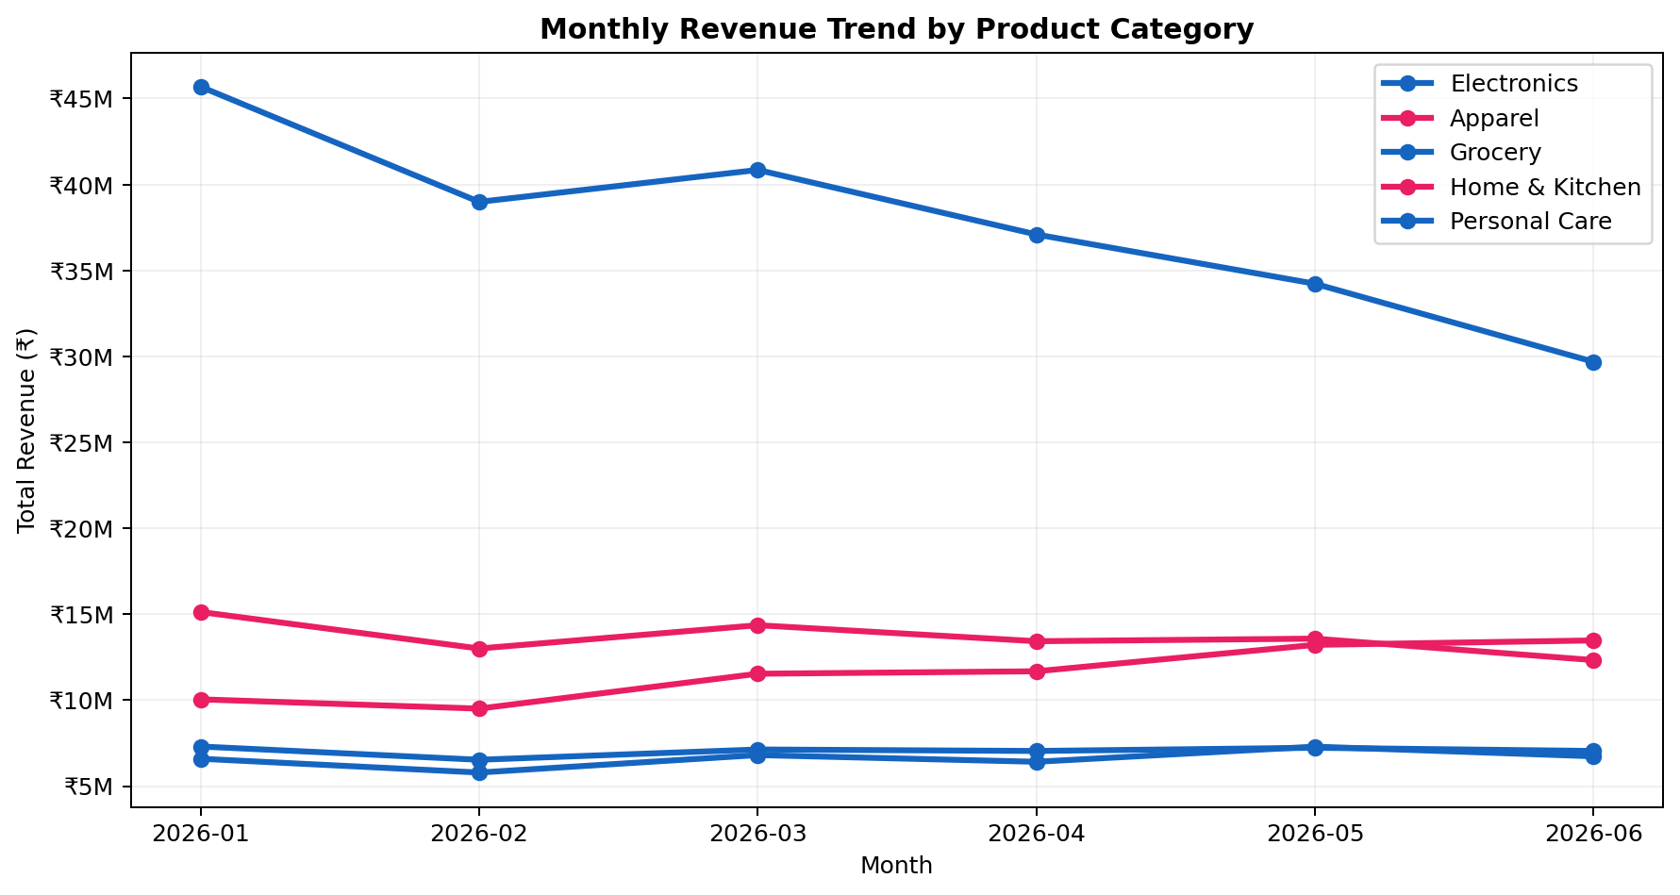
Revenue Trend by Category
January → June 2026
Electronics: -35.0%
Apparel: +34.1%
Grocery: -3.5%
Home & Kitchen: -18.5%
Personal Care: +2.2%
Strongest growth: Apparel (+34.1%)
6

Slide 7
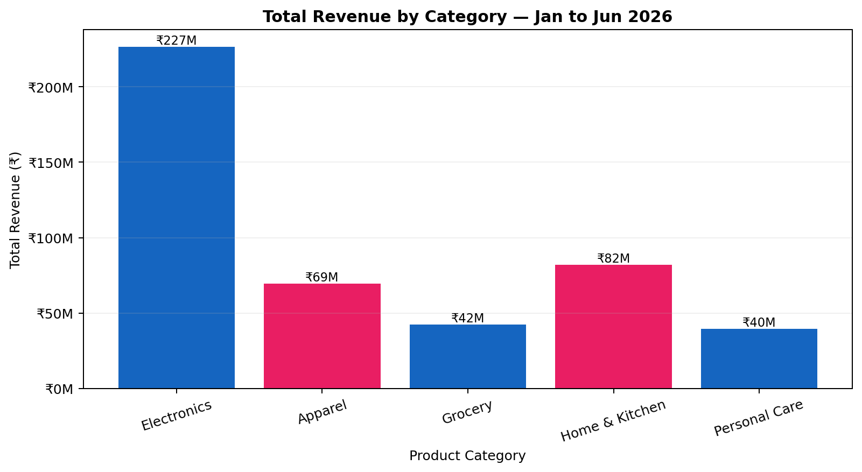
Category Performance at a Glance
Total revenue across the six-month period
Electronics generated ₹226,527,725 — the largest category.
Electronics also fell 35.0% from January to June.
Grocery is the most consistent category (CV ≈ 0.039).
Apparel grew 34.1% and is the only category with sustained growth across the window.
7

Slide 8
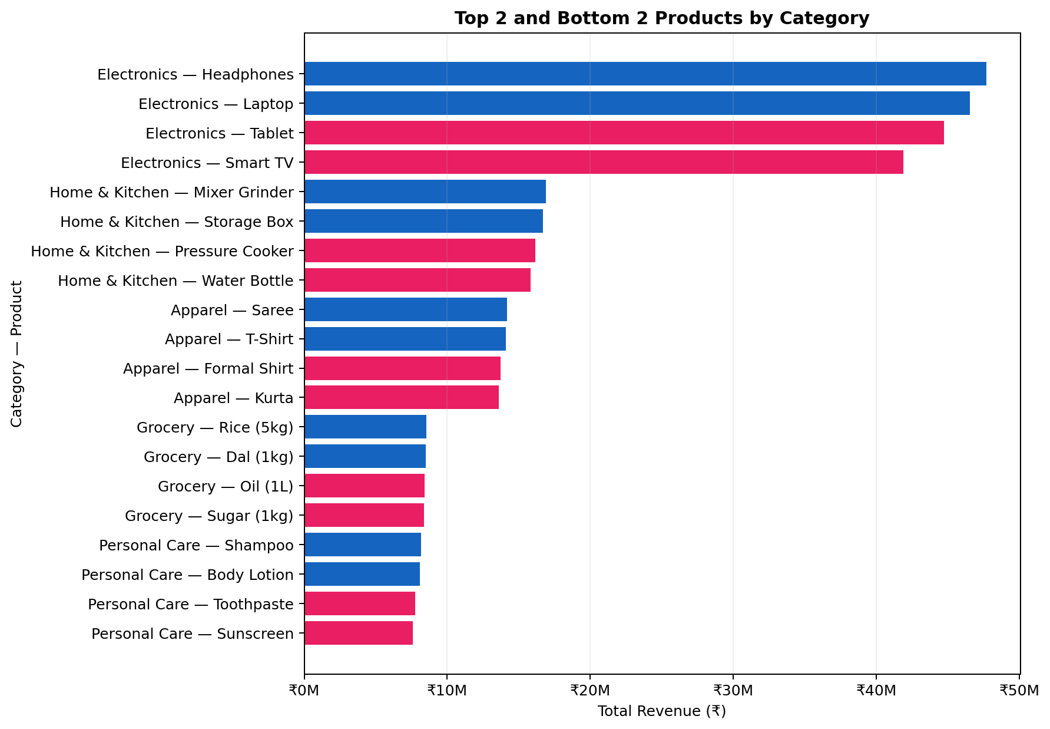
Top & Bottom Products
Product-level revenue ranking within each category
Revenue is fairly evenly spread across the five products within each category.
The weakest products chain-wide are concentrated in Personal Care and Grocery.
The product-level view does not show one isolated SKU causing the Electronics decline.
8

Slide 9
Product-Level Business Signal
What the product analysis adds to the category trend
Electronics decline is broad-based
Electronics 6-month revenue: ₹226,527,725
The top/bottom product analysis shows that weakness is not confined to one single Electronics product.
That shifts the supplier-review conversation from only fixing one SKU to understanding category-level demand and assortment performance.
The lowest-revenue products overall include Sunscreen (₹7.59M), Toothpaste (₹7.77M), Sugar (₹8.38M), and Oil (₹8.43M).
These figures describe revenue performance; they do not measure supplier margin or profitability.
9

Slide 10
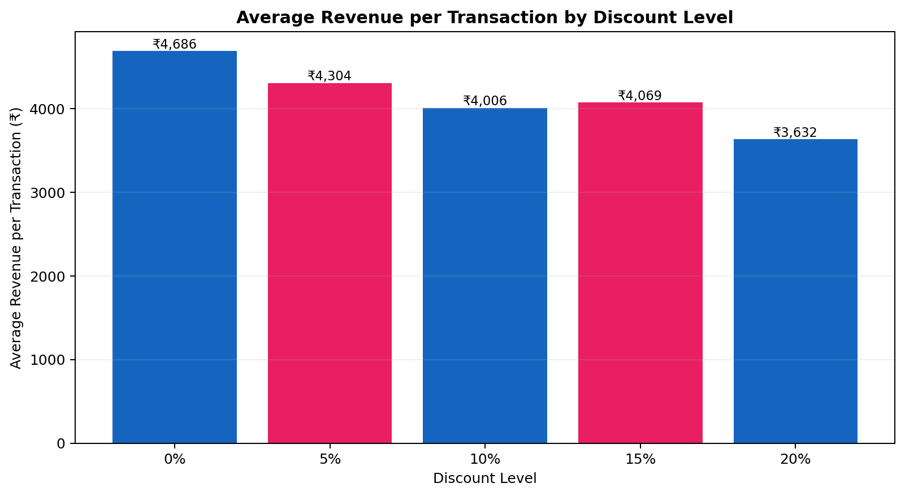
Discount Effectiveness
Average revenue per transaction falls as observed discount depth increases
0% discount: ₹4,686
20% discount: ₹3,632
Difference: −22.5%
Average units sold remain nearly flat: 2.57–2.60 per transaction.
25%+ has no observations in the dataset.
10

Slide 11
Discount Analysis — Numbers Behind the Chart
Observed discount levels in the dataset
Discount | Transactions | Avg Revenue / Txn | Avg Units / Txn
0% | 36,033 | ₹4,685.65 | 2.59
5% | 23,922 | ₹4,303.73 | 2.59
10% | 23,810 | ₹4,005.55 | 2.57
15% | 11,935 | ₹4,069.16 | 2.60
20% | 12,136 | ₹3,631.73 | 2.58
Interpretation: deeper discounts are not accompanied by a matching increase in units sold.
11

Slide 12
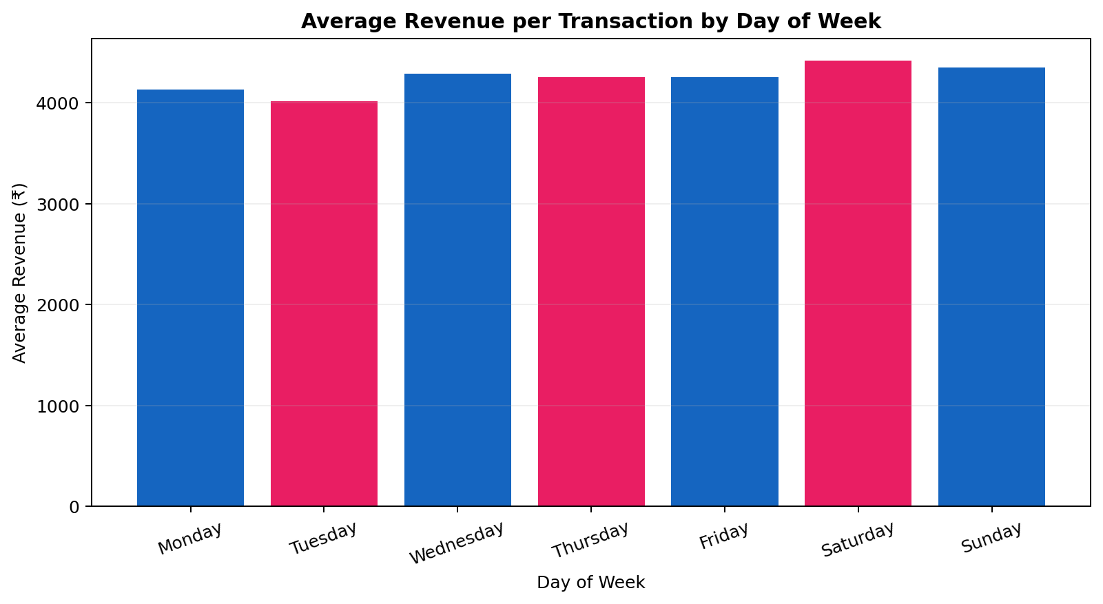
Day-of-Week Pattern
Average revenue per transaction
Strongest: Saturday — ₹4,420
Weakest: Tuesday — ₹4,018
The observed pattern supports considering weekend-focused promotional timing rather than relying on mid-week demand.
12

Slide 13
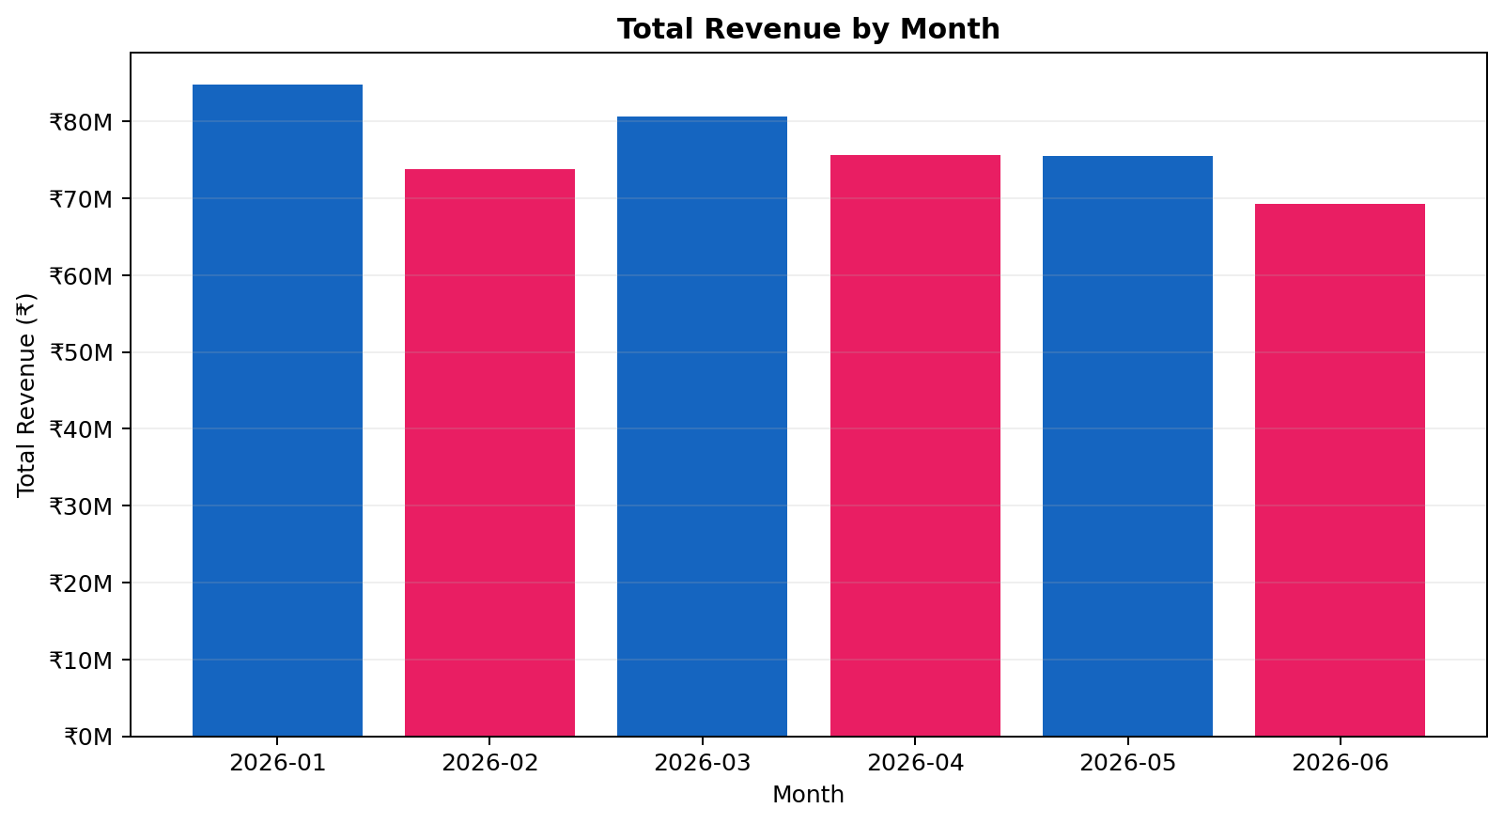
Monthly Pattern & Electronics Share
Chain-wide revenue falls while Electronics loses share
Best month: January — ₹84,768,131.
Worst month: June — ₹69,282,134.
Electronics share falls from 53.9% in January to 42.8% in June.
This indicates Electronics is losing ground relative to the rest of the chain, not simply following the overall monthly slowdown.
13

Slide 14
Category Manager Briefing
Final business takeaways from Steps 2–5
Apparel shows the strongest growth signal, rising 34.1% from January to June.
Electronics should receive focused supplier attention: it is the largest category at ₹226,527,725, yet revenue fell 35.0%.
At 20% discount, average revenue per transaction is ₹3,632 versus ₹4,686 at 0%, while units sold stay almost flat.
Saturday is the strongest day and Tuesday the weakest; January is the strongest month and June the weakest.
Before a final profitability or ROI decision, product cost / margin data is needed.
Key message: use the revenue evidence to guide the supplier conversation, then validate profitability with cost/margin data.
14

