Slide 1
Presentation on :
ATM
Automated Teller Machine
Presented by
Abhijeet Shinde
Chetan Bedarekar
Chetan Walvekar
Nagpritam Naik

Slide 2
INTRODUCTION
An ATM is an electronic device which allows a bank’s customer to make financial transactions in a public space & check their account balance at any time without the need for a human teller.
The customer is identified by a plastic ATM card with a magnetic stripe or a plastic smartcard with a chip.
Services available through an ATM
  Withdraw cash.
  Transfer money between accounts.
  Obtain account balance.
  Make deposits of cash and checks

Slide 3
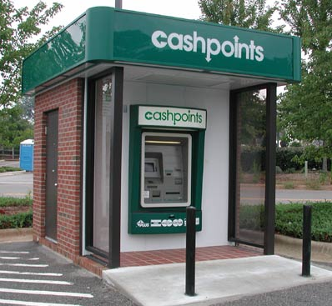
AN ATM COUNTER
ATMs are a
quick and
convenient
way to access
money in your
account.

Slide 4
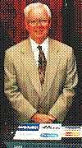
HISTORY
De La Rue developed the first electronic ATM, which was installed first in Enfield Town in North London, United Kingdom on 27 June 1967 by Barclays Bank.
The modern, networked ATM was
invented in Dallas, Texas, by
Don Wetzel in 1968.
The first ATM was installed at the
Rockville Centre (New York) based Chemical Bank.
Don Wetzel

Slide 5
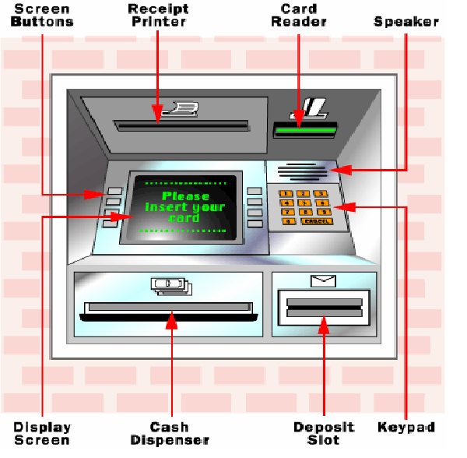
PARTS OF THE ATM SYSTEM

Slide 6
HARDWARE AND SOFTWARE
GSM Modem
IR Sensor
Personal computer
Microcontroller LPC2148
RFID Reader
Driver
Relay
Motor
Keypad
Power supply
Embedded c
Keil µvision
Flash Magic

Slide 7
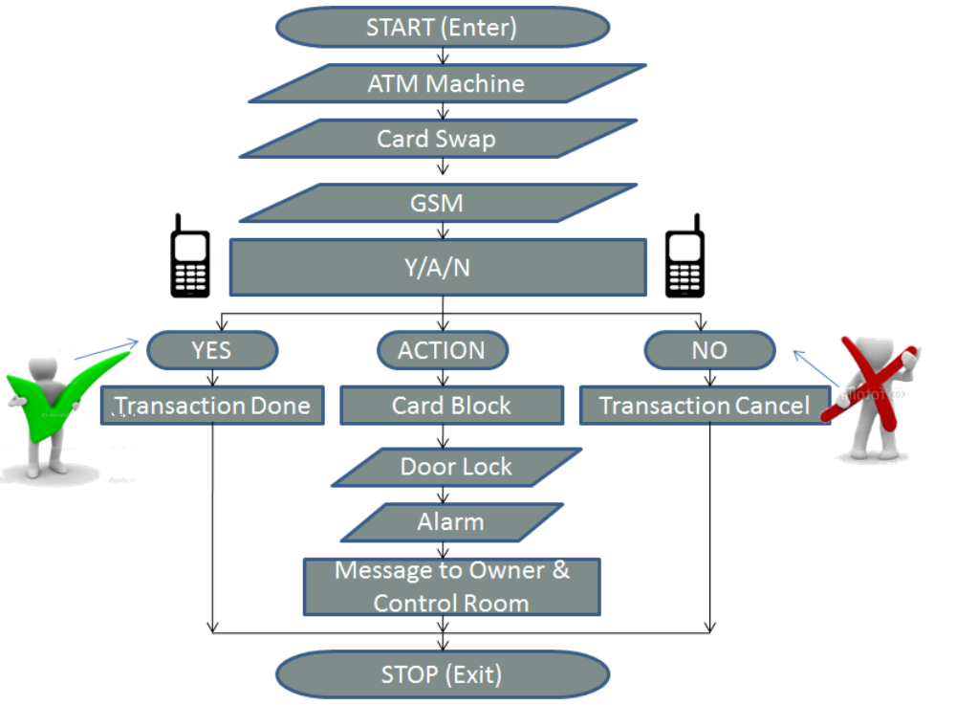
FLOWCHART

Slide 8
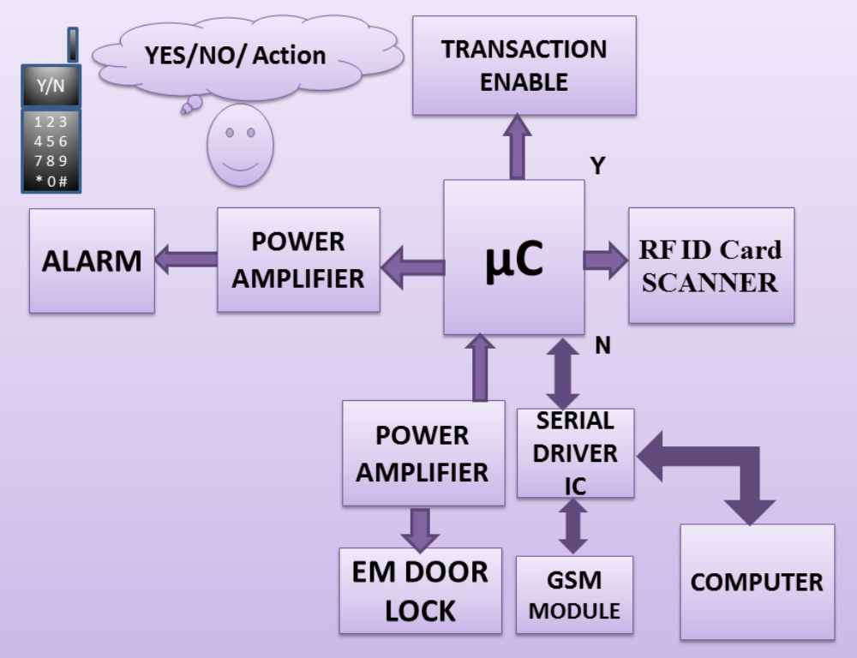
BLOCK DIAGRAM

Slide 9
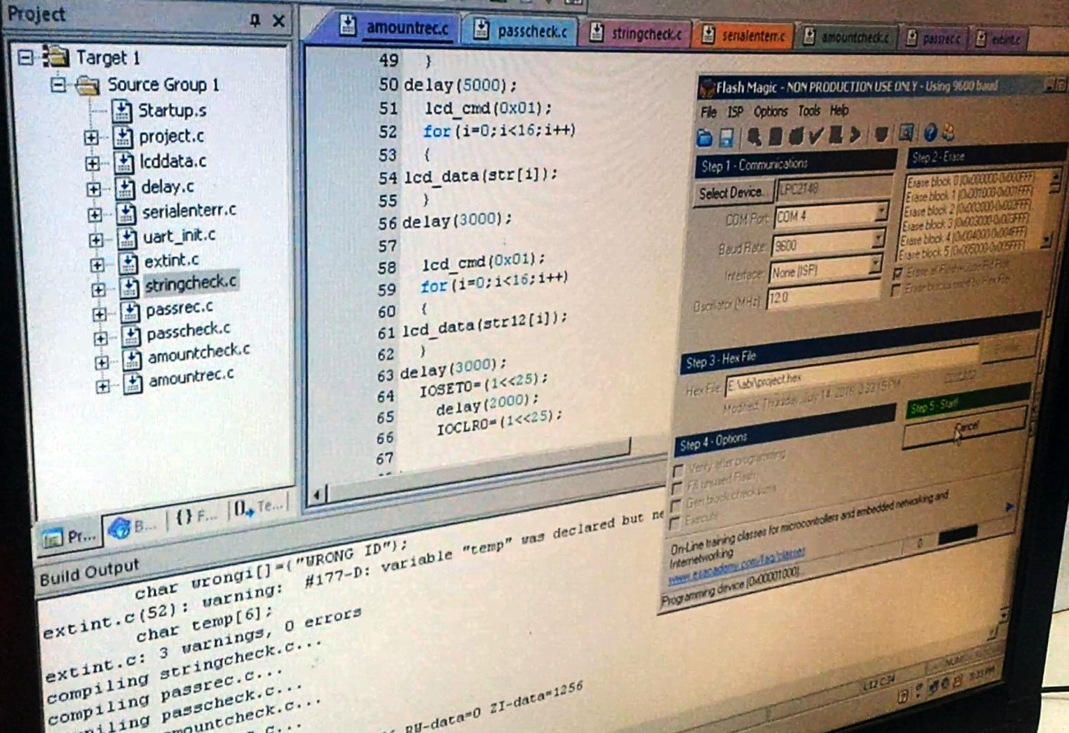
PICTURES

Slide 10
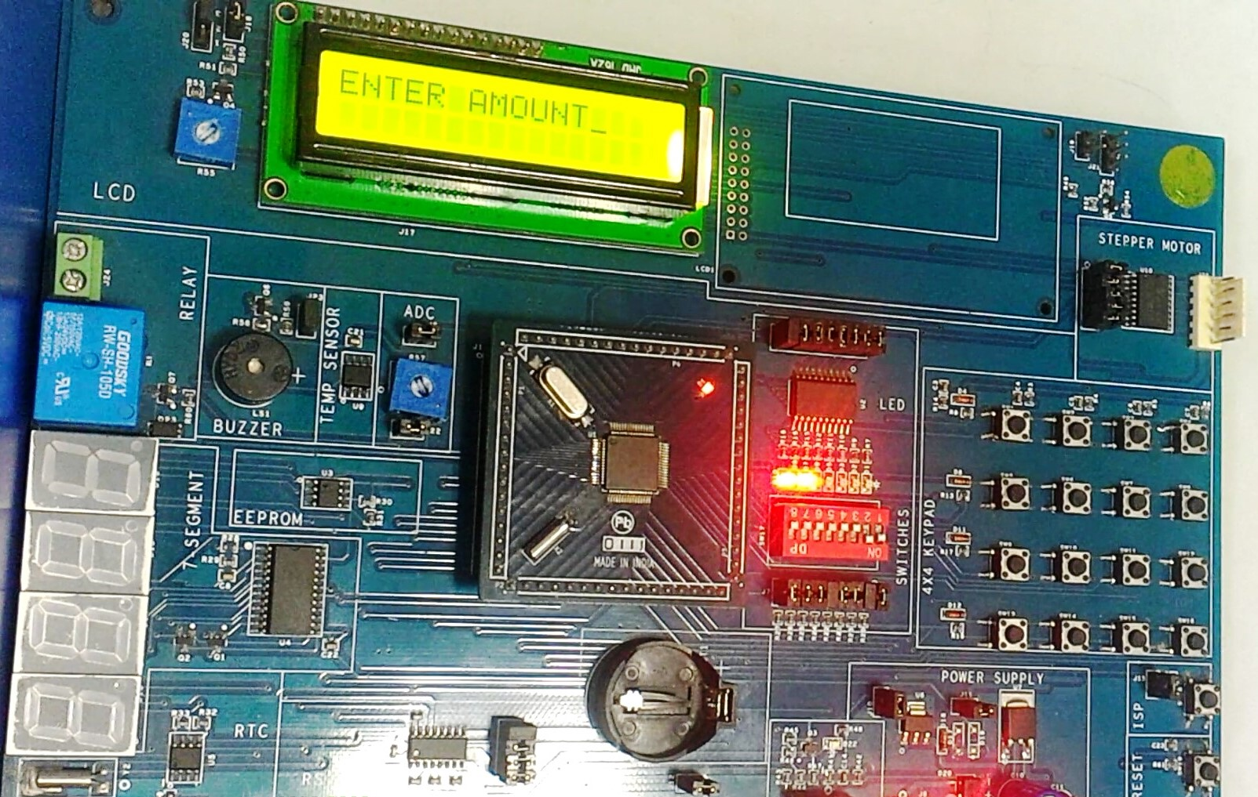

Slide 11
BENEFITS OF ATM
FOR THE BANK
  Increases existing business.
  Generates new business.
  Provides additional revenue streams.
FOR THE CUSTOMER
  Saves time and money.
  Can get cash whenever and wherever
  required.

Slide 12
SECURITY FEATURES INSIDE AN ATM
Surveillance camera.
Doors that automatically lock if there is an attempt to break open the machine.
Microprocessor based alarm system that connects to central monitoring point.

Slide 13
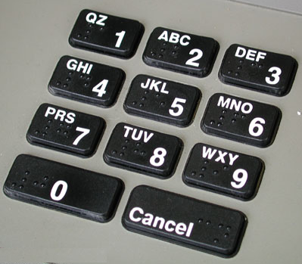
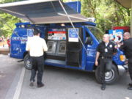
NEW INNOVATIONS
PC- based ATM
ATM with keypad having Braille letters and numbers.
Wireless ATM
Mobile ATM

Slide 14
CONCLUSION
ATM is very useful for human society. ATM is now introduced so many bank in almost all in the Globe.
The commercial purpose of ATM is now demanding all among like students, service man, business man and so general people. Now it also preferred for blind man. Due to its advantages the popularity is now increased.
The future of ATM is almost bright. Advanced techniques are being developed to give security to this machine and make people beneficial.

Slide 15
Thank You !

