Slide 1

Presentation on :
ATM
Automated Teller Machine
Presented by
Nrusingh Charan Ray.
Regd.No.--08052650079
MCA (2nd Sem )
ORISSA COMPUTER ACADEMY
Orissa computer academy
4-May-08

Slide 2
OUTLINE
Introduction
History
Parts of an ATM
Working of an ATM
Networking concept of ATM
Hardware & Software
Security
New Innovations
Conclusion
ORISSA COMPUTER ACADEMY

Slide 3
INTRODUCTION
An ATM is an electronic device which allows a bank’s customer to make financial transactions in a public space & check their account balance at any time without the need for a human teller.
The customer is identified by a plastic ATM card with a magnetic stripe or a plastic smartcard with a chip.
Services available through an ATM
  Withdraw cash.
  Transfer money between accounts.
  Obtain account balance.
  Make deposits of cash and checks
ORISSA COMPUTER ACADEMY

Slide 4
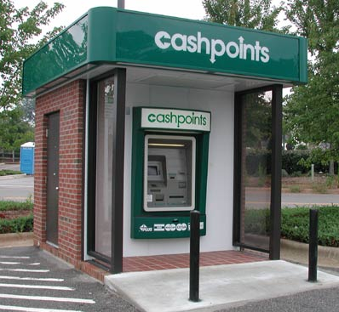
AN ATM COUNTER
ATMs are a
quick and
convenient
way to access
money in your
account.
ORISSA COMPUTER ACADEMY

Slide 5
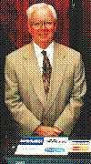
HISTORY
De La Rue developed the first electronic ATM, which was installed first in Enfield Town in North London, United Kingdom on 27 June 1967 by Barclays Bank.
The modern, networked ATM was
invented in Dallas, Texas, by
Don Wetzel in 1968.
The first ATM was installed at the
Rockville Centre (New York) based
Chemical Bank.
Don Wetzel
ORISSA COMPUTER ACADEMY

Slide 6
PARTS OF THE ATM SYSTEM
Card reader
Keypad
Speaker
Display screen
Receipt printer
Deposit slot
Screen buttons
Cash dispenser
ORISSA COMPUTER ACADEMY

Slide 7
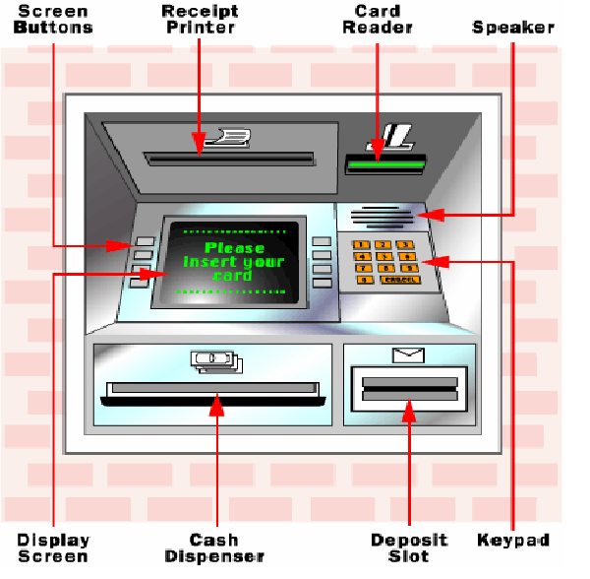
ORISSA COMPUTER ACADEMY

Slide 8
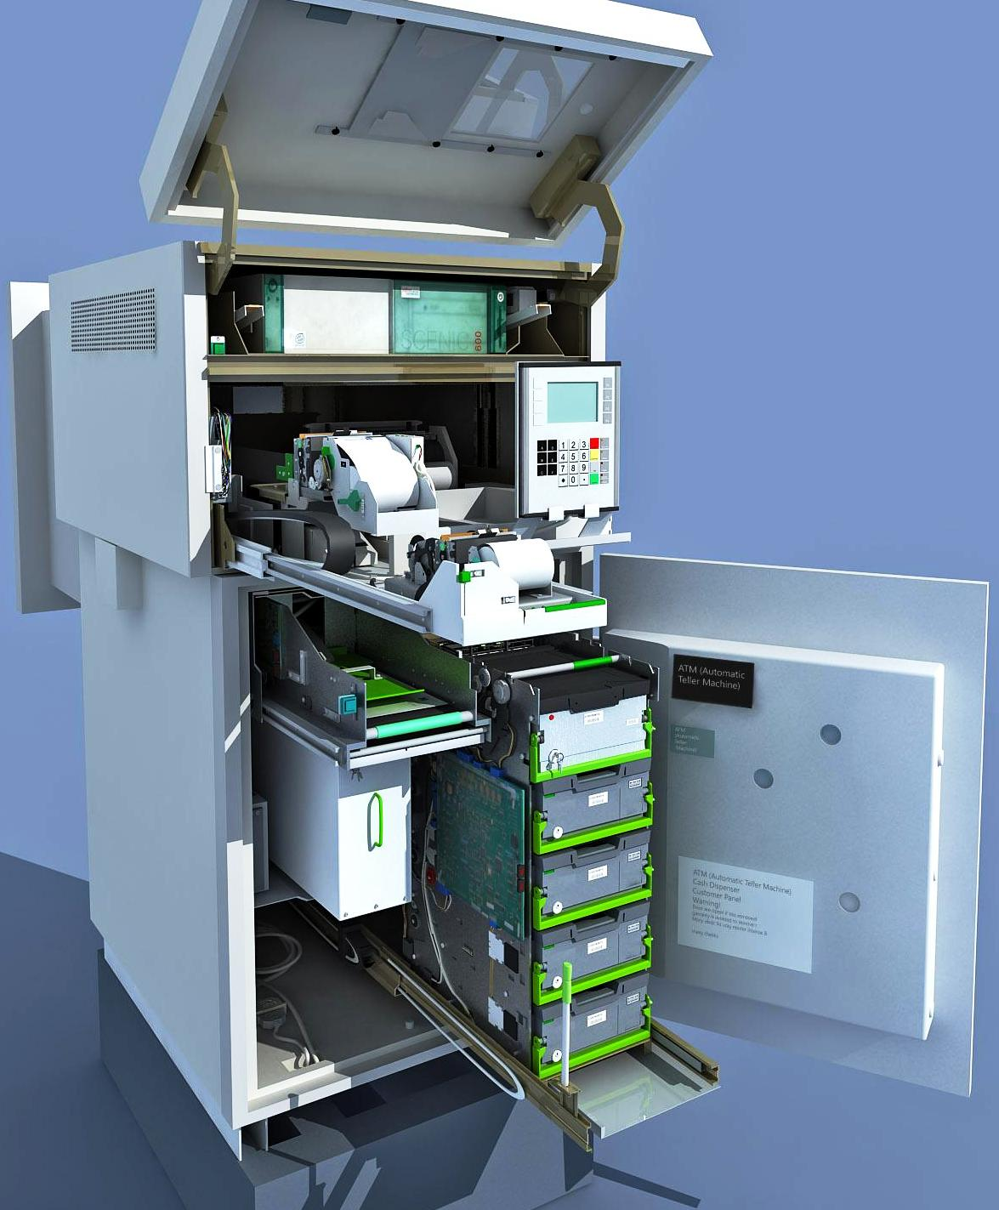
INSIDE VIEW
OF
AN ATM
ORISSA COMPUTER ACADEMY

Slide 9
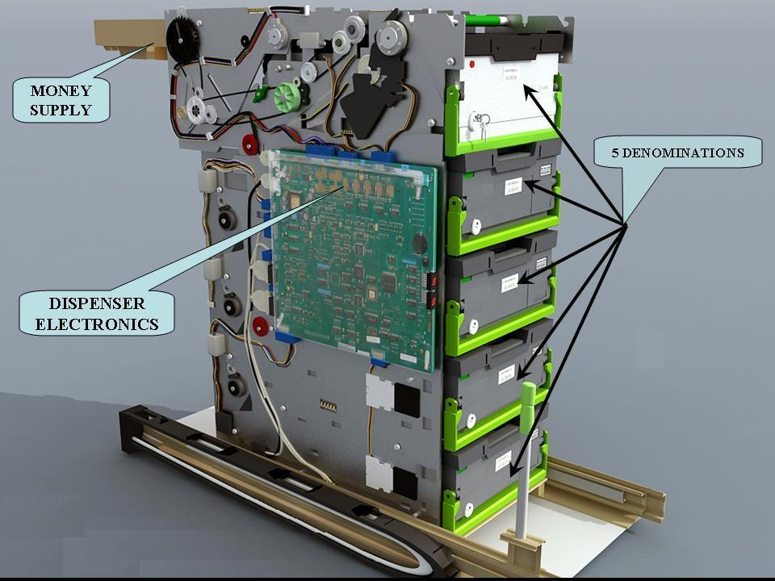
C
A
S
H
D
I
S
P
E
N
S
E
R
ORISSA COMPUTER ACADEMY

Slide 10
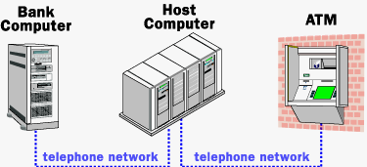
WORKING OF ATM
ORISSA COMPUTER ACADEMY

Slide 11
TYPES OF ATM CONNECTIVITY
The ATM acts as a data terminal. ATM has to connect to or communicate through a host computer .
The host computer in analogous to an Internet service provider (ISP) .
The host computer is the gateway through which all the various ATM network becomes available to the user.
Two types of connectivity
  Leased line : ATM connects directly to the host through a 4 wire point-to-point dedicated phone line.
  Dial-up Line : ATM connects to the host through a normal phone line using a modem and atoll free number.
The host computer may be owned by a bank or any financial institutions or it may be used by an independent service provider.
ORISSA COMPUTER ACADEMY

Slide 12
DIFFERENCE BETWEEN LEASED AND DIAL-UP LINE
Leased line:
  High throughput.
  Initial cost of setting up very high.
  Monthly operating costs very high.
Dial-up line:
  Low throughput.
  Initial cost of setting less than half of leased line.
  Monthly operating costs fraction of that of leased line.
ORISSA COMPUTER ACADEMY

Slide 13
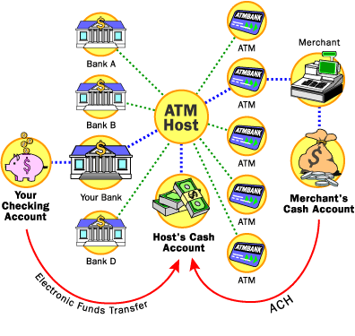
ATM NETWORK
ORISSA COMPUTER ACADEMY

Slide 14
HARDWARE AND SOFTWARE
ATM contain secure crypto-processors, generally within an IBM PC compatible host computer in a secure enclosure .
The security of the machine relies mostly on the integrity of the secure crypto-processor.
ATM machines runs with operating systems such as Windows 2000 and Linux.
ATM transactions are usually encrypted.
ORISSA COMPUTER ACADEMY

Slide 15
BENEFITS OF ATM
FOR THE BANK
  Increases existing business.
  Generates new business.
  Provides additional revenue streams.
FOR THE CUSTOMER
  Saves time and money.
  Can get cash whenever and wherever
  required.
ORISSA COMPUTER ACADEMY

Slide 16
SECURITY FEATURES INSIDE AN ATM
Surveillance camera.
Doors that automatically lock if there is an attempt to break open the machine.
Microprocessor based alarm system that connects to central monitoring point.
ORISSA COMPUTER ACADEMY

Slide 17
SAFE USAGE
Don’t scratch or bent your ATM card.
Treat your ATM card like cash. Always keep your card in a safe place.
Keep your secret code as secret. Don’t use date of birth, address ,phone number as your PIN.
Take your receipt on every ATM transaction.
Don’t leave it at or near the ATM counter.
Report a lost or stolen card at once.
ATM users should seek out a machine that is located in a well-lighted area.
ORISSA COMPUTER ACADEMY

Slide 18
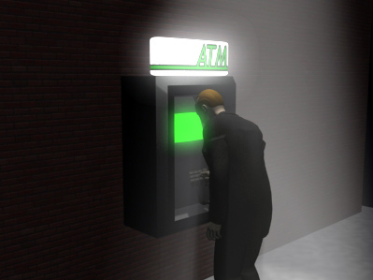
It is important to use a well-lighted public ATM at night.
ORISSA COMPUTER ACADEMY

Slide 19
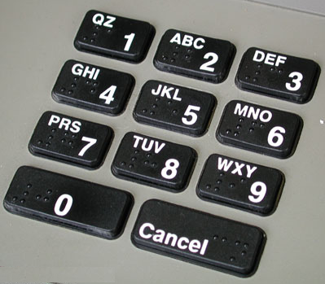
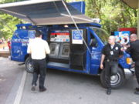
NEW INNOVATIONS
PC- based ATM
ATM with keypad having Braille letters and numbers.
Wireless ATM
Mobile ATM
ORISSA COMPUTER ACADEMY

Slide 20
CONCLUSION
ATM is very useful for human society. ATM is now introduced so many bank in almost all in the Globe.
The commercial purpose of ATM is now demanding all among like students, service man, business man and so general people. Now it also preferred for blind man. Due to its advantages the popularity is now increased.
The future of ATM is almost bright. Advanced techniques are being developed to give security to this machine and make people beneficial.
ORISSA COMPUTER ACADEMY

Slide 21

?
ORISSA COMPUTER ACADEMY

Slide 22
Thank You !
shibayaha@gmail.com
Orissa computer academy
4-May-08

