Slide 1

Presented By :
Sireesha

Slide 2
Agenda
What is JIRA
JIRA Concepts
Features
Why JIRA
Live Demonstration

Slide 3
What is JIRA
JIRA lets you prioritize, assign, track, report and audit your ‘issues’, from software bugs and helpdesk tickets to project tasks and change requests
More than just an issue trackers, JIRA is an extensible platform that you can customize to match your business processes
JIRA improves productivity by cutting down on time wasted on tracking issues and coordination
JIRA improves quality by ensuring all tasks are recorded down with all the details and followed up till completion

Slide 4
One application . Many uses.
Bugs/Change Requests Tracking
Help-desk /Support / Customer Service
Project Management
Task Tracking
Requirements Managements
Workflow / Process Management

Slide 5
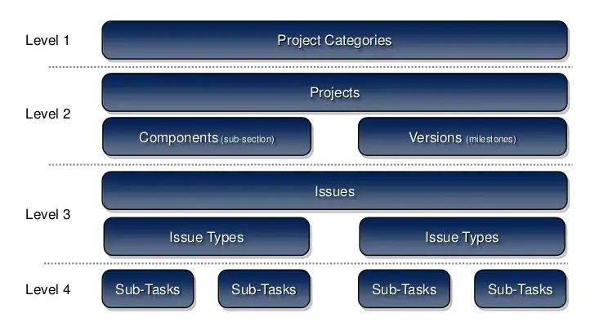
JIRA CONCEPTS: Projects, Issues &Subtasks

Slide 6
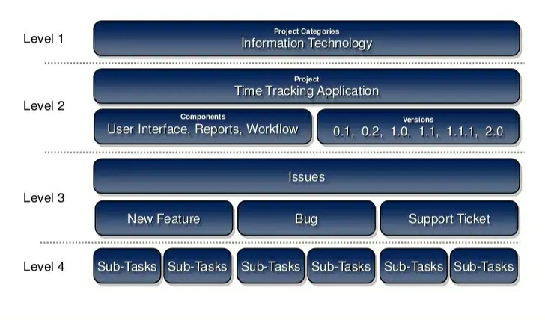
Example : A Software Development project

Slide 7
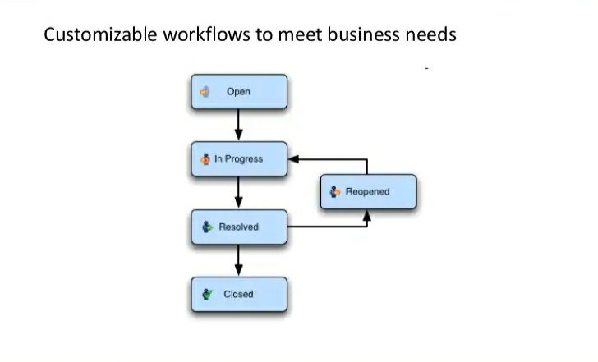
JIRA Concepts - workflow

Slide 8
JIRA Features – Issue Creation
Creating tasks, bug reports, feature requests, helpdesk tickets, is a breeze
No need to transcribe issues from emails to Excel worksheet anymore
Issue can be easily created via
Web : Filling the form on the Web page
Email : Sending an email to a preconfigured email address
Allows Customizable items for different issues types

Slide 9
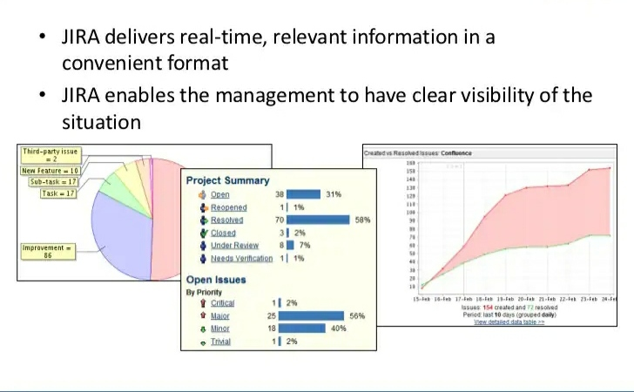
JIRA Features - Reports

Slide 10
JIRA Features - Notifications
JIRA enables you to receive the information you need, When you need it.
Configurable email alerts as and when issues are updated
Optional emails to remain on overdue tasks
Subscribe to weekly / monthly reports on issue status

Slide 11
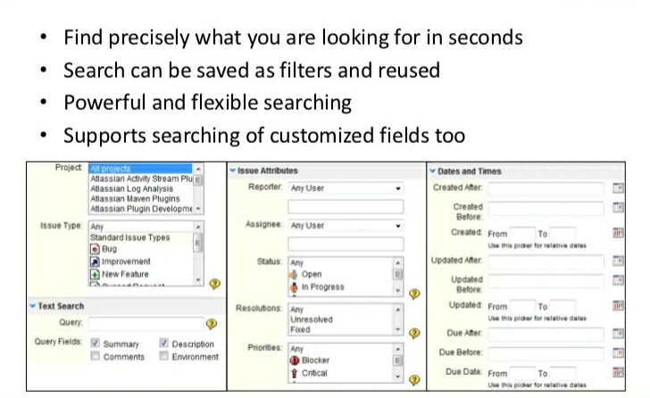
JIRA Features – Powerful Search

Slide 12
JIRA Features - Others
Secure : JIRA provides fine- grained enterprise level security
Usable : Intuitive interface designed with both business and technical users in mind
Track : Keep track of all activities, changes and work logged against issues
Administration : A low maintenance system with straight forward administration capability
Extensible : with over 100 pluggins contributed by the community
Open : An open API, full source code access allow for further integration customization of JIRA functionality

Slide 13
Top 10 reasons to use JIRA
Features you won’t find elsewhere
It…….just…….works
Fair , Upfront licensing policy
Battle tested by the world corporations
The information you need, when you need it
Easily customizable and extensible
Legendary service
JIRA runs anywhere
Continually improving
Recognized with many industry awards

Slide 14
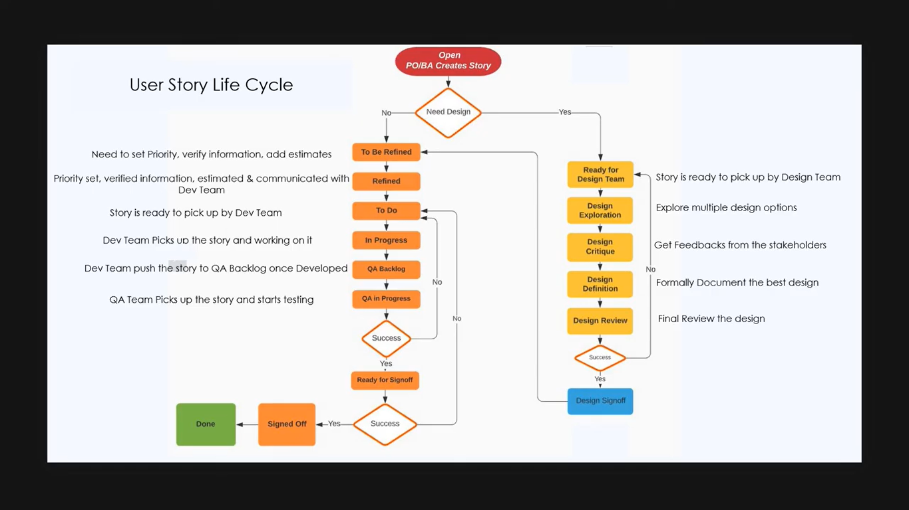

Slide 15
THANK YOU

