Slide 1

Presented by
Imam Basha

Slide 2
Agenda:
What is JUnit
Junit-Features
Junit-Test Framework
Junit-Classes
JUnit-Ignore Test
Junit-Time Test
Junit-Exception Test
Junit-Parameterized Test

Slide 3
Junit:
Junit stands for Java Unit.
JUnit is a unit testing framework for Java programming language.
JUnit has been important in the development of test-driven development.
Increase the productivity of a programmer and stability of code.

Slide 4
Features:
JUnit is an open source framework, which is used for writing and running tests.
Provides annotations to identify test methods.
Provides assertions for testing expected results.
Provides test runners for running tests.
JUnit tests allow you to write codes faster, which increases quality.
JUnit is simple. It is less complex and takes less time.
JUnit tests can be run automatically and they check their own results and provide immediate feedback.
There's no need to manually comb through a report of test results.
JUnit tests can be organized into test suites containing test cases and even other test suites.
JUnit shows test progress in a bar that is green if the test is running smoothly, and it turns red when a test fails.

Slide 5
Test Framework:
JUnit is the most popular unit Testing framework in Java.
It is explicitly recommended for Unit Testing.
JUnit does not require server for testing web application, which makes the testing process fast.
Features of JUnit Test Framework:
JUnit test framework provides the following important features −
Fixtures - Fixtures is a fixed state of a set of objects used as a baseline for running tests.
Test suites - A test suite bundles a few unit test cases and runs them together. In JUnit, both @RunWith and @Suite annotation are used to run the suite test.
Test runners - Test runner is used for executing the test cases.
JUnit classes - JUnit classes are important classes, used in writing and testing Junits .

Slide 6
Junit-Classes
Assert − Contains a set of assert methods.
Test Case − Contains a test case that defines the fixture to run multiple tests.
Test Result − Contains methods to collect the results of executing a test case.

Slide 7
JUnit-Ignore Test
The @Ignore test annotation is used to ignore particular tests or group of tests in order to skip the build failure.
The @Ignore annotation helps in this scenario.
A test method annotated with @Ignore will not be executed.
If a test class is annotated with @Ignore, then none of its test methods will be executed.

Slide 8
Junit-Time Test
The time test is used to check that if a test case is completed within the specified time or not.
JUnit terminate and mark it failed automatically if it takes more time than the specified milliseconds.
We have to specify time in milliseconds in @Test(timeout = timeInMilliSeconds) action.
JUnit tests with timeout behavior. If any test does not complete execution in given time limit then it’s execution will stop by Junit.
Junit-Exception Test
Expected exception test is used for the methods which can throw an exception.
We have to specify expected exception in @Test(expected = expectedException.class) action.
If expected exception or any of its subclass exception is thrown by the method then JUnit will pass this unit test.

Slide 9
Junit-Parameterized Test
The parameterized test is a new feature introduced in JUnit 4.
It provides the facility to execute the same test case again and again with different values.
Steps to create a parameterized test:
1. Test class have to be annotated with @RunWith(Parameterized.class) annotation.
2. Create a public static method with @Parameters annotation which returns a collection of objects as test data set.
3. Create data members for each column of test data set.
4. Create a public constructor which takes one object of test data set.
5. Create test case using test data set.

Slide 10
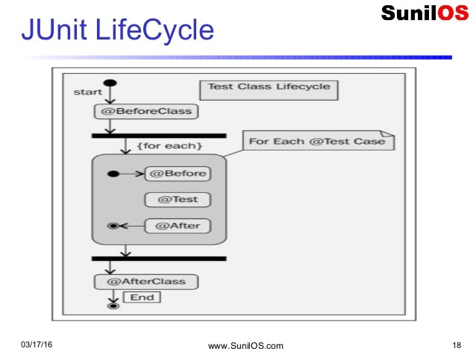

Slide 11
Annotations
@BeforeClass – Run once before any of the test methods in the class .
@AfterClass – Run once after all the tests in the class have been run.
@Before – Run before @Test.
@After – Run after @Test .
@Test – This is the test method to run .
@Ignore: It is used to ignore the test case.

Slide 12


