Slide 1
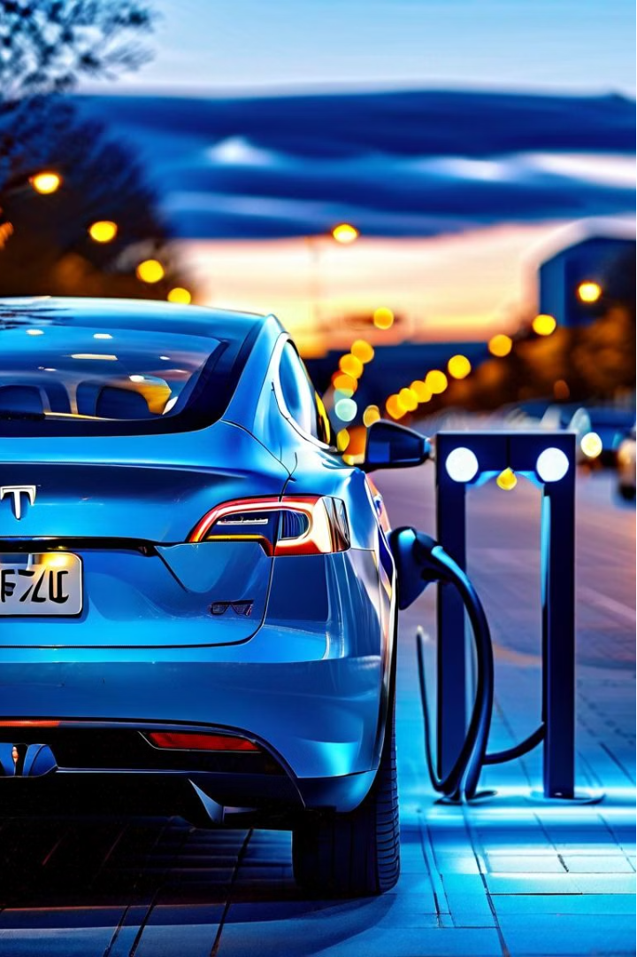
Driving the Electric Vehicle Revolution: A Data-Driven Approach
As the world moves towards a more sustainable future, electric vehicles (EVs) have emerged as a crucial component in the fight against climate change. This comprehensive analysis explores the factors driving the adoption of electric vehicles using digital twins - virtual replicas that simulate real-world scenarios. By leveraging data-driven insights, we unveil the intricate dynamics that shape consumer behavior and guide the industry towards a more informed, strategic approach to EV adoption.
by Nagesh B U
Supreeth Dandu
Yashwanth Pasupeleti

Slide 2
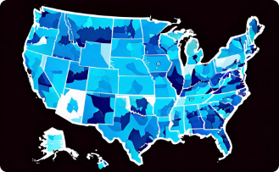
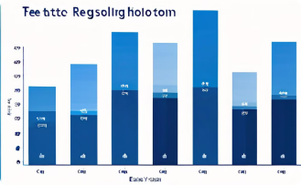

Mapping the EV Landscape in Washington State
Geographic Distribution
Top Adopting Counties
Popular EV Models
The analysis reveals a diverse landscape of EV adoption across Washington state, with certain regions and counties emerging as hotspots. By examining the spatial distribution of electric vehicle registrations, we gain a deeper understanding of the factors that influence consumer preferences and accessibility to charging infrastructure.
The data shows that King County, home to the state's largest city of Seattle, leads the charge with the highest number of electric vehicle registrations. Other populous counties, such as Snohomish and Pierce, also demonstrate significant EV adoption rates, reflecting the growing demand for sustainable transportation options.
The analysis of EV models reveals that the Tesla Model Y and Model 3 dominate the market, accounting for a substantial portion of the overall registrations. This trend highlights the appeal of these vehicles among Washington state's eco-conscious consumers, who value the performance, range, and technological advancements offered by these industry-leading electric cars.

Slide 3
Factors Influencing EV Adoption
Incentives and Policies
Charging Infrastructure
Consumer Preferences
Government incentives, such as tax credits and rebates, play a crucial role in driving EV adoption. The analysis shows that regions with more favorable policies and financial support have witnessed a higher uptake of electric vehicles, as these measures help offset the initial cost barrier for consumers.
The availability and accessibility of charging stations is another key factor in consumer adoption of EVs. Areas with a robust network of public and private charging options have seen a more rapid transition to electric transportation, as drivers gain the confidence to switch from traditional gasoline-powered vehicles.
Beyond the tangible factors, the analysis also reveals the influence of consumer attitudes and preferences on EV adoption. Factors such as environmental consciousness, technological savvy, and the perceived convenience of electric vehicles all contribute to the growing demand for cleaner, more sustainable transportation options.

Slide 4

Leveraging Digital Twins for Predictive Modeling
1
Data Collection
The foundation of our analysis lies in the extensive data collected from various sources, including vehicle registration records, census data, and geographic information. This comprehensive dataset allows us to create detailed digital twins that simulate the real-world dynamics of EV adoption.
2
Model Development
Using advanced machine learning techniques, we develop predictive models that can forecast the future trends and patterns of electric vehicle adoption. These models incorporate a wide range of factors, from demographic data to infrastructure investments, to paint a holistic picture of the EV landscape.
3
Scenario Testing
The power of digital twins lies in their ability to simulate various scenarios and test the impact of different policy interventions or market conditions. By experimenting with these virtual models, we can identify the most effective strategies to accelerate EV adoption and support the transition to a sustainable transportation future.

Slide 5
Insights for Policymakers and Industry Leaders
Targeted Incentives
Charging Network Expansion
The analysis highlights the need for tailored incentive programs that address the unique needs and barriers faced by different consumer segments. Policymakers should prioritize financial support and infrastructure investments in underserved communities to ensure equitable access to electric vehicles.
The data clearly demonstrates the importance of a robust and accessible charging network in driving EV adoption. Industry leaders should collaborate with local governments to strategically plan and deploy charging stations in high-demand areas, catering to the diverse needs of urban, suburban, and rural communities.
Consumer Education
Innovative Partnerships
Raising awareness and addressing misconceptions about electric vehicles is crucial to accelerating adoption. Comprehensive educational campaigns, highlighting the environmental and economic benefits of EVs, can empower consumers to make informed choices and overcome the barriers to adoption.
Fostering collaborative partnerships between public and private sectors can unlock new opportunities for innovation and accelerate the transition to electric mobility. Policymakers and industry leaders should explore creative solutions, such as public-private charging infrastructure initiatives and cross-sector data-sharing agreements.

Slide 6



Bridging the Adoption Gap
Awareness
Affordability
Accessibility
Increased consumer awareness about the benefits and capabilities of electric vehicles is crucial to driving adoption. Educational campaigns and test-drive opportunities can help overcome misconceptions and demonstrate the real-world advantages of EVs.
Addressing the upfront cost barrier through incentives, subsidies, and innovative financing options can make electric vehicles more accessible to a wider range of consumers, particularly those in lower-income communities.
Expanding the charging infrastructure network, both in public and private spaces, ensures that drivers have the confidence and convenience to transition to electric vehicles, addressing range anxiety and other logistical concerns.

Slide 7




The Road Ahead: A Sustainable Future
Environmental Impact
Economic Benefits
Technological Advancements
Societal Impact
The transition to electric vehicles can foster a more inclusive and equitable transportation system, providing access to clean and affordable mobility options for diverse communities.
The widespread adoption of electric vehicles has the potential to significantly reduce greenhouse gas emissions and fossil fuel consumption, making a meaningful contribution to the fight against climate change.
The growth of the EV industry creates new economic opportunities, from the development of innovative technologies to the creation of green jobs and the expansion of a sustainable transportation ecosystem.
Continuous improvements in battery technology, charging infrastructure, and vehicle design are driving the evolution of electric mobility, making EVs more efficient, affordable, and appealing to a broader range of consumers.

Slide 8
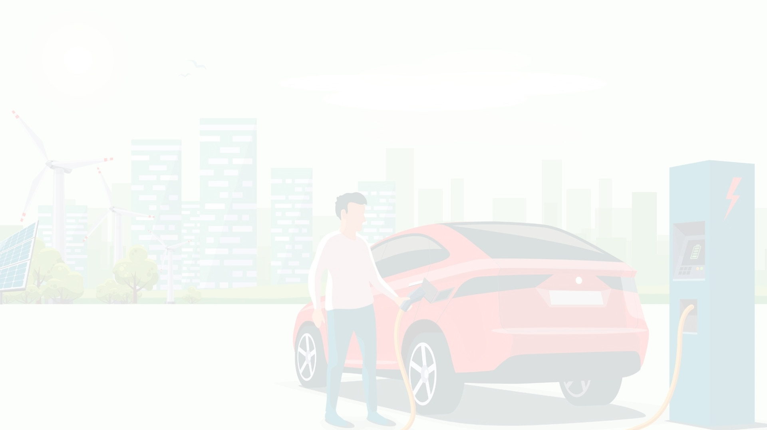
Predictive Modeling for Accuracy & F1-Score
Model
Accuracy
ROC AUC Score
Precision
Recall
F1-Score
Naive Bayes
0.896437339530351
0.8193302711926629
0.92
0.96
0.94
Logistic Regression
0.834423433722521
0.6884668793554423
0.86 0.95 0.90
Random Forest classifier
0.9999062950954853
0.9998155689989119 1.00 1.00 1.00
To further understand the factors influencing electric vehicle type, we have implemented various machine learning models to predict this key characteristic. The Random Forest Classifier and Naïve Bayes emerge as the top performers, with R-squared scores exceeding 0.90, indicating a strong predictive capability. These models can be leveraged to guide future EV development and infrastructure planning efforts, ensuring a more informed and data-driven approach to supporting the state's transition to sustainable transportation.

Slide 9
Conclusion: Driving Towards a Sustainable Future
Key Insights
Implications
Next Steps
- Spatial distribution of EV adoption in Washington state - Popularity of Tesla models - Role of incentives, policies, and charging infrastructure
- Targeted investments and interventions to address regional disparities - Collaboration between industry and policymakers to address consumer needs - Holistic approach to sustainable mobility planning
- Expand the digital twin framework to other regions and markets - Deepen the analysis of consumer behaviors and preferences - Explore the integration of emerging technologies, such as autonomous driving and vehicle-to-grid integration

