Slide 1
Employee Data Analysis using Excel
STUDENT ME: J. Nagulan
REGISTER NO: 312204223
DEPARTMENT: B.com A/F
COLLEGE: Annai Violet arts and science college

Slide 2
PROJECT TITLE
Using Pivot Tables For Employees Turnover Analysis

Slide 3


AGENDA
Problem Statement
Project Overview
End Users
Our Solution and Proposition
Dataset Description
Modelling Approach
Results and Discussion
Conclusion
3/21/2024 Annual Review

Slide 4

PROBLEM STATEMENT
High employee turnover can significantly impact organizational performance and culture. To address this issue, we aim to analyze employee turnover data to identify patterns, trends, and factors contributing to turnover rates within the organization. The analysis will utilize Pivot Tables to summarize key metrics such as turnover rates by department, tenure, and demographics.

Slide 5

PROJECT OVERVIEW
This project focuses on using Pivot Tables to analyze employee turnover data, aiming to identify patterns and trends across various dimensions such as department, tenure, age, and gender. By summarizing the data efficiently, Pivot Tables will help uncover key insights into factors contributing to turnover.
.

Slide 6

WHO ARE THE END USERS?
1. HR Managers 2. Executives 3. Department Managers 4. Recruitment Teams 5. Business Analysts

Slide 7

OUR SOLUTION AND ITS VALUE PROPOSITION
Our Solution: Using Pivot Tables to analyze employee turnover data, uncover trends, and identify key factors contributing to employee attrition. Value Proposition: Provides data-driven insights for reducing turnover, improving employee retention, and optimizing workforce management, leading to cost savings and enhanced organizational performance.

Slide 8
Dataset Description
The dataset includes key employee details such as ID, department, tenure, age, gender, salary, hire/exit dates, job role, and reason for leaving. This data will be used in Pivot Tables to analyze turnover trends and factors influencing employee attrition.

Slide 9

THE "WOW" IN OUR SOLUTION
Our solution transforms complex employee turnover data into clear, actionable insights using Pivot Tables, enabling quick identification of trends and patterns. This empowers HR and management to make informed decisions that enhance employee retention and improve organizational performance.
3/21/2024 Annual Review
9

Slide 10
MODELLING
1. Data Collection: Gather employee data (e.g., demographics, tenure, turnover reasons). 2. Data Preparation: Clean and organize data. 3. Pivot Table Setup: Use categories like department, tenure, and turnover rates. 4. Analysis: Identify trends and high-turnover areas. 5. Visualization: Create charts for clear insights. 6. Insights: Generate actionable recommendations for retention improvement.
10

Slide 11
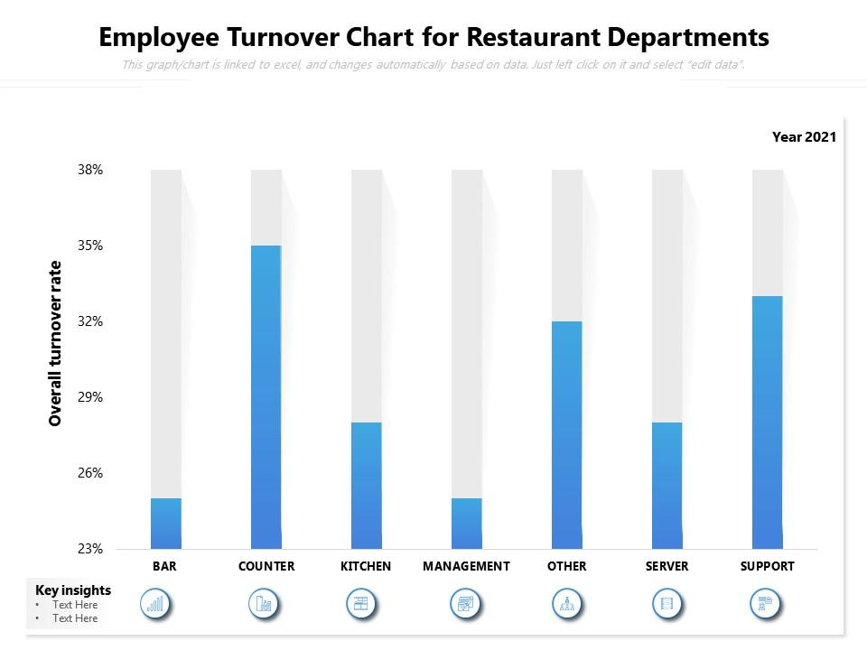
RESULTS
11

Slide 12
conclusion
The employee turnover analysis using Pivot Tables provided valuable insights into turnover trends and contributing factors. By identifying high-risk demographics and correlating performance with attrition, we developed targeted retention strategies. Implementing these strategies can enhance employee satisfaction, reduce turnover costs, and ultimately improve organizational performance.

