Slide 1
HOTEL BOOKINGS
Presented by: Naguleshwari.S.R
Mentor :Jaya pandey

Slide 2
About Dataset
This data set contains bookings information for a hotel type , and includes information such as when the booking was made length of stay, number of adults, children, babies, the number of available parking spaces and among other things
This dataset is taken from Kaggle which is the home of all free to use datasets
Business objective
The main objective of this project is to find actionable insights for the smooth functioning of the hotel and suggest some necessary changes based on it. So, that the business runs smoothly in upcoming years

Slide 3
Tools used and workflow
There are three tools are used
Python
SQL
Tableau
For the data preprocessing and cleaning –python is used in primarily
Dataset is filtered and stored in SQL database.
For report making , dashboards and visualization tableau is used

Slide 4
Business Questions
For python
How to create the bar chart to visualize the hotel type?
How can you create a line chart to visualize the trend of lead time over the years?
How can you create a pie chart to show the distribution of meal types chosen by guests?
How can you create a bar chart to show the distribution of booking channels?
How can you create a scatter plot to visualize the correlation between lead time and total special requests?

Slide 5
For Tableau
How can you visualize the average daily rate (ADR) by customer type?
How many bookings were canceled in resort hotel?
What is the most popular meal type chosen by guests?
Which country has the highest number of bookings?
What is the distribution of booking channels ?
There are 9 types of assigned room types-138
Assigned room type 'A' contains the highest number of car parking spaces -41
Assigned room type 'I' contains the highest number of car parking spaces -1
What is the car parking spaces based on the assigned room type?

Slide 6
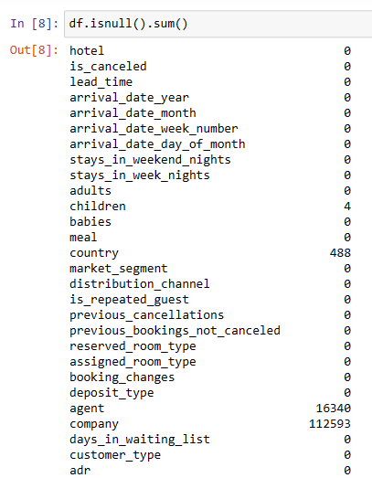
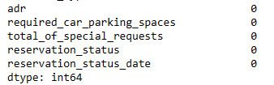
Business requirments
Cleaning the data is essential to make the data prepared to further analysis without any redundancy or missing values
This is the data set before cleaning

Slide 7
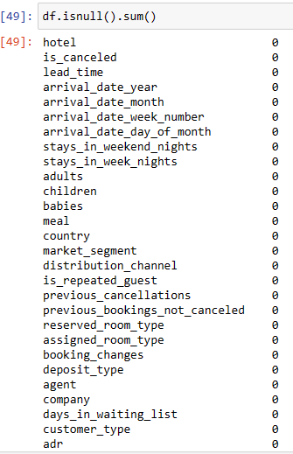
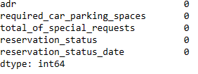
Dataset after cleaning

Slide 8
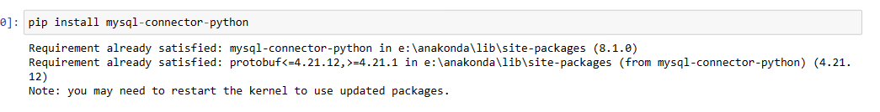
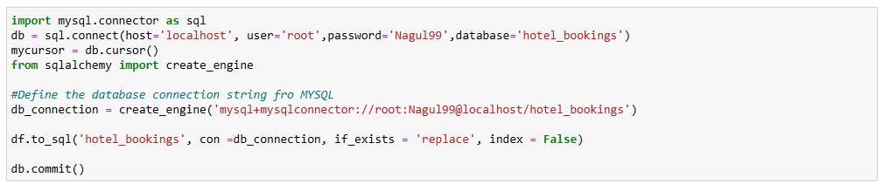
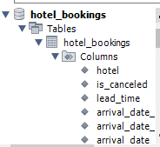
Connecting the cleaned dataset to SQL from python
Using SQL and creating new excel sheet for cleaned data
Dataset in SQL

Slide 9
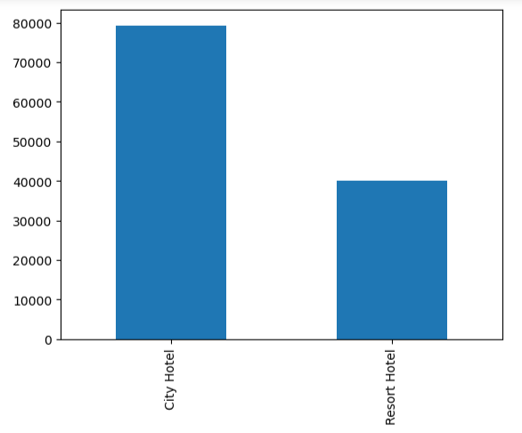
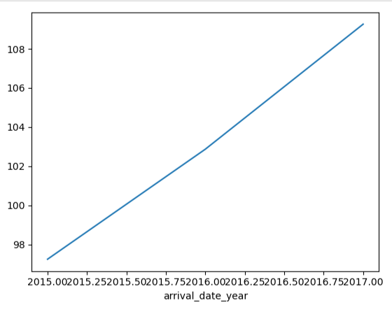
EDA with python
Count of the hotel type
Trend of lead time over the years

Slide 10
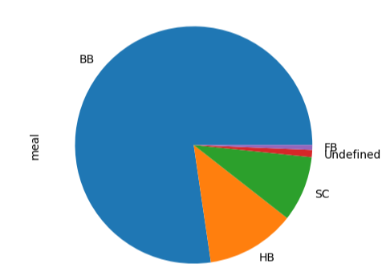
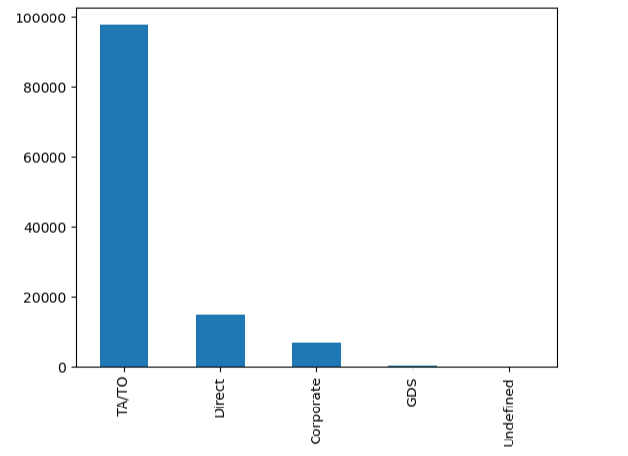
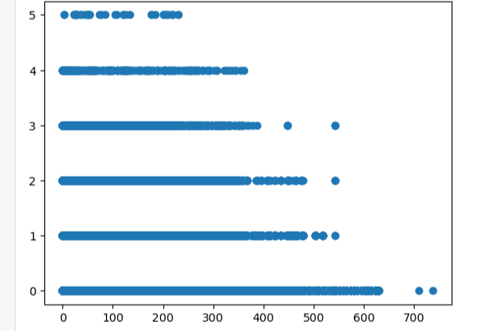
Distribution of different meal types chosen by guest
Distribution of booking channel
Correlation between
Lead time and total special requests

Slide 11
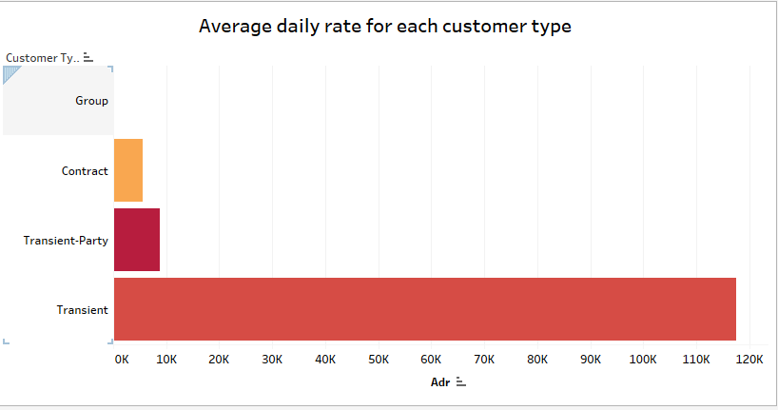

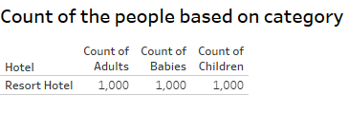
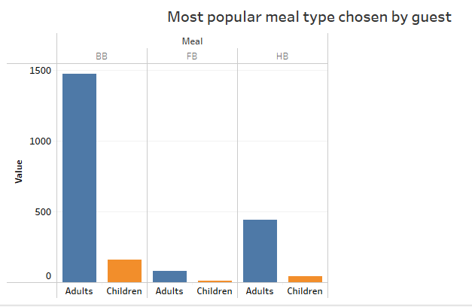
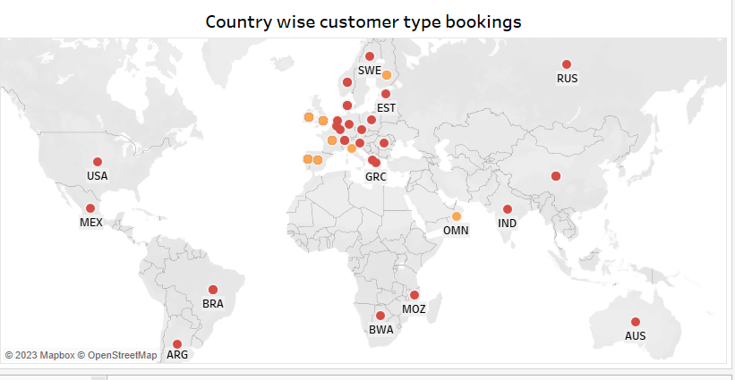
EDA

Slide 12
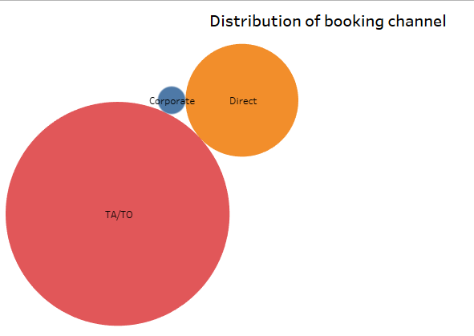
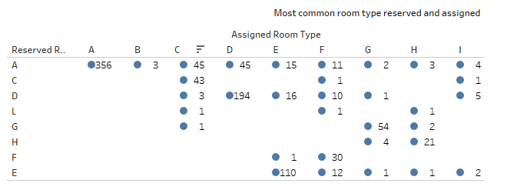
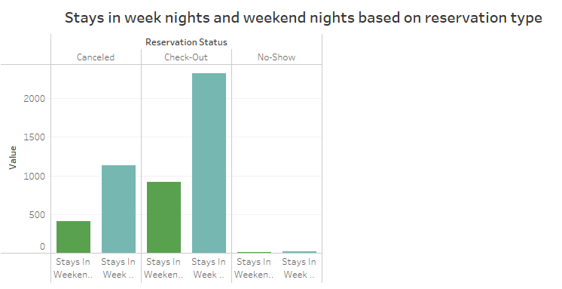
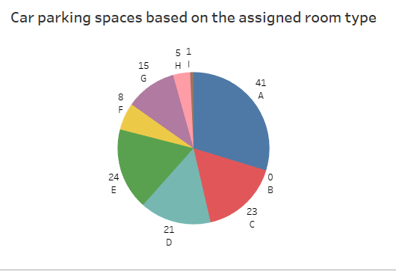

Slide 13
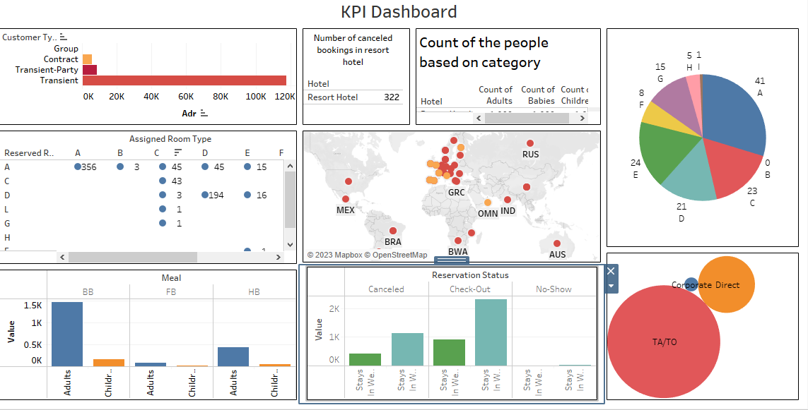

Slide 14
Interpretation
City hotel contains more number of people than resort hotel
In the year of 2017 ,reached the trend of lead time
IN meal types, the BB meal type was chosen by maximum number of guests and FB meal type chosen by minimum number of guests
The TA/TO contribution was more in the distribution of booking channels
The peak lead time correlating more than 300 special guests
Transient contributes the highest average daily rate and Group contributes the lowest average daily rate
There are 322 canceled bookings in resort hotel?
For all the meal type-BB,FB and HB was chosen more by adults because they contributes higher than the children
The maximum country comes under the transient-party customer type and the minimum country comes under the contact customer type

Slide 15
TA/TO is the highest booking channel and Corporate is the highest booking channel
The highest reserved room type was 'A-A' with 356 number of assigned rooms and the lowest reserved room type was 'C-G' , 'C-L' , 'E-F' , 'F-C' , 'F-L' , 'G-D' , 'G-E' , 'H-E' , 'H-L' , 'I-C' with 1 number of assigned room
All the 3 category of people are in the same count of 1000
Those 2 categories in reservation type are stay in weekend and stays in week and for all the 3 values of canceled , check out, and no show having the highest number of stays in week nights and lowest number of stays in weekend
There are 9 types of assigned room types-138, Assigned room type 'A' contains the highest number of car parking spaces -41 and Assigned room type 'I' contains the highest number of car parking spaces -1

Slide 16
Key points from my analysis
From the analysis we can introduce new meal which is liked by children , since it helps to choose the meal by children . Because then only they wont leave the hotel to had their food
We can build the children parks , swimming pool for adults and children , garden to chill out in evening . If we will give these extra facility, then it will be recommended by the visitors
We can able to give some offer to the regular visitors. Then people will definitely choose this hotel ,whenever they visit the place and for vacation.

Slide 17
Conclusion
In the project, we have successfully analyzed the hotel bookings data set using the python and tableau. For the key aspects we have analysis the data set through the python that we got about hotel type , trend of lead time over years , meal type chosen by guests , distribution of booking channel are examined .we have examined further things in tableau. This project provided valuable insights for decision making and future opportunities for further analysis

