Slide 1
CUSTOMER CHURN ANALYSIS
(CAPSTONE PROJECT FOR TABLEU)
- NAGULESHWARI S.R

Slide 2
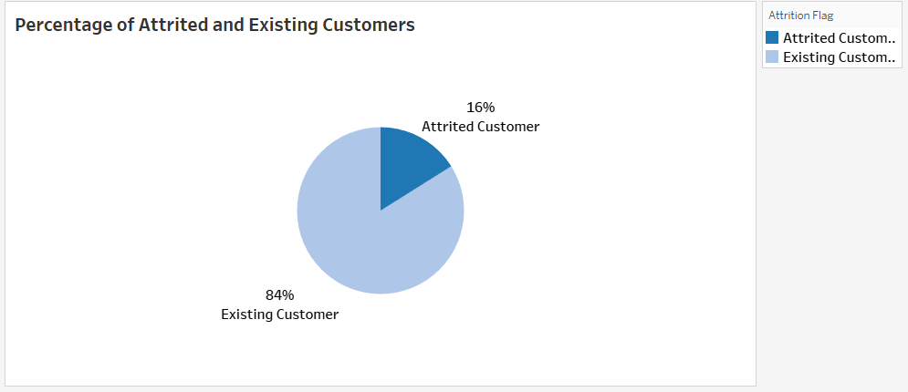
TASK 1
Interpretation:
This chart represents the percentage of attrited and existing customers
The existing customer contributes 84%
The attrited customer contributes 16%

Slide 3
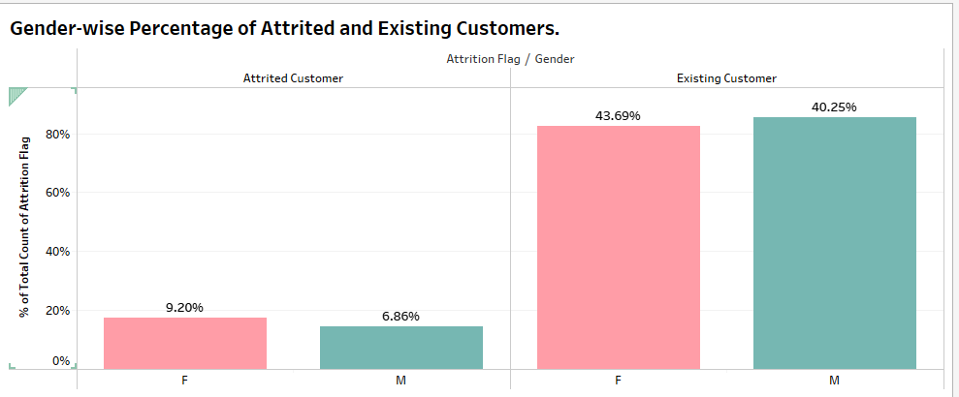
TASK 2
Interpretation:
This chart represents the genderwise percentage of attrited and existing customers
In existing customer female contains 43.69% and male contains 40.25%
In attrited customer female contains 9.20% and male contains 6.86%

Slide 4
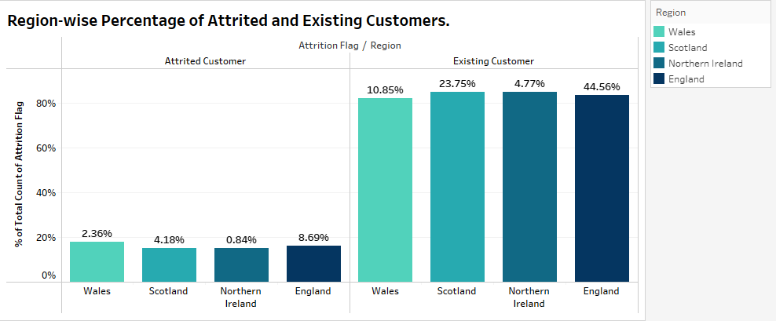
TASK 3
Interpretation:
This chart represents the regionwise percentage of attrited and existing customers
In attrited customer wales contains 2.36% , scotland contains 4.18% , northern ireland contains 0.84% and england contains 8.69%
In existing customer wales contains 10.85% , scotland contains 23.75% , northern ireland contains 4.77% and england contains 44.56%

Slide 5
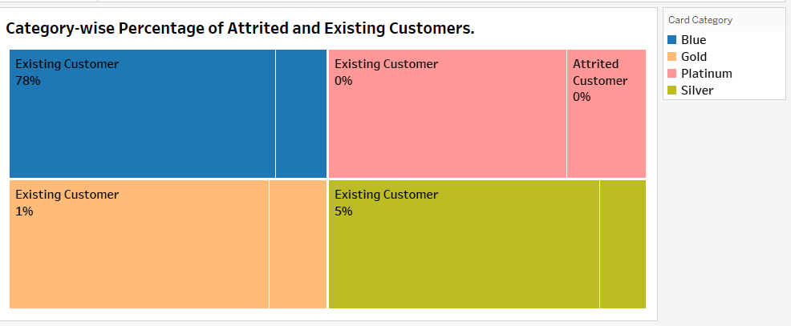
TASK 4
Interpretation:
This chart represents the categorywise percentage of attrited and existing customers Blue card customer contains 78% of existing customer , attrited customer contains 15% Planium card customer contains 0% of existing customer , attrited customer contains 0% Gold card customer contains 1% of existing customer , attrited customer contains 0% Silver card customer contains 5% of existing customer , attrited customer contains 1%

Slide 6
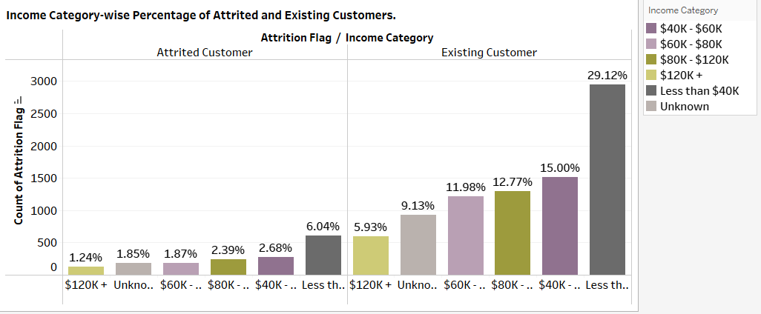
TASK 5
Interpretation:
This chart represents the income categorywise percentage of attrited and existing customers
In existing customer the lowest income got by 5.93% as $120k and highest income got by 29.12% as less than $40k
In attributed customer the lowest income got by 1.24% as $120k and highest income got by 6.04% as less than $40k

Slide 7
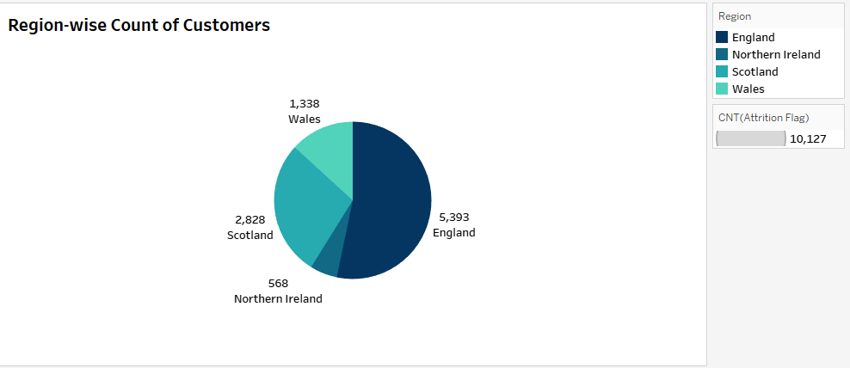
TASK 6
Interpretation:
This chart represents the region wise Count of customers
The highest count of customers was 5393 in England
The lowest count of customers was 568 inn Northern Ireland

Slide 8
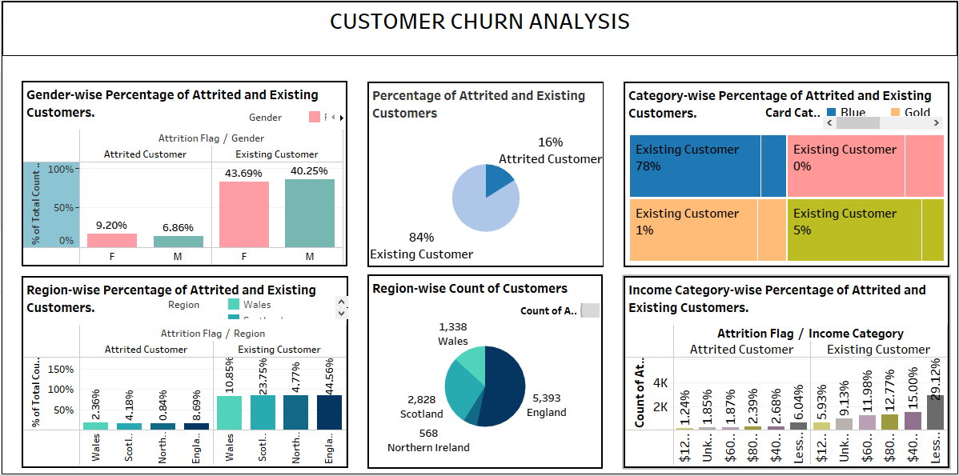
KPI DASHBOARD

Slide 9
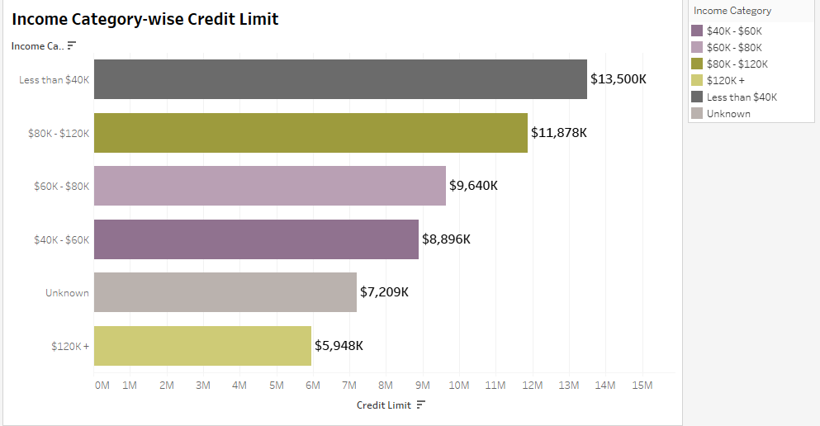
TASK 7
Interpretation;
This chart represents the income category wise credit limit
The highest income category under $40K has the sum of the credit limit - $13,500K
The lowest income category under $120k has the sum of the credit limit - $5948k

Slide 10
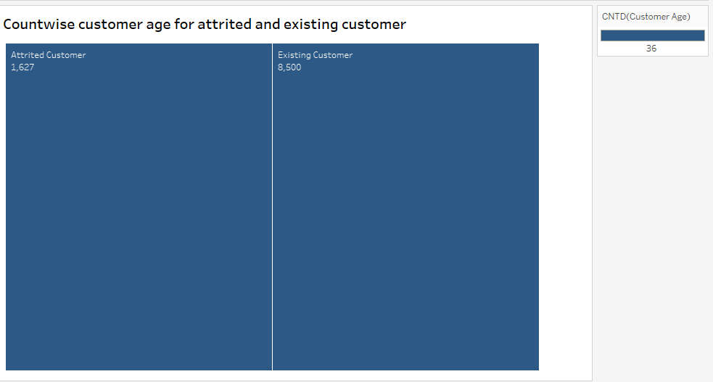
TASK 8
Interpretation:
This chart represents the count wise customer age for attrited and existing customer.
The highest contribution by existing customer for 8500.
The lowest contribution by attrited customer for 1627

Slide 11
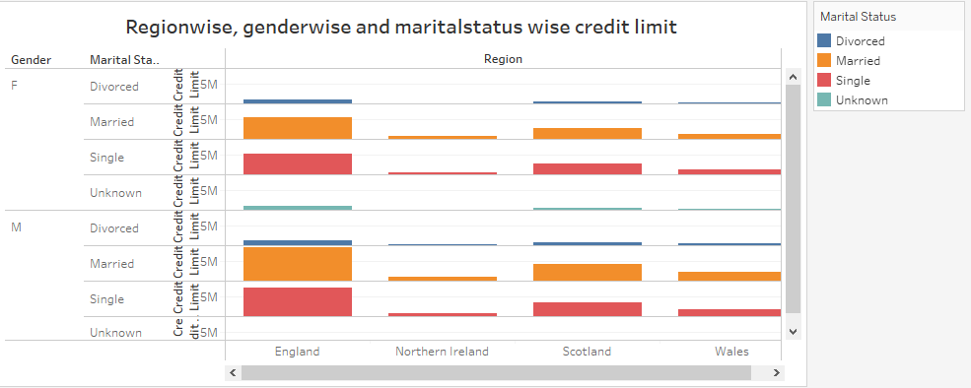
TASK 9
Interpretation:
This chart shows the region wise, genderwise and martial status wise credit limit
For both male and female highest limits for married,divorced, single and unknown in England
For both male and female lowest limits for married,divorced, single and unknown in England

Slide 12
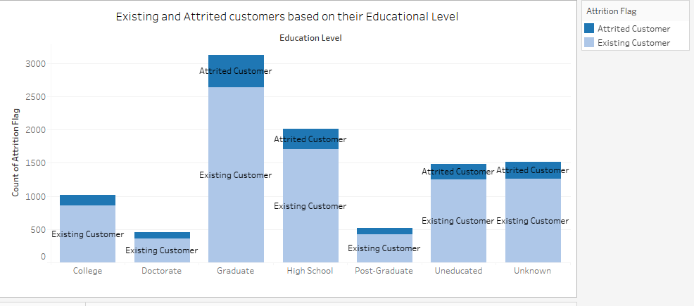
TASK 10
Interpretation:
This chart represents the Existing and Attrited customers based on their Educational Level
The highest education level was contributed by graduate
The lowest education level was contributed by doctorate

Slide 13
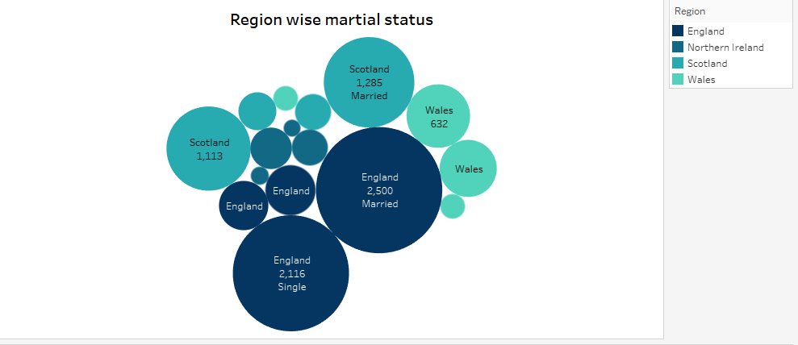
TASK 11
Interpretation:
This chart represents the regionwise martial status
The highest marital status was contributed by England for married
The lowest marital status was contributed by Northern ireland for unknown

Slide 14
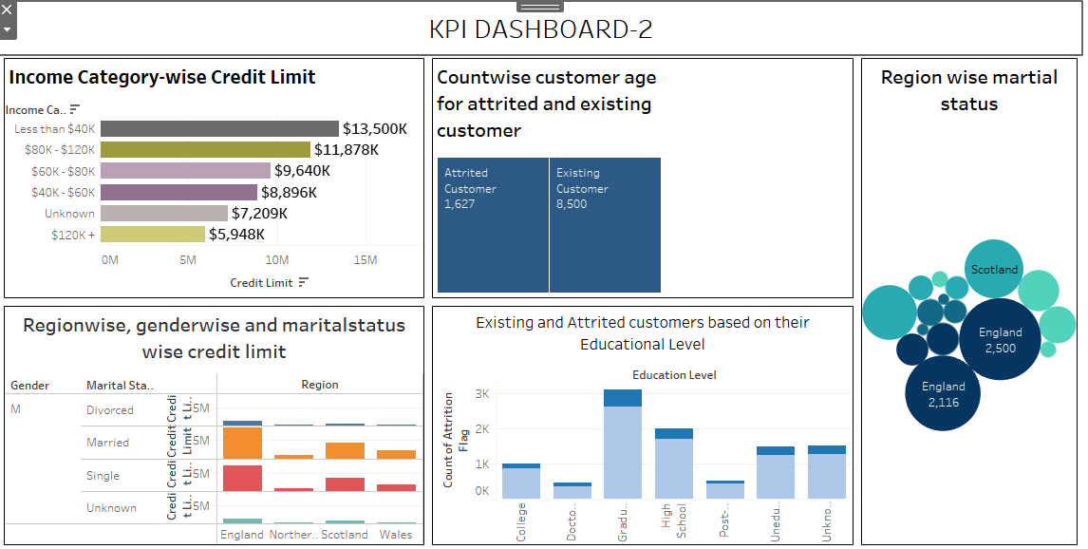
KPI DASHBOARD- 2

Slide 15
Conclusion
We have effectively analyzed customer churn data, producing actionable insights through visualization and an interactions dashboard, enabling informed strategies to reduce customer attention in the bank’s credit card business. The key findings are:
A person might churn/ churner if they are:
A female, from England or Wales
Having less than 3 years of relationship with the bank
Having a blue card
Having a balance of $2000-$2500
Earning less than 50k
Completed only graduation and
Married or single

Slide 16
Thank You

