Slide 1
TMDB MOVIE DATA ANALYSIS
Naguleshwari.S.R

Slide 2
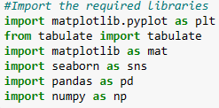
Understanding of data
Importing Libraries
Reading the data set

Slide 3
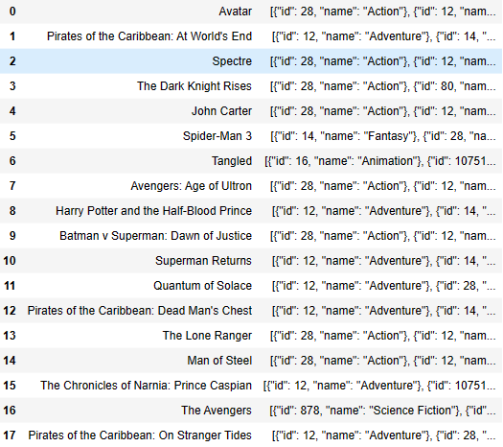
TASK 1
Interpretation:
counting number of rows colu﻿mns
Displaying the titles and geners of the first 50 movies from the provided data set

Slide 4
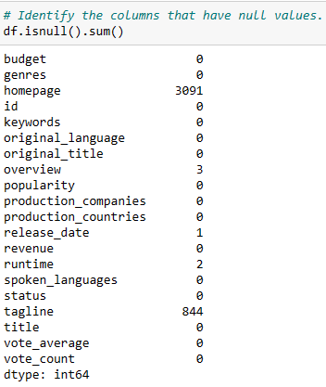
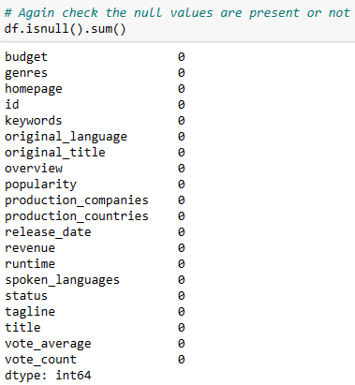

TASK 2
Interpretation:
first we have to check if thee is any null value.
due to the presence of null value , we have to replace it mode and again checked the null values. It shows that no null values after cleaning
similarly we have to do the same process for
tagline
overview
release_date
run_tme

Slide 5

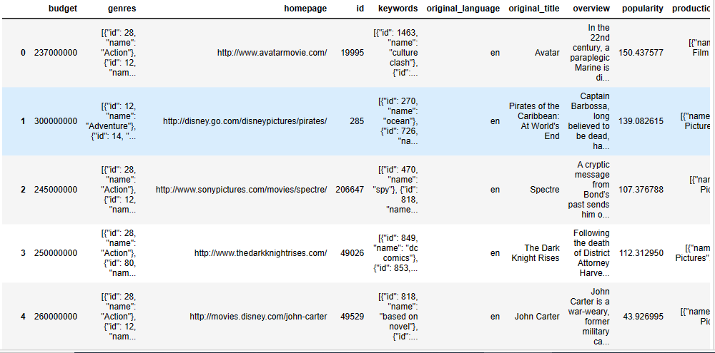
TASK 3
Interpretation:
Here we filtering the data as per the condition the budget should be greater than 220000

Slide 6

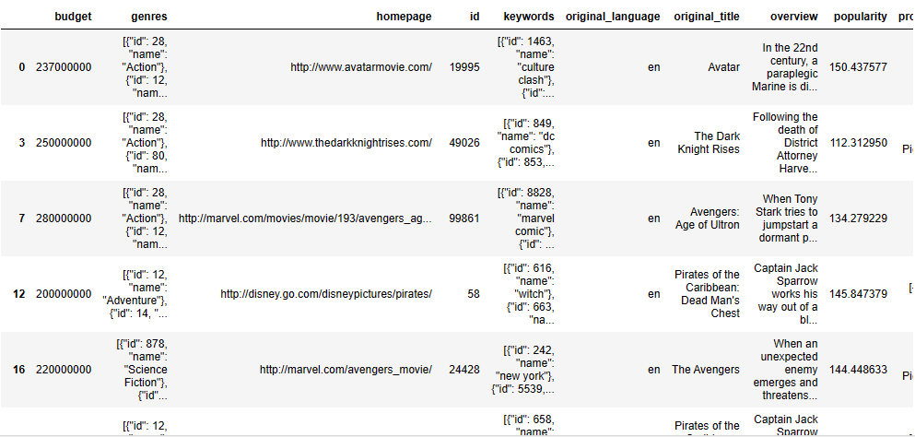
TASK 4
Interpretation:
Here we filtering the data as per the condition the revenue should be greater than 961000000

Slide 7
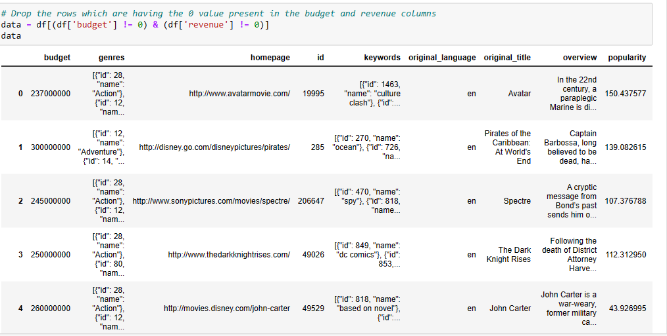
TASK 5
Interpretation:
Here we filtering the data as per the condition droping the data due to the value is 0 for budget and revenue

Slide 8
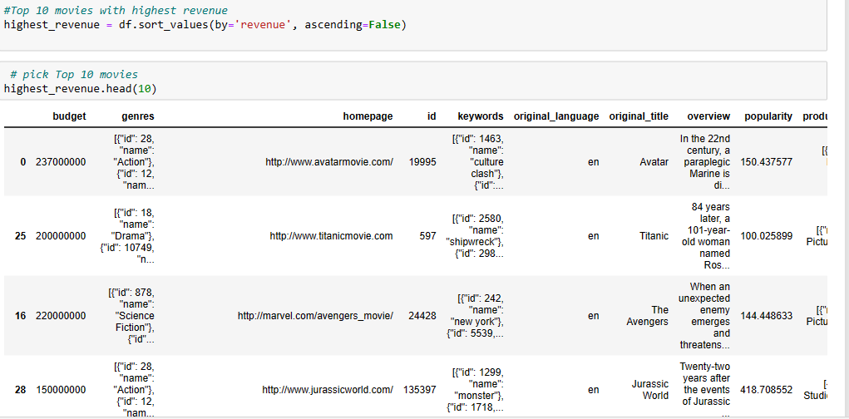
TASK 6
Interpretation:
Here we filtering the data as per the condition of fetching the top 10 movies with highest revenue

Slide 9
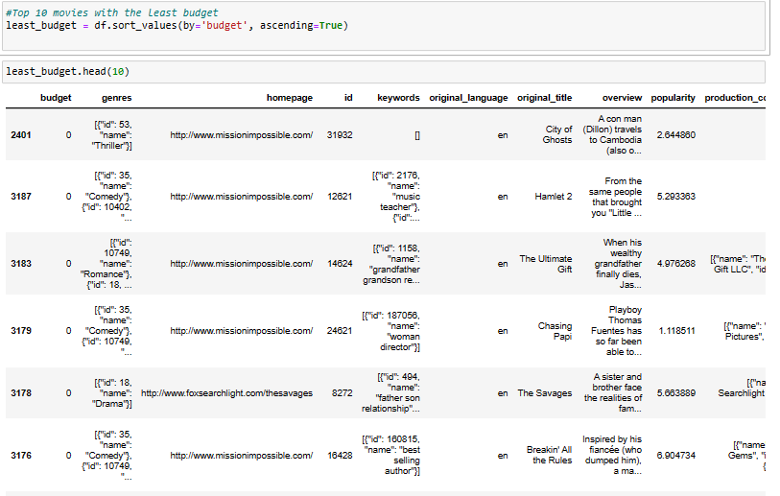
TASK 6(B)
Interpretation:
Here we filtering the data as per the condition of fetching the top 10 movies with least budget

Slide 10
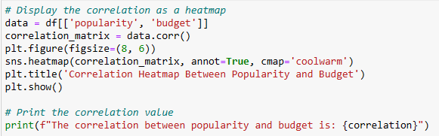
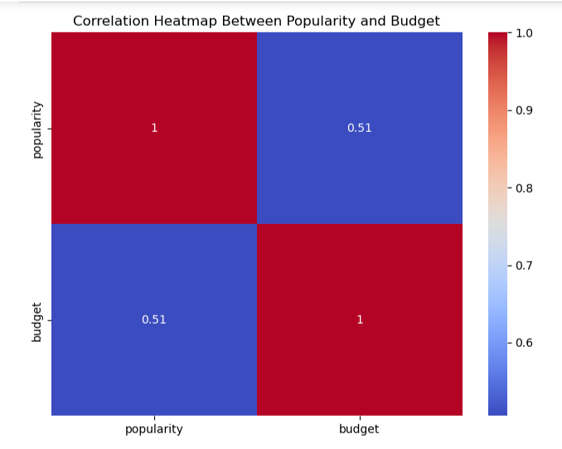
TASK 7
The correlation between popularity
and budget is 0.5054139990665322

Slide 11

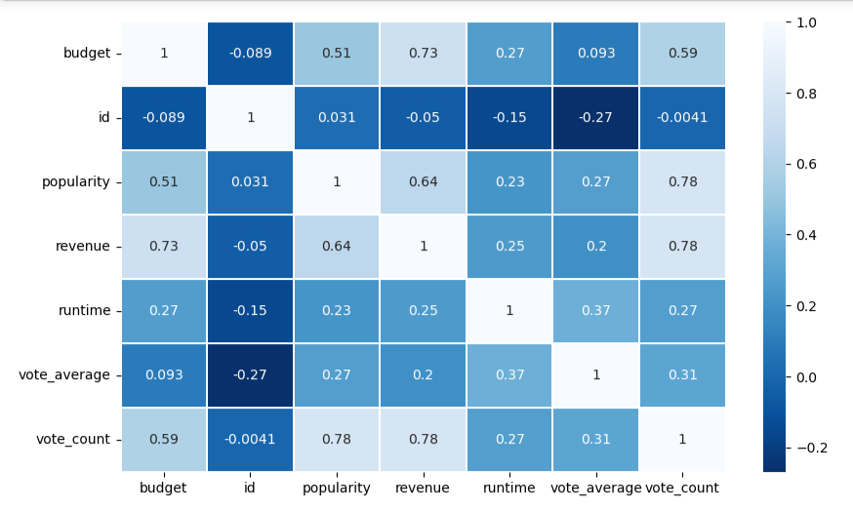
TASK 7(b)
Interpretation:
Here we displaying the correlation between popularity of movies and movie budget

Slide 12
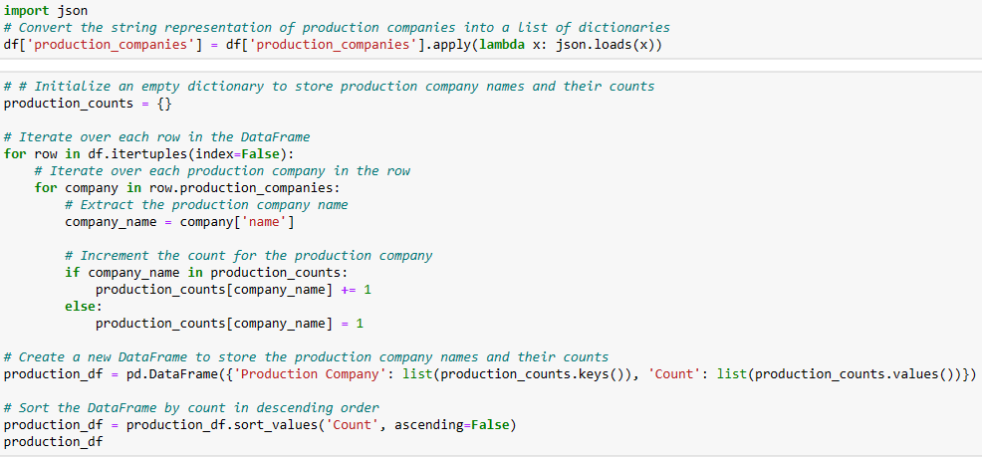
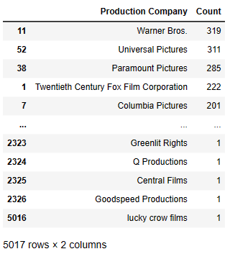
TASK 8
Interpretation:
there are 5017 rows and 2 columns for the names of the production companies along with the number of times they appear in data set

Slide 13
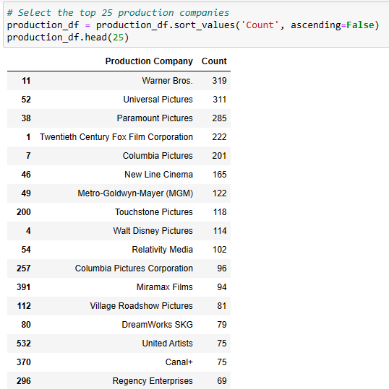
TASK 9
Interpretation:
here we have to display 25 production companies based on the number of movies they in descending order of the number of movies they produced

Slide 14
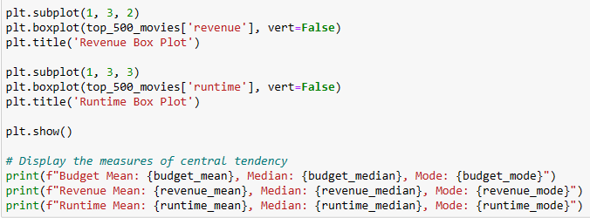
TASK 10

Slide 15
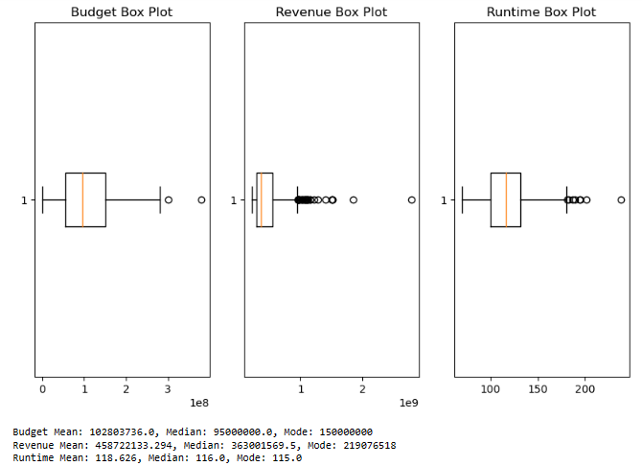
TASK 10(b)
Interpretation:
Here we sorting the data in descending order based on revenue and filter the top 500 movies.
displaying the central tendency for
budget
revenue
runtime

Slide 16
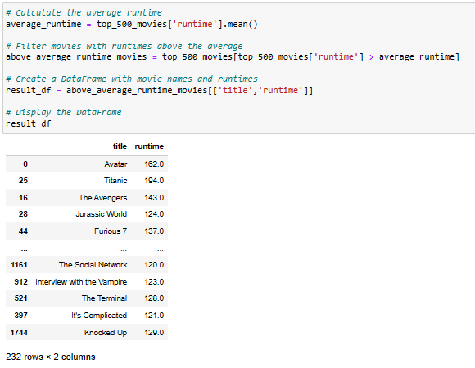
TASK 11
Interpretation:
Here we displaying the name of movies along with their runtime of the movies that has above the average runtime

Slide 17
Conclusion
This is to emphasize the significance enhancing overall business performance.​
By leveraging the insights gathered from the data analysis, all can make informed decisions, optimize operational processes, and improve customer satisfaction. ​
It will serve as a vital tool for tracking progress, setting targets, and ensuring that the business remains agile and responsive to evolving market dynamics.

Slide 18
THANK YOU

