Slide 1
OBE Implementation
PROGRAM LEVEL OBJECTIVE SETTING
SUBMITTED BY:
Thalakola Nikhil Sireesh (AP22110010009)
Shaik Mansoor Mujahid (AP22110010019)
Shaik Nagur Meeravalli (AP22110010061)
Ram Gopal Mukhamatam (AP22110010063)

Slide 2
Introduction to Project
SRM University - AP is adopting OBE (Outcome Based Education). As part of this initiative, our team has been assigned the task of developing a Windows and Mobile Application using Java. The application supports CRUD (Create, Retrieve, Update, Delete) operations to manage and monitor OBE implementation data effectively.
Project Modules:
Various Modules available in the project are
1. Blooms Level setting 2. Program Level Objective Setting 3. University
4. Schools 5. Department 6. Programs
7. Courses 8. Course objective setting
9. Course Outcome Setting 10. Course Articulation matrix Setting
11. Course Utilization Setting 12. Course Reference Setting.

Slide 3
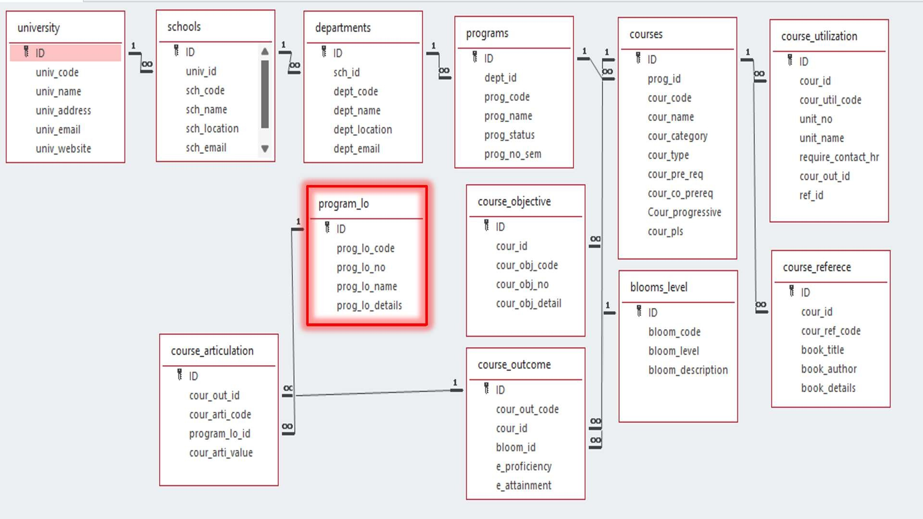
Architecture Diagram

Slide 4
Module Description : Program Level Objective (PLO) Setting Module
This module is designed to perform CRUD operations on Program Level Objectives. Users can create, edit, view, and delete program objectives using Windows. The data is stored in a relational database (e.g., SQLite/MySQL) for persistence.
Programming Details naming conventions to be used:
● class name/activity name: teamplo_program_level_objective_setting
● Function/method name:
○ Create: TeamPLO_plo_create()
○ Update: TeamPLO_plo_update()
○ Retrieve: TeamPLO_plo_retrieve()
○ Delete: TeamPLO_plo_delete()

Slide 5
Program Level Objective (PLO) Setting Module :Field/table details
Field Name | Data Type
ID | Integer
prog_lo_code | String
prog_lo_no | String
prog_lo_name | String
prog_lo_details | String

Slide 6
University Setting:Programming Details
File name: : teamplo_program_level_objective_setting
Function/method name
○ Create: TeamPLO_plo_create()
○ Update: TeamPLO_plo_update()
○ Retrieve: TeamPLO_plo_retrieve()
○ Delete: TeamPLO_plo_delete()

Slide 7
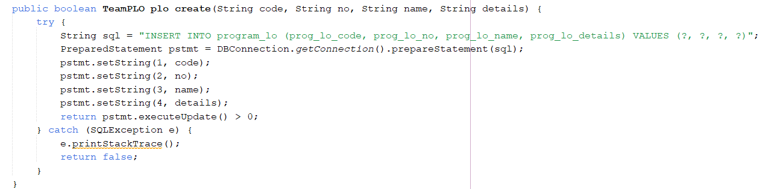
Source Code CREATE:

Slide 8
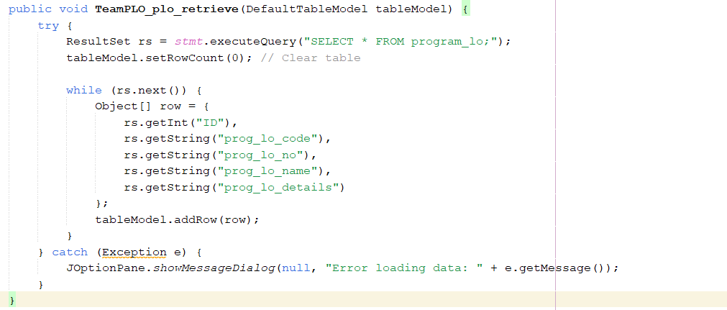
Source Code RETRIEVE:

Slide 9
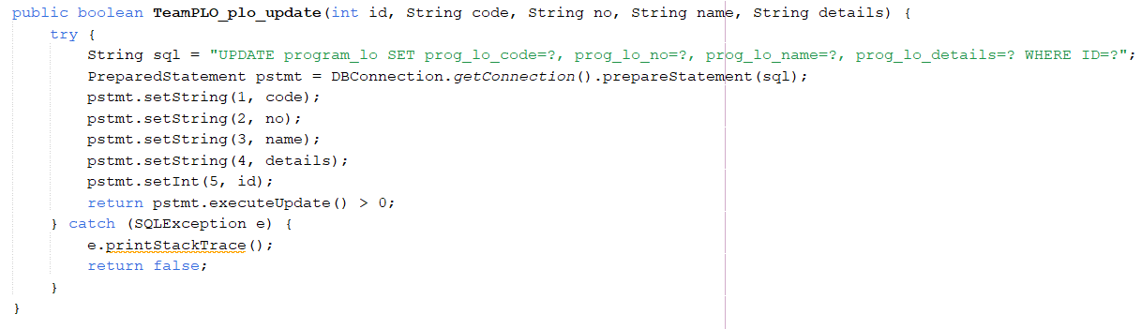
Source Code UPDATE:

Slide 10
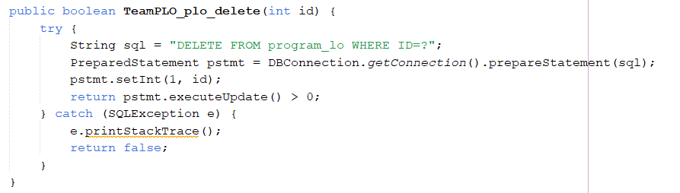
Source Code DELETE:

Slide 11
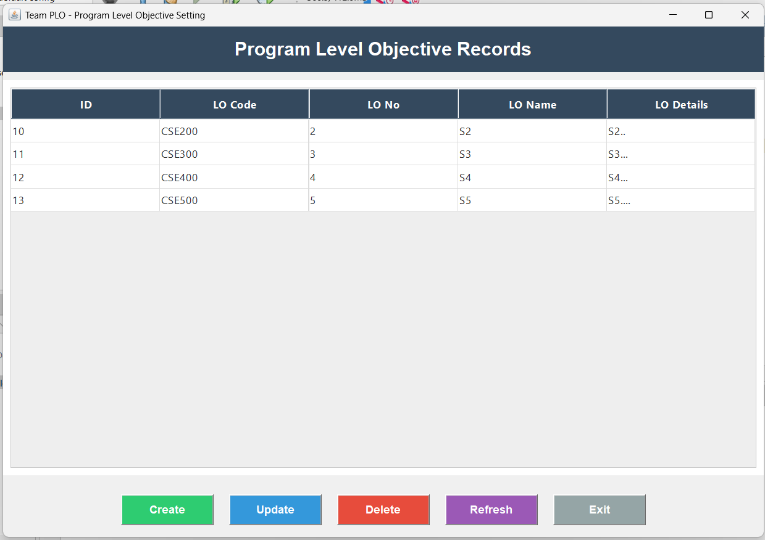
SCREEN SHOTS RETRIEVE:

Slide 12
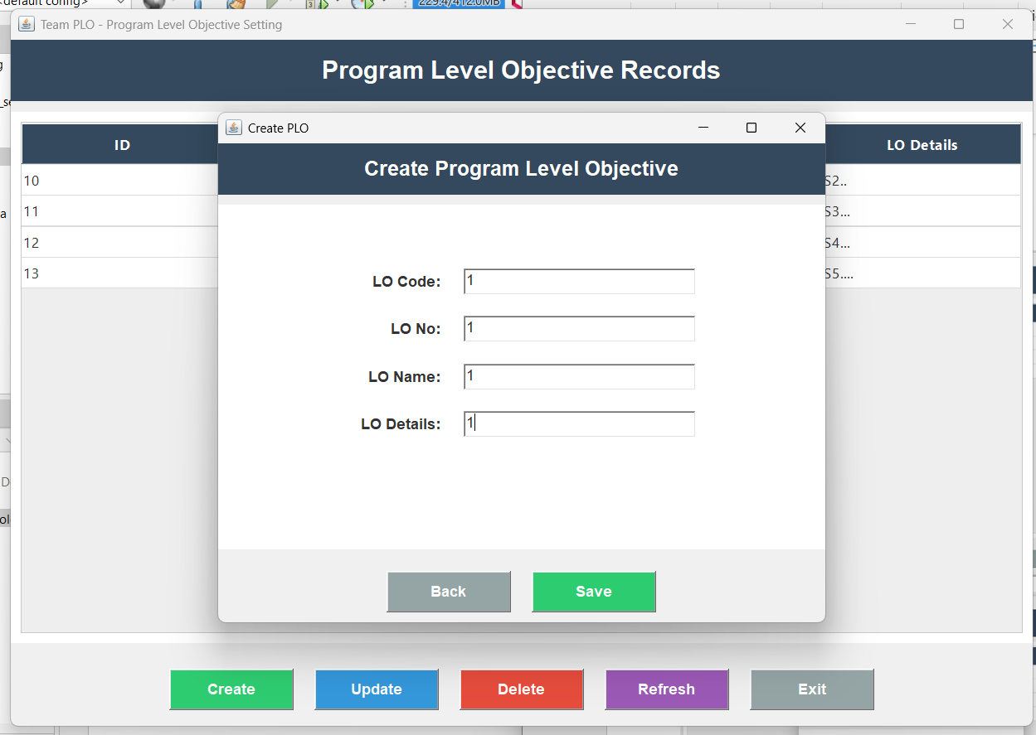
SCREEN SHOTS CREATE:

Slide 13
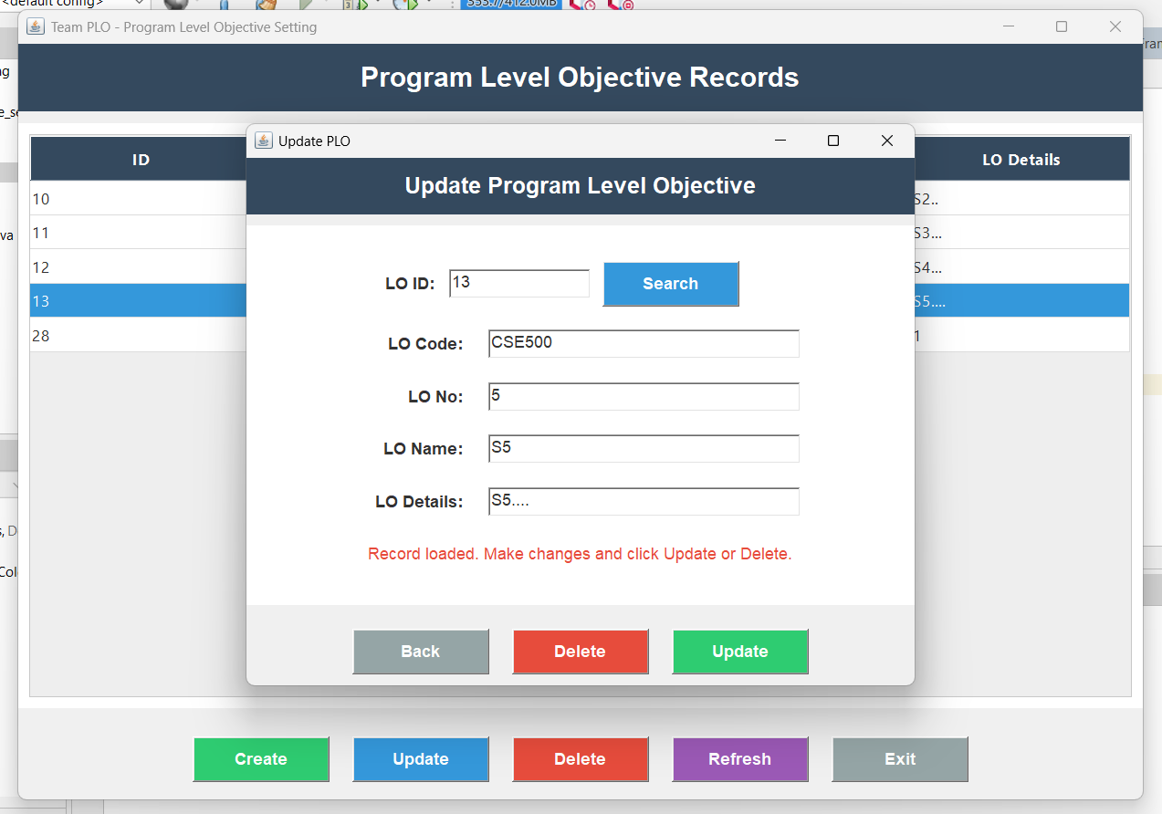
SCREEN SHOTS UPDATE:

Slide 14
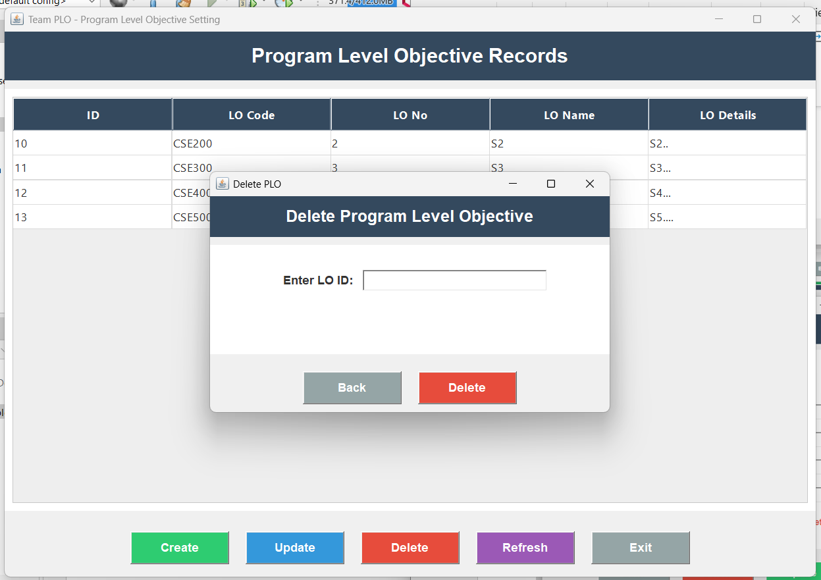
SCREEN SHOTS DELETE:

Slide 15
Conclusion
The Program Level Objective Setting module provides a simple and effective way to manage program objectives using Java and SQLite. It supports all basic CRUD operations and helps in organizing OBE-related data efficiently. This project enhanced our understanding of Java GUI development and database handling, contributing to the OBE initiative at SRM University

Slide 16
Thank You

