Slide 1
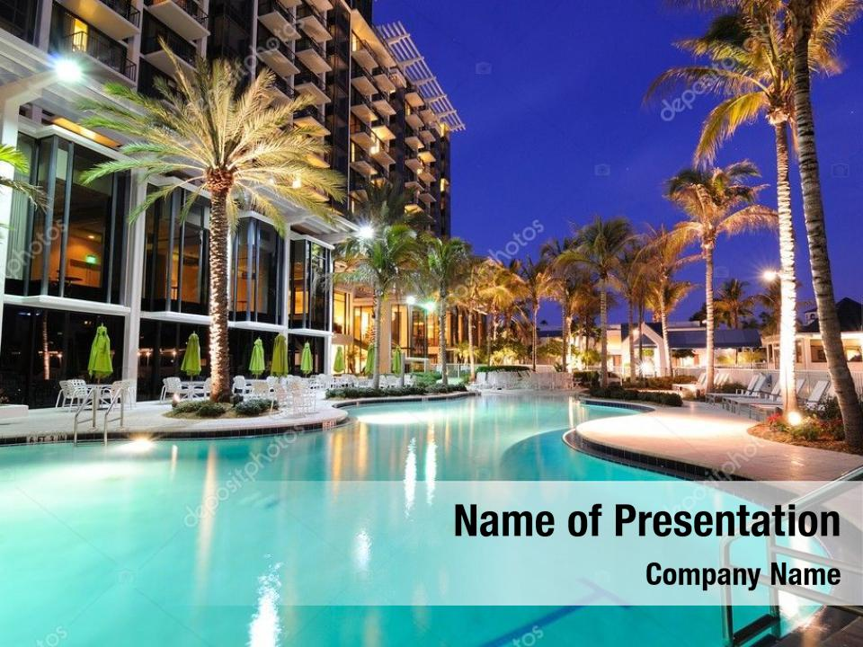
HOTEL RESERVATION ANALYSIS
SQL
MENTORNESS
MIP-DA-04Batch
By: Trapti Nagwanshi

Slide 2
Presentation Overview
Introduction
Data Collection
Data Management in SQL
Diagram
Source Code using PostgreSQL
Result
Recommendations
Thank You

Slide 3
Introduction:
Objective: This presentation is dedicated to an in-depth examination of hotel reservation data analysis. Through meticulous exploration of trends and guest behaviours, the aim is to uncover valuable insights to drive the hotel's strategic endeavors forward.
Scope: Following thorough analysis of the dataset, insights have been extracted to address the specified query, contributing to a deeper understanding of relevant patterns and dynamics.

Slide 4
Data Collection:
Data Origin: The analysis is grounded in a dataset sourced from MentorNess, publicly available in CSV format on Google Drive. This approach ensures the transparency and reproducibility of the findings.
Criteria for Inclusion: The dataset was selected due to its comprehensive nature and relevance, offering a solid foundation for exploring reservation trends and guest preferences in detail.

Slide 5
Data Management in SQL
Database Environment: Utilizing PostgreSQL 16 and the intuitive interface of pgAdmin4, I imported the prepared dataset into a structured SQL environment.
Schema Design: I crafted a schema that mirrors the complexities of hotel operations, encompassing tables for reservations, market segments, distribution channels, and meals, complete with relational integrity through primary and foreign keys.
Data Transformation: The SQL queries not only organized the data but also transformed it into a CSV file within PostgreSQL.

Slide 6
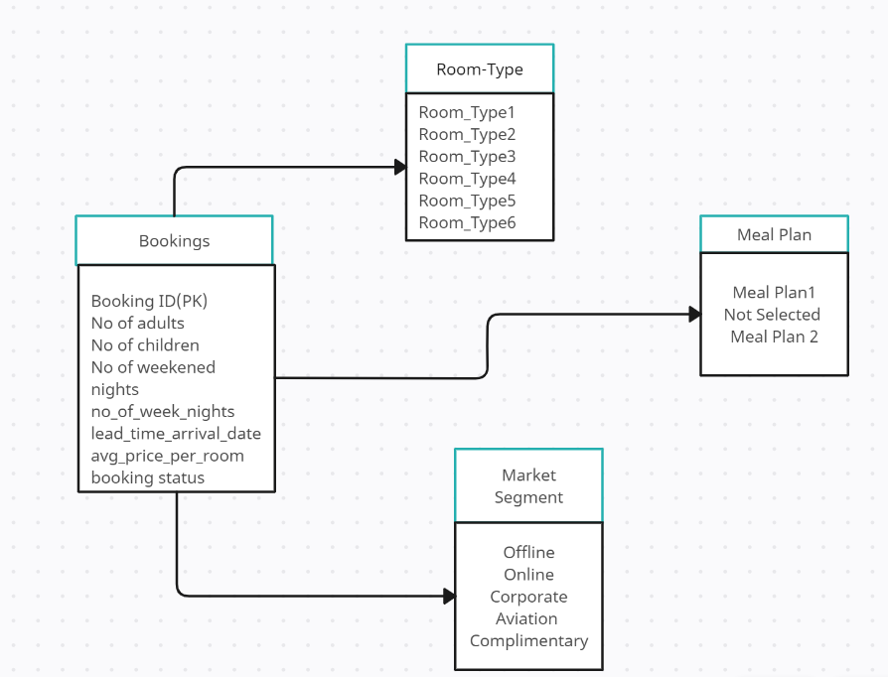
Diagram:

Slide 7
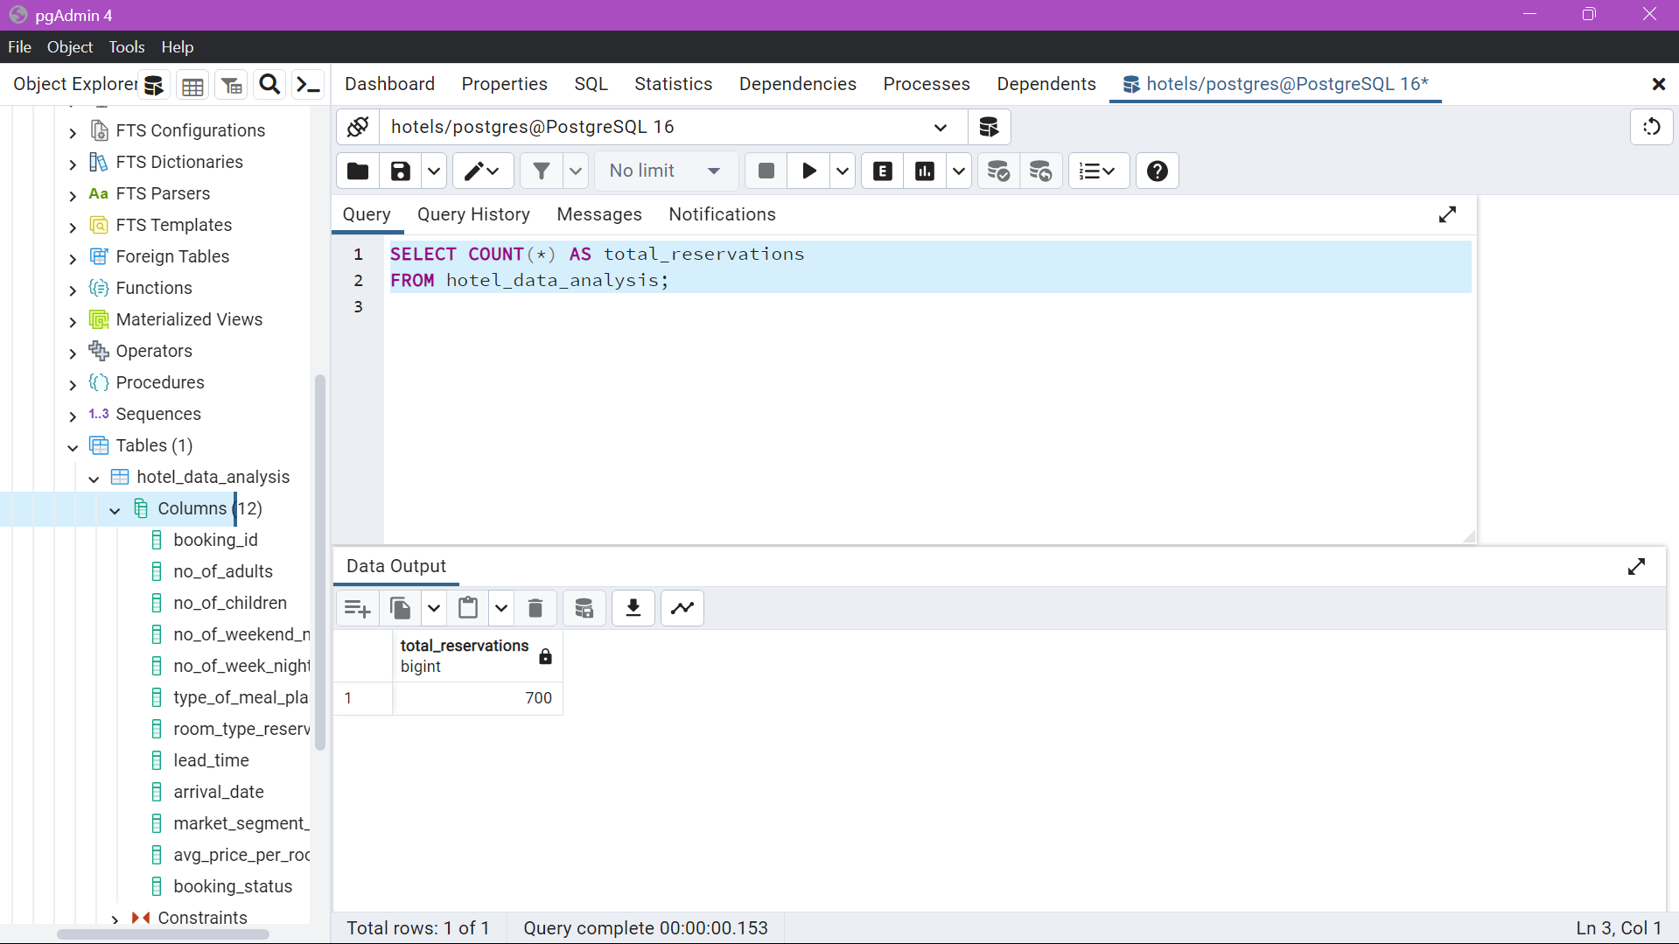
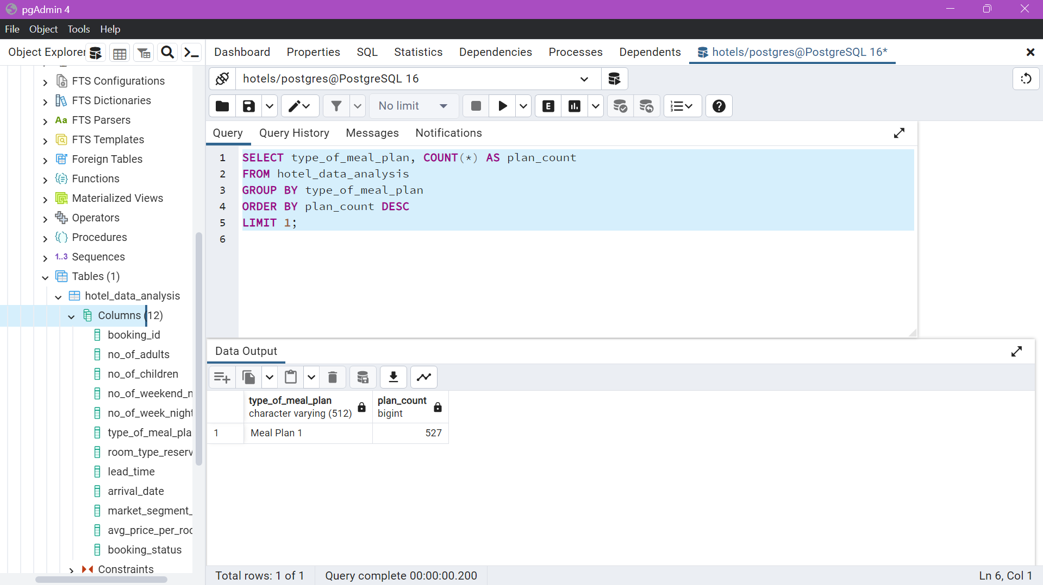
Source Code Using Postgre SQL
Total Reservation
Meal Plan

Slide 8
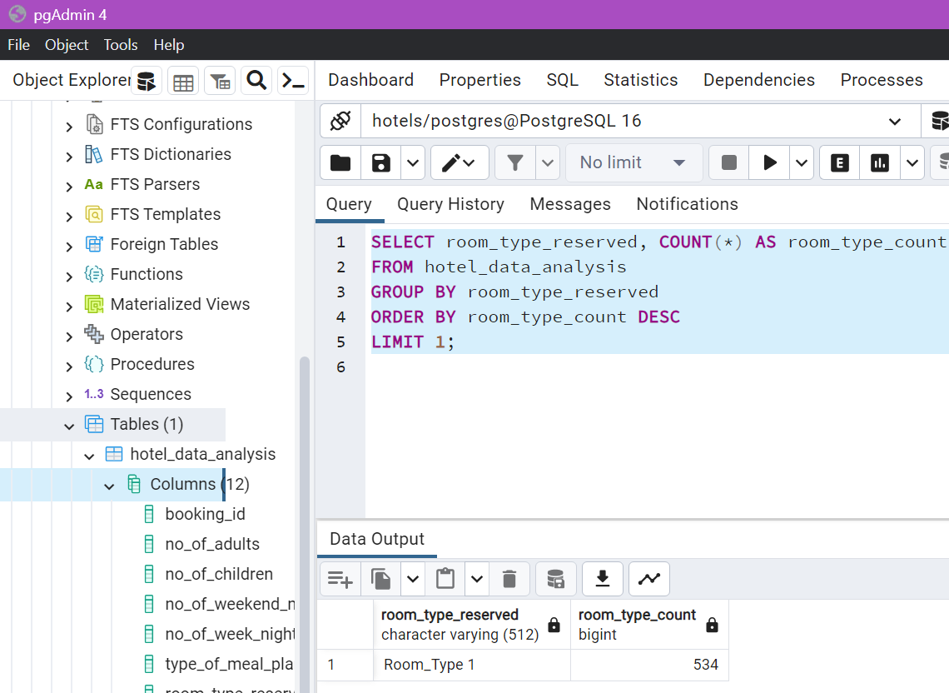
Source Code Using Postgre SQL
Common Room Reserved

Slide 9
Results
Detailed Hotel Reservation Analysis
Total Reservations: A robust figure of 700 bookings indicates strong market demand.
Meal Plan: Popular meal plan among guest is Meal Plan 1, with the highest count of 527.
Common Room Reserved: The most commonly used reserved room type is Room_Type 1 with the highest count of 534.

Slide 10
Recommendations
Enhance Direct Booking
Foster
Guest
Retention
Optimize Pricing
Strategies
Develop loyalty initiatives and provide exclusive deals to attract customers.
HOTEL RESERVATION
ANALYSIS
Implement Programs offering perks to returning guests.
Change prices based on demand using data from average daily rates.

Slide 11
Thank You……

