Slide 1
MOTIFS of size 3

Slide 2
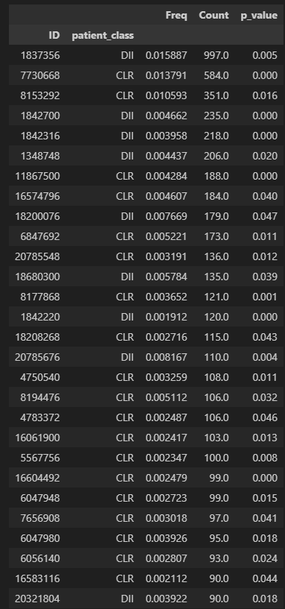
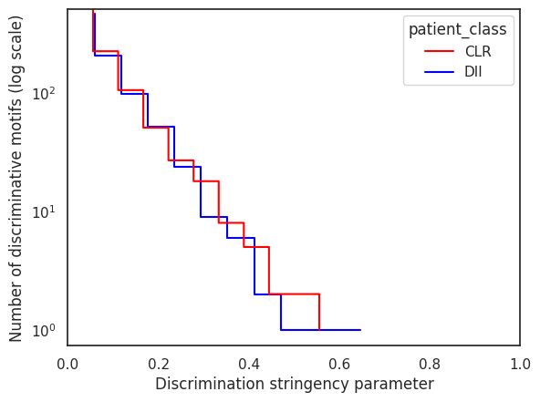
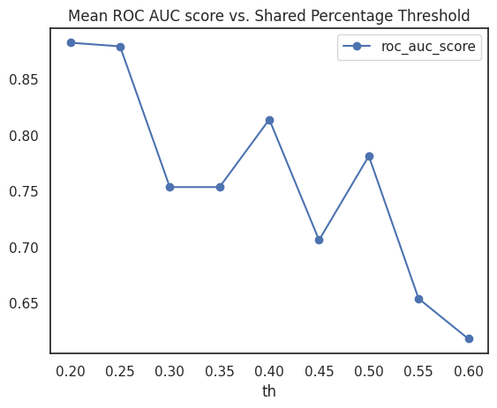
number of discriminative motifs vs stringency (size 3)

Slide 3
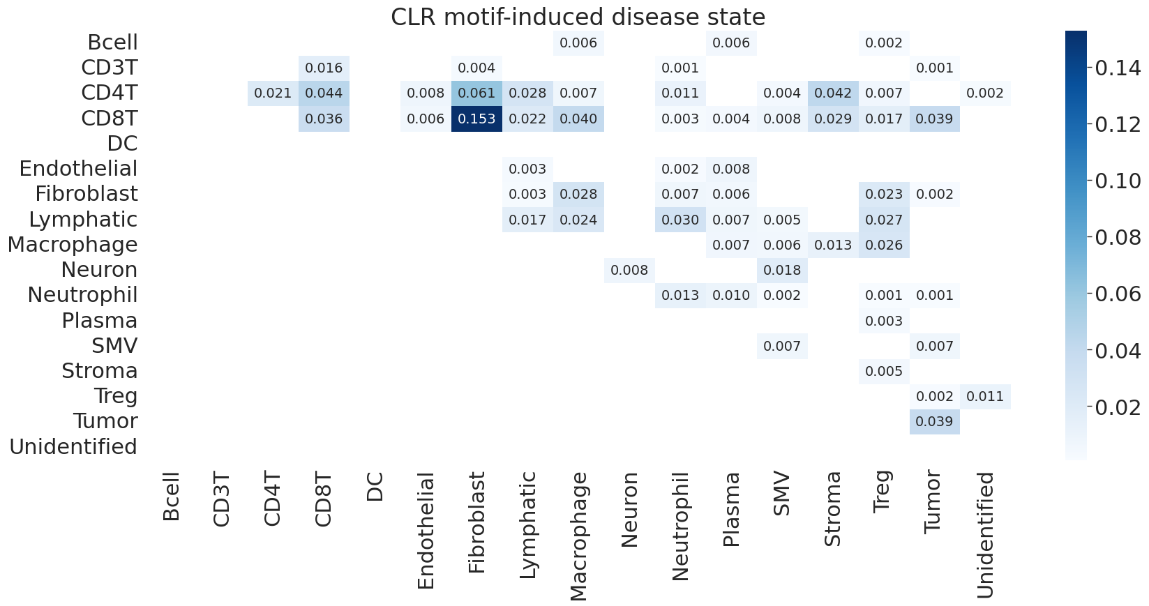
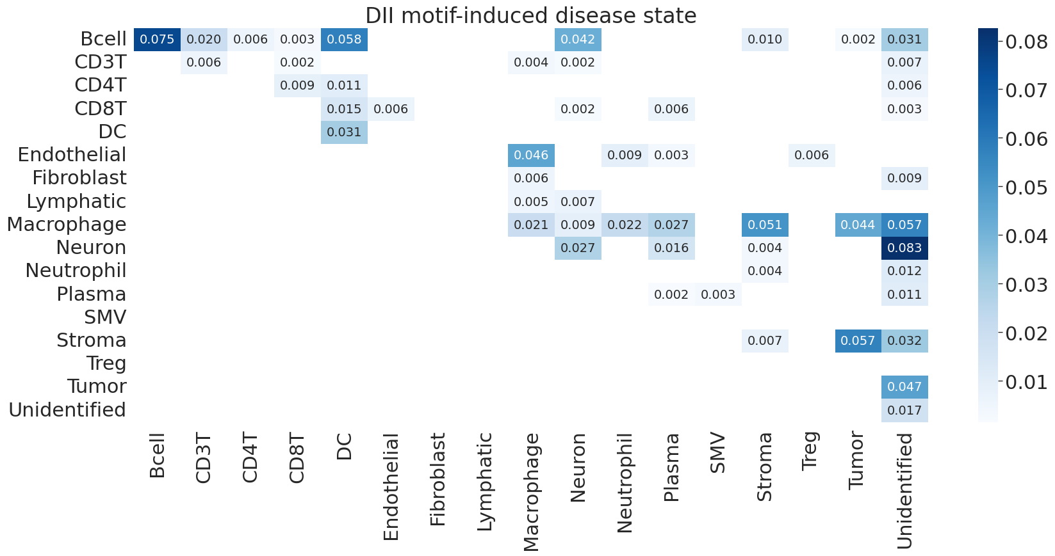

Slide 4
MOTIFS of size 4

Slide 5
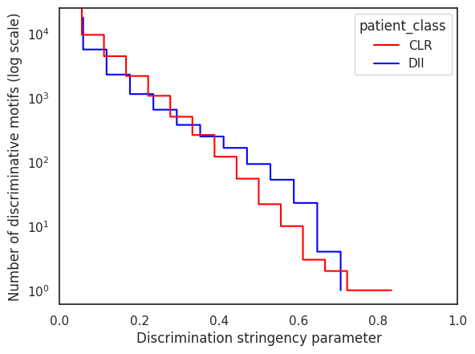
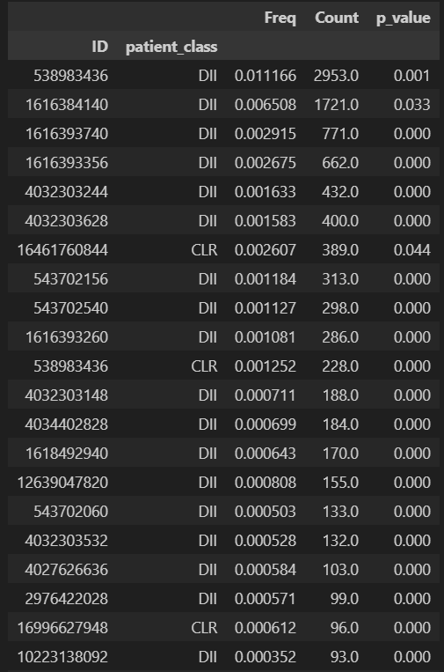
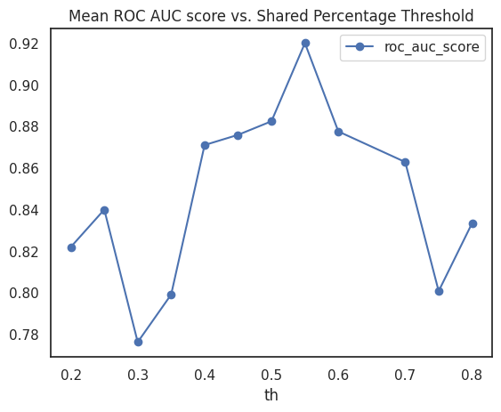
number of discriminative motifs vs stringency (size 4)

Slide 6
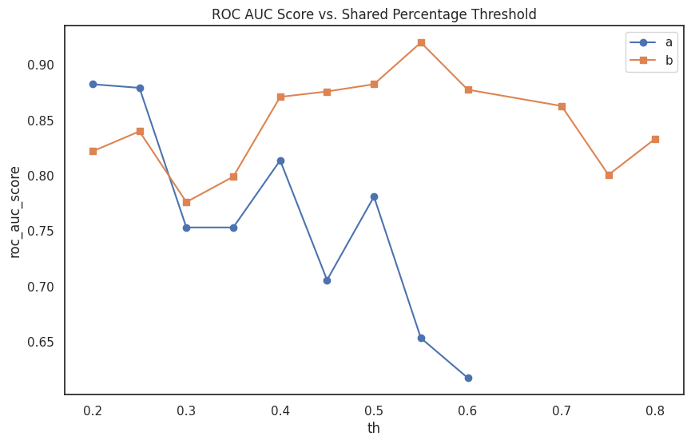

Slide 7
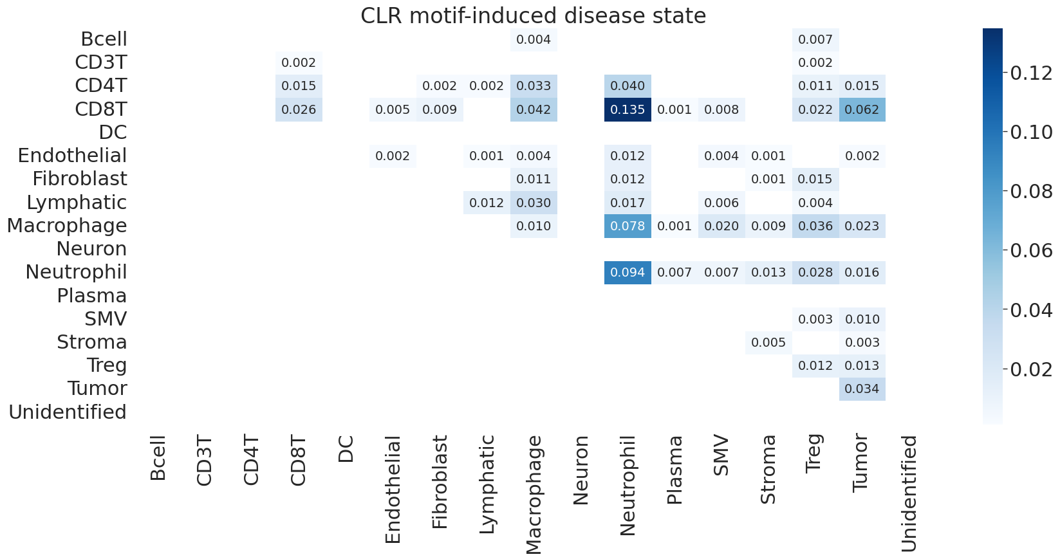
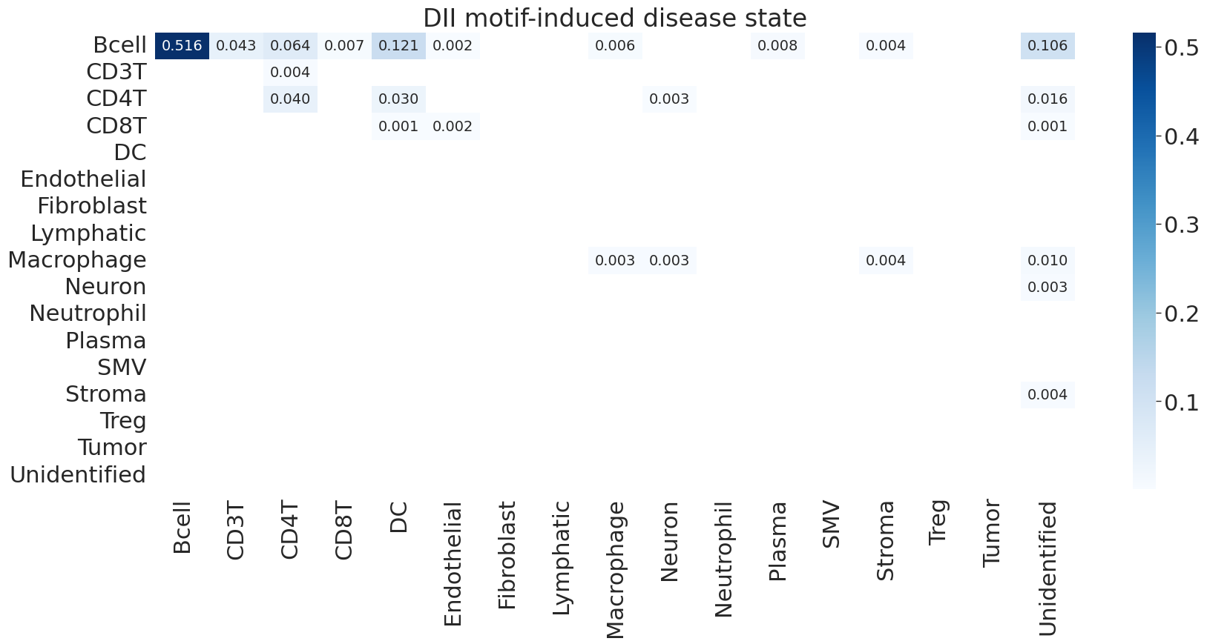

Slide 8
Pairwise and Singleton Analysis

Slide 9
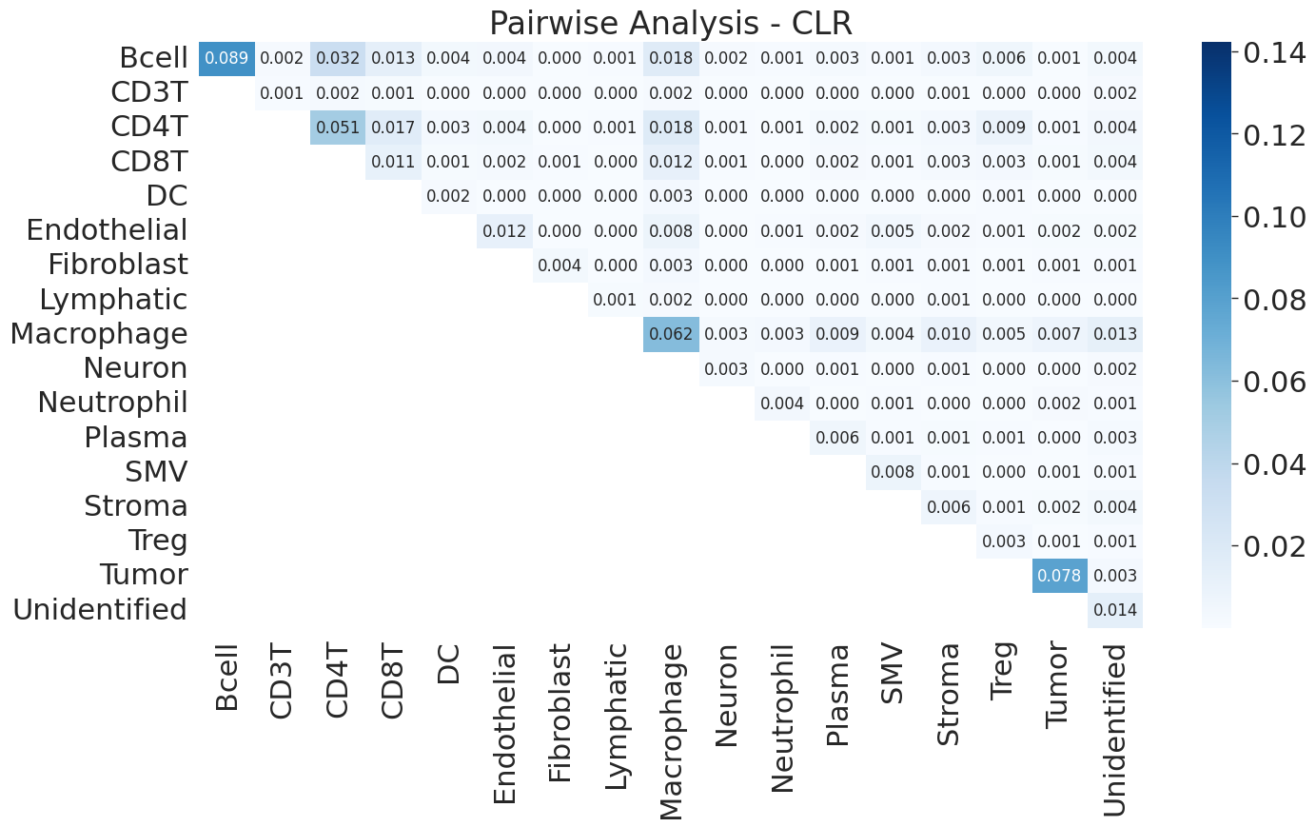
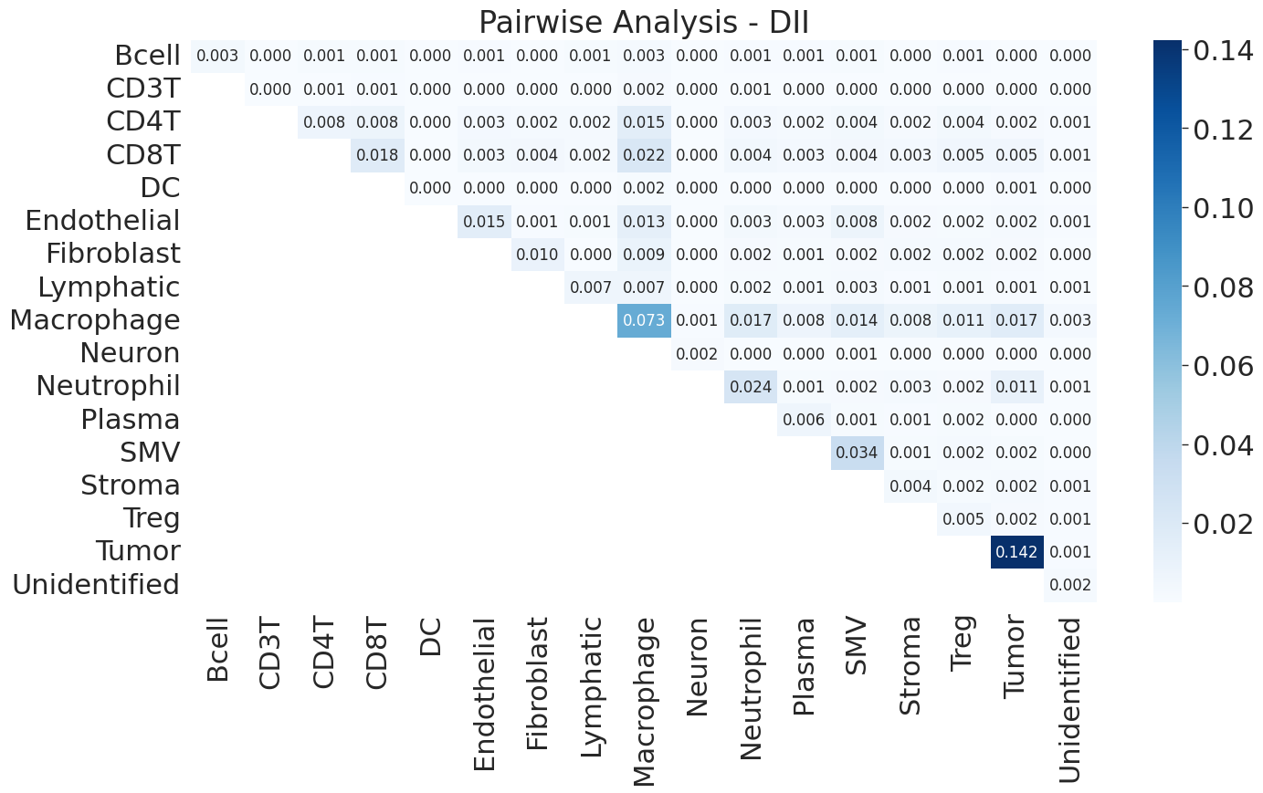
Pairwise

Slide 10
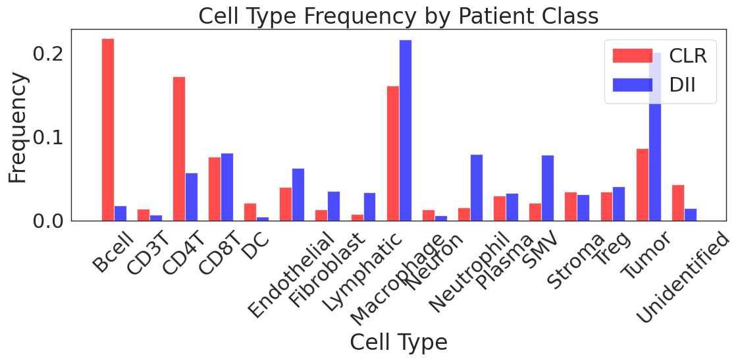
Singleton
Using Random forest with LOO
Accuracy = 0.857
Roc_auc = 0.858
Patient number 12 has close to 0.25 of her cells unidentified

Slide 11
Shuffled class labels

Slide 12
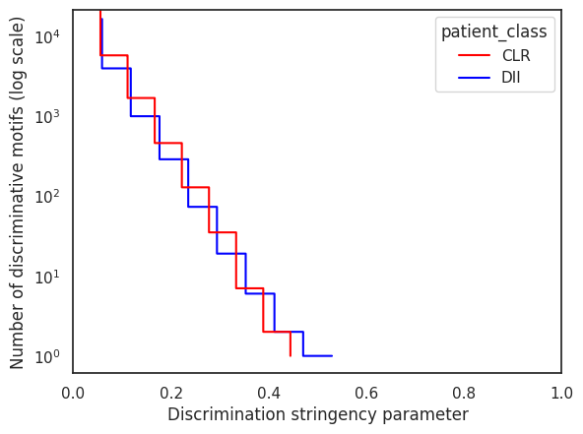
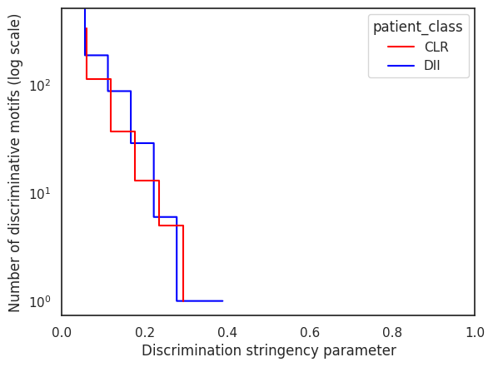
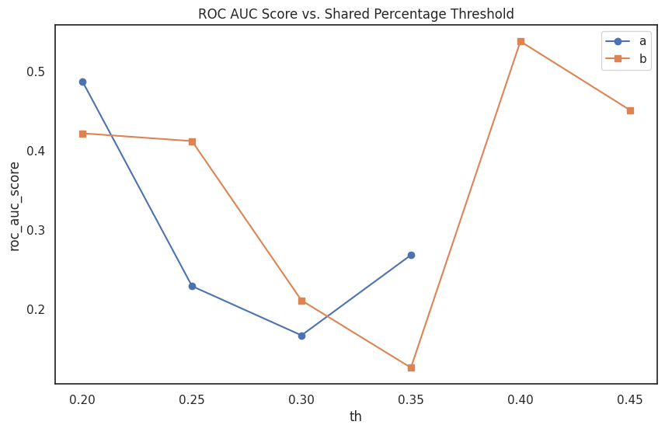
We can see way less motifs on size =4
We can see way less motifs on size =3
roc_auc < 0.5 – stringency gets cut off sooner
B – motifs of size 4 A- motifs of size 3

Slide 13
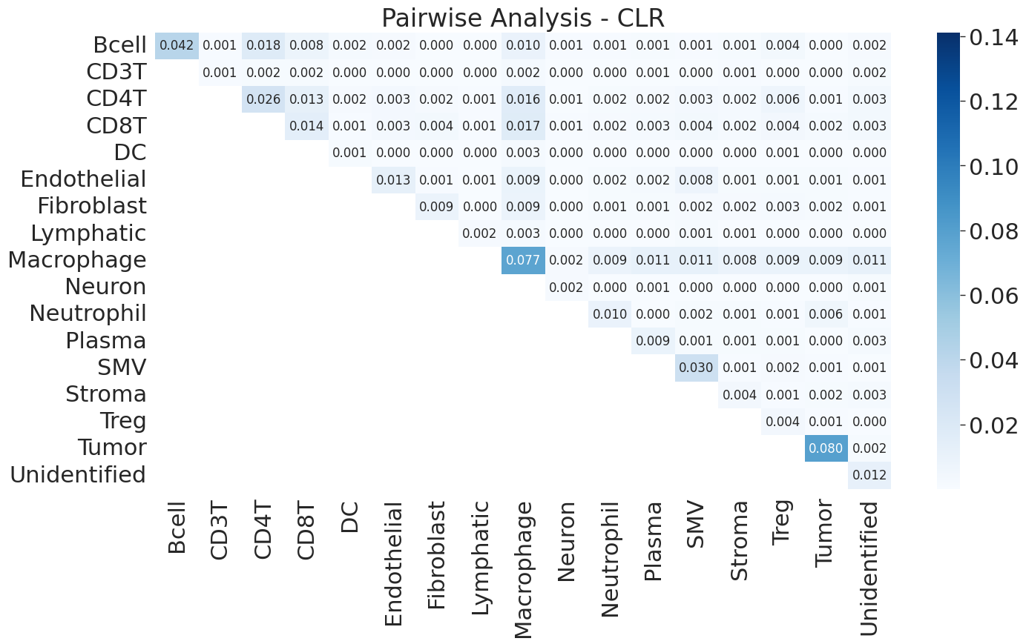
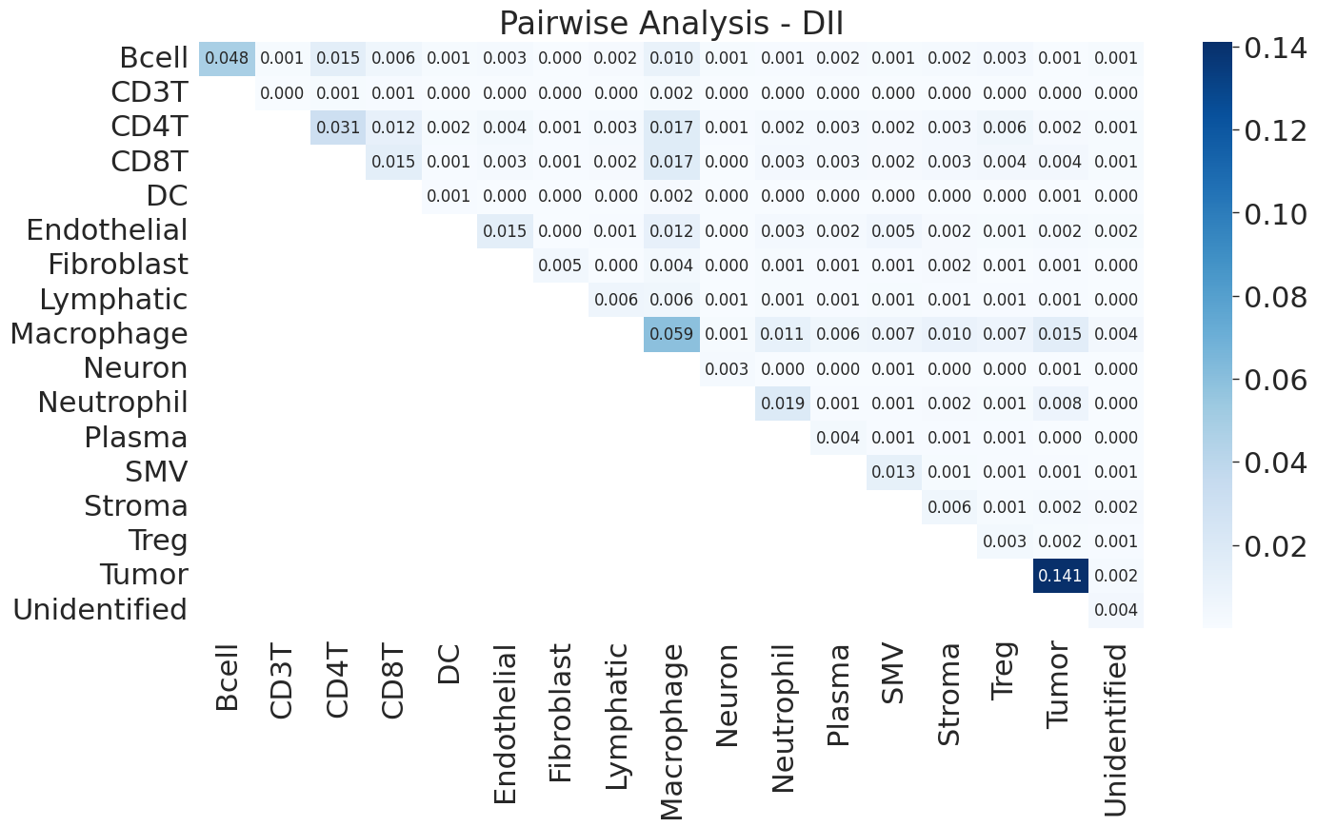
Pairwise analysis

Slide 14
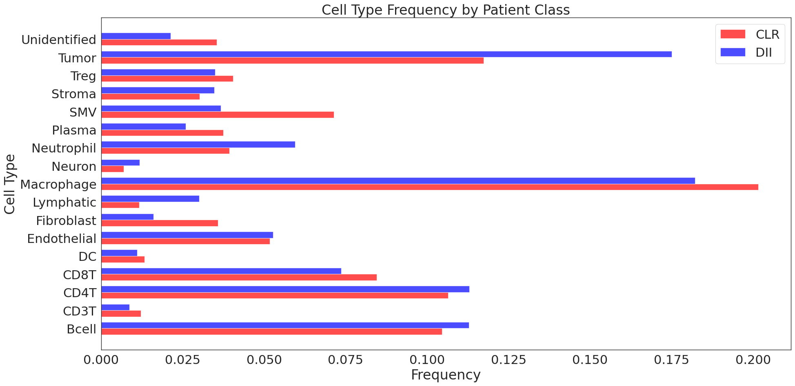

Shuffled singleton

