Slide 1
MA Economics, Data & Policy · CEU · May 2026
When Governments Say "Green" — Do Bond Markets Believe Them?
Supervisor: Zoltán Csaba Tóth
Climate speeches → Sovereign Green Bond Yields in Asian Emerging Markets
Short Answer: Speeches don't move prices
Gap: Prior studies use monthly data, monthly averages mask the contradictions
2,221
2
4 yrs
350K+
Panel Observations
6 Green-Conventional twin pairs
Countries
India · Indonesia
Daily data
2020 – 2024
News articles
GDELT V2Tone sentiment
Nahian Ibnat

Slide 2
THE QUESTION
02
Investors accept a yield discount on green bonds — if they trust the issuer's commitment
Green bonds = sovereign loans pledged to green projects
The Paradox
Greenium = yield discount investors accept for the green label
YTMgreen − YTMconventional is the outcome
India & Indonesia are two of the world's largest coal users.
Yet both issue sovereign "green" bonds.
Finance Ministry: "We are committed to green energy" ↑
Energy Ministry: "Approved 10 new coal plants" ↓
Do investors price this contradiction?
Three Hypotheses:
H1: Sentiment → Greenium
H2: Signaling Noise → Greenium
H3: Policy event → structural shift
Political speech shifts the green yield spread
Contradictory signals affect investor trust
Inaugural issuance permanently shifts the greenium

Slide 3
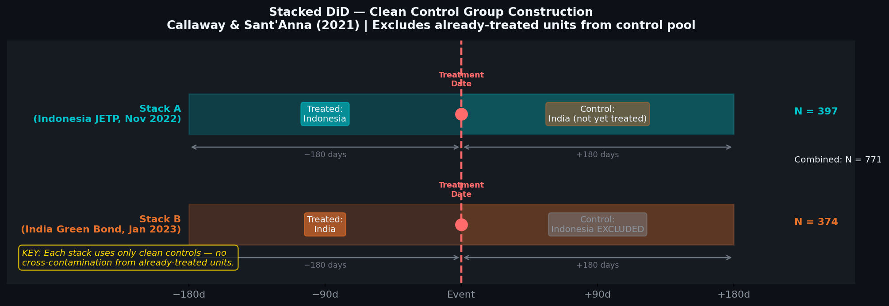
METHODOLOGY
03
Twin-bond design + Staggard DiD + Stacked DiD robustness
Twin-Bond Design
What is Stacked DiD doing?
same government · same coupon · same maturity
→ default & currency risk cancel out
India Treatment Event: Green Bond Auction Jan 2023
Indonesia Treatment Event: JETP G20 Nov 2022
Regression Model:
ΔGreenium = β₁·ΔSentiment + β₂·ΔNoise
+ β₃·Post + γ'·ΔControls + αᵢ + ε
Controls: VIX, CDS, FX
All regressors standardised (SD=1)

Slide 4
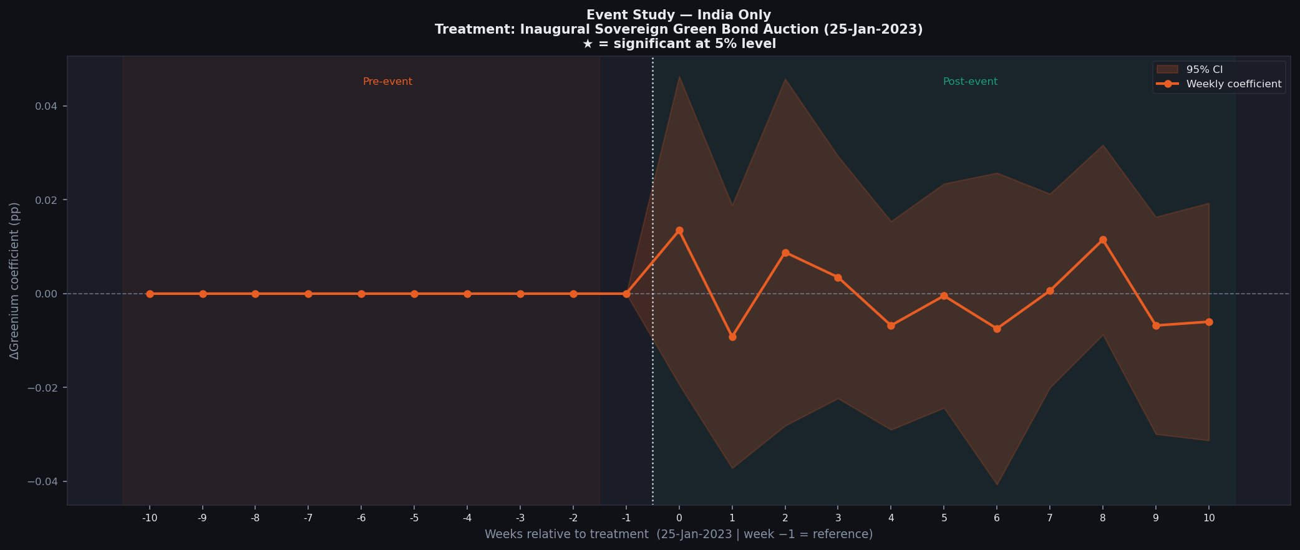
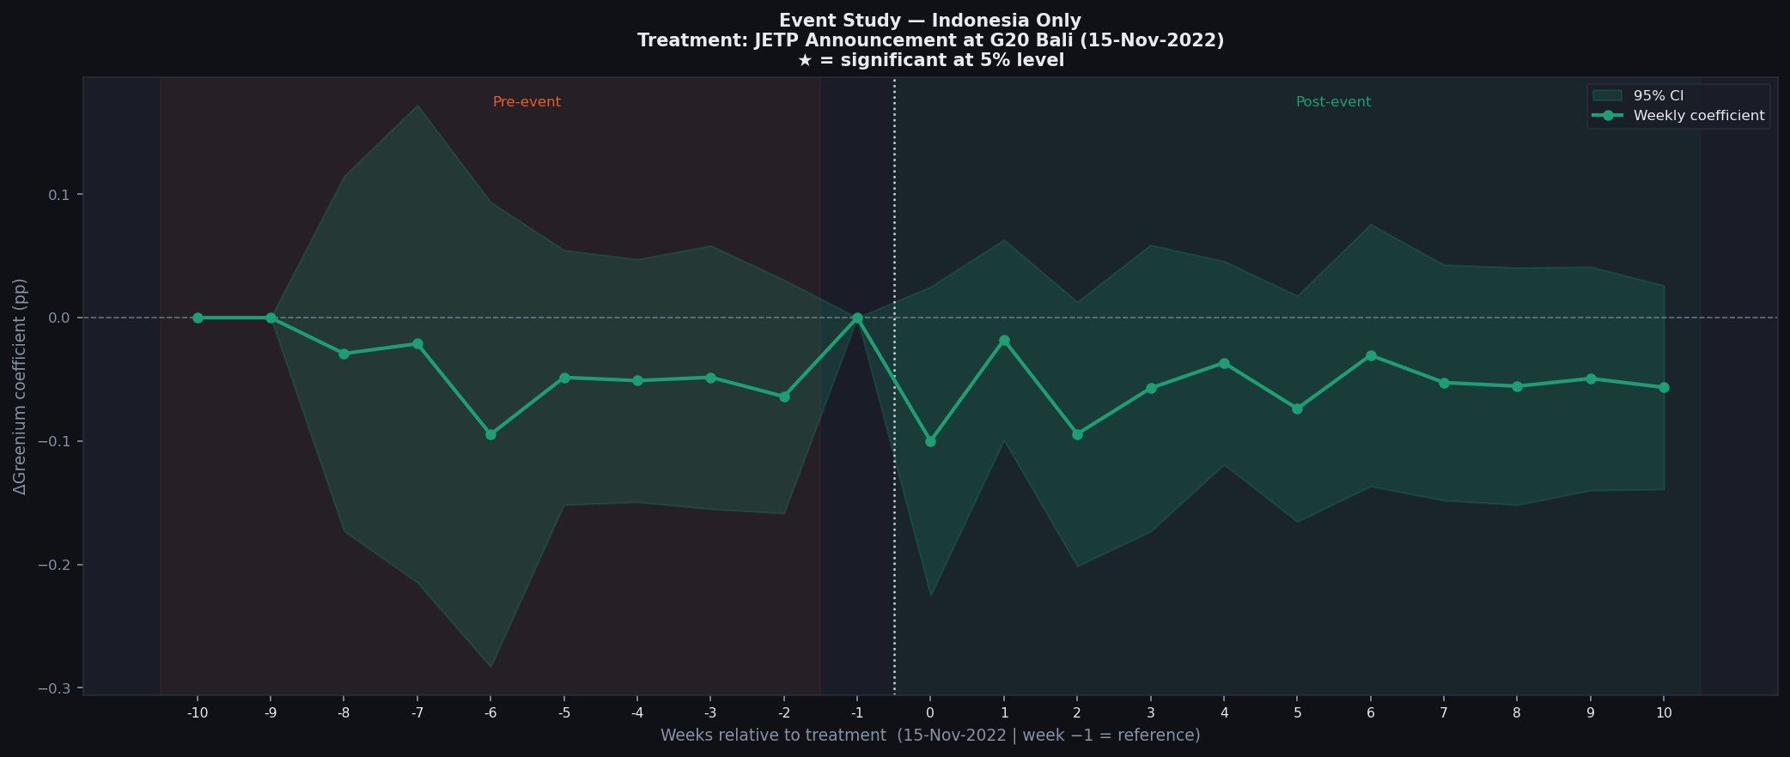
IDENTIFICATION VALIDITY
04
Parallel Trends — Event Study Validation
India ✓ Parallel Trends Satisfied
Indonesia ⚠ Pre-Trend Detected
Treatment: Inaugural Green Bond Auction — 25-Jan-2023
Treatment: JETP G20 Announcement — 15-Nov-2022
India: 0 of 9 pre-event weeks significant → DiD assumption satisfied
Indonesia: Pre-event drift driven by 2022 global rate cycle (Fed hikes) — affects both bonds identically
→ Stacked DiD (±180d windows, clean controls) is the methodological solution.

Slide 5
RESULTS
05
Speeches don't move bond prices -- global fear does.
H1 -- Sentiment
H2 -- Signaling Noise
H3 -- Policy Event
(politicians' speeches)
(contradictory signals)
(JETP / green auction)
NULL
WEAK / OPPOSITE SIGN
PARTLY SUPPORTED
b ~= +0.0002, p > 0.50
b = −0.0036, p < 0.089
b = -0.0295, p < 0.373
Political tone is noise: a full 1-SD sentiment swing shifts the greenium by ~0.02bp — economically zero
Mixed signals = no signal: 1-SD more noise narrows the greenium by ~0.36 bp toward zero
Switching from pre- to post-issuance permanently shifts the greenium level by
~2.95 bp

Slide 6
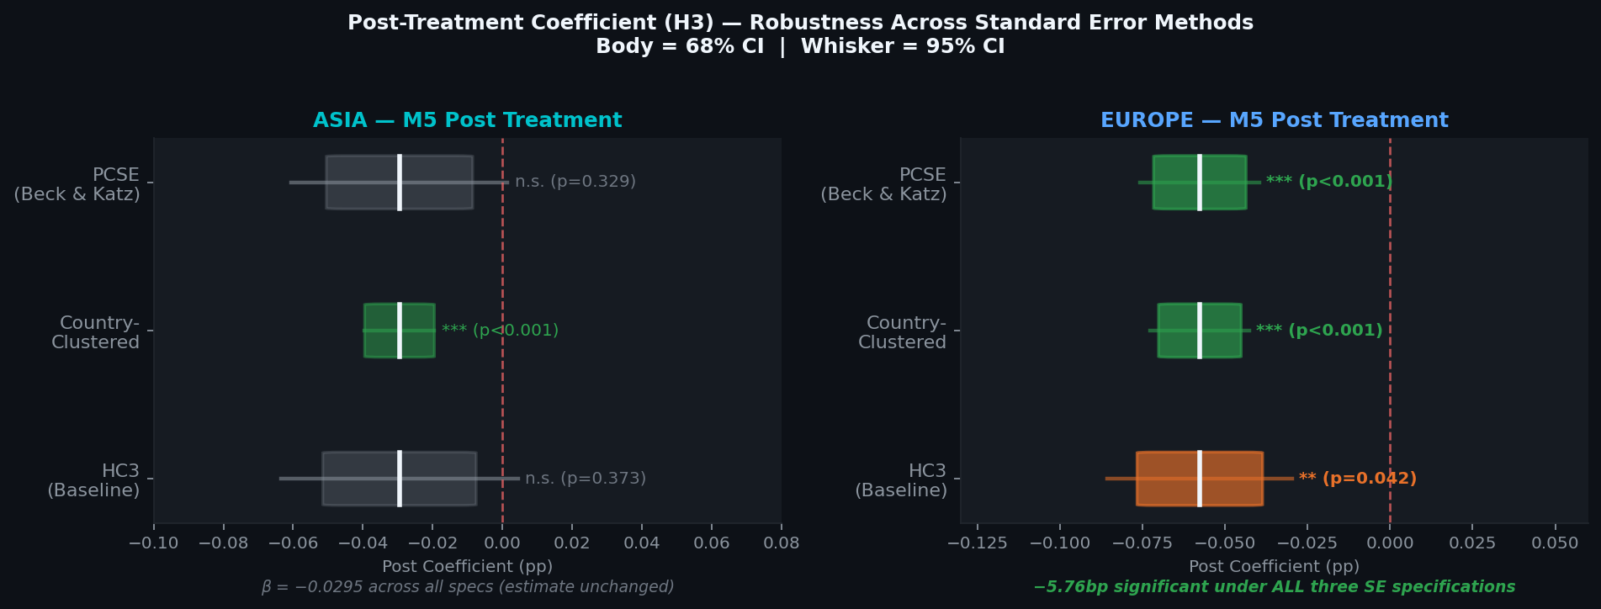
ROBUSTNESS
06
Standard Error Robustness
Asia Post (H3): β=−0.0295, n.s. under HC3 and PCSE, *** under cluster (country-level clustering inflates significance — treat with caution).
Europe Post (H3): β=−0.0576, ** HC3 · *** Cluster · *** PCSE → robust finding across all three specifications.

Slide 7
POLICY COMPARISON
07
What can Asia learn from Europe?
Asia — what we found
Policy lesson for India & Indonesia
Green bond prices do not respond to political speeches
1
Legally-Binding CapEx Transition Plans
Don't just promise to go green — publish a legally binding, audited timeline showing exactly when each coal plant closes.
Europe — for comparison
2
"Do No Significant Harm" Screening
When Germany committed to a PERMANENT annual green bond programme, investors responded — greenium compressed by 5.8bp. Speeches alone did nothing.
Certify that green bond money isn't funding projects that fix one environmental problem while creating another.
3
Independent Reviewer Registry
Make green bond auditors government-licensed and legally accountable — so investors trust the label, not just the promise.

Slide 8
CONCLUSION
08
Political Credibility is a Fiscal Variable
What gap does this fill?
High Frequency causal evidence on Greenium dynamics in Asian Emerging Markets
What did I do?
Compared green vs conventional bonds daily across 2 countries, 6 bond pairs (2020–2026). Used stacked DiD to handle multiple treatment dates. Tested three statistical methods to confirm results.
What did we find?
When governments say "green," markets don't listen. When they build institutions, markets do

Slide 9
APPENDIX A
All 8 Bond Pairs — Full Detail
Country | Green ISIN | Conv. ISIN | Currency | Treatment Date | Mean Greenium
India 10Y-orig | IN0020220144 | IN0020190362 | INR | 25-Jan-2023 | +13.8 bp
India 5Y-orig | IN0020230143 | IN072629G | INR | 25-Jan-2023 | −0.0 bp
India 10Y-new | IN072933G | IN072632G | INR | 25-Jan-2023 | −1.4 bp
India 5Y-new | IN071028G | IN071029G | INR | 25-Jan-2023 | −9.2 bp
Indonesia 10Y | US71567RAV87 | US455780DN36 | USD | 15-Nov-2022 | −5.5 bp
Indonesia 2033 | US71567RAY27 | US455780DR40 | USD | 15-Nov-2022 | +5.5 bp
Germany 10Y ★ | DE0001030708 | DE0001102507 | EUR | 2-Sep-2020 | −1.8 bp
Denmark 10Y ★ | DK0009924375 | DK0009924102 | DKK | 21-Jan-2022 | −2.7 bp
★ Strict twin-bond: identical coupon + maturity · Source: Refinitiv Eikon · Mean greenium over full sample period

Slide 10
APPENDIX B
Full Regression Table M1–M5
Variable | M1 | M2 | M3 | M4 | M5 Asia | M5 Europe
ΔSentiment (H1) | +0.0003 | +0.0002 | +0.0002 | +0.0002 | +0.0002 | +0.0002
ΔSignaling Noise (H2) | — | — | +0.0002 | +0.0003 | — | +0.0002
ΔNoise × ΔSentiment | — | — | — | +0.0018* | — | −0.0001
Δlog(VIX) | — | −0.0021* | −0.0021* | −0.0020* | −0.0022** | +0.0000
ΔCDS Spread | — | −0.0015 | −0.0015 | −0.0014 | −0.0017 | −0.0001
Δlog(FX Rate) | — | +0.0003 | +0.0003 | +0.0003 | +0.0002 | −0.0002
Post Treatment (H3) | — | — | — | — | −0.0295 | −0.0576**
N | 2,221 | 2,221 | 2,221 | 2,221 | 2,221 | 2,482
R² | 0.000 | 0.004 | 0.004 | 0.005 | 0.013 | 0.009
* p<0.10 ** p<0.05 *** p<0.01 | HC3 robust SE | First-differenced within pair | Pair FE: M1–M5 | Monthly time FE: M5 only

Slide 11
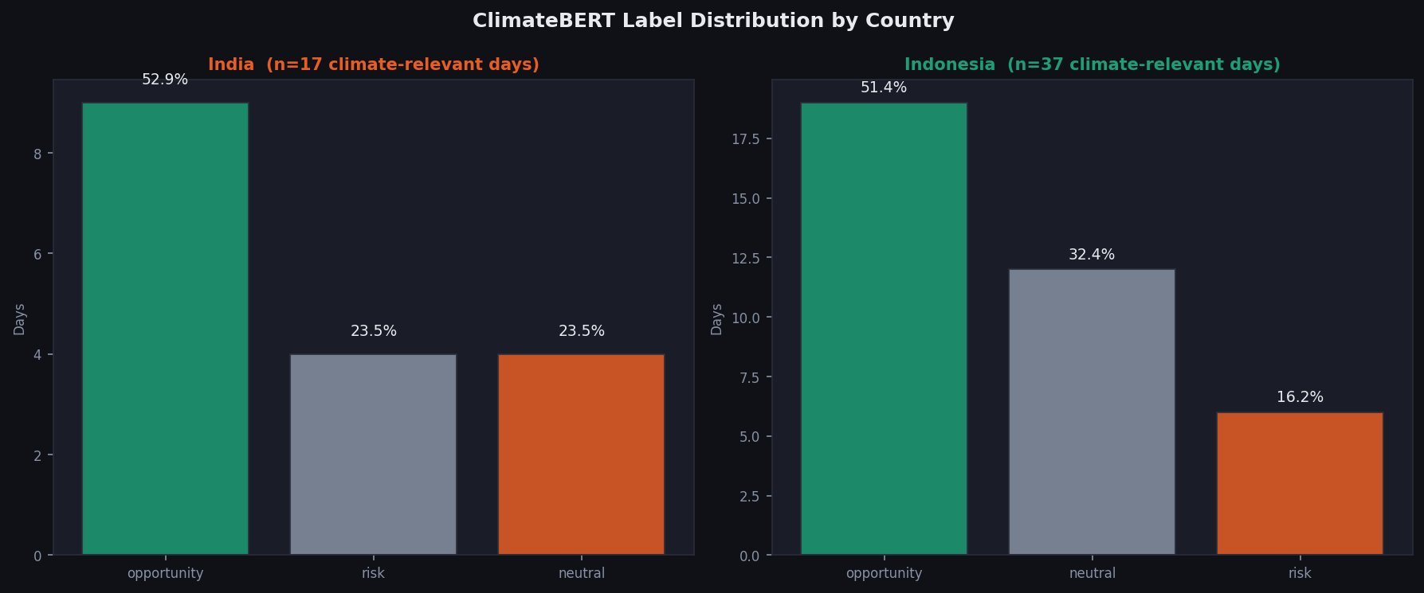
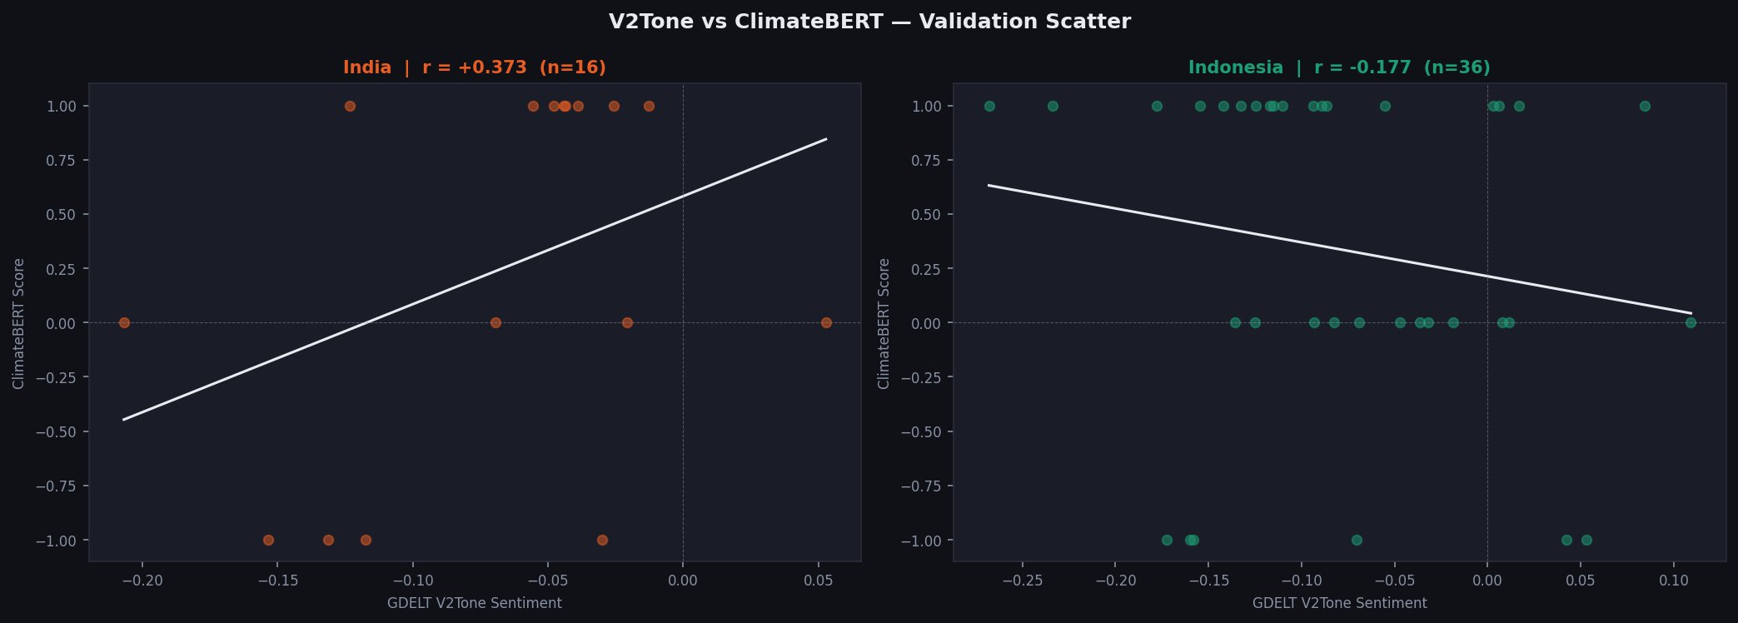
APPENDIX C
ClimateBERT — Why V2Tone is Primary
Domain-specific NLP validates but cannot replace V2Tone in this context
Coverage: Only 22 of 2,221 observations (1%) have ClimateBERT-scored headlines — too sparse for reliable inference. Input mismatch: ClimateBERT is designed for natural language prose. GDELT theme codes (e.g. CLIMATE_CHANGE; ENV_NUCLEAR) are structured tags, not sentences — the model is misspecified for this input. Correlation: India r=+0.37 (weak), Indonesia r=−0.18 (near zero vs V2Tone). V2Tone confirmed as primary variable.

