Slide 1
Title
1/9
Do Politicians' Words Have a Dollar Value?
Does daily political climate sentiment influence the Greenium in India & Indonesia?
Climate speeches → sovereign green bond yields in India & Indonesia
Gap: existing literature uses monthly data; politics moves daily
Answer: signaling noise costs money; raw sentiment does not
Nahian Ibnat · MA Economics, Data & Policy · CEU · 2026

Slide 2
Motivation
2/9
When Finance Ministry says "green" but
Energy Ministry says "coal"
Credibility Premium
Consistent signals →
lower borrowing costs
Green bonds = sovereign loans pledged to green projects
Greenium = yield discount investors accept for the green label
India, Indonesia: large coal economies issuing green bonds — structural paradox
Credibility Gap
Contradictory signals →
trust penalty
1 bp saving on $1bn bond = $1m/yr less interest
Emerging markets need every bp they can get

Slide 3
Data
3/9
Daily bond yields + Daily political sentiment, 2020–2024
1,455
Panel observations
4
Green–Conventional twin pairs
120,000
GDELT Articles
Bond yields: Refinitiv — daily YTM, green vs. conventional twin
Sentiment: GDELT + ClimateBERT — daily political climate tone
Controls: VIX, CDS spreads, Exchange Rates

Slide 4
Method
4/9
Twin-bond DiD: green bond vs. maturity-matched conventional twin
Same issuer, same currency, same maturity → default & currency risk cancel out
Greenium = YTMgreen − YTMconventional is the outcome
Staggered DiD: Events
- India Jan 2023 (green bond auction);
- Indonesia Nov 2022 (JETP/G20)
Event study (±10 weeks) validates parallel trends + tests pre-announcement drift
All regressors first-differenced and Standardized
Standard errors are HC3 heteroskedasticity-robust throughout
Signaling noise = std of daily article scores

Slide 5
Main Results
5/9
Noise is priced; sentiment alone is not
H1 — Positive sentiment → wider greenium
β = +0.0009, not statistically significant
✗ null — sentiment doesn't move Greenium
H2 — Higher signaling noise → narrower greenium
β = −0.0031***
✓ significant at 1%
H3 — Policy events → structural shift in greenium
Post = −0.0301 (JETP)
✓ Indonesia detected; India null
Parallel trends
0/9 pre-event Statistically significant
✓ DiD identification valid

Slide 6
Interpretation
6/9
Markets don't price words — they price consistency
Higher noise (MoF vs. MoE contradiction) widens Greenium spread — markets demand consistency premium, not just green rhetoric
Indonesia's JETP shock detectable; India's green bond auction null → international validation matters more than domestic auction
Null sentiment result supports weak-form efficiency for climate discourse
ClimateBERT robustness limited (N=20, 1.4% coverage) — GDELT remains primary measure

Slide 7
Limitation
7/9
Next Goal is to Reduce the Limitations
GDELT is not green-bond specific
ClimateBERT coverage too sparse
Small sample — 2 countries, 4 bond pairs
Secondary market only

Slide 8
Conclusion
8/9
Political credibility is a fiscal variable
What need does this fill?
First high-frequency causal evidence on Greenium dynamics in Asian emerging markets
What did I do?
DiD + event study with NLP sentiment on daily green vs. conventional bond pairs (India, Indonesia)
Main takeaway
Signaling noise — not sentiment — costs money; ~3bp per 1-SD noise increase

Slide 9

9/9
Full replication available on GitHub
Raw Data · Processed sentiment CSV · Panel Data · Notebook · Plots · Chapters

Slide 10
References
Flammer, C. (2021). Corporate green bonds. Journal of Financial Economics, 142(2), 499–516.
Zerbib, O. D. (2019). The effect of pro-environmental preferences on bond prices. Journal of Banking & Finance, 98, 39–60.
Huang, C. et al. (2023). Sovereign green bonds and the greenium. Journal of International Money and Finance.
Leidner, J. L. & Schilder, F. (2010). Introducing GDELT: Global database of events, language and tone. Proceedings of the AAAI Workshop.
Webersinke, N. et al. (2022). ClimateBERT: A pretrained language model for climate-related text. arXiv:2110.12010.
Callaway, B. & Sant'Anna, P. H. C. (2021). Difference-in-differences with multiple time periods. Journal of Econometrics, 225(2), 200–230.
Data sources: Refinitiv Workspace (bond yields) · GDELT BigQuery (sentiment) · FRED (VIX) · Investing.com (CDS spreads)

Slide 11
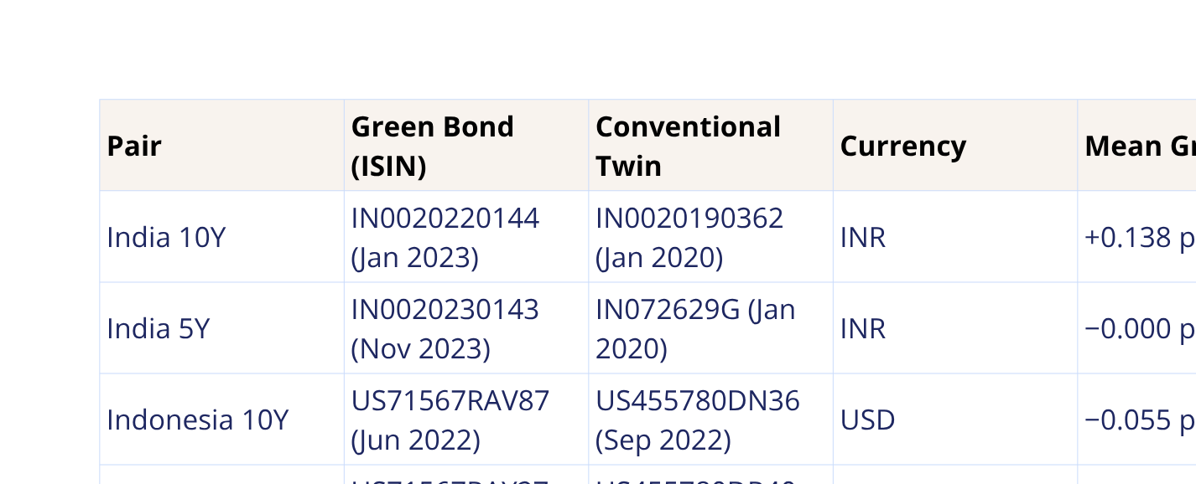
Appendix A
Bond Inventory — All 8 Instruments
Source: Refinitiv Workspace via CEU institutional access

Slide 12


Appendix B
Sentiment Pipeline & ClimateBERT Coverage
GDELT V2Tone (primary)
ClimateBERT (robustness only)
Model: | distilroberta-base-climate-sentiment
Stage 1: | Climate detector → filter headlines
Stage 2: | opportunity (+1) / neutral / risk (−1)
Coverage: | 52 matched days (1.4% of panel)
After FD: | Only 20 obs → sparse
India r: | r = +0.276 vs V2Tone (weak positive)
Indonesia r: | r = −0.037 vs V2Tone (diverges)
Verdict: | Directionally consistent for India; inconclusive overall
1 Query GDELT BigQuery — India/Indonesia × climate themes
2 Sample 1,000 articles/country/month
3 Parse V2Tone → normalise to [−1, +1]
4 Aggregate: daily mean (sentiment) + daily std (signaling noise)
3654
Country-days
120,000
Total Articles
India 0.33 ·
Indonesia 0.40
Mean noise σ

Slide 13
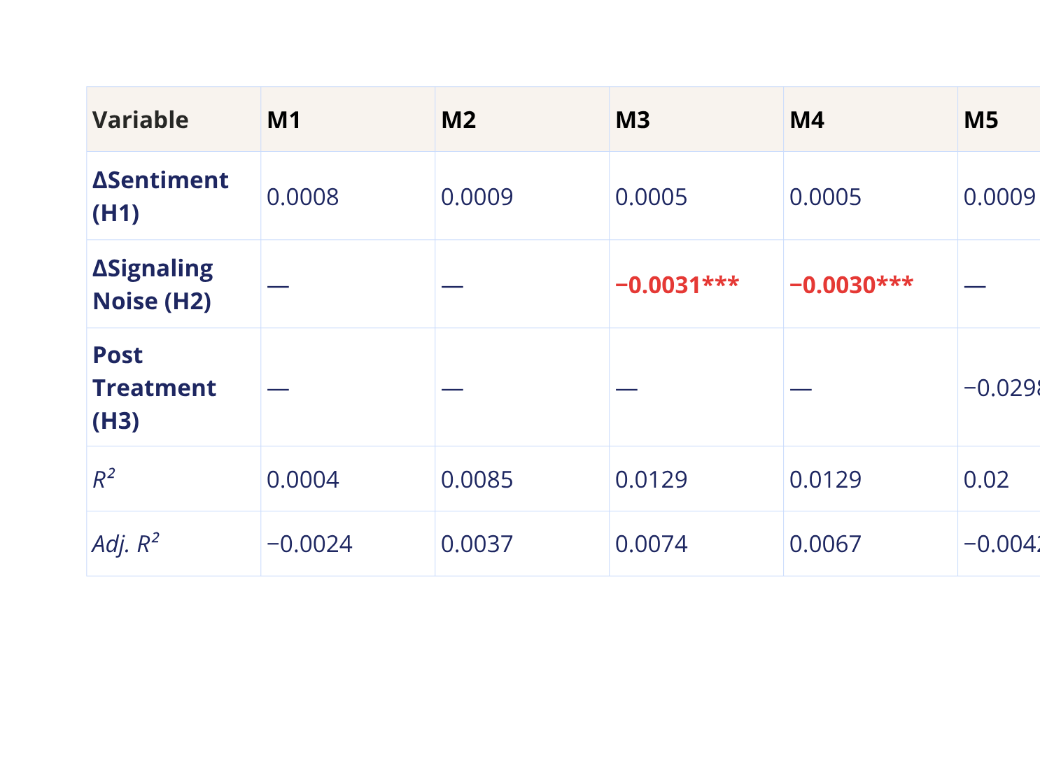
Appendix C
Full Regression Table
* p<0.1 ** p<0.05 *** p<0.01

Slide 14
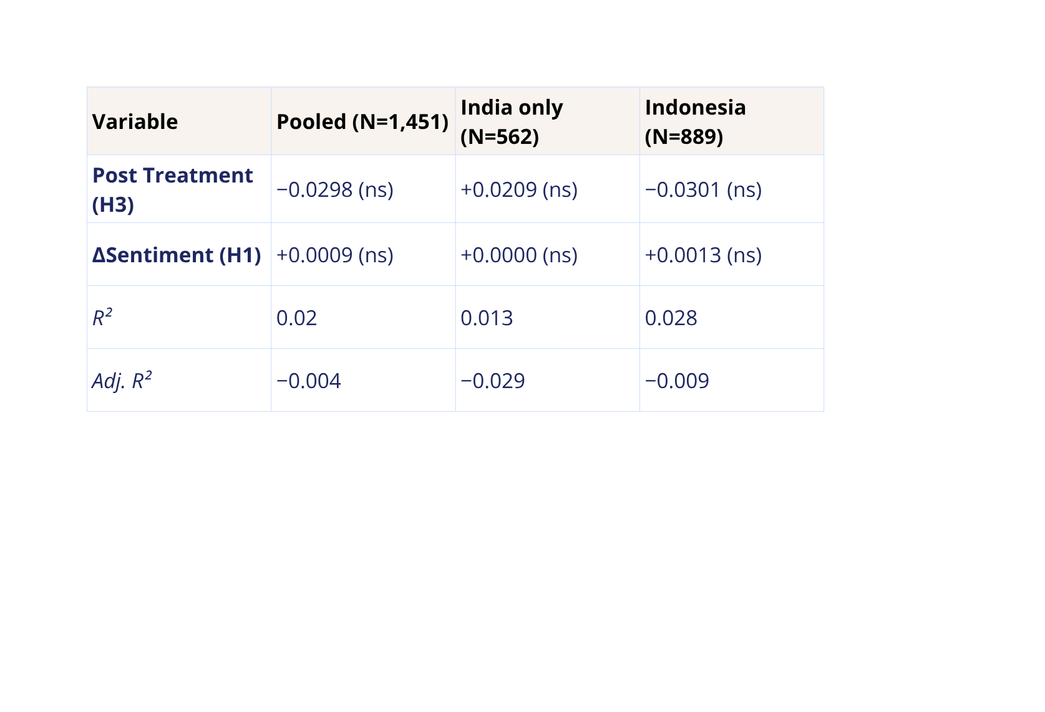
Appendix D
Country Specific Regression (M5 Specification)
* p<0.1 ** p<0.05 *** p<0.01

