Slide 1
INFO 5731.020: Project Presentation
ANALYZING CLINICAL TEXT FOR MEDICAL INSIGHTS USING NATURAL LANGUAGE PROCESSING (NLP)
Presented by: Group #6
SAI TEJA MUNJA – 11591803
VENKATASURYASATYA KAKARLA – 11606141
MAHESHWAR REDDY BOYALLA – 11608419
PRASANNA MALREDDY – 11604121
NAHID FATHIMA SYED – 11535490
SOWMYA BANALA – 11599589
Date of presentation: 12/13/23

Slide 2
Table of contents
QUESTIONS TO BE ANSWERED
STEPS FOLLOWED
DATA COLLECTION
DATA CLEANING
DATA PREPROCESSING
DATA VISUALIZATION
NER MODEL
TOPIC MODELLING
CONCLUSION
INTRODUCTION
RELATED WORK
PURPOSE ANALYSIS
REFERENCE

Slide 3
Introduction
In this project, we study how to use Natural Language Processing (NLP) methods to the analysis of a variety of clinical text datasets, such as research papers and patient records. Finding important patterns, recognizing important medical entities, and revealing hidden connections within this intricate textual data are our main goals.
We aim to overcome the inherent complexity of clinical language by utilizing advanced language processing technology to extract useful insights that can improve medical decision-making and further clinical research. This work demonstrates how NLP can be revolutionary in deciphering the complex web of clinical narratives and promoting a more knowledgeable and data-driven healthcare setting.

Slide 4
Related Work
1.Recent advancements in neural language models, such as BERT and GPT, have had a profound impact on extracting medical information from clinical texts. Reference: Devlin, J., Chang, M. W., Lee, K., & Toutanova, K. (2018). "BERT: Pre-training of Deep Bidirectional Transformers for Language Understanding."
2.Li et al. (2022) proposed a unique strategy for medical entity detection and connection extraction. Their approach leverages pretrained language models to enhance the comprehension of complex medical concepts and relationships. Reference: Li, Xi, et al. "Clinical Relation Extraction Using Transformer-based Models." 2021.
3.Yang, Xi, et al. (2021) delved into critical aspects of using transformers for clinical relation extraction. Reference: Yang, Xi, et al. "Clinical Relation Extraction Using Transformer-based Models." 2021.

Slide 5
Purpose of Analysis
Discover
Discover Popular Healthcare Themes
Utilize NLP to identify prevalent themes within clinical narratives.g people’s opinions
Uncover recurring topics, facilitating a nuanced understanding of healthcare priorities.
Determine
Determine Important Entities
Leverage NLP algorithms to recognize key medical entities such as heart diseases, treatments, and procedures.
Enhance medical decision-making by focusing on crucial elements within the dataset.
Examine
Examine Word Distribution for Patterns
Investigate the distribution of healthcare-related words in clinical texts.
Identify patterns and relationships, providing actionable insights for improved patient care and informed medical research.

Slide 6
Questions to be answered
Evaluate how well NLP models can accurately and efficiently pull medical details from various clinical texts for better healthcare insights.
What information are you going to extract and how it will be useful?
The study will detail the types of information extracted from clinical texts, emphasizing their relevance and utility in improving medical decision-making, research, and patient outcomes.
To what extent can NLP models be used to accurately and efﬁciently extract medical information from a variety of clinical texts?
Identify and analyze prevalent healthcare themes in the dataset, using topic modeling to gain valuable insights into patterns and trends.
What are the most common healthcare themes covered in the dataset, and how may topic modeling provide valuable insights?

Slide 7
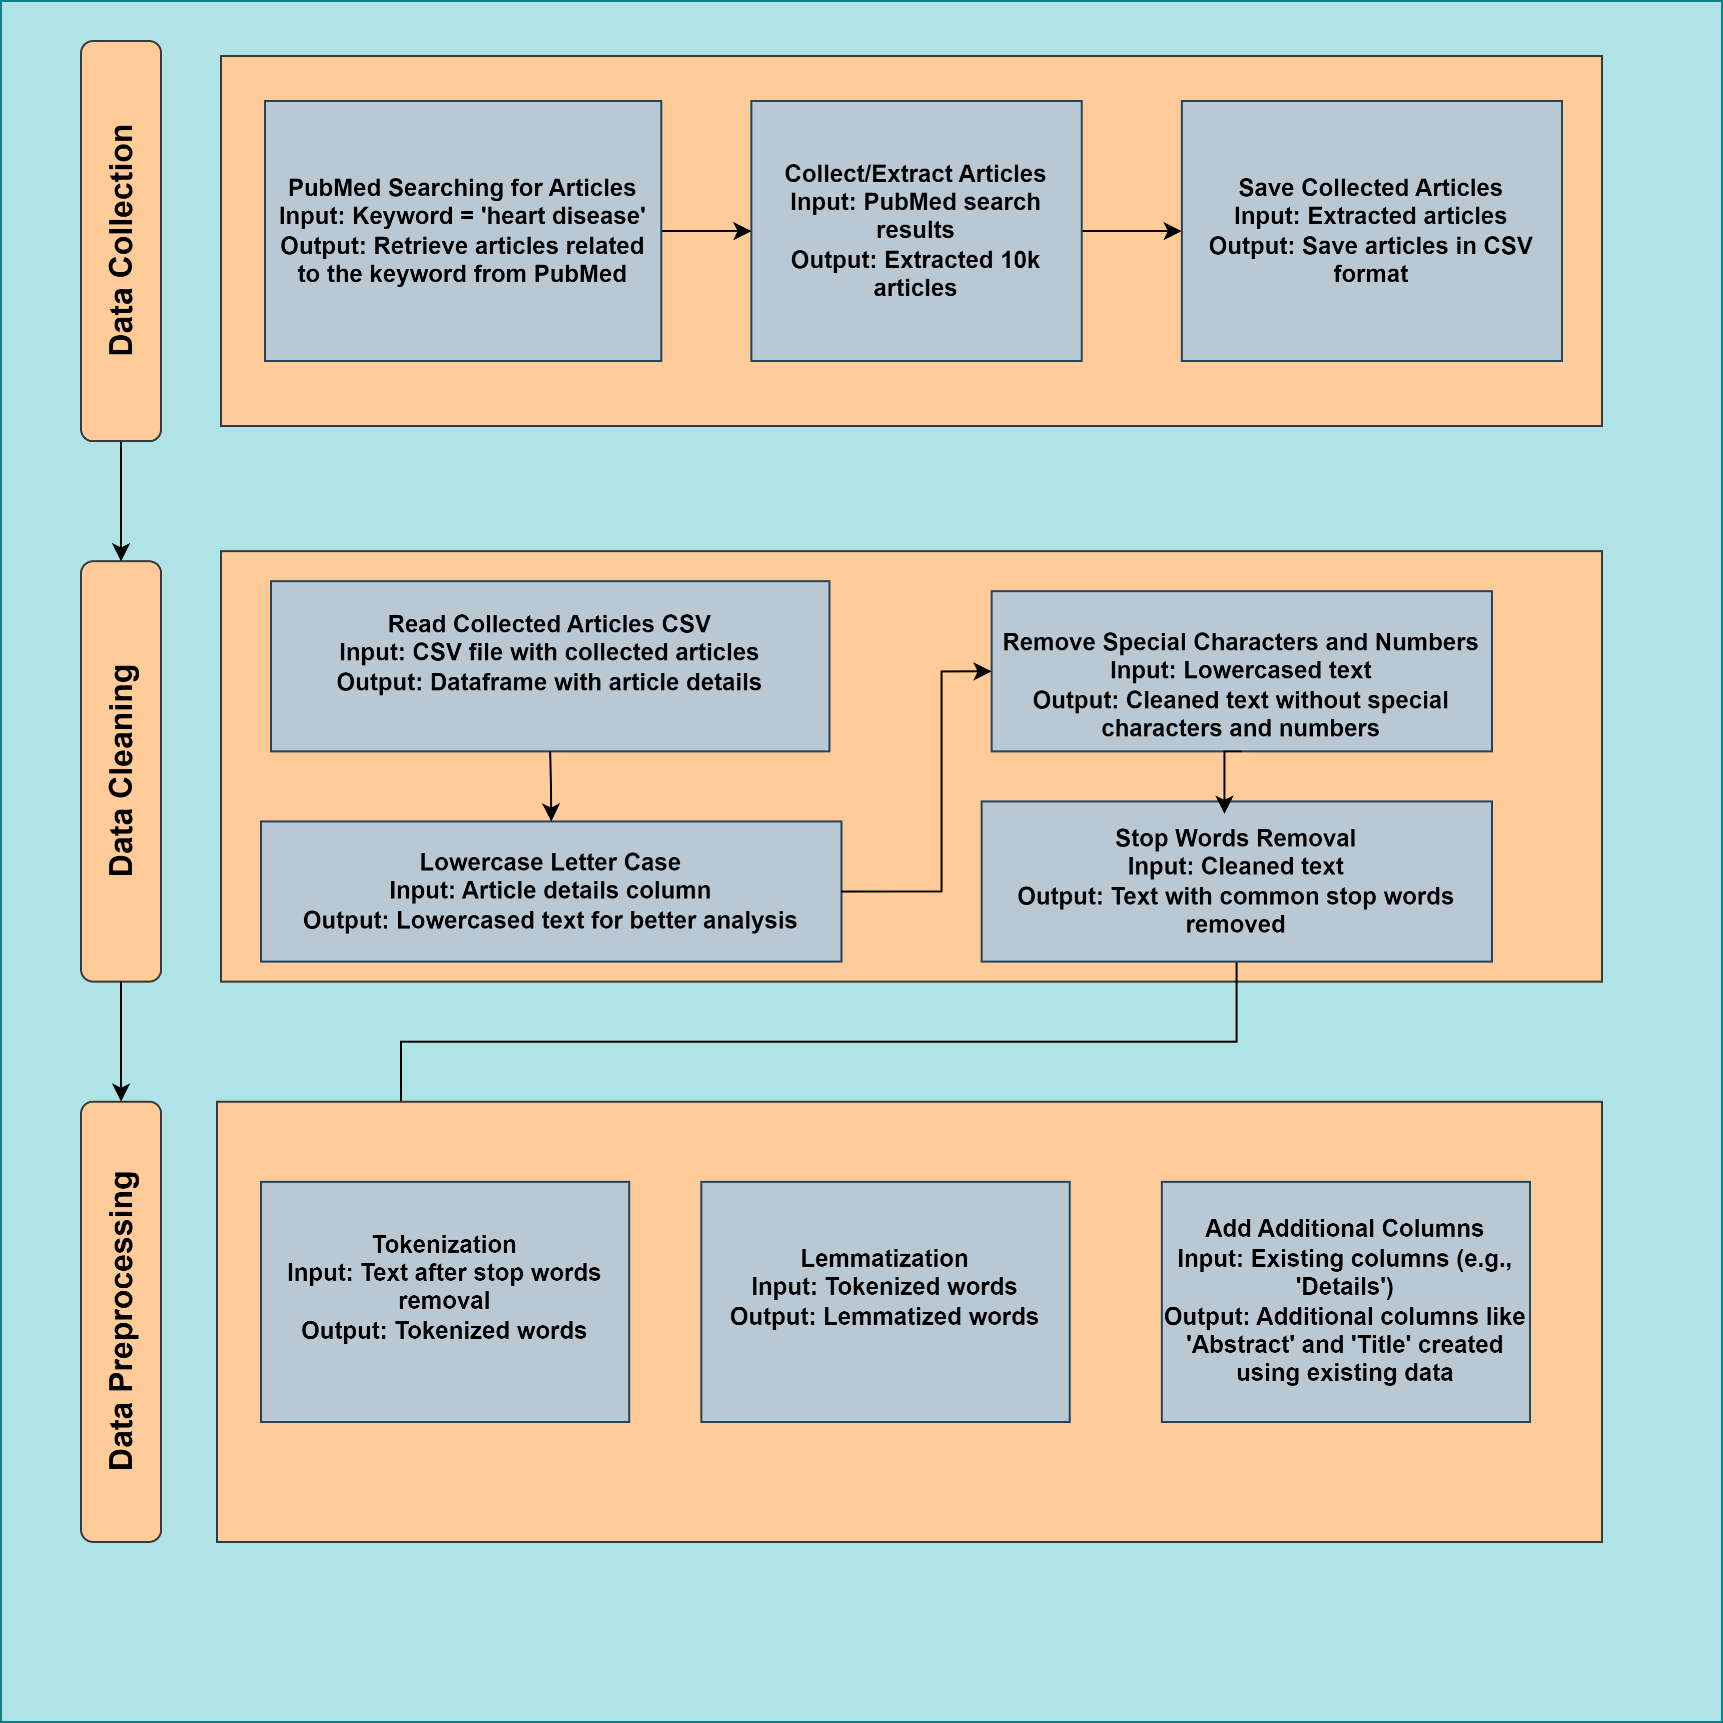
Steps followed

Slide 8
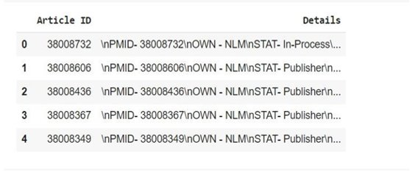
Data Collection
Selecting a search keyword 'heart disease'
PubMed for extracting articles
Collected 10K articles
Saving the extracted data in CSV format

Slide 9
Data Cleaning
Why is data cleaning important?
Unstructured data
Contains noise & garbage data
Can affect results of analysis
Ways to clean the data:
Lowercasing the data
Removing stopwords
Using Python libraries & packages:
NLTK: Natural Language Toolkit
Tokenize

Slide 10
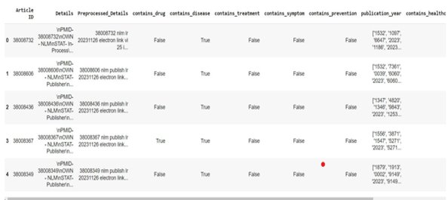
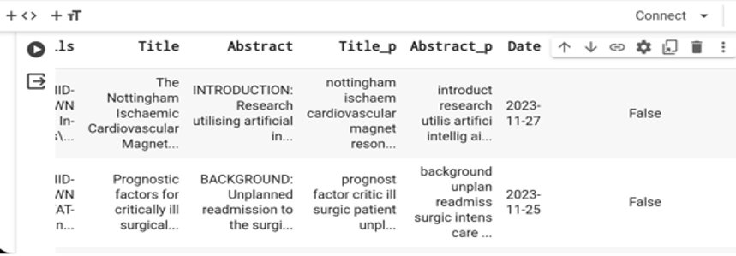
Data Preprocessing
Tokenization
Adding new columns
Removing stopwords
Lemmatization

Slide 11
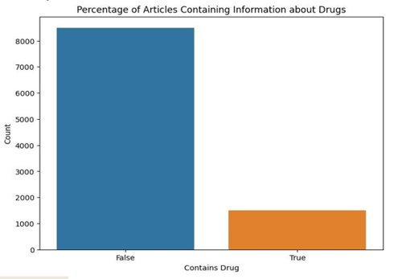
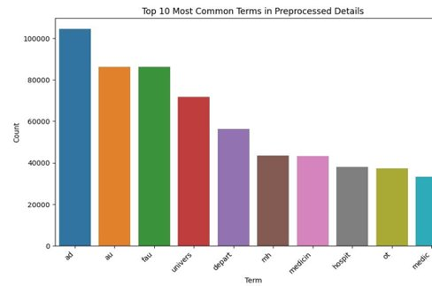
Data Visualization

Slide 12
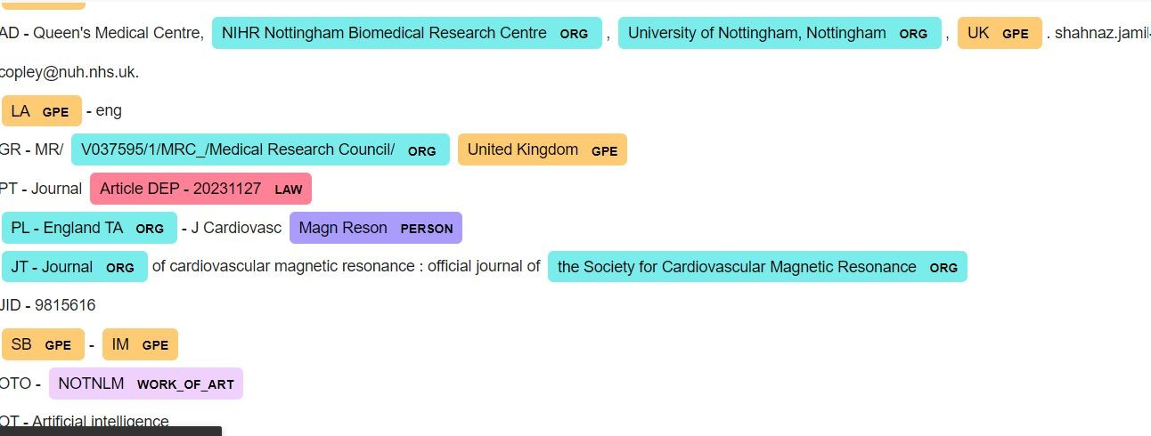
NER Model
Library: Used spaCy, a natural language processing library.​
Training: Pre-trained model on a large corpus and ﬁne-tuned for healthcare domain.​
Through NER Model, we identify entities in a healthcare dataset. Performed on the 'PreprocessedDetails' column of the dataset. Identified entities such as illnesses and treatments.
​

Slide 13
Topic modelling
Dictionary Creation: Represent words in the dataset uniquely.
Corpus Formation: Convert text data into a bag-of-words model.
LDA Model: Apply Latent Dirichlet Allocation for topic modeling.
Visualization: Visualize topics using pyLDAvis.

Slide 14
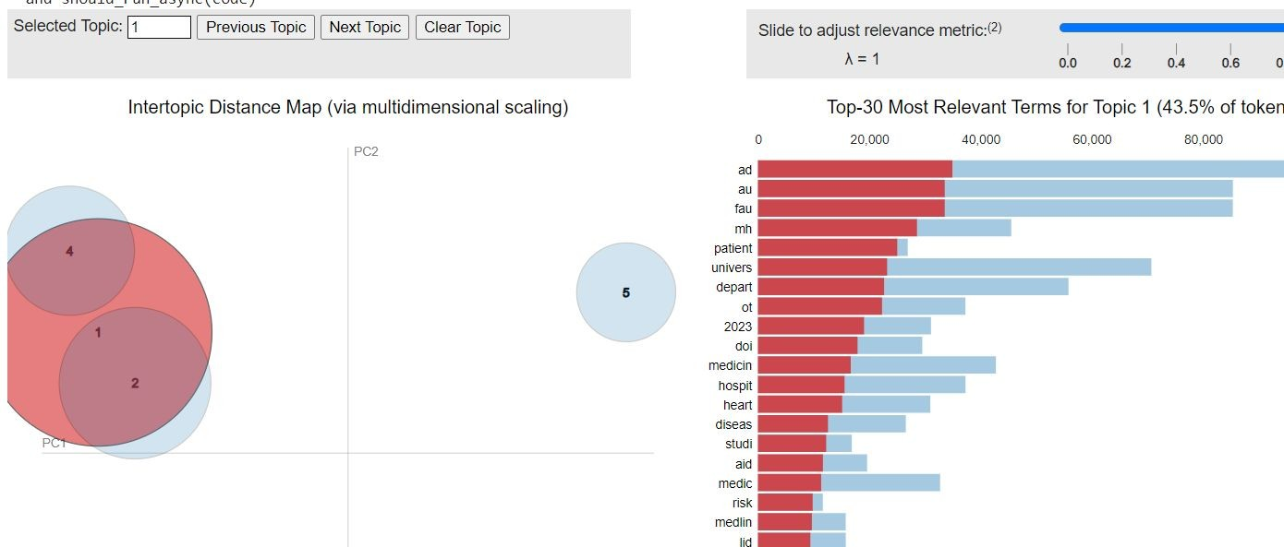
Topic modelling
Through LDA, able to reveal unique healthcare subjects, such as therapy and medicine, disease diagnosis and prevention, and healthcare providers and services. Improve the extraction of medical insights, facilitate quick information retrieval, and assist in thorough clinical text analysis.

Slide 15
Conclusion
Sets the stage for future research by indicating the potential for continued refinement of NLP models and incorporation of domain-specific knowledge for more targeted healthcare analyses.
• The application of advanced natural language processing technologies provided a thorough grasp of the healthcare dataset, illustrating the capabilities of NLP in dealing with complex medical language.
• Potential applications include enhancing information retrieval systems and improving decision-making in the healthcare domain.
• Identification of essential subjects: illnesses, treatments, and healthcare providers through topic modeling.
• Results open the way for improved information retrieval and knowledge extraction.

Slide 16
References
Jacqueline Peng, Mengge Zhao, James Havrilla, Cong Liu, Chunhua Weng, Whitney Guthrie, Robert Schultz, Kai Wang and Yunyun Zhou,Natural language processing (NLP) tools in extracting biomedical concepts from research articles: a case study on autism spectrum disorder,30 Dec 2020.\
Naila Camila da Rocha,Abner Macola Pacheco Barbosa ,Yaron Oliveira Schnr,Juliana Machado-Rugolo ,Luis Gustavo Modelli de Andrade,Jose ́ Eduardo Corrente and Liciana Vaz de Arruda Silveira,Natural Language Processing to Extract Information from Portuguese-Language Medical Records, 29 December 2022.
S. Biruntha,M Revathy,Raashma Mahaboob, V Meenakshi, Comprehensive Review of Deep learning Techniques in Electronic Medical Records.
Links to GitHub files: https://github.com/NahidFathima/Grop6Project_5731
Link to OneDrive folder with files : INFO5731_GROUP6project

