Slide 1
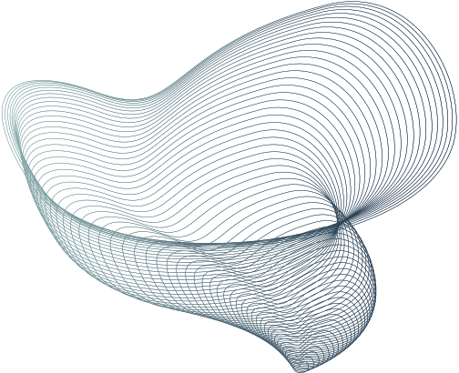

HOME
U-NET
DATASET
MODEL
RESULTS
REMARKS
FUTUREWORK
Final Project Demo
Nuclei Segmentation Using U-Net Architecture
PRESENTED BY: GROUP-2
NAHID SARWAR RATUL 2212790042
MUHAMMAD BIN MAMUN 2222953042
EKFAT JAHAN ASHRAFY 2132236642
COURSE CODE: CSE445
SECTION: 05
FACULTY: MSRB

Slide 2
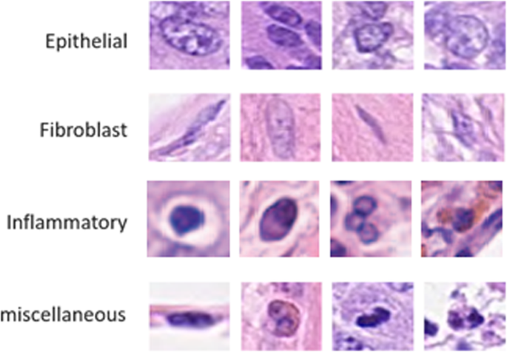
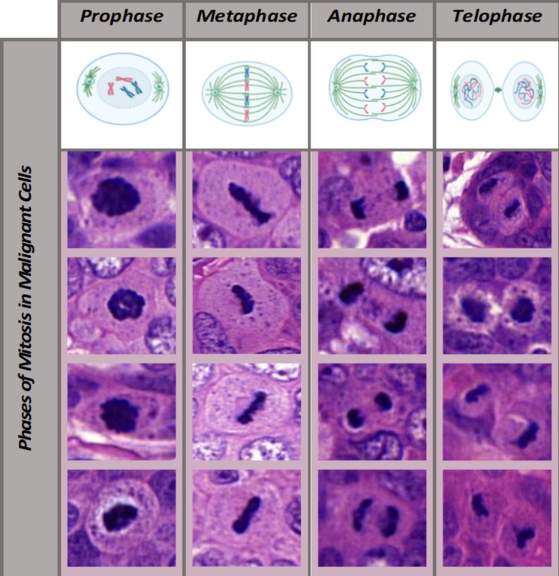
HOME
U-NET
DATASET
MODEL
RESULTS
REMARKS
FUTUREWORK
IDENTIFICATION OF DIFFERENT CELL TYPES (EPITHELIAL, FIBROBLAST, INFLAMMATORY, ETC.) BASED ON THE CHARACTERISTICS OF THEIR NUCLEI.
THE IMAGE ILLUSTRATES HOW THE NUCLEUS OF A MALIGNANT CELL UNDERGOES CHANGES THROUGH THE DIFFERENT PHASES OF MITOSIS, HIGHLIGHTING THE PROGRESSION OF CELL DIVISION IN CANCEROUS CELLS.
Nahid Sarwar Ratul Muhammad Bin Mamun Ekfat Jahan Ashrafy
2212790042 2222953042 2132236642

Slide 3
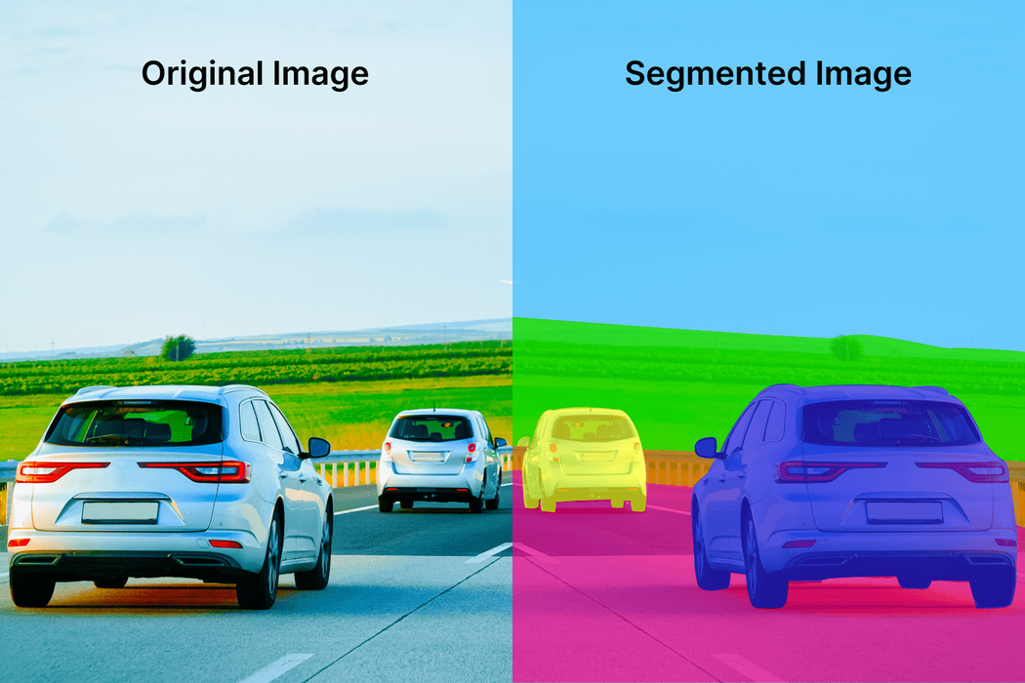
HOME
U-NET
DATASET
MODEL
RESULTS
REMARKS
FUTUREWORK
U-Net is an encoder-decoder architecture designed for image segmentation, with skip connections that help retain spatial information for precise segmentation, especially in small structures like cell nuclei.
The advantage of using the U-Net architecture in this project lies in its ability to perform precise pixel-wise segmentation. The skip connections help retain fine spatial details, which is crucial for accurately segmenting small and complex structures like cell nuclei in medical images. This made the task of segmenting different cell types more efficient and reliable.
Nahid Sarwar Ratul Muhammad Bin Mamun Ekfat Jahan Ashrafy
2212790042 2222953042 2132236642

Slide 4
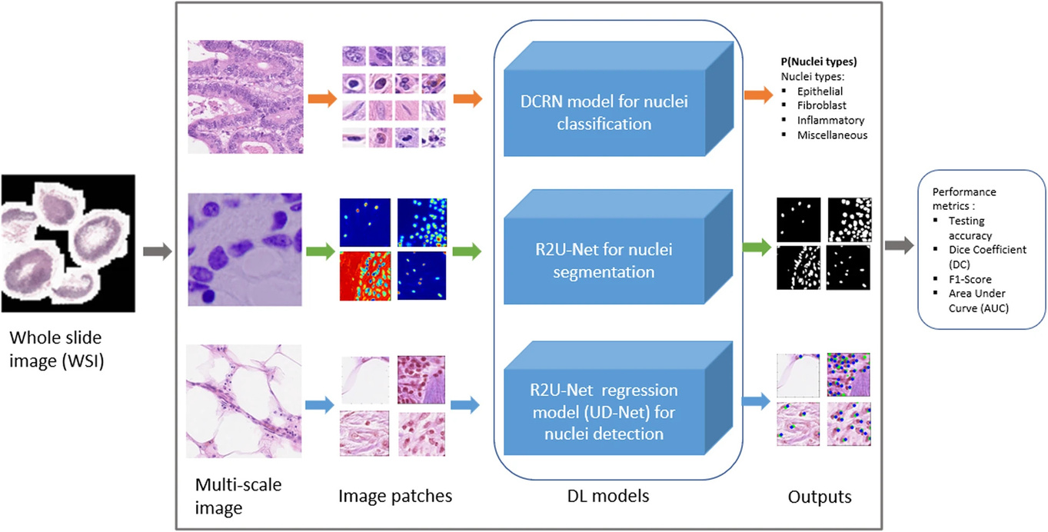
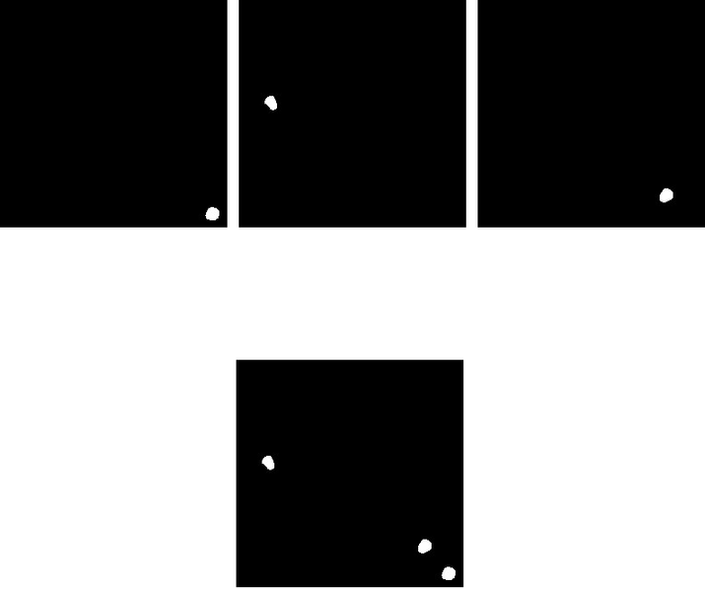
HOME
U-NET
DATASET
MODEL
RESULTS
REMARKS
FUTUREWORK
We process Whole Slide Images (WSIs) by dividing them into manageable 256x256 patches.
Multiple smaller masks are merged to create a single ground truth mask, representing the entire region of interest.
Nahid Sarwar Ratul Muhammad Bin Mamun Ekfat Jahan Ashrafy
2212790042 2222953042 2132236642

Slide 5
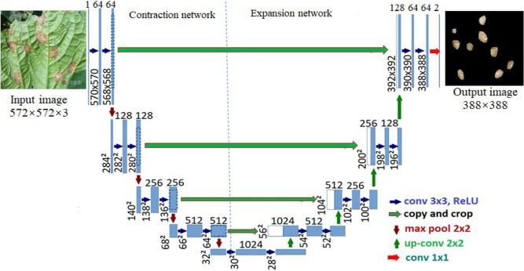
HOME
U-NET
DATASET
MODEL
RESULTS
REMARKS
FUTUREWORK
Training Process
Compilation: Adam optimizer with binary cross-entropy loss for binary segmentation (nuclei vs. background). Dice coefficient used as evaluation metric.
Callbacks: Early stopping after 4 epochs of no improvement in validation loss. Learning rate reduction by 0.5 when validation loss plateaus.
Training: Model trained for 30 epochs, using training data and evaluated on validation data, optimized with callbacks to avoid overfitting.
Nahid Sarwar Ratul Muhammad Bin Mamun Ekfat Jahan Ashrafy
2212790042 2222953042 2132236642

Slide 6
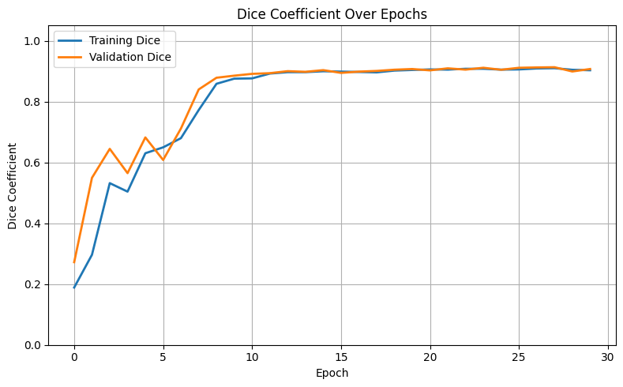
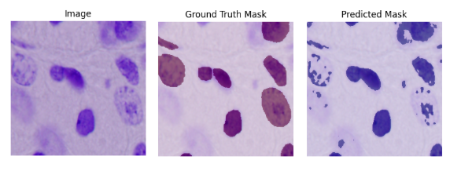
HOME
U-NET
DATASET
MODEL
RESULTS
REMARKS
FUTUREWORK
"SEGMENTATION MODEL EVALUATION: COMPARISON OF GROUND TRUTH AND PREDICTED MASKS ON TEST IMAGE"
THE DICE COEFFICIENT IS A METRIC USED TO MEASURE THE OVERLAP BETWEEN TWO BINARY MASKS, RANGING FROM 0 (NO OVERLAP) TO 1 (PERFECT OVERLAP).
Nahid Sarwar Ratul Muhammad Bin Mamun Ekfat Jahan Ashrafy
2212790042 2222953042 2132236642

Slide 7
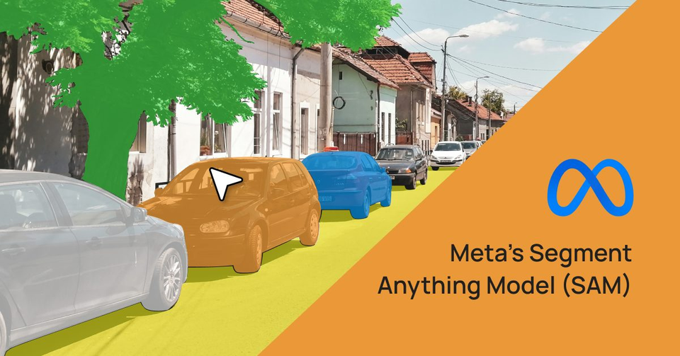
HOME
U-NET
DATASET
MODEL
RESULTS
REMARKS
FUTUREWORK
INTIAL PLANS:
USE RAW WSIS + MANUAL SEGMENTATION OF NUCLEI
IMPRACTICAL → VERY LARGE IMAGE SIZES, TILING OVERHEAD, MANUAL ANNOTATION TOO TIME-CONSUMING
SAM (SEGMENT ANYTHING MODEL) FOR AUTO-SEGMENTATION
POOR PERFORMANCE ON HISTOPATHOLOGY DATA → INACCURATE & INCONSISTENT NUCLEI MASKS
FINAL APPROACH: PUBLICLY AVAILABLE PRE-SEGMENTED DATASET
RELIABLE GROUND TRUTH MASKS
ENABLED FOCUS ON MODEL DEVELOPMENT & TRAINING
Nahid Sarwar Ratul Muhammad Bin Mamun Ekfat Jahan Ashrafy
2212790042 2222953042 2132236642

Slide 8

HOME
U-NET
DATASET
MODEL
RESULTS
REMARKS
FUTUREWORK
Model Improvement: Explore advanced architectures like U-Net++ or Transformer-based models to improve segmentation performance.
Data Diversity: Use datasets with images containing diverse backgrounds (e.g., tissue samples, varying lighting, or environmental factors) to make the model more robust.
Real-Time Inference
Model Deployment
Nahid Sarwar Ratul Muhammad Bin Mamun Ekfat Jahan Ashrafy
2212790042 2222953042 2132236642

Slide 9
THANK YOU
Nahid Sarwar Ratul Muhammad Bin Mamun Ekfat Jahan Ashrafy
2212790042 2222953042 2132236642

