Slide 1
The Pipeline
One reusable, 5-step workflow — Task 5
1
2
3
4
5
LIVE IN CEDAR
SOURCE
Protocols SOPs Datasets Data dicts Results
Paper
RETRIEVE
POPULATE
VALIDATE
VISUALIZE
UPLOAD
Get the template, or design a new one
Extract real values + live BioPortal lookups
Validate locally and on CEDAR's server
Preview as a live, fillable CEDAR form
Push the finished template to CEDAR
• Same 5 steps, same 4 MCP servers, run pipeline on a journal article: Chosen case (Published Paper):
Nahid Zeinali et al., “Symptom-BERT: enhancing cancer symptom detection in EHR clinical notes”

Slide 2
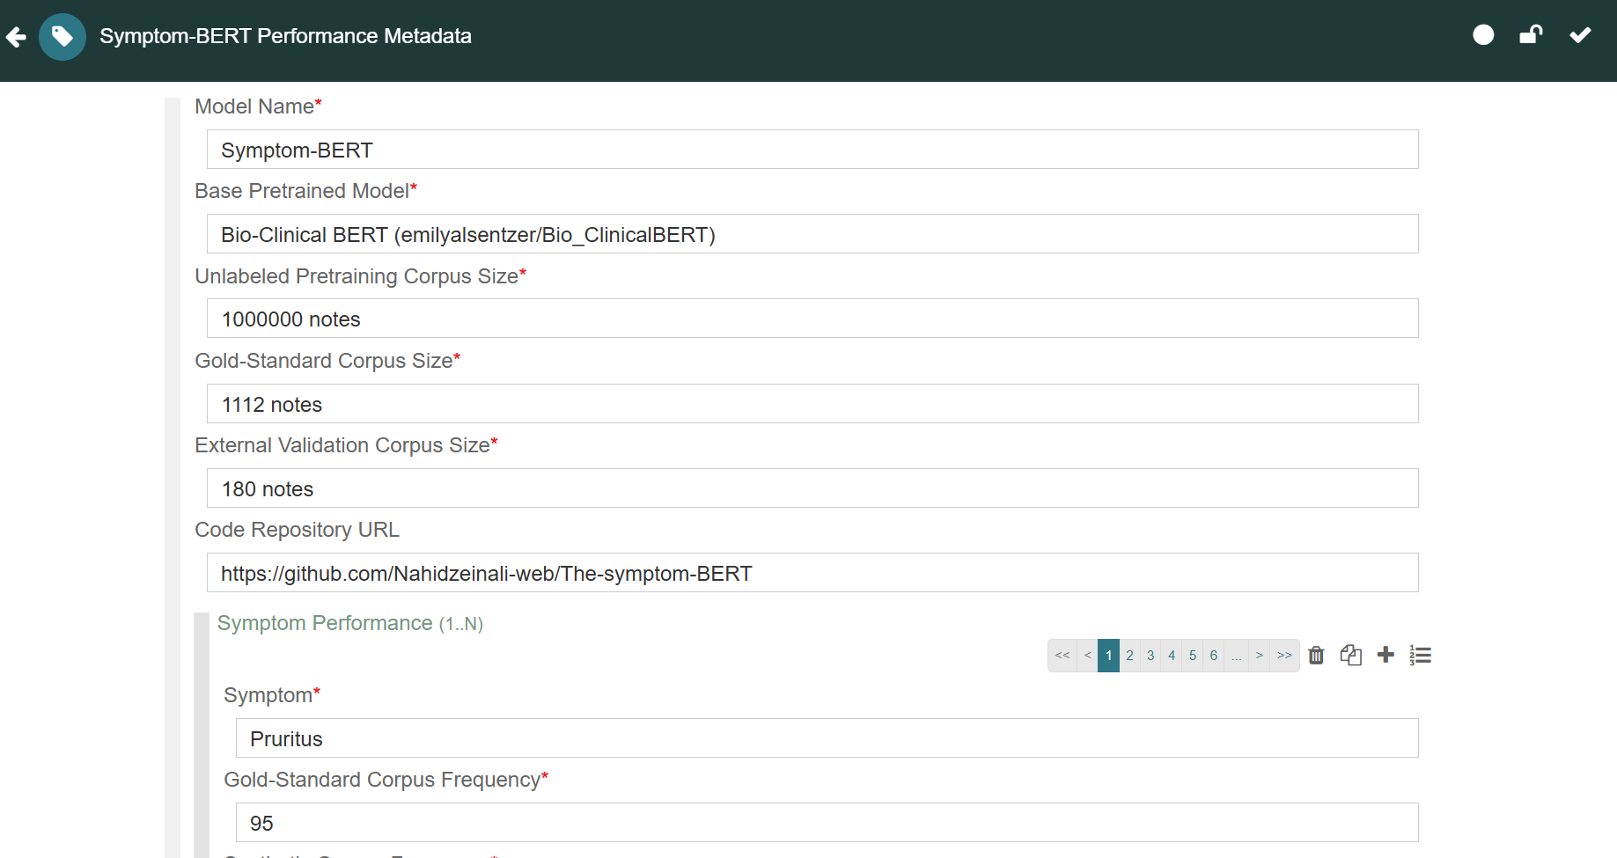
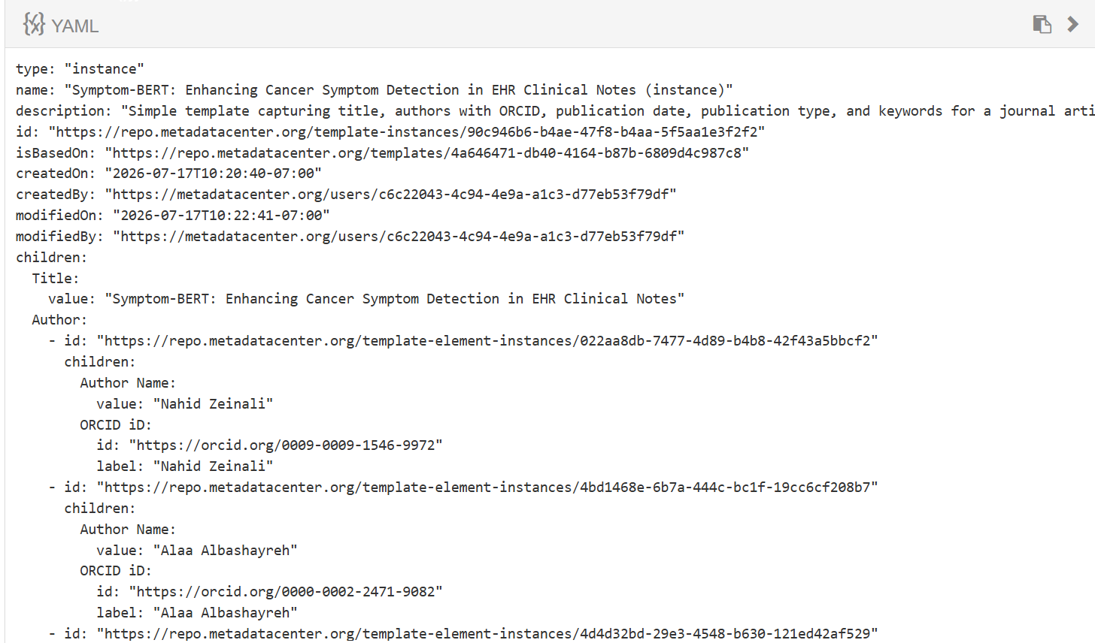
Task 5: Testing Reusability on Real Research
Case study — applying the same pipeline to the presenter's own published paper
• “Symptom-BERT Model Metadata Template”
• “Symptom-BERT Model Metadata Instance”
Rendered fillable CEDAR form
Instance metadata as YAML

Slide 3
Task 5: Real Data, Real Numbers
Every value below came directly from the paper's Table 2 and Figure 3
Symptom | HP Term | Gold Freq | Synth Freq | Int. F1 | Int. AUC | Ext. F1 | Ext. AUC
Pruritus | Pruritus | 95 | 21 | 0.985 | 0.995 | 0.833 | 0.812
Disturbed Sleep | Insomnia | 73 | 28 | 0.978 | 0.985 | 0.796 | 0.778
Nausea | Nausea and vomiting | 97 | 40 | 0.974 | 0.949 | 0.807 | 0.821
Impaired Memory | Memory impairment | 70 | 20 | 0.974 | 0.899 | 0.860 | 0.842
Appetite Loss | Poor appetite | 81 | 22 | 0.968 | 0.924 | 0.818 | 0.824
Fatigue | Fatigue | 127 | 47 | 0.934 | 0.951 | 0.769 | 0.823
Pain | Pain | 148 | 122 | 0.920 | 0.964 | 0.711 | 0.804
Shortness of Breath | Dyspnea | 97 | 33 | 0.919 | 0.856 | 0.870 | 0.893
Constipation | Constipation | 80 | 33 | 0.911 | 0.908 | 0.829 | 0.881
Swelling | Edema | 120 | 42 | 0.910 | 0.936 | 0.747 | 0.712
Depressed Mood | Depression | 120 | 21 | 0.898 | 0.902 | 0.920 | 0.912
Numbness | Paresthesia | 76 | 24 | 0.882 | 0.895 | 0.899 | 0.888
Anxiety | Anxiety | 117 | 33 | 0.881 | 0.917 | 0.820 | 0.855

