Slide 1

Welcome

Slide 2
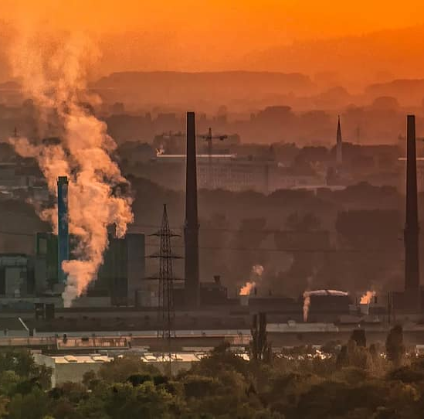
Environment pollution: A global concern
Presented By
Nahin Naznin
Department of Anthropology
Shahjalal University of Science and Technology

Slide 3
What is Environmental Pollution?
The contamination of the natural environment, leading to adverse effects on ecosystems, human health, and biodiversity.
Types of Pollution:
Air Pollution
Water Pollution
Soil Pollution
Noise Pollution
Plastic Pollution

Slide 4
Causes of Environmental Pollution
Air Pollution: Industrial emissions, vehicle exhaust, deforestation, and burning fossil fuels
Water Pollution: Waste discharge from factories, oil spills, agricultural runoff, and plastic waste
Soil Pollution: Use of pesticides, chemical waste, and deforestation
Other Causes: Overpopulation, urbanization, and improper waste disposal

Slide 5
Effects of Environmental Pollution
On Human Health: Respiratory diseases, cardiovascular problems, and waterborne diseases
On Ecosystems:
Habitat destruction
Loss of biodiversity
Coral bleaching
Climate Impact: Contribution to global warming and extreme weather events

Slide 6
Solutions to Environmental Pollution
Reduce
Reduce, Reuse, Recycle: Minimize waste and promote sustainable consumption
Adopt
Adopt Renewable Energy: Solar, wind, and other clean energy sources
Regulate
Stronger Policies and Enforcement: Regulate emissions and promote eco-friendly practices
Raise
Community Action: Raise awareness, participate in cleanups, and support green initiatives
Tree
Tree Plantation: Combat deforestation and improve air quality

Slide 7

Thank You

