Slide 1
Algorithms
Nahian Salsabil

Slide 2
Introduction
Faculty Name: Nahian Salsabil
Room No: 4K71
Consultation: Sun - Wed: 11am - 12:20pm
Email: nahian.salsabil@bracu.ac.bd
Resources: tiny.cc/cse221_resources_NSB
Slack link: http://tiny.cc/cse221_slack_join

Slide 3
What will we learn in this course?*
1. Intro to time complexity, RAM Model 2. Asymptotic Time Complexity
1. Time complexity (contd.) 2. Recursion brush up: base case, branching, stack
1. Searching Linear / Binary / Ternary Search self study: n^2 sorting algo 2. Merge Sort, Quick Sort, Count sort 3. Divide and conquer: Count inversion (from merge sort), karatsuba, max sum subarray
1. DnC (contd.) 2. Heap data structure and heap sort (discussed in lab, included in theory mid) 3. Recursive time complexity, Master theorem
1. Graph basics (Adjacency List , Matrix , Space complexity and Time complexity, Symmetricity property , Dense graph , Sparse graph , Indegree, Outdegree )
1. BFS , DFS, and applications: cycle detection, bipartite/bicolorable graph 2. Edge classification
Mid Exam
1.DAG, Topological sort, Strongly Connected Components (Kosaraju, Tarjan) 2.Shortest path Dijkstra, Negative cycle: Bellman-Ford
MST: Prim's, Kruskal's (+DSU)
1. Introduction to greedy, time scheduling interval 2. Fractional knapsack, 3. Huffman encoding decoding
1. DP Basics, Knapsack 0/1 2. LCS 3. Coin Change (how many ways, minimum no. of coins) 4. Recursive and iterative DP formulation, comparison
P vs NP
Final Exam
* This is a tentative outline and can change over the course of this semester

Slide 4
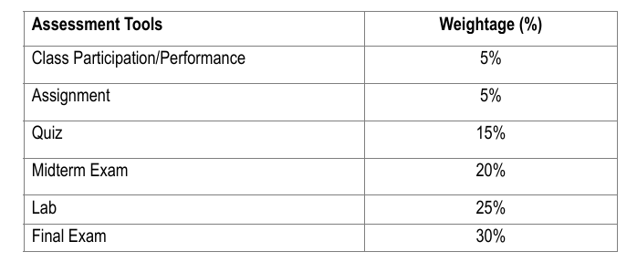
Marks Distribution*
* This is tentative and can change over the course of this semester

Slide 5
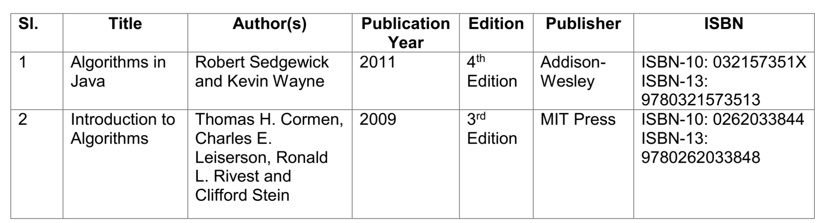
Reference Books

