Slide 1
MLP

Slide 2
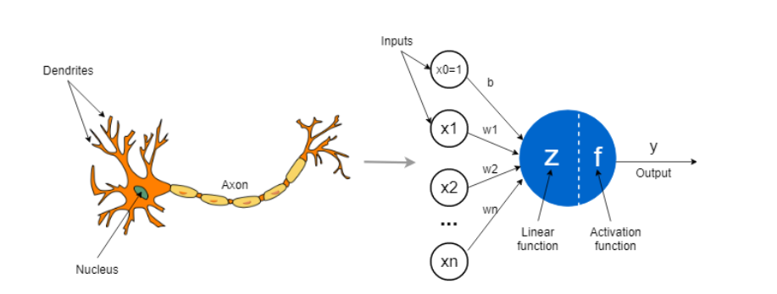
Perceptron

Slide 3
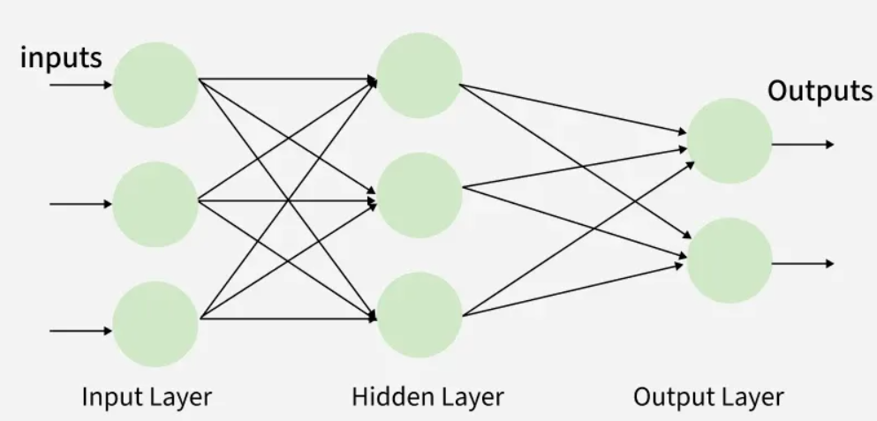
Multilayer Perceptron

Slide 4
Activities of MLP
Forward Propagation
Activation Function
Loss Function
Backpropagation
Optimization

Slide 5
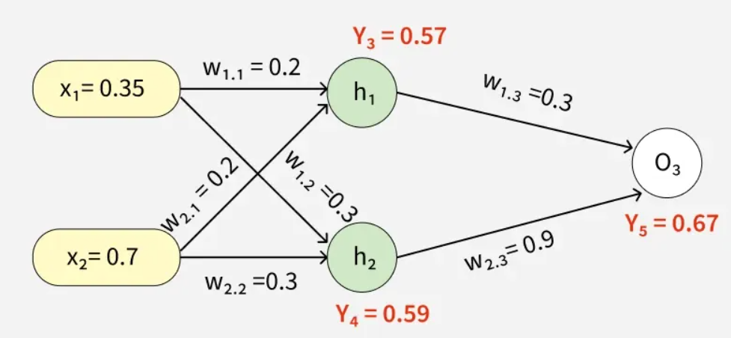
Forward Propagation

Slide 6
Activation Function
Sigmoid
Tanh
ReLU
Softmax

Slide 7
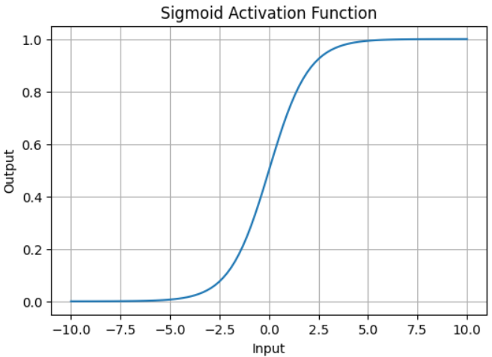
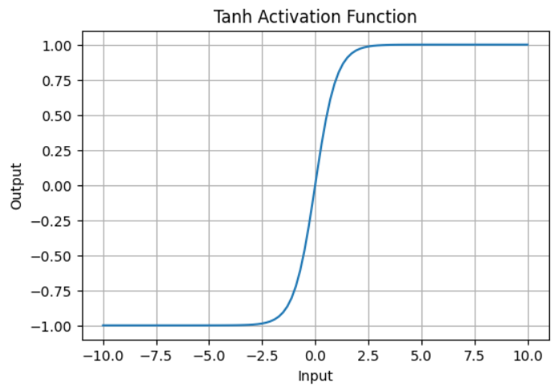
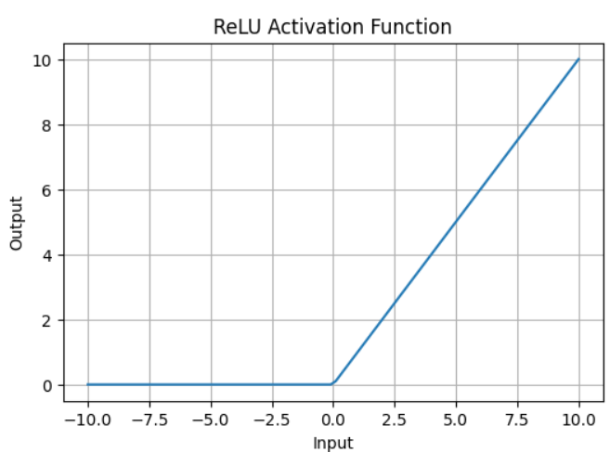
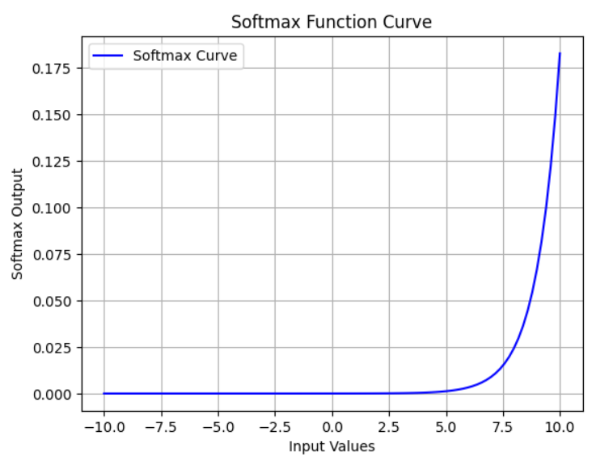
Activation Function

Slide 8

Loss Function
Binary Cross Entropy
Mean Squared Error (MSE)

Slide 9
Backpropagation

Slide 10


Optimizer
Gradient Descent
Adam Optimizer

Slide 11
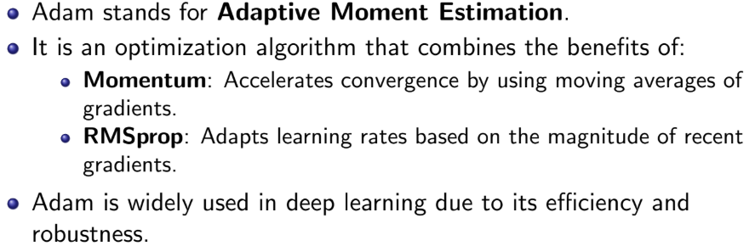
Adam Optimizer

Slide 12
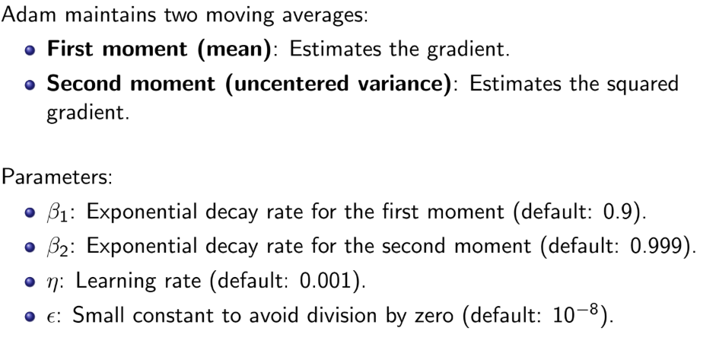
Adam Optimizer

Slide 13
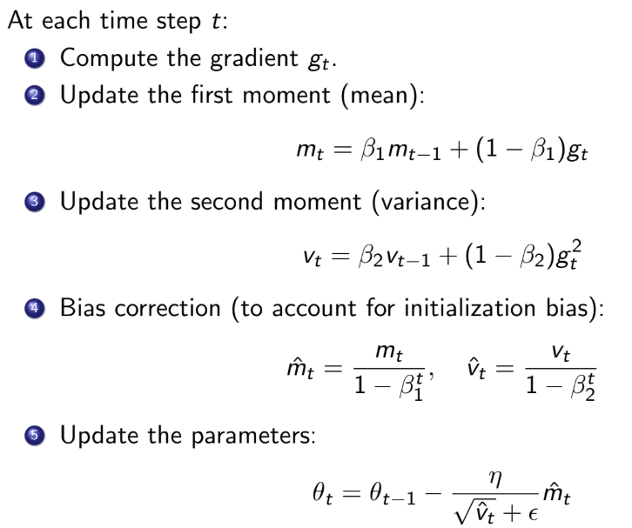
Adam Optimizer

Slide 14
Batch Vs Epoch
Batch :
Batch is a subset of the training dataset used to train the network in one step.
Epoch:
Epoch is one complete pass of the entire training dataset through the neural network.

Slide 15
Parameters Vs Hyperparameters
Parameters:
Parameters are the internal variables of the model that are learned automatically from the training data.
Hyperparameter:
Hyperparameters are the settings chosen by the user before training the network.

