Slide 1


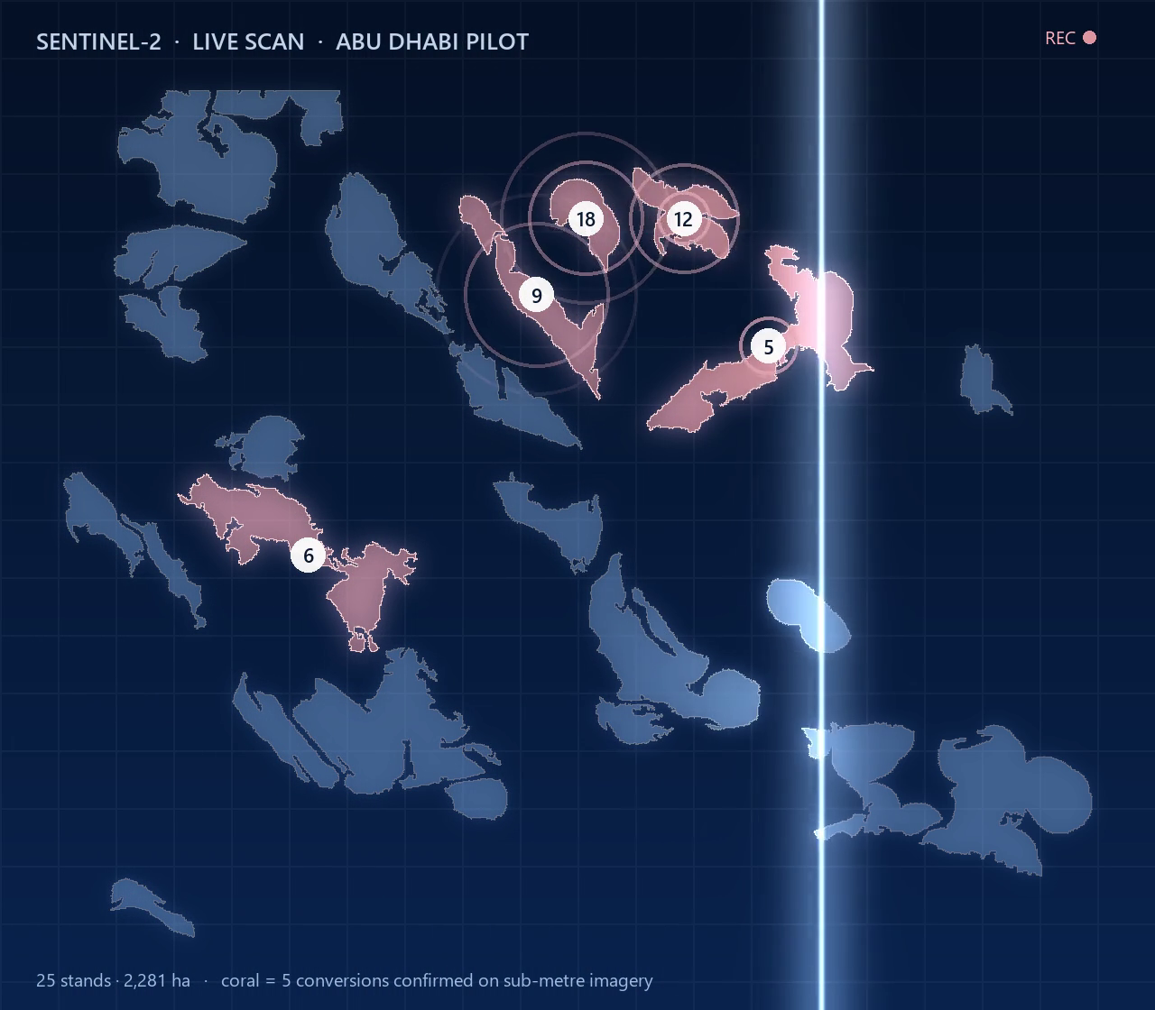



ARAB YOUTH SPACE HACKATHON 2026 · CHALLENGE 813 · FINAL
Blue Carbon Guardian
Tide-aware satellite monitoring for Gulf mangroves,
from alert to evidence.
Team: Blue Athar · الأثر الأزرق
Theme: Ecosystem Health, Biodiversity & Blue Carbon
91
5
73 %
≈ 1
stands monitored
conversions confirmed
partial loss caught (chance 13 %)
false alarm per stand-year
Study area: Abu Dhabi, UAE
Built in Bahrain
Nahla Nabil · Bahrain

Slide 2
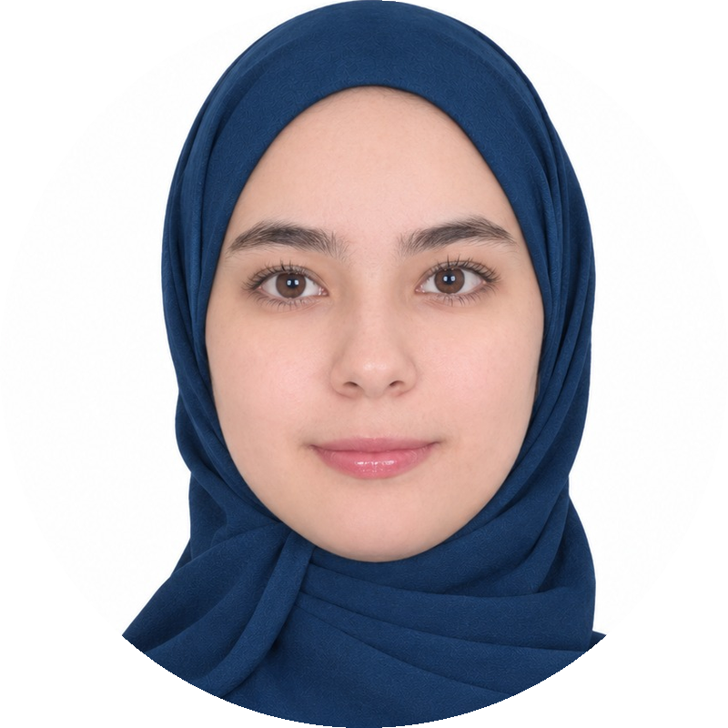







A solo project: one engineer, every role
THE TEAM
ROLES & RESPONSIBILITIES IN THIS PROJECT
Nahla Nabil
Solo founder · AI engineer
Project lead & owner
EO data engineer
Bahrain
problem framing, user needs, scope, every claim
778 Sentinel-2 dates, EnMAP reader, sub-metre checks
linkedin.com/in/nahla-nabil-876597211
EDUCATION
BSc Artificial Intelligence · Arab Open University, Bahrain, UK · final semester · First-Class Honours standing
Modelling & statistics
Validation & integrity
RESEARCH
tide-aware model, stand + cell alert, calibration
real events, simulations, unseen stands
Current focus: AI for measuring blue carbon
2 IEEE papers: ICCA 2025 and ICAISET 2026
3rd paper, presenting 29 Oct 2026: PIGNN-UQ, uncertainty-aware blue carbon crediting
Product & delivery
Business & impact
EXPERIENCE
dashboard, website, site reports, notebook
customers, pricing hypotheses, carbon ranges
IT intern · Ministry of Interior, Bahrain
AI & LLM engineering · Doo Bahrain, FlyRank US
Data Analysis
COMMUNITY
Incubation gap we will close: a mangrove ecologist mentor · a restoration or agency partner · a GIS analyst
NASA Space Apps Challenge Local Lead, Manama 2026

Slide 3
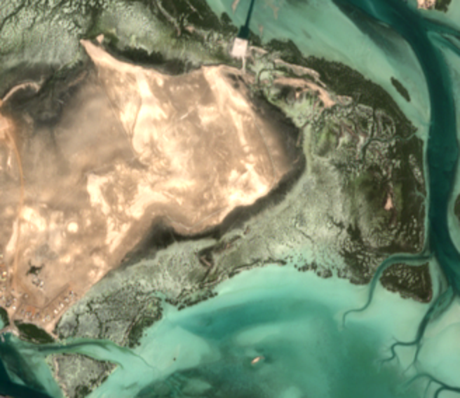
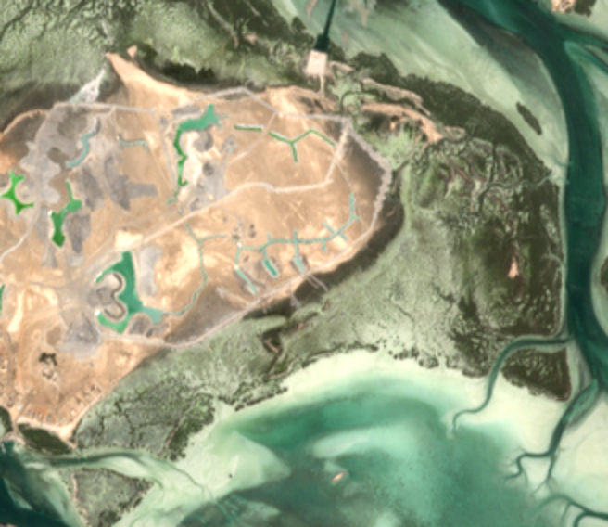
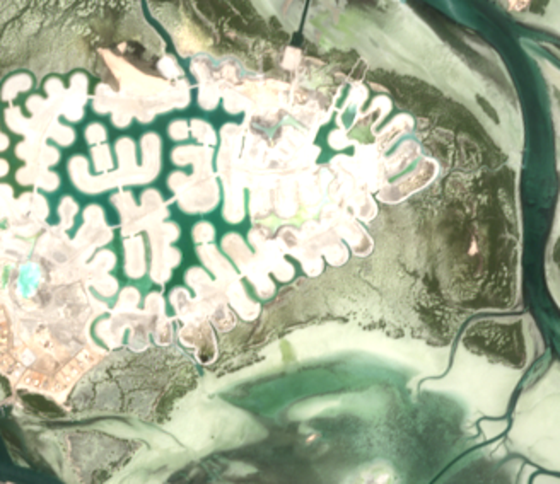
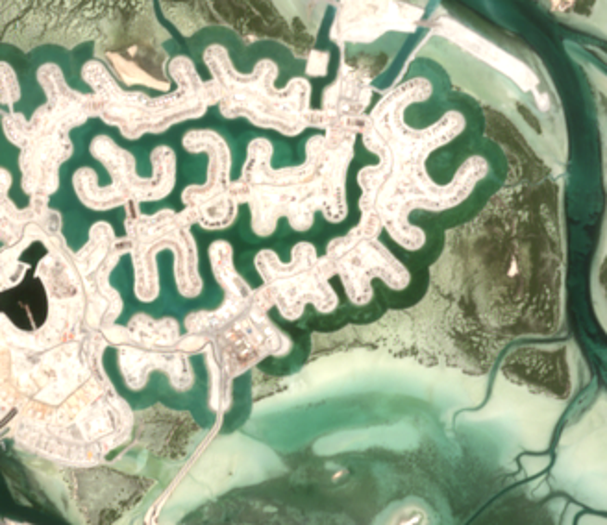
Restoration is scaling faster than monitoring
THE PROBLEM
100 M
UAE mangrove pledge by 2030
THIS IS HAPPENING NOW · STAND 5, ABU DHABI
COP26, 2021 · Abu Dhabi Mangrove Initiative
Nov 2021 · intact
Oct 2022 · works start, alert fires
100 M+
Saudi mangrove pledge by 2030
Saudi Green Initiative
×4
Bahrain mangrove pledge by 2035
COP26, 2021 · national net-zero path
Feb 2026
Jun 2023 · canals cut
May 2026 · development
first GCC mangrove monitoring guide
EAD + IUCN Mangrove Specialist Group
TODAY field surveys and one-off studies, no standing alert.
WE SOLVE a calibrated alert every ~5 days that says where to inspect and what carbon is at stake.
Sentinel-2 true colour (contains modified Copernicus Sentinel data). Our alert began on 25 Oct 2022, during the works.
Sources: UAE 100 M by 2030 — MOCCAE, COP26 (2021) · Saudi 100 M+ — Saudi Green Initiative · Bahrain ×4 by 2035 — COP26 (2021) · GCC mangrove monitoring guide — Environment Agency – Abu Dhabi with IUCN Mangrove Specialist Group (Feb 2026) · Guidelines for Mangrove Restoration in the UAE — EAD, MOCCAE, Emirates Nature–WWF

Slide 4
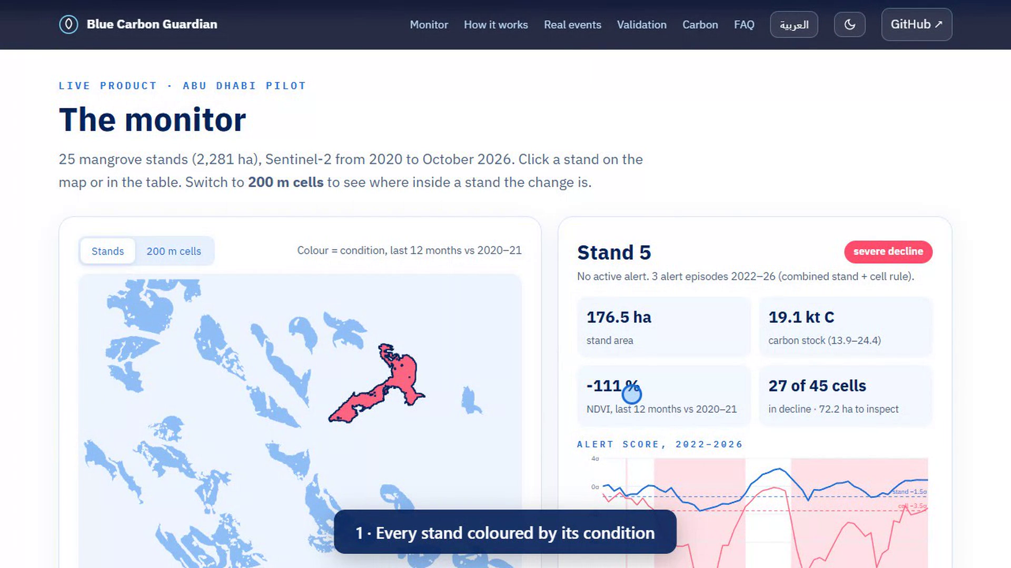





From signal to decision, in one screen
EXAMPLE OUTPUT · THE PRODUCT
nahla-nabil.github.io/blue-carbon-guardian
One alert
stand OR any 200 m cell, calibrated
Where to look
a 200 m cell map for the inspector
Condition
last 12 months vs own 2020–21 baseline
Carbon at stake
stock with a range, from field data
Site report
one page per stand, every number traced
● DEMO · the live website, stand 9

Slide 5



Who uses it, and for which decision
BUSINESS USE CASE & END USERS
Growth and protection, together: the UAE is planting 100 million mangroves as it builds its coast. This monitor helps both succeed.
Environment agencies
Planting & carbon developers
Developers & regulators
EAD, MOCCAE, Saudi NCVC
ADNOC, Red Sea Global, carbon projects
EIA consultants, permit offices
THEIR DECISION
THEIR DECISION
THEIR DECISION
Which stands do we inspect this month?
Is the carbon we report still there?
Did works stay outside the mangrove line?
Today: periodic field surveys
Today: plots and drone campaigns
Today: comparing two images by eye
monthly alert + 200 m cell map: inspect only flagged cells
condition + carbon stock with a range, a site report
an alert when works enter mangrove cells, dated evidence
New scene
Alert
Cell map
Inspection
Site report
every ~5 days
~1 false alarm / stand-yr
where to look
only flagged cells
carbon at stake

Slide 6
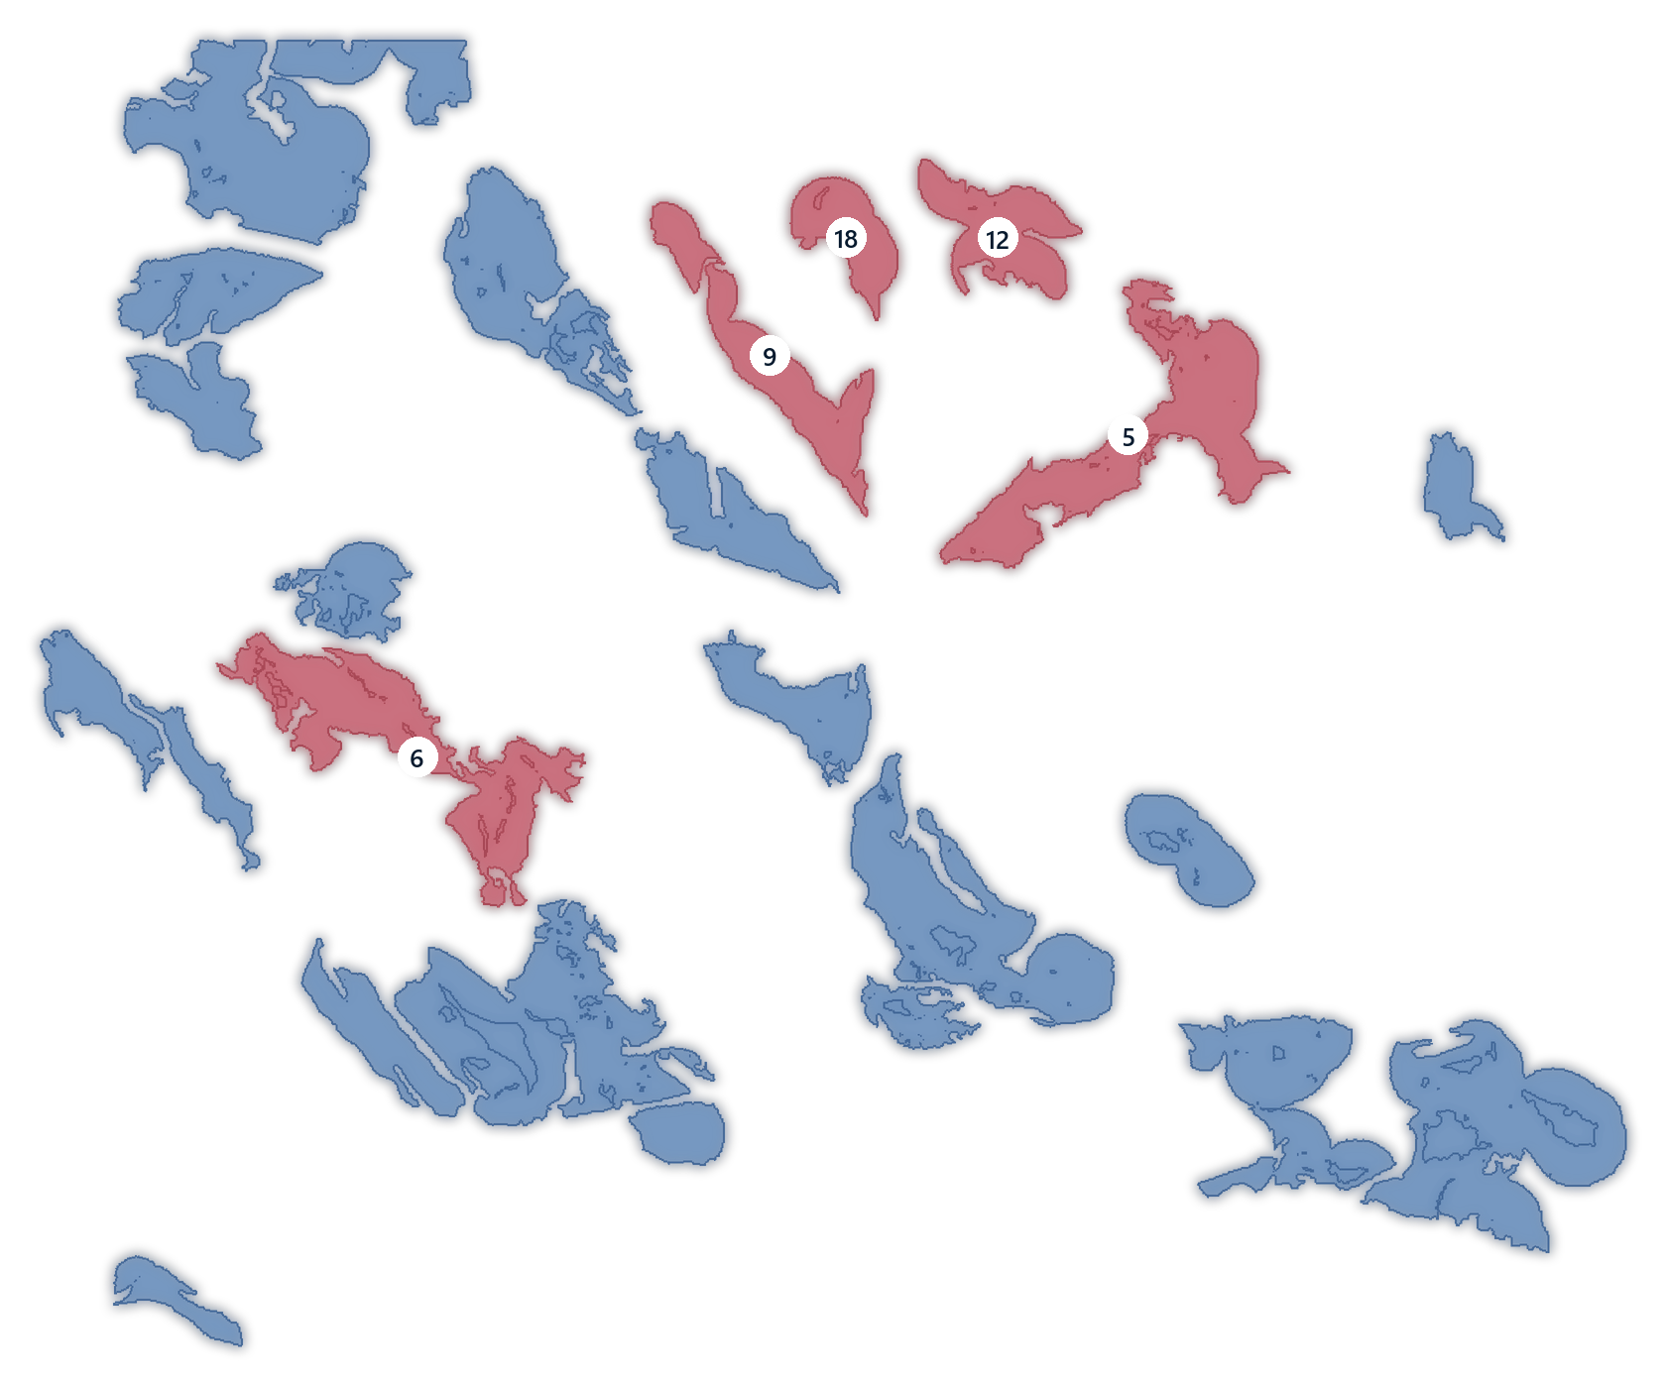

Five independent data sources, six years, 91 stands
DATA & STUDY AREA
Sentinel-2 L2A
778 dates
ESA / Copernicus · 10–20 m time series
EnMAP hyperspectral
2 scenes
DLR · 224 bands · independent check
ESA WorldCover 2021
CC BY 4.0
10 m land cover · stand outlines
Field carbon plots
24 plots
Schile et al. 2016 · carbon density
Pilot: 25 stands · 2,281 ha (WorldCover 2021 patches ≥ 3 ha). +66 unseen stands in Abu Dhabi N/W and Saudi Tarut Bay test transfer.
Sub-metre captures
0.3–0.5 m
WorldView-2/3, Legion-1 · confirm events
Quality control: cloud masks · interior pixels only · tide model · second-source checks

Slide 7
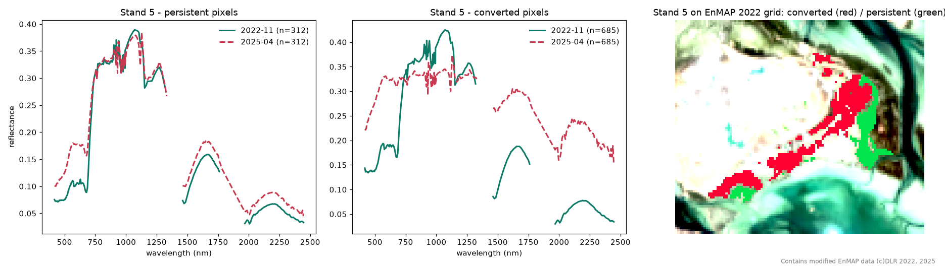
A second sensor shows what the mangrove became
SPACE DATA · HYPERSPECTRAL (ENMAP, 224 BANDS)
r = 0.84–0.99
62 vs 26 ha
Vegetation → mineral
agreement with our Sentinel-2 indices on the same dates (25 and 14 stands)
stand-5 loss: EnMAP pixel count vs our conservative Sentinel-2 flag
converted pixels take the spectrum of sand and fill: reclamation, not dieback
Honest limit: as a classifier, the full spectrum is no better than Sentinel-2-like bands (F1 0.74 vs 0.72). Contains modified EnMAP data © DLR 2022, 2025.

Slide 8


Sentinel-2 says when. Satellite 813 says what.
SPACE DATA · READY FOR SATELLITE 813
Sensor | Bands | Range | Pixel | Revisit | Role in the product
Sentinel-2 | 13 | 443–2190 nm | 10–20 m | ~5 days | WHEN: the alert, every pass
EnMAP (used) | 224 | 420–2450 nm | 30 m | ~27 days | WHAT: tested on stand 5
Satellite 813 (next) | ~205 | ~400–1700 nm | ~20 m | on demand | WHAT, sharper: tasked on flagged cells
1 · Sentinel-2 alert
2 · Task Satellite 813
3 · Spectral diagnosis
→
→
stand or 200 m cell below its threshold
only over the flagged cells, on demand
vegetation, or sand and fill: an evidence pack
Every index the monitor uses (NDVI, red edge, SWIR moisture at 1610 nm, wetness) sits inside 813's ~400–1700 nm range, at 20 m instead of EnMAP's 30 m. Simulated with EnMAP’s 400–1700 nm bands: the stand-5 loss still reads vegetation → sand and fill (97 % of converted pixels, 0.4 % of intact ones). Not yet on real 813 data.

Slide 9
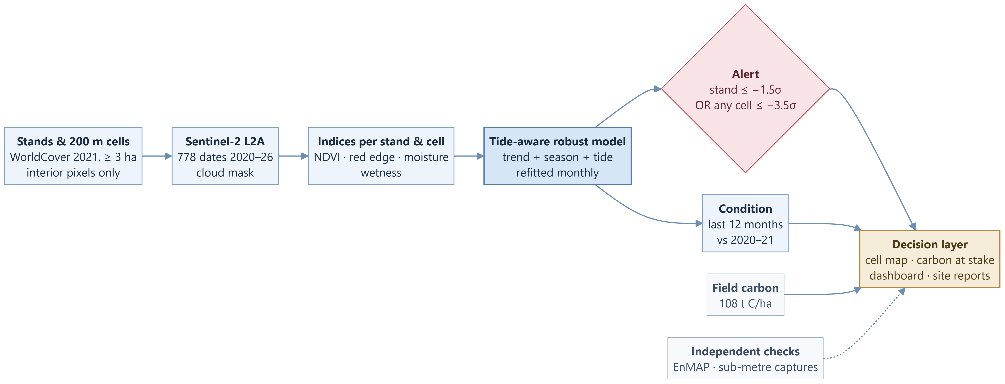
From satellite pixels to a decision
APPROACH · HOW IT WORKS
Read left to right:
Core model
Alert rule
Output to the user
Inputs and checks

Slide 10
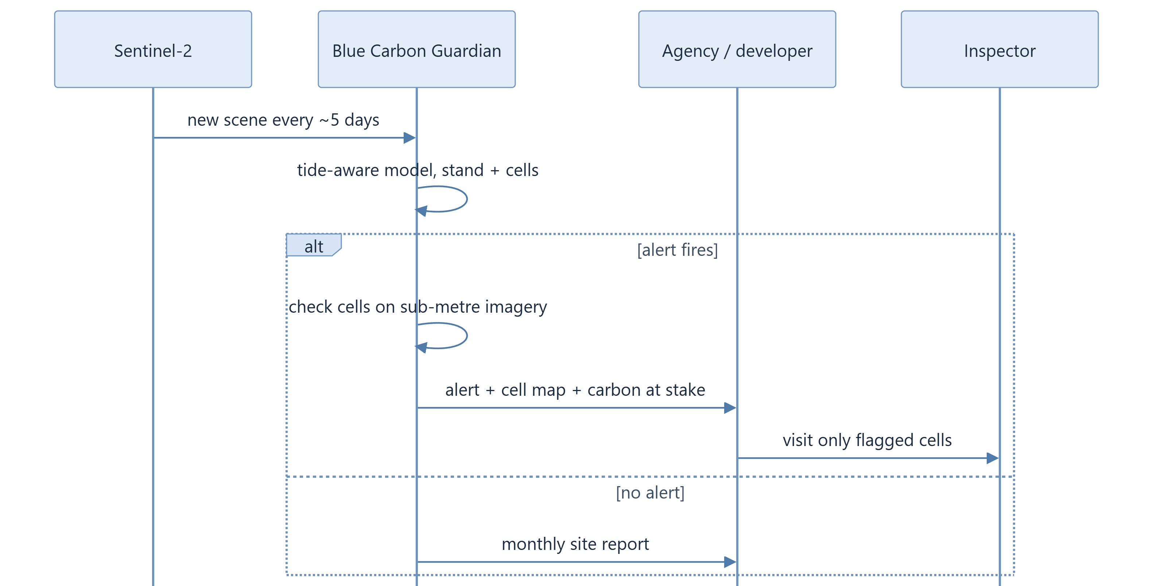


One alert, one message, one targeted visit
DELIVERY · HOW A USER RECEIVES IT
Every ~5 days
a new Sentinel-2 scene is read in place and run through the tide-aware model, per stand and per 200 m cell
If an alert fires
we check the flagged cells on sub-metre imagery, then send the alert by email or JSON API with the cell map and the carbon at stake
If nothing changes
the user still gets a monthly site report: condition, trend and carbon stock for every stand

Slide 11
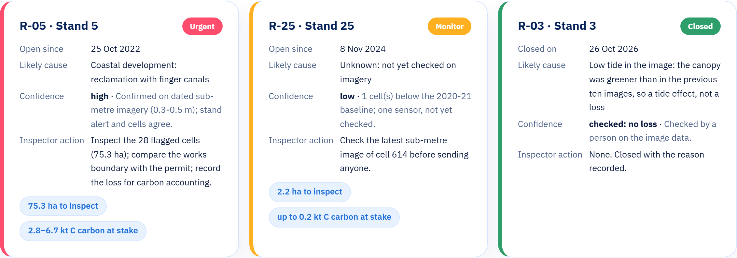
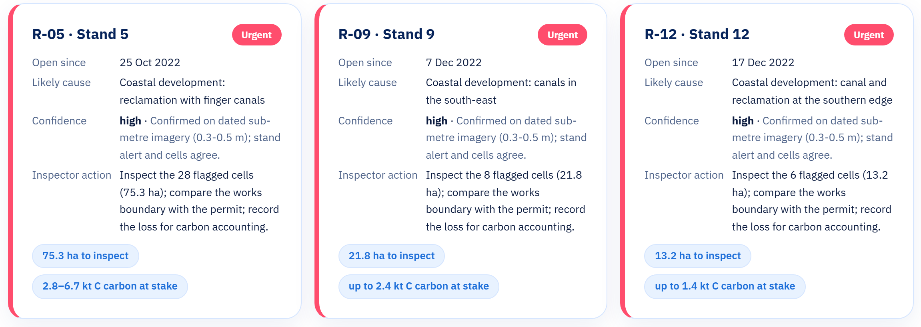
A F T E R B A H R A I N S P A C E A G E N C Y F E E D B A C K
Every flag becomes a case
4 · Urgent
4 · Monitor
1 · Closed
date · likely cause · confidence · inspector action · open until a person closes it
Live on the website (Risks section) and as a data feed: api/v1/risks.json

Slide 12

The tide looks like tree loss — until you correct for it
TECHNICAL INNOVATION 1
WHY SIMPLE MONITORS STRUGGLE ON TIDAL FLATS
Low tide
High tide
NDVI 0.30
NDVI 0.18
Same trees, same season. Measured on our stands: noise vs wetness r ≈ −0.9.
−29 to −35 %
less noise on every index: we model trend, season and the tide before flagging anything
1.61 → 0.96
false alarms per stand-year: NDVI alone vs our tide-aware monitor, same alert rule, same 25 stands (40 % fewer)

Slide 13
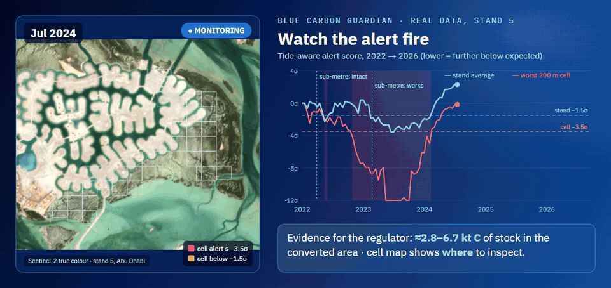
A stand average hides partial loss. 200 m cells do not.
TECHNICAL INNOVATION 2
8 of 28
cells of stand 9 in severe decline while its average reads “stable”
3 of 5
real conversions found only by the cells (stands 12, 18, 6)
ONE ALERT RULE
Real stand-5 data, 2022 → 2026: cells turn red while the stand average barely moves.
stand ≤ −1.5σ
OR
any cell ≤ −3.5σ
Partial loss caught within 60 days (simulated)
calibrated together: 0.96 false-alarm episodes per stand-year
73 % stand + cells
25 % stand alone
13 % by chance

Slide 14
M E T H O D I N O N E S L I D E
How the numbers are made
T I D E , F R O M T H E I M A G E I T S E L F
E X P E C T E D V A L U E , P E R S T A N D A N D C E L L
MNDWI = (Green − SWIR) / (Green + SWIR)
flooded share = % of pixels with MNDWI > 0
index ≈ trend + season + tide
tide = MNDWI, MNDWI², flooded share
No tide table: the image shows how much water is under the trees at that exact moment (Sentinel-2 bands B3 and B11).
Robust regression for NDVI, red edge and NDMI, refitted every month on the past 3 years only. The tide terms cut noise by 29–35 %.
A L E R T
W H Y 2 0 0 - M E T R E C E L L S
z = (observed − expected) / robust σ
alert: stand ≤ −1.5σ OR any cell ≤ −3.5σ
200 m = 20 × 20 Sentinel-2 pixels
= 400 pixels = 4 ha
1 cell = 400 px
Median of the last 5 images, so one bad image cannot fire it. Thresholds set on unchanged stands: about 1 false alarm per stand per year.
Enough pixels to average out noise, small enough to send an inspector to 4 ha. 3 of the 5 real losses were found only by cells.
Carbon = area × 108 t C/ha (field plots, Schile et al. 2017). Full equations and sources: README › References and equations.

Slide 15
How we differ from what exists today
INNOVATION & DIFFERENTIATION
 | Field surveys | One-off satellite maps | Free loss alerts (Global Mangrove Watch) | Blue Carbon Guardian
How often | campaigns | yearly or less | monthly | every ~5 days
Corrects for the tide | n/a | not usually | not documented | ✓ tide model
Says where inside a stand | ✓ | — | — | ✓ 200 m cells
Published false-alarm rate | n/a | n/a | accuracy only | ✓ ≈ 1 per stand-year
Carbon at stake per alert | — | — | — | ✓ field-based
Gulf coverage | ✓ | ✓ | not confirmed | ✓ Abu Dhabi + Tarut Bay
Complementary, not competing: Global Mangrove Watch flags loss worldwide; we add the tide model, the 200 m cells, a measured false-alarm rate and the carbon at stake — built and tested for the Gulf.

Slide 16
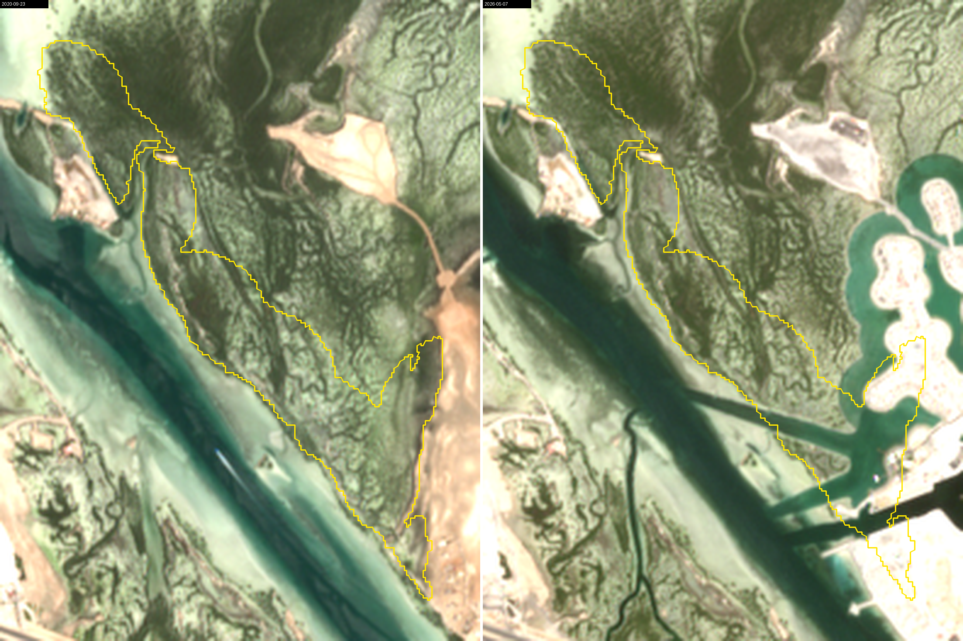
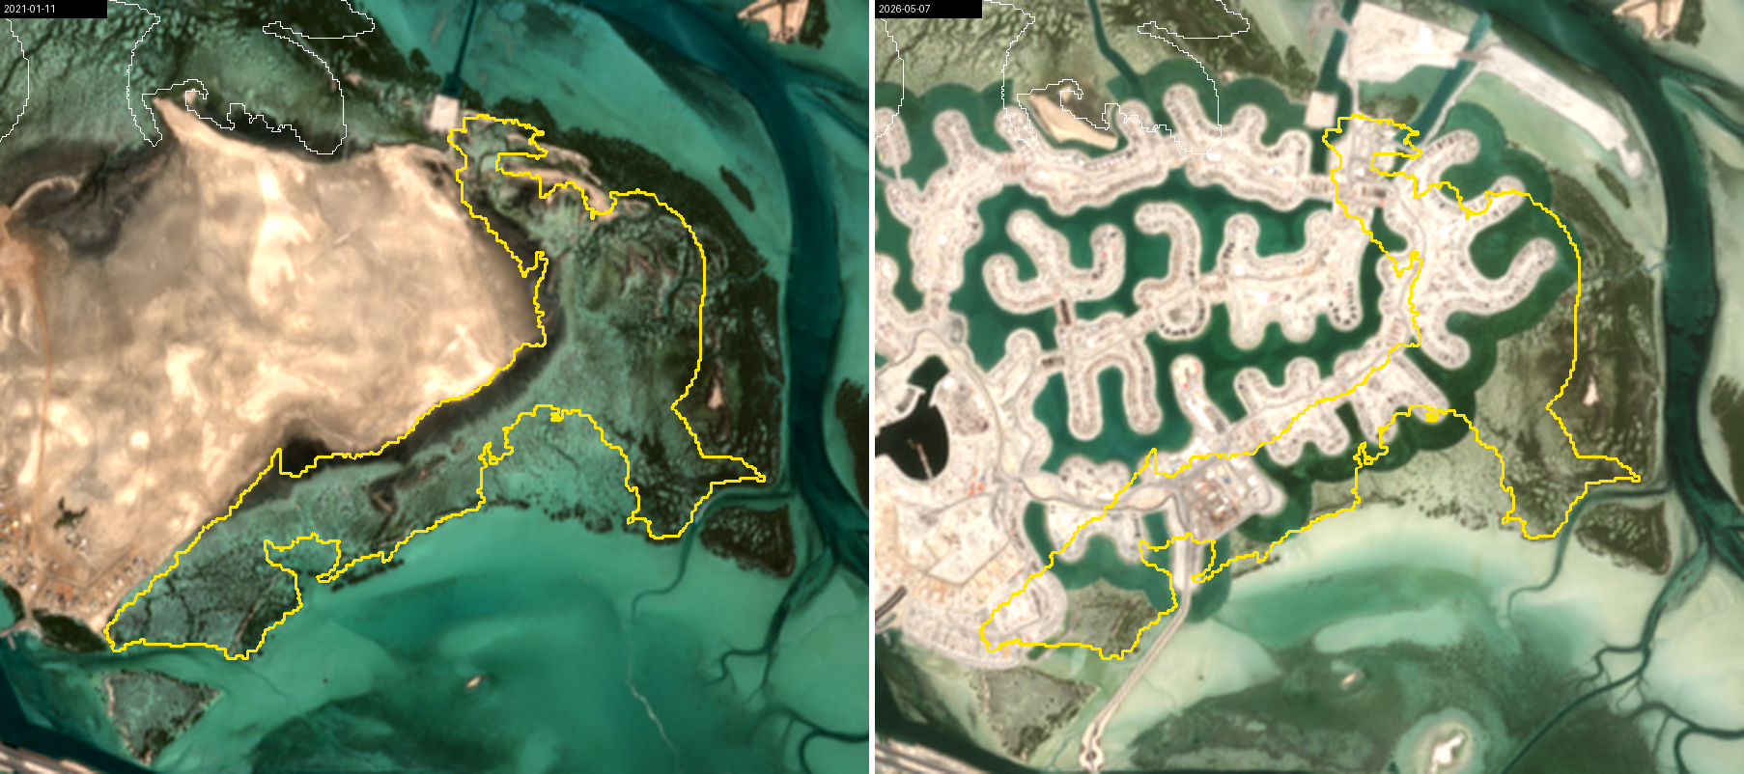
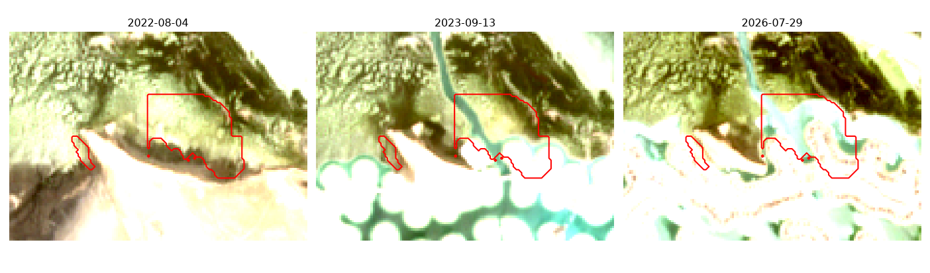
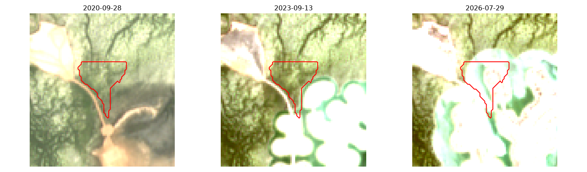
Five real conversions, confirmed on sub-metre imagery
VALIDATION 1 · REAL EVENTS
WHEN DID THE ALERT START?
Stand 5
Stand 9
Stand 12
Stand 6
Stand 5 reclamation with finger canals
Stand 9 canal development, south-east
Stand 18
2022
2023
2024
2025
last intact → first capture with works
our alert starts
Every alert began inside the window. Detection as works happen, not advance warning.
Stand 12 found only by the cells
Stand 18 found only by the cells, 2025

Slide 17
Every rate next to its chance rate
VALIDATION 2 · CHANCE, UNSEEN STANDS, SECOND SENSOR
CALIBRATED · 25 STANDS
0.96
false-alarm episodes per stand-year
UNSEEN · 65 STANDS
0.79
per stand-year, 305 stand-years, incl. Saudi Tarut Bay
ENMAP · SAME DATES
r = 0.84–0.99
vs our Sentinel-2 indices; stand-5 loss 62 ha vs our 26 ha
A detection counts only if a new alert starts after the loss begins. ~160–240 trials per row.
What we do not claim: advance warning, field verification, species discrimination, or that hyperspectral classifies better (F1 0.74 vs 0.72).

Slide 18
Carbon at stake, and who pays to protect it
IMPACT & BUSINESS VIABILITY
108 t C/ha
247 kt C
2.8–6.7 kt C
field density near the stands (90 % CI 79–138); 82 % of it is in the soil
pilot stock, 2,281 ha (range 180–316) ≈ 907 kt CO₂e
stock on the 26–62 ha lost at stand 5: what one alert puts on the table
SERVICE TIERS (PRICES ARE PILOT HYPOTHESES)
COMPETITION
Global Mangrove Watch sends free monthly loss alerts (Gulf coverage not confirmed). We are complementary: tide-aware, calibrated, stand + cell, carbon and reports.
Monitor
Evidence
Development watch
$12k
$25k
$8k
per site / yr
per site / yr
per project / yr
alert, cell map, condition, carbon, monthly reports
+ sub-metre check of every alert, audit pack
for coastal developers and EIA consultants
THE HONEST MARKET
Gulf + Red Sea subscriptions ≈ $0.2–0.4 M / yr. The real prize: a national MRV contract or a monitoring layer on gIQ. SDG 13 · 14 · 15.
Cost to serve ≈ $3.3k / site / yr: compute < $5 (measured), sub-metre checks $500–750, analyst $2k (assumption).
Carbon at stake = lost area × field carbon density: 26–62 ha (our Sentinel-2 and EnMAP estimates) × 108 t C/ha (90 % CI 79–138; Schile et al. 2017, Ecol. Appl. 27:859; data Dryad doi 10.15146/R3K59Z) = 2.8–6.7 kt C; × 3.67 = t CO₂e. Cost to serve = compute < $5 (measured; Azure D8s v5 $0.384/h) + sub-metre checks $500–750 (SkyWatch $19–29/km²) + analyst $2k (assumption). Prices are pilot hypotheses.

Slide 19






Reproducible today, built to scale tomorrow
DOCUMENTATION & EVIDENCE · DEVELOPMENT POTENTIAL
DOCUMENTATION & EVIDENCE
DEVELOPMENT POTENTIAL
Public repository, MIT licence
Proven now
code, notebook, figures, provenance and licences
91 stands · 2 countries · 2 Sentinel-2 tiles · 65 unseen stands at 0.79 false alarms / stand-yr · compute < $5 per site per year
Re-runs end to end in ~24 s
Python 3.12 · Planetary Computer · pinned requirements
Incubation
Clean-machine test passed
Satellite 813 in the spectral step · deployment on gIQ · a pilot customer + site records · recovery tracking for planting
fresh environment, same numbers, 0 errors
Every number traceable
each figure comes from a script and a written summary
Scale
Live website + site reports
Gulf ≈ 165 km² + Red Sea ≈ 200 km² of mangrove · sub-metre data for small stands (Bahrain) · national MRV, licensing
anyone can open the monitor and check a stand
Areas: Frontiers in Marine Science 2025. Compute measured; prices assumed.

Slide 20



W H Y I T M A T T E R S I N T H E R E G I O N
Big pledges, and a coast that is changing fast
🌍
UAE
Saudi Arabia
Bahrain
Arab region
100 M
100 M+
×4
≈ 365 km²
mangroves by 2030 · MOCCAE, COP26. First GCC monitoring guide: EAD with IUCN, Feb 2026.
mangroves by 2030 · Saudi Green Initiative. Red Sea Global alone: 50 million by 2030.
its mangroves by 2035 · pledged at COP26 (2021). Small stands: they need higher-resolution imagery.
of mangrove on the Gulf (≈ 165) and Red Sea (≈ 200) coasts; monitoring still “uneven”.
5 / 25
pilot stands lost mangrove to coastal development in 2022–25, confirmed on sub-metre imagery (our result).
$25–29
per tonne of CO₂e: blue-carbon credit prices 2024–25 (S&P Global Platts). A lost hectare is also lost value.
Tested: Abu Dhabi + Saudi Tarut Bay · same species across the Gulf (Avicennia marina) · Next: Bahrain, sharper imagery
Sources: MOCCAE COP26 pledge (2021) · EAD–IUCN GCC mangrove monitoring guide (Feb 2026) · Saudi Green Initiative · Red Sea Global (2023) · Bahrain four-fold by 2035 (GDN, COP26) · Frontiers in Marine Science 2025, doi 10.3389/fmars.2025.1695426 · S&P Global Platts 2024–25

Slide 21
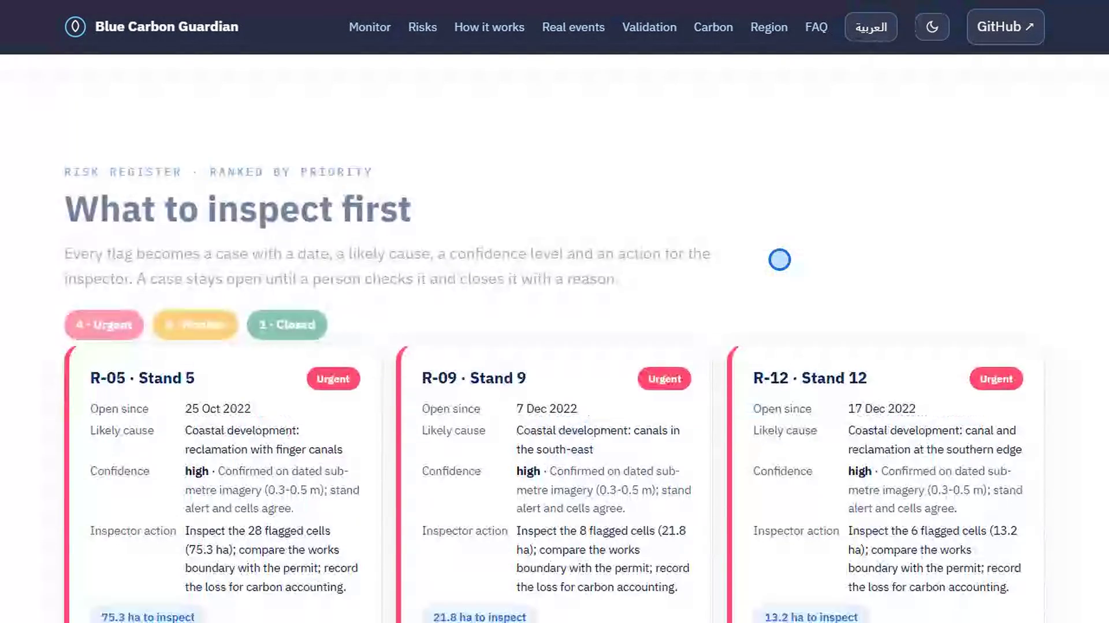

Slide 22
TEAM BLUE ATHAR · الأثر الأزرق
Every lost mangrove leaves a trace.
We find it from space.
Overall value: a working product · five real events confirmed · every number reproducible
Tide-aware
5 of 5
0.79
Open
29–35 % less noise
conversions alerted during the works, 3 only by cells
false alarms / stand-yr on unseen stands
public code, re-runs in ~24 s
Next: from PoC to an MVP on GIQ. In incubation: publish on the GIQ marketplace, pilot with a Gulf agency in Abu Dhabi or Bahrain, add Satellite 813 scenes and recovery tracking.
nahla-nabil.github.io/blue-carbon-guardian · github.com/Nahla-Nabil/blue-carbon-guardian

Slide 23




B A H R A I N S P A C E A G E N C Y
Expert Evaluation and Feedback
O F F I C I A L S T A T E M E N T
“
The Bahrain Space Agency commends Ms. Nahla Nabil for presenting Blue Carbon Guardian, an innovative project using Earth Observation data to monitor regional mangrove ecosystems. The Agency provided specialised assessment and technical feedback, reaffirming its commitment to supporting research and innovation that advance Bahrain's environmental objectives and sustainability goals.
Specialised assessment and technical feedback
— Bahrain Space Agency, official statement
for research that advances Bahrain's environmental goals
Meeting and written feedback, 26 Oct 2026 ·
Eng. Roaya Bubshait, Head of Satellite Images & Data Analysis,
with Eng. Aysha Aljawder, Eng. Aysha Almahmeed and Eng. Suad Khalifa
P O T E N T I A L A D O P T E R S I N B A H R A I N · supporting the national pledge to quadruple mangroves by 2035
Bahrain's mangrove stands are smaller than Abu Dhabi's: monitoring them needs higher-resolution imagery than open data (10 m) provides.
Supreme Council for Environment
Municipalities & Agriculture
Universities
tracking the national mangrove target
planting and coastal permits
Earth-observation research

Slide 24
Thank you
شكراً لدولة الإمارات العربيـة المتحدة
To the United Arab Emirates for leading the region in protecting its mangroves, and for opening space to Arab youth.
With thanks to: UAE Space Agency · National Space Academy · Space42 · the mentors and the judges
From Bahrain, with gratitude | Nahla Nabil · Team Blue Athar

Slide 25
R E F E R E N C E S
Where every number comes from
EXTERNAL SOURCES
UAE: 100 M mangroves by 2030 Ministry of Climate Change and Environment, COP26 (2021); Abu Dhabi Mangrove Initiative, EAD (2022)
Saudi Arabia: 100 M+ by 2030 Saudi Green Initiative (sgi.gov.sa); Red Sea Global, 50 M by 2030 (2023)
Bahrain: ×4 mangroves by 2035 COP26 pledge (2021), GDN Online
GCC mangrove monitoring guide EAD with IUCN Mangrove Specialist Group (Gulf News, 24 Feb 2026); Guidelines for Mangrove Restoration in the UAE (EAD, MOCCAE, Emirates Nature–WWF)
Mangrove areas, “uneven” monitoring Frontiers in Marine Science (2025), doi 10.3389/fmars.2025.1695426
108 t C/ha (90 % CI 79–138) Schile et al. 2017, Ecological Applications 27:859–874, doi 10.1002/eap.1489; field data Dryad doi 10.15146/R3K59Z (CC0)
$25–29 per t CO₂e S&P Global Platts blue-carbon assessments, 2024–25
Cost to serve SkyWatch imagery pricing $19–29/km²; Azure D8s v5 $0.384/h; analyst time = assumption
Global Mangrove Watch alerts Bunting et al. 2023, Remote Sensing 15:2050
Data Sentinel-2 L2A (ESA Copernicus, via Microsoft Planetary Computer) · EnMAP L2A © DLR 2022, 2025 · ESA WorldCover 2021 (CC BY 4.0) · Esri World Imagery Wayback (Maxar)
OUR OWN RESULTS · FILE IN THE PUBLIC REPOSITORY
Tide model: −29 to −35 % noise analysis/07_summary.md
40 % fewer false alarms (1.61 → 0.96) analysis/35_textbook_baseline.md
73 % vs 13 % by chance analysis/29_cell_trigger.md, 30_backtest_null.md
0.96 calibrated · 0.79 on 65 unseen stands analysis/31_union_alerts.py, 33_scaleout_union_summary.md
Five real events, alert inside image windows analysis/34_vhr_summary.md, 26_substand_summary.md
EnMAP r 0.84–0.99 · 26–62 ha lost analysis/18_enmap_summary.md
Satellite 813 simulation (97 % / 0.4 %) analysis/36_sat813_summary.md
247 kt C · 2.8–6.7 kt C at stake analysis/13_carbon_summary.md (area × field density)
Prices and unit economics docs/business_plan_draft.md (13 numbered sources)
Everything re-runs notebooks/01_blue_carbon_guardian.ipynb · github.com/Nahla-Nabil/blue-carbon-guardian

Slide 26
B A C K U P · M E T H O D
All the equations behind the numbers
1 · Indices (Sentinel-2 bands)
NDVI = (B8 − B4) / (B8 + B4)
NDRE = (B8A − B5) / (B8A + B5)
NDMI = (B8A − B11) / (B8A + B11)
greenness · chlorophyll (red edge) · canopy moisture
2 · Tide, from the image
MNDWI = (B3 − B11) / (B3 + B11)
flooded share f = % of pixels with MNDWI > 0
median over interior pixels of each stand / cell, every image
3 · Expected value (per stand, cell, index)
index(t) = a + b·t + seasonal (1 and 2 cycles a year)
+ e₁·MNDWI + e₂·MNDWI² + e₃·f + noise
Huber robust regression, refitted monthly on [t − 36 m, t − 3 m]
4 · How unusual is today?
σ = 1.4826 × median | r − median(r) |
z = (observed − expected) / σ
state = median of last 5 of mean(z_NDVI, z_NDRE, z_NDMI)
r = residuals of the fit; one bad image cannot fire an alert
5 · Alert
ALERT if stand state ≤ −1.5 OR any cell state ≤ −3.5
thresholds set on stands with no change → 0.96 false-alarm episodes / stand-year
6 · Condition (last 12 months vs 2020–21)
change % = (now − base) / |base| × 100
severe: NDVI and NDMI ≤ −50 % · decline: ≤ −15 % and ≤ −3σ
on the tide-corrected series; now = median of the last 12 months, base = median of 2020–21
7 · Carbon
stock = area × 108 t C/ha (90 % CI 79–138)
CO₂e = C × 44 / 12 (= 3.67)
stand 5: 26–62 ha × 108 = 2.8–6.7 kt C
density from 24 field plots near the stands (Schile et al. 2017)
8 · Validation
false-alarm rate = alert episodes ÷ stand-years (no change)
detection = % of simulated losses with a NEW alert ≤ 60 days
chance = the same test with no loss → 73 % vs 13 %
simulated loss = a tenth of a stand loses half its canopy

Slide 27
NDVI alone against our monitor, same alert rule
BACKUP · FOR QUESTIONS
Configuration | Indices | Tide model | False alarms per stand-year | Real conversions caught
A · NDVI only | NDVI | no | 1.61 | 5 of 5
B | NDVI | yes | 1.04 | 5 of 5
C | NDVI + red edge + SWIR moisture | no | 1.36 | 5 of 5
D · ours | NDVI + red edge + SWIR moisture | yes | 0.96 | 5 of 5
40 % fewer false alarms
The tide model is most of the gain
Honest limit
20 stands with no known change, 93.9 stand-years: about 16 fewer unnecessary inspections a year for 25 stands.
NDVI alone 1.61 → with tide terms 1.04; the extra indices bring it to 0.96.
Thresholds calibrated for our monitor; all four catch the five conversions. The difference is the false-alarm cost, not detection.

Slide 28

Where it breaks — and what we do not claim
BACKUP · FOR QUESTIONS
Detection, not early warning
10 m pixels
Imagery, not site visits
Alerts fire as works happen. We never claim to see stress before it is visible.
Patches under ~0.6 ha and young plantings are missed, Bahrain's small stands included.
Conversions confirmed on dated sub-metre captures, not yet on permits or field records.
Simulated losses
Hyperspectral
Carbon
Canopy-cover loss, not leaf stress; every rate shown next to its chance rate.
EnMAP confirms our indices but was not a better classifier (F1 0.74 vs 0.72).
Area × field density from four sites (2013–14): a stock with a range, never a sequestration rate.
Rule we kept: no detection rate without its chance rate; no claim of advance warning, field verification or species discrimination.

