Slide 1


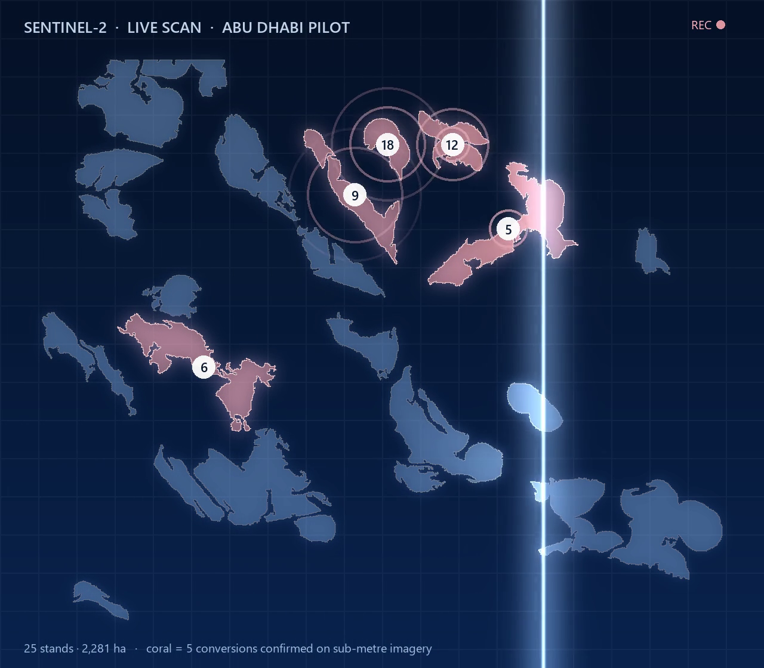



ARAB YOUTH SPACE HACKATHON 2026 · CHALLENGE 813 · FINAL
Blue Carbon Guardian
Tide-aware satellite monitoring for Gulf mangroves —
from alert to evidence.
Team Blue Athar · الأثر الأزرق
Theme: Ecosystem Health, Biodiversity & Blue Carbon
91
5
73 %
≈ 1
stands monitored
conversions confirmed
partial loss caught (chance 13 %)
false alarm per stand-year
Study area: Abu Dhabi, UAE
Built in Bahrain
Nahla Nabil · Bahrain
Notes:
TIME: 15 s
SAY (calm, slow): "Good morning. I'm Nahla Nabil, team Blue Athar.
What you are watching is a satellite pass over 25 mangrove stands in Abu Dhabi.
The five in red were lost to construction between 2022 and 2025 — and our system raised an alert on every one of them while the works were happening.
This is Blue Carbon Guardian."
DO: let the scan run for one sweep, then press → .
BEFORE YOU START: PowerPoint in Slide Show (Presenter View); browser already open on nahla-nabil.github.io/blue-carbon-guardian/#monitor (page loaded, zoom 100 %); notifications off.

Slide 2
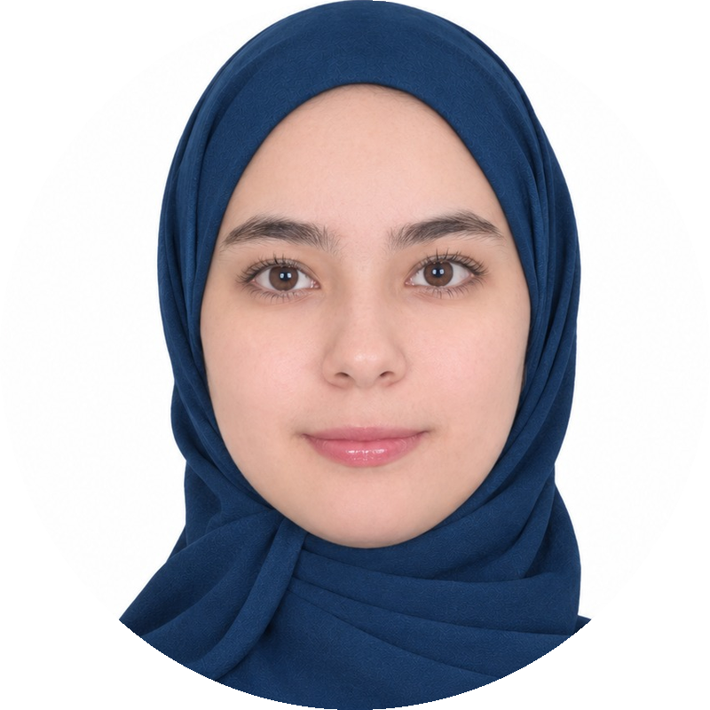






One engineer, every role — delivered in the open
THE TEAM
ROLES & RESPONSIBILITIES IN THIS PROJECT
Nahla Nabil
Team lead · AI engineer · IEEE researcher
Project lead & owner
EO data engineer
Bahrain
problem framing, user needs, scope, every claim
778 Sentinel-2 dates, EnMAP reader, sub-metre checks
EDUCATION
BSc Artificial Intelligence · Arab Open University, Bahrain · final semester · First-Class Honours standing
Modelling & statistics
Validation & integrity
tide-aware model, stand + cell alert, calibration
real events, simulations, unseen stands
RELEVANT EXPERTISE
2 IEEE papers (ICCA 2025, ICAISET 2026): federated learning for industrial IoT; random-forest audit of GCC sustainability
AI & LLM product engineering (Doo Bahrain; FlyRank backend AI)
Machine learning, computer vision (deepfake detection), Python geospatial stack
Product & delivery
Business & impact
dashboard, website, site reports, notebook
customers, pricing hypotheses, carbon ranges
COMMUNITY
Incubation gap we will close: a mangrove ecologist mentor · a restoration or agency partner · a GIS analyst
NASA Space Apps Challenge local lead (Manama): organising and mentoring space-data teams
Notes:
TIME: 30 s
SAY: "Before the problem — who is behind this. A team of one. I held every role on this slide — satellite pipeline, statistics, product and business case.
I'm finishing a BSc in Artificial Intelligence at the Arab Open University in Bahrain, with First-Class Honours standing; I have two IEEE papers in machine learning, and I lead NASA Space Apps locally. I worked with an AI-assisted engineering workflow that I direct and review — and every number is public and checkable.
In incubation I will add what I don't have: a mangrove ecologist and a field partner."
DO: press → .

Slide 3
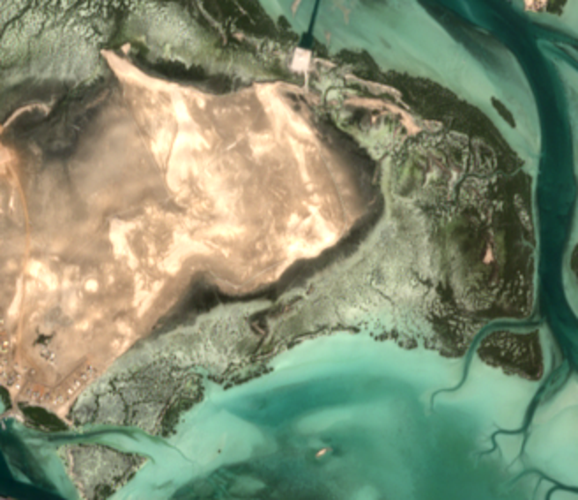
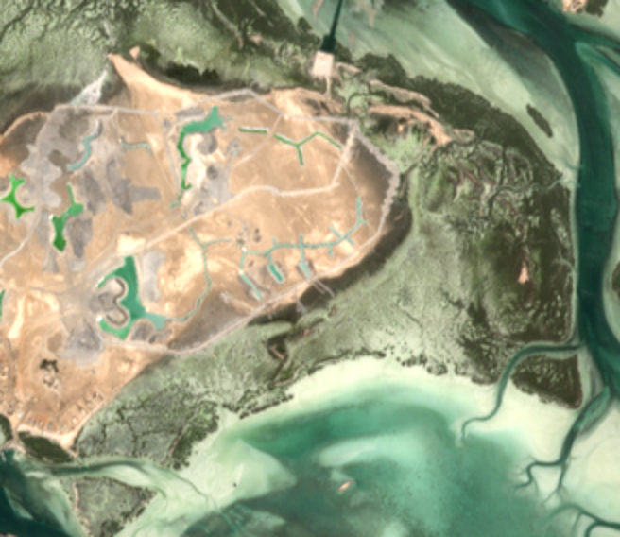
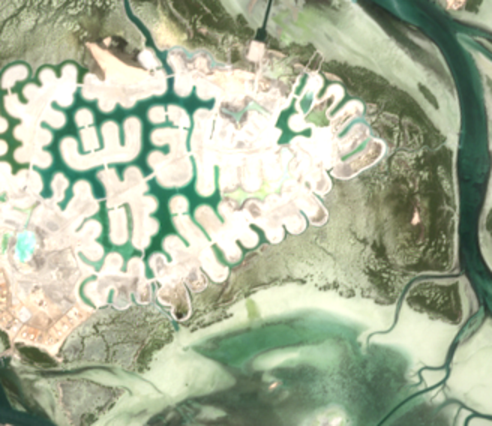
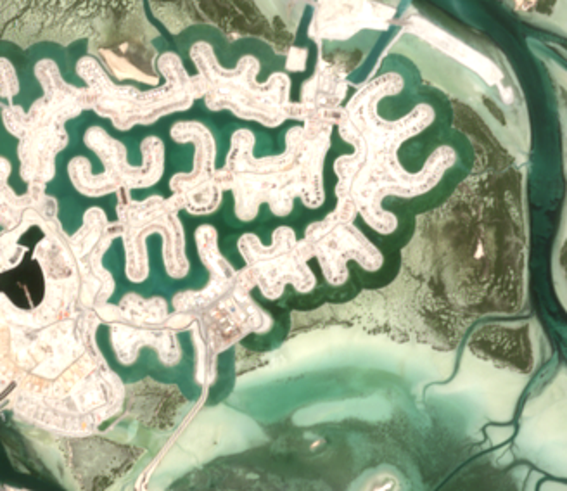
Restoration is scaling faster than monitoring
THE PROBLEM
THIS IS HAPPENING NOW · STAND 5, ABU DHABI
100 M
UAE mangrove pledge by 2030
COP26, 2021 · Abu Dhabi Mangrove Initiative
Nov 2021 · intact
Oct 2022 · works start, alert fires
100 M+
Saudi mangrove pledge by 2030
Saudi Green Initiative
Feb 2026
first GCC mangrove monitoring guide
Jun 2023 · canals cut
May 2026 · development
EAD + IUCN Mangrove Specialist Group
TODAY field surveys and one-off studies, no standing alert.
WE SOLVE a calibrated alert every ~5 days that says where to inspect and what carbon is at stake.
Sentinel-2 true colour (contains modified Copernicus Sentinel data). Our alert began on 25 Oct 2022, during the works.
Notes:
TIME: 35 s
SAY: "The Gulf is planting mangroves at record scale: 100 million pledged by the UAE, more than 100 million by Saudi Arabia.
But planting is scaling faster than watching. Look at stand 5." (point at the images, left to right)
"November 2021: intact. October 2022: works start — and that is when our alert fired. 2023: canals. Today: a canal development.
Today, a loss like this is found at the next field survey — after the fact. What we solve: a calibrated alert every five days that says where to inspect, and what carbon is at stake."
DO: press → after "at stake".

Slide 4

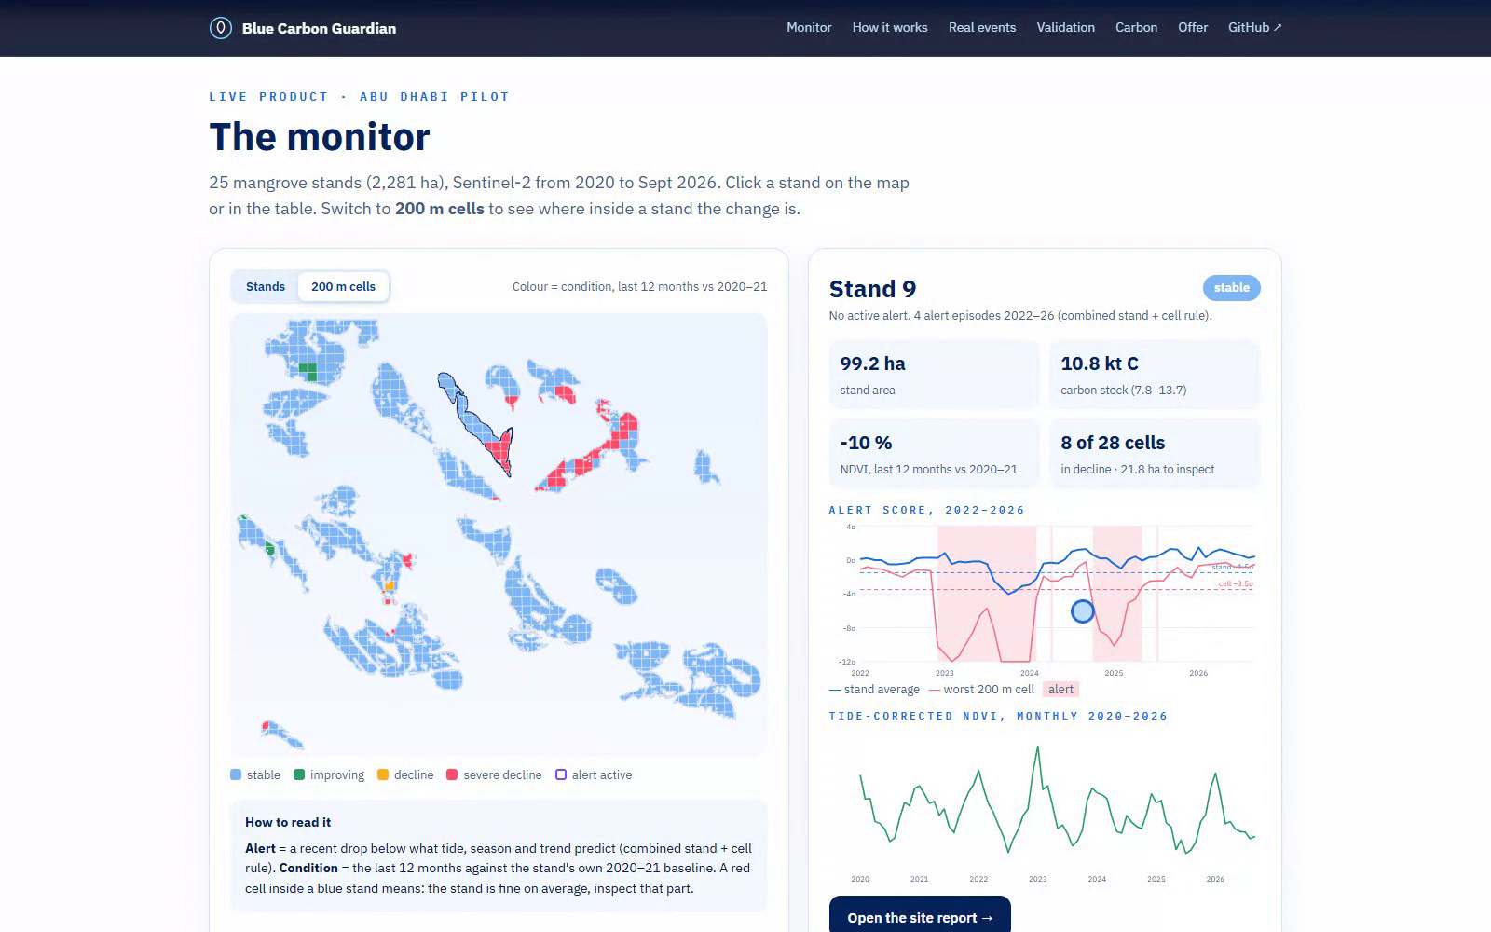




From signal to decision, in one screen
EXAMPLE OUTPUT · THE PRODUCT
nahla-nabil.github.io/blue-carbon-guardian
One alert
stand OR any 200 m cell, calibrated
Where to look
a 200 m cell map for the inspector
Condition
last 12 months vs own 2020–21 baseline
Carbon at stake
stock with a range, from field data
Site report
one page per stand, every number traced
● LIVE DEMO · open stand 9 on the website
Notes:
TIME: 75 s
SAY: "So here is what we built. Let me show you — live."
DO: Alt+Tab to the browser (monitor section).
SAY: "Every stand is coloured by its condition. Stand 5, in red: severe decline."
DO: click "200 m cells" above the map.
SAY: "Now the key idea: we split every stand into 200-metre cells."
DO: scroll down to the table → click the row "9" → scroll back up to the map.
SAY: "Stand 9. On average it reads 'stable'. But 8 of its 28 cells are in severe decline. That is exactly where you send the inspector."
DO: move the mouse over the alert-score chart.
SAY: "Blue is the stand average, red is the worst single cell. The red line plunges far below its threshold — the cells see the damage much more sharply than the average does."
DO (only if ahead of time): click "Open the site report" → new tab → 3 seconds → Ctrl+W.
SAY: "And every stand gets a one-page report with the carbon at stake."
DO: Alt+Tab back to PowerPoint → press → .
FALLBACK: if the site does not load, stay on this slide — the recording plays the same steps; narrate it with the same lines.

Slide 5



Who uses it, and for which decision
BUSINESS USE CASE & END USERS
Environment agencies
Planting & carbon developers
Developers & regulators
EAD, MOCCAE, Saudi NCVC
ADNOC, Red Sea Global, carbon projects
EIA consultants, permit offices
THEIR DECISION
THEIR DECISION
THEIR DECISION
Which stands do we inspect this month?
Is the carbon we report still there?
Did works stay outside the mangrove line?
Today: periodic field surveys
Today: plots and drone campaigns
Today: comparing two images by eye
monthly alert + 200 m cell map: inspect only flagged cells
condition + carbon stock with a range, a site report
an alert when works enter mangrove cells, dated evidence
New scene
Alert
Cell map
Inspection
Site report
every ~5 days
~1 false alarm / stand-yr
where to look
only flagged cells
carbon at stake
Notes:
TIME: 15 s
SAY: "Three users, three decisions.
Agencies: which stands do we inspect this month. Planting and carbon developers: is the carbon we report still there. Developers and regulators: did the works stay outside the mangrove line."
DO: press → .

Slide 6
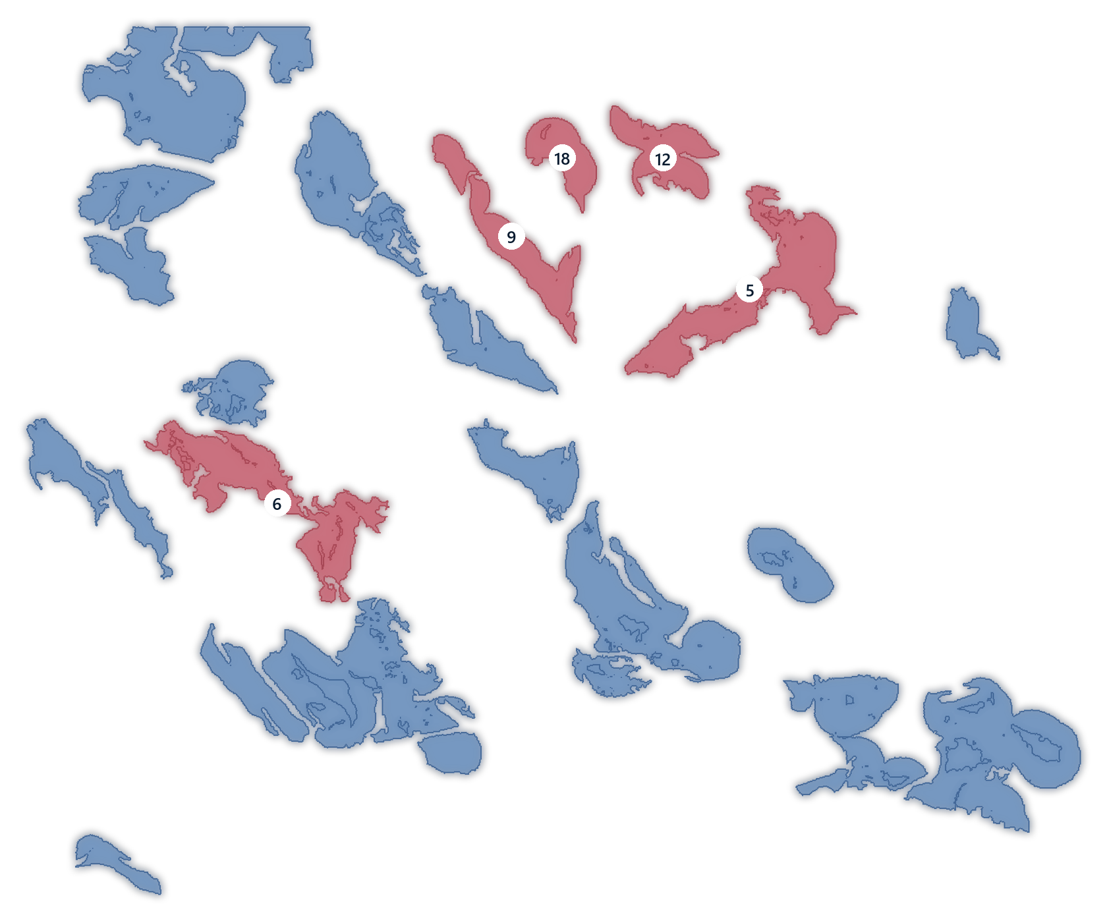

Five independent data sources, six years, 91 stands
DATA & STUDY AREA
Sentinel-2 L2A
778 dates
ESA / Copernicus · 10–20 m time series
EnMAP hyperspectral
2 scenes
DLR · 224 bands · independent check
ESA WorldCover 2021
CC BY 4.0
10 m land cover · stand outlines
Field carbon plots
24 plots
Schile et al. 2016 · carbon density
Pilot: 25 stands · 2,281 ha (WorldCover 2021 patches ≥ 3 ha). +66 unseen stands in Abu Dhabi N/W and Saudi Tarut Bay test transfer.
Sub-metre captures
0.3–0.5 m
WorldView-2/3, Legion-1 · confirm events
Quality control: cloud masks · interior pixels only · tide model · second-source checks
Notes:
TIME: 15 s
SAY: "The analysis rests on five independent data sources: 778 Sentinel-2 dates over six years, EnMAP hyperspectral, ESA WorldCover, field carbon plots, and dated sub-metre imagery.
Every image is cloud-masked, only interior pixels are used, and every finding is cross-checked by a second source."
DO: press → .

Slide 7
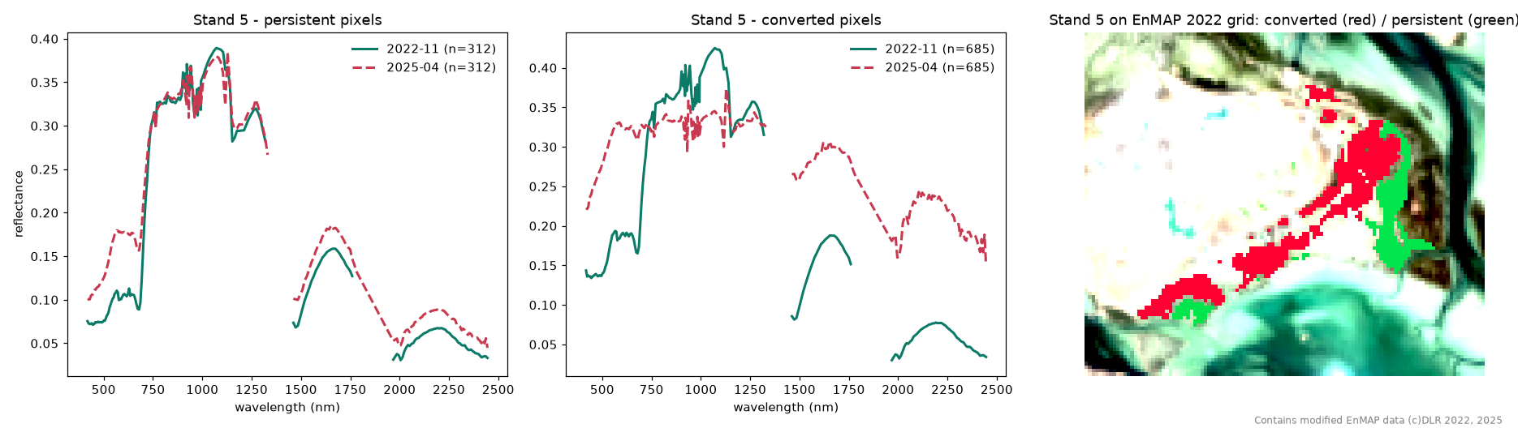
A second sensor shows what the mangrove became
SPACE DATA · HYPERSPECTRAL (ENMAP, 224 BANDS)
r = 0.84–0.99
62 vs 26 ha
Vegetation → mineral
agreement with our Sentinel-2 indices on the same dates (25 and 14 stands)
stand-5 loss: EnMAP pixel count vs our conservative Sentinel-2 flag
converted pixels take the spectrum of sand and fill: reclamation, not dieback
Honest limit: as a classifier, the full spectrum is no better than Sentinel-2-like bands (F1 0.74 vs 0.72). Contains modified EnMAP data © DLR 2022, 2025.
Notes:
TIME: 20 s
SAY: "Here is the second source at work: EnMAP hyperspectral, 224 bands.
On stand 5, the green curves are the vegetation in 2022; the red dashed curves are the same pixels in 2025 — the spectrum of sand and fill. That is reclamation, not dieback.
On the same dates, EnMAP agrees with our Sentinel-2 indices with r up to 0.99."
DO: press → .

Slide 8


Sentinel-2 says when. Satellite 813 says what.
SPACE DATA · READY FOR SATELLITE 813
Sensor | Bands | Range | Pixel | Revisit | Role in the product
Sentinel-2 | 13 | 443–2190 nm | 10–20 m | ~5 days | WHEN: the alert, every pass
EnMAP (used) | 224 | 420–2450 nm | 30 m | ~27 days | WHAT: tested on stand 5
Satellite 813 (next) | ~205 | ~400–1700 nm | ~20 m | on demand | WHAT, sharper: tasked on flagged cells
1 · Sentinel-2 alert
2 · Task Satellite 813
3 · Spectral diagnosis
→
→
stand or 200 m cell below its threshold
only over the flagged cells, on demand
vegetation, or sand and fill: an evidence pack
Every index the monitor uses (NDVI, red edge, SWIR moisture at 1610 nm, wetness) sits inside 813's ~400–1700 nm range, at 20 m instead of EnMAP's 30 m. Planned, not yet tested: 813 scenes were not available in the proof of concept.
Notes:
TIME: 20 s
SAY: "And this is where Satellite 813 comes in. Sentinel-2 tells us when something changed, every five days. Satellite 813 tells us what: once a cell is flagged, we task 813 over just that cell.
Every index we use sits inside 813's range, at 20 metres. It is planned — 813 scenes were not available in this proof of concept."
DO: press → .

Slide 9
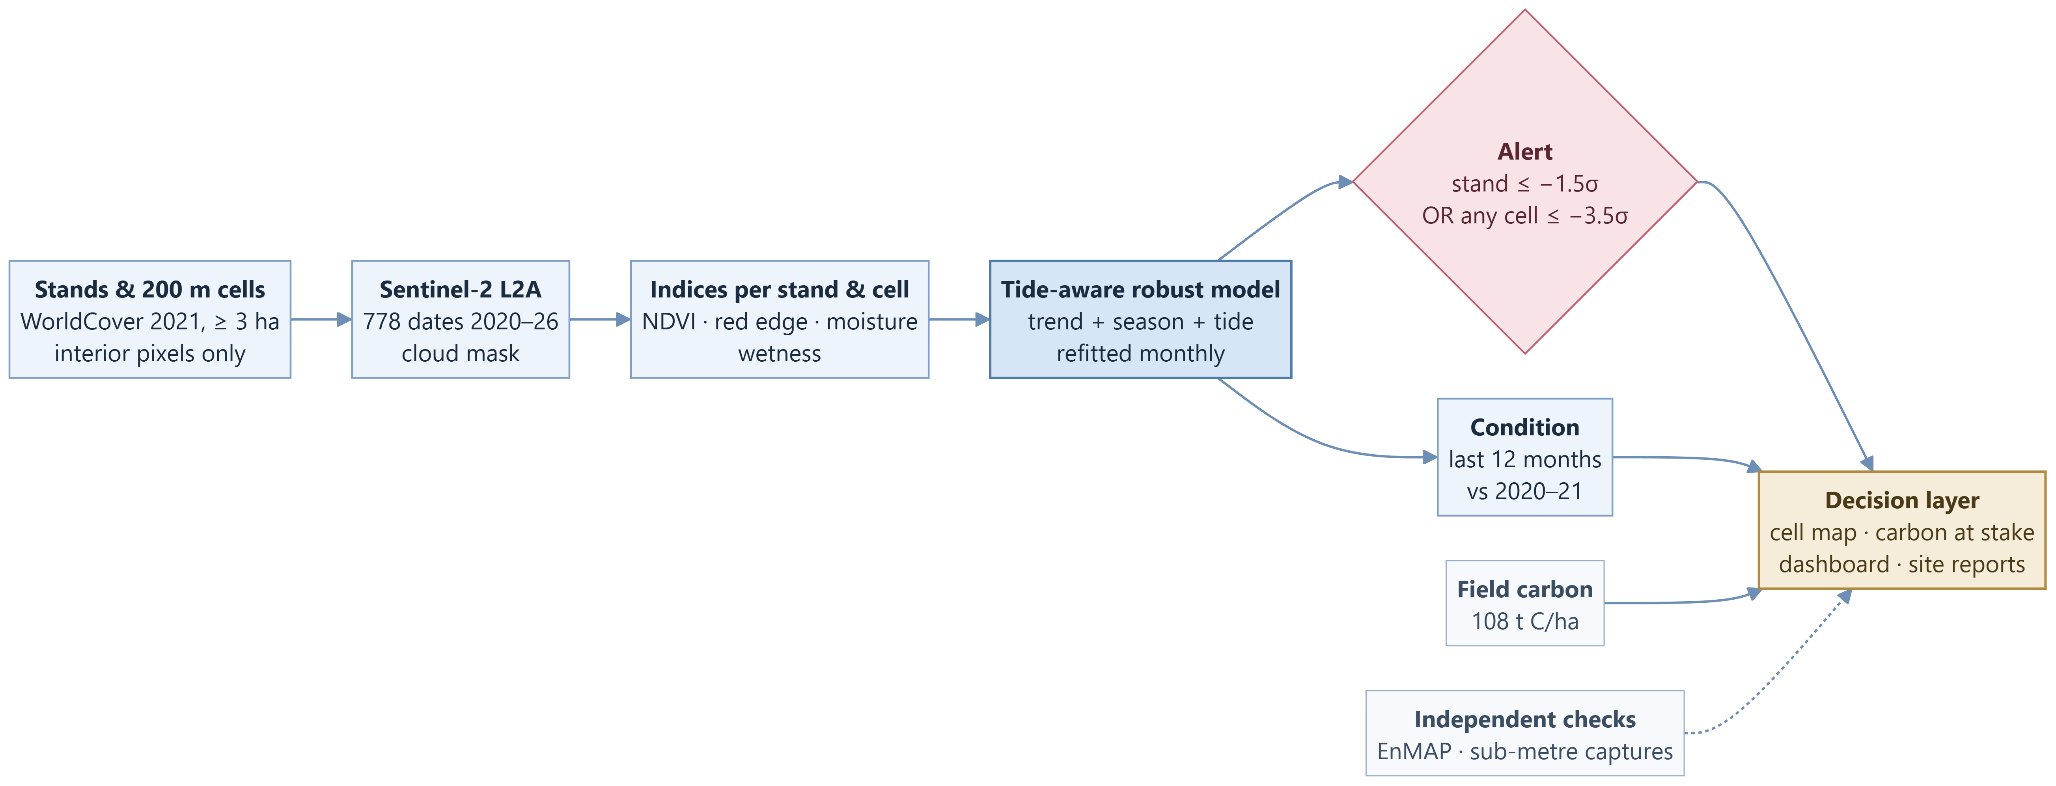
From satellite pixels to a decision
APPROACH · HOW IT WORKS
Read left to right:
Core model
Alert rule
Output to the user
Inputs and checks
Notes:
TIME: 20 s
SAY: "Here is the whole method, left to right.
We cut every stand into 200-metre cells and read every Sentinel-2 date. The tide-aware model — in blue — predicts what each stand and each cell should look like.
If reality falls too far below, the alert rule — in rose — fires. The decision layer — in sand — adds the cell map and the carbon at stake, with EnMAP and sub-metre imagery as independent checks."
DO: point along the boxes as you speak, then press → .

Slide 10
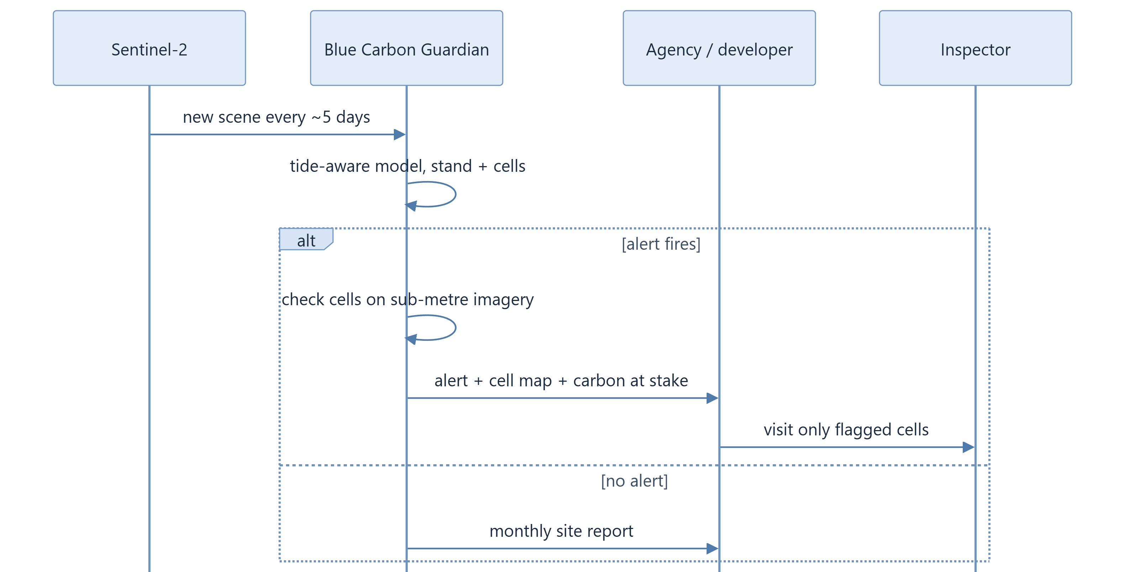


One alert, one message, one targeted visit
DELIVERY · HOW A USER RECEIVES IT
Every ~5 days
a new Sentinel-2 scene is read in place and run through the tide-aware model, per stand and per 200 m cell
If an alert fires
we check the flagged cells on sub-metre imagery, then send the alert by email or JSON API with the cell map and the carbon at stake
If nothing changes
the user still gets a monthly site report: condition, trend and carbon stock for every stand
Notes:
TIME: 10 s
SAY: "For the user: an alert with the cell map and the carbon at stake — the inspector visits only those cells. If nothing changes, a monthly report."
DO: press → .

Slide 11

The tide looks like tree loss — until you correct for it
TECHNICAL INNOVATION 1
WHY NAIVE MONITORS FAIL ON TIDAL FLATS
Low tide
High tide
NDVI 0.30
NDVI 0.18
Same trees, same season. Measured on our stands: noise vs wetness r ≈ −0.9.
−29 to −35 %
less noise on every index: we model trend, season and the tide before flagging anything
1.61 → 0.96
false alarms per stand-year: textbook NDVI-only vs our tide-aware monitor, same alert rule, same 25 stands (40 % fewer)
Notes:
TIME: 45 s
SAY: "Now the hard part — the one that breaks most monitors in the Gulf: the tide.
When the tide comes in, flooded mangroves look, from space, like dying mangroves. In this illustration the same trees drop from 0.30 to 0.18.
On our stands, index noise follows wetness with a correlation of minus 0.9.
So for every stand and every date we model trend, season — and the tide.
Noise falls by 29 to 35 percent on every index." (point at the right card at the bottom)
"And we tested the textbook recipe — NDVI alone, no tide model — on the same stands with the same alert rule: 1.61 false alarms per stand per year. Ours: 0.96. Forty percent fewer wasted site visits, and the tide model is most of that gain. That is what makes a reliable alert possible."
DO: wait for the water to rise in the illustration, then press → on "reliable alert".

Slide 12
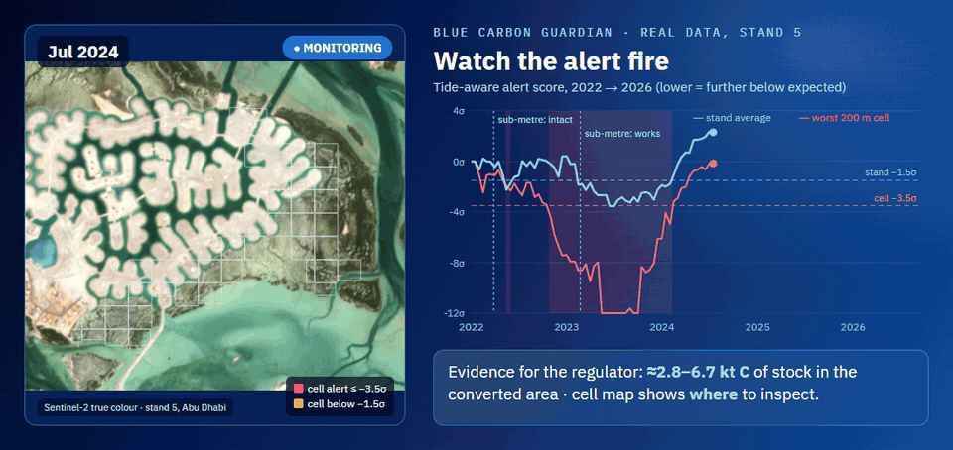
A stand average hides partial loss. 200 m cells do not.
TECHNICAL INNOVATION 2
8 of 28
cells of stand 9 in severe decline while its average reads “stable”
3 of 5
real conversions found only by the cells (stands 12, 18, 6)
ONE ALERT RULE
Real stand-5 data, 2022 → 2026: cells turn red while the stand average barely moves.
stand ≤ −1.5σ
OR
any cell ≤ −3.5σ
Partial loss caught within 60 days (simulated)
calibrated together: 0.96 false-alarm episodes per stand-year
73 % stand + cells
25 % stand alone
13 % by chance
Notes:
TIME: 25 s
SAY: "Our second innovation: averages hide damage.
Real data from stand 5: watch the cells turn red while the stand average barely moves. Three of our five real conversions were found only by the cells.
In simulation, a partial loss is caught within 60 days 73 percent of the time — against 13 percent by chance."
DO: press → .

Slide 13
How we differ from what exists today
INNOVATION & DIFFERENTIATION
 | Field surveys | One-off satellite maps | Free loss alerts (Global Mangrove Watch) | Blue Carbon Guardian
How often | campaigns | yearly or less | monthly | every ~5 days
Corrects for the tide | n/a | not usually | not documented | ✓ tide model
Says where inside a stand | ✓ | — | — | ✓ 200 m cells
Published false-alarm rate | n/a | n/a | accuracy only | ✓ ≈ 1 per stand-year
Carbon at stake per alert | — | — | — | ✓ field-based
Gulf coverage | ✓ | ✓ | not confirmed | ✓ Abu Dhabi + Tarut Bay
Complementary, not competing: Global Mangrove Watch flags loss worldwide; we add the tide model, the 200 m cells, a measured false-alarm rate and the carbon at stake — built and tested for the Gulf.
Notes:
TIME: 20 s
SAY: "How is this different? Surveys are periodic, maps are one-off, and Global Mangrove Watch's free monthly alerts are complementary.
What we add" (point down the blue column) ": every five days, the tide removed, where inside the stand, a measured false-alarm rate, and the carbon at stake — built and tested for the Gulf."
DO: press → .

Slide 14
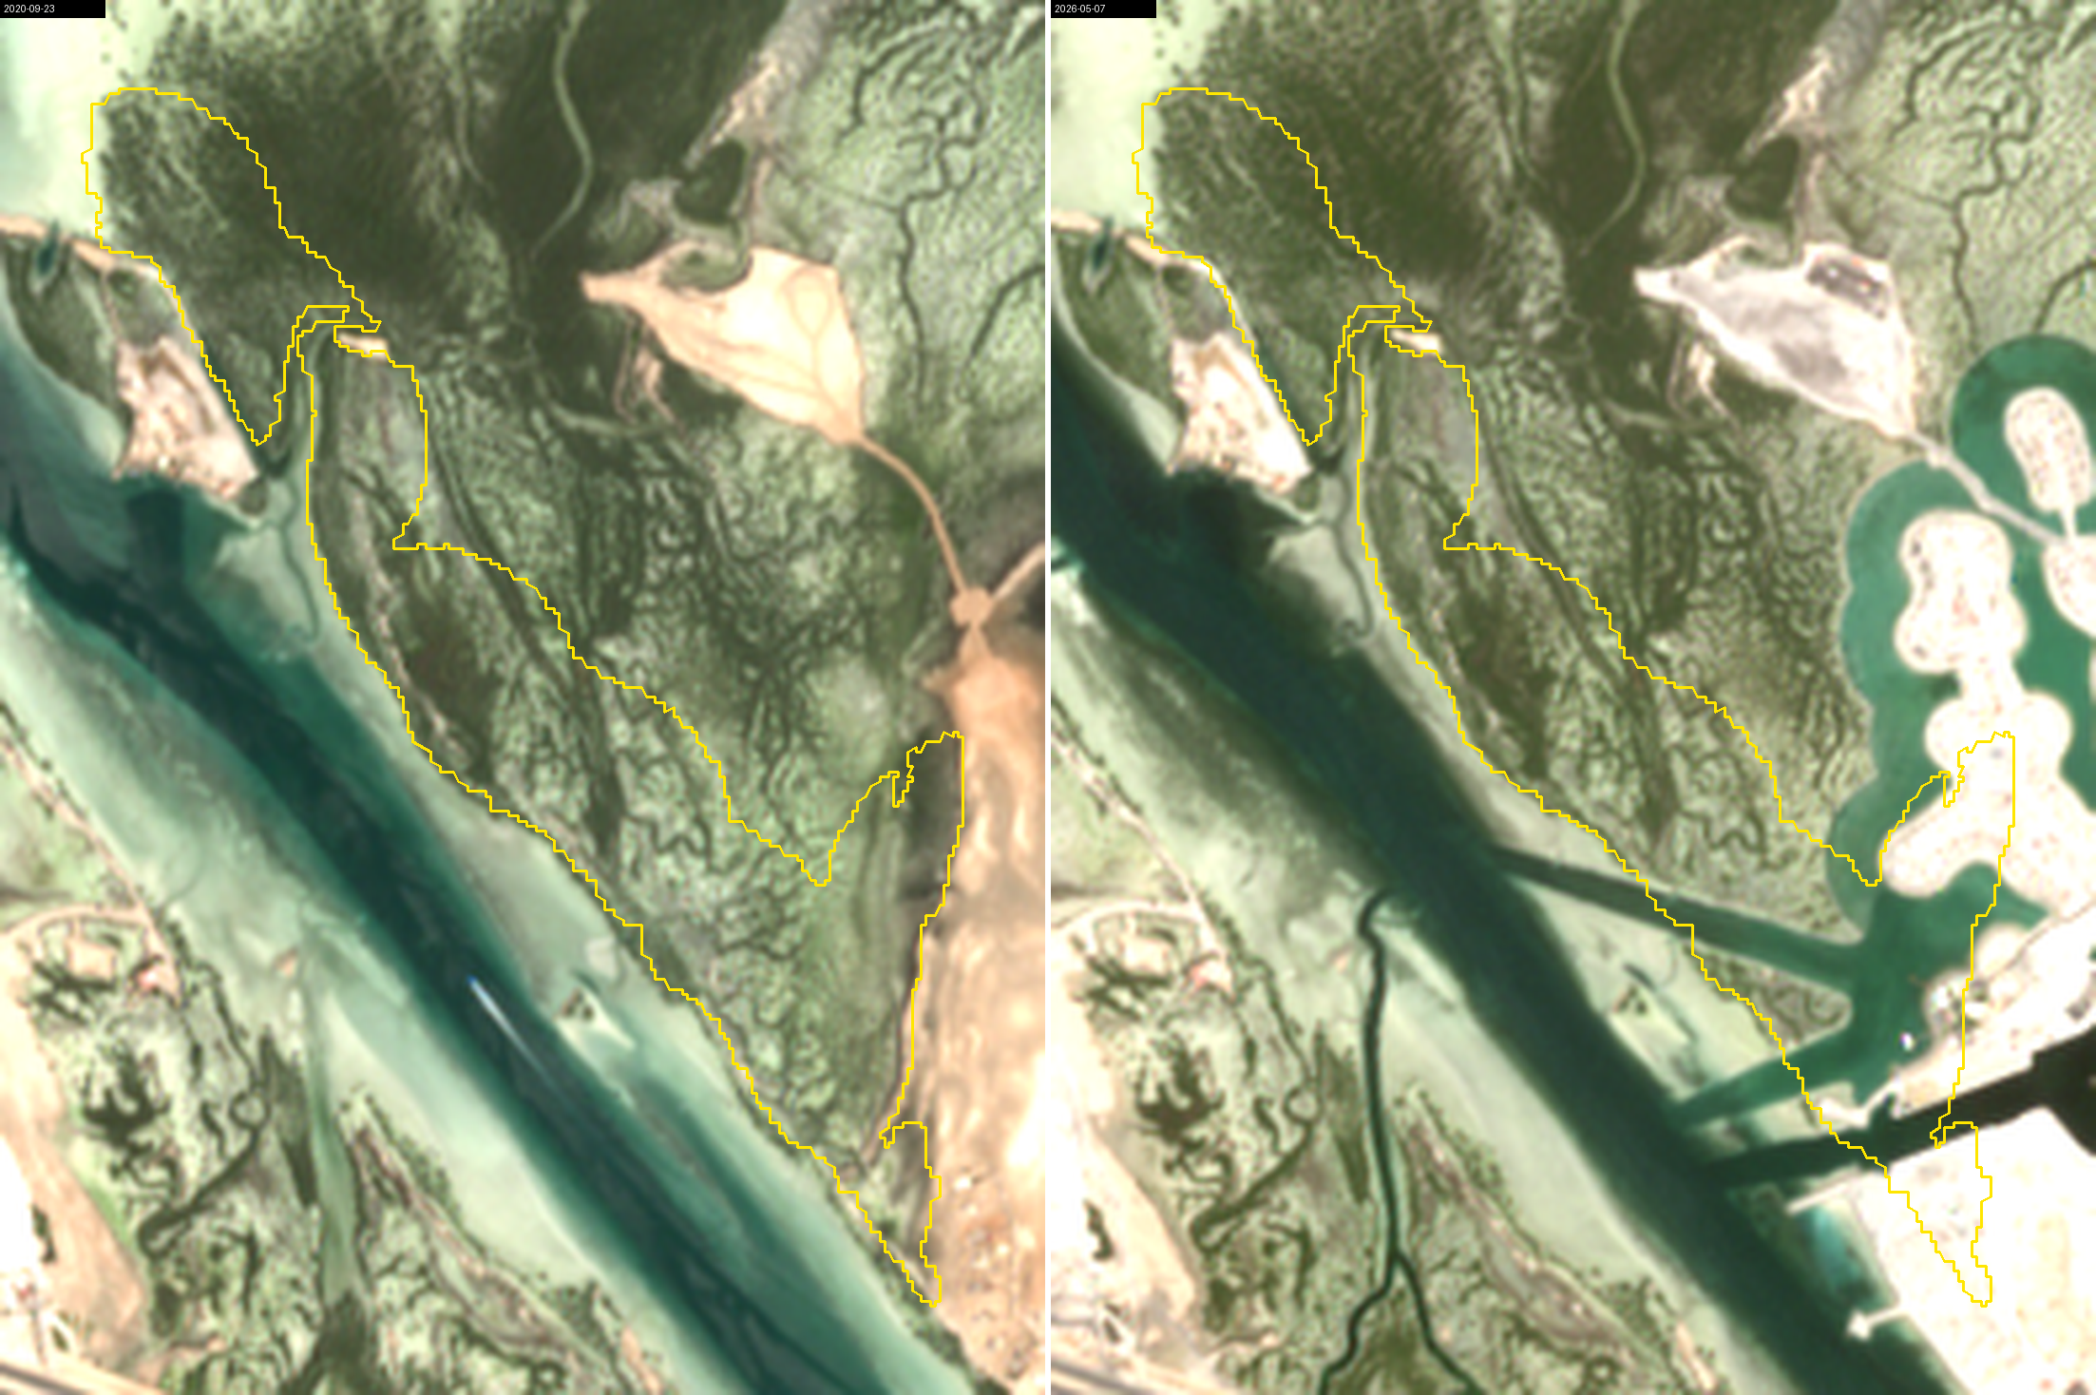
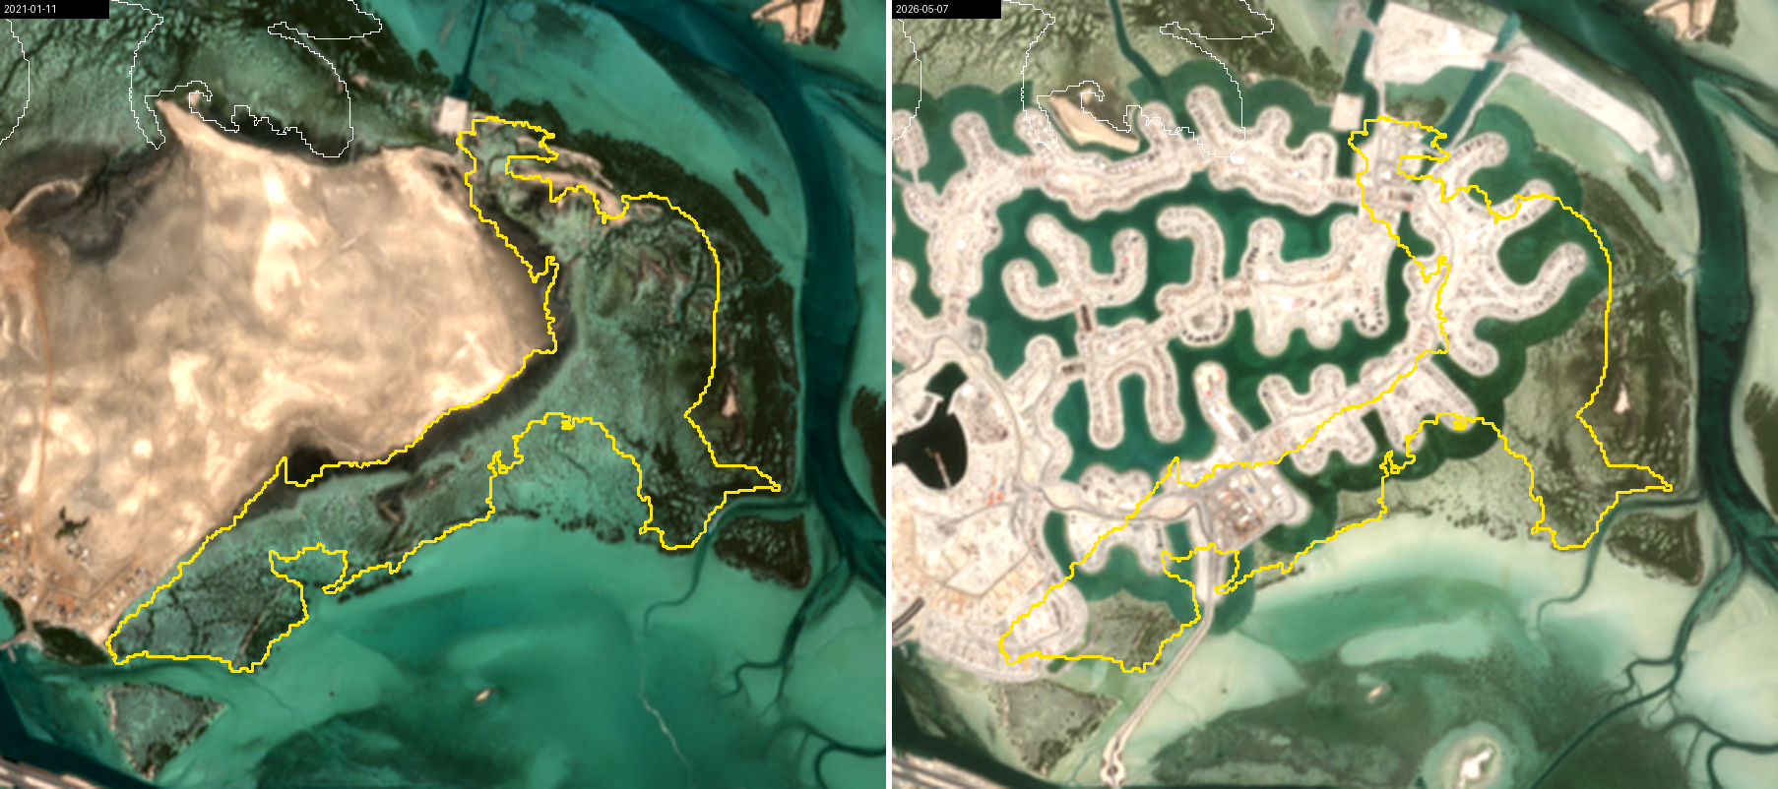
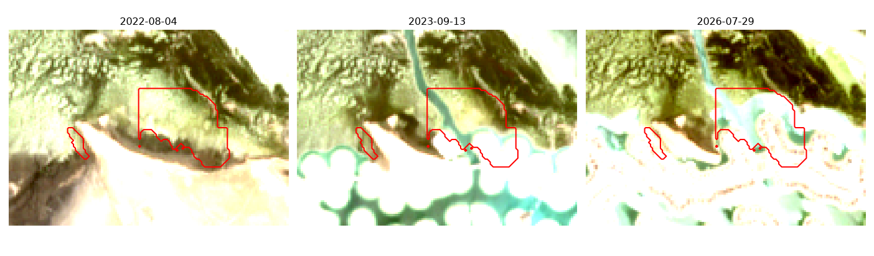
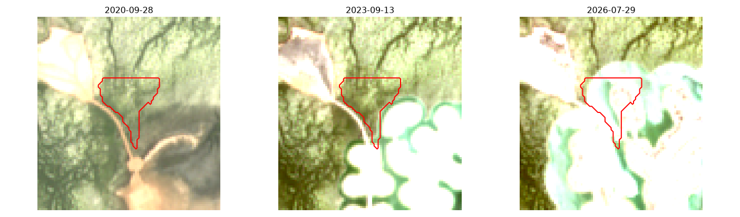
Five real conversions, confirmed on sub-metre imagery
VALIDATION 1 · REAL EVENTS
WHEN DID THE ALERT START?
Stand 5
Stand 9
Stand 12
Stand 6
Stand 5 reclamation with finger canals
Stand 9 canal development, south-east
Stand 18
2022
2023
2024
2025
last intact → first capture with works
our alert starts
Every alert began inside the window. Detection as works happen, not advance warning.
Stand 12 found only by the cells
Stand 18 found only by the cells, 2025
Notes:
TIME: 35 s
SAY: "Does it work on real events? Five real conversions, all confirmed on 30-to-50-centimetre imagery.
The blue bar is the window between the last intact image and the first image showing works; the diamond is when our alert started. Every alert falls inside that window." (point at stand 5's diamond)
"This is detection while the works happen — not a prediction. We never claim advance warning."
DO: press → .

Slide 15
Every rate next to its chance rate
VALIDATION 2 · CHANCE, UNSEEN STANDS, SECOND SENSOR
CALIBRATED · 25 STANDS
0.96
false-alarm episodes per stand-year
UNSEEN · 65 STANDS
0.79
per stand-year, 305 stand-years, incl. Saudi Tarut Bay
ENMAP · SAME DATES
r = 0.84–0.99
vs our Sentinel-2 indices; stand-5 loss 62 ha vs our 26 ha
A detection counts only if a new alert starts after the loss begins. ~160–240 trials per row.
What we do not claim: advance warning, field verification, species discrimination, or that hyperspectral classifies better (F1 0.74 vs 0.72). We withdrew our own first test (58 % / 90 %): it had no chance baseline.
Notes:
TIME: 35 s
SAY: "We also tested ourselves against pure chance — every rate has its chance rate next to it.
Partial loss: 73 percent caught, 13 by chance; a uniform loss, 63 versus 36.
On 65 stands the model never saw, thresholds frozen, false alarms stayed at 0.79 per stand-year.
And when we found a flaw in our own first test, we withdrew it. These are the numbers that survived — and our limits are on the record; I am happy to go through them."
DO: press → on "go through them". (If asked about limits or NDVI later: type 21 or 20 + Enter.)

Slide 16
Carbon at stake, and who pays to protect it
IMPACT & BUSINESS VIABILITY
108 t C/ha
247 kt C
2.8–6.7 kt C
field density near the stands (90 % CI 79–138); 82 % of it is in the soil
pilot stock, 2,281 ha (range 180–316) ≈ 907 kt CO₂e
stock on the 26–62 ha lost at stand 5: what one alert puts on the table
SERVICE TIERS (PRICES ARE PILOT HYPOTHESES)
COMPETITION
Global Mangrove Watch sends free monthly loss alerts (Gulf coverage not confirmed). We are complementary: tide-aware, calibrated, stand + cell, carbon and reports.
Monitor
Evidence
Development watch
$12k
$25k
$8k
per site / yr
per site / yr
per project / yr
alert, cell map, condition, carbon, monthly reports
+ sub-metre check of every alert, audit pack
for coastal developers and EIA consultants
THE HONEST MARKET
Gulf + Red Sea subscriptions ≈ $0.2–0.4 M / yr. The real prize: a national MRV contract or a monitoring layer on gIQ. SDG 13 · 14 · 15.
Cost to serve ≈ $3.3k / site / yr: compute < $5 (measured), sub-metre checks $500–750, analyst $2k (assumption).
Notes:
TIME: 30 s
SAY: "Why it matters. 108 tonnes of carbon per hectare in these stands — 82 percent in the soil, released when the stand is cleared. The pilot holds about 247 thousand tonnes; stand 5 alone lost 3 to 7 thousand.
As a service: about 12 thousand dollars per site per year, against a cost to serve of about 3 thousand. The real prize is a national MRV contract, or a monitoring layer on gIQ."
DO: press → .

Slide 17






Reproducible today, built to scale tomorrow
BONUS CRITERIA · BEYOND THE PROOF OF CONCEPT
BONUS · DOCUMENTATION & REPRODUCIBILITY
BONUS · SCALABILITY BEYOND THE POC
Public repository, MIT licence
Proven now
code, notebook, figures, provenance and licences
91 stands · 2 countries · 2 Sentinel-2 tiles · 65 unseen stands at 0.79 false alarms / stand-yr · compute < $5 per site per year
Re-runs end to end in ~24 s
outputs committed · pinned requirements · example in/out
Incubation
Clean-machine test passed
Satellite 813 in the spectral step · deployment on gIQ · a pilot customer + site records · more EnMAP dates
fresh environment, same numbers, 0 errors
Every number traceable
each figure comes from a script and a written summary
Scale
Live website + site reports
Gulf ≈ 165 km² + Red Sea ≈ 200 km² of mangrove · sub-metre data for small stands (Bahrain) · national MRV, licensing
anyone can open the monitor and check a stand
Areas: Frontiers in Marine Science 2025. Compute measured; prices assumed.
Notes:
TIME: 15 s
SAY: "Beyond the proof of concept: everything is public and reproducible — the notebook re-runs in 24 seconds, and a clean-machine test gives the same numbers.
It already transferred to unseen stands and a second country, at under five dollars of compute per site per year."
DO: press → .

Slide 18
TEAM BLUE ATHAR · الأثر الأزرق
Every lost mangrove leaves a trace.
We find it from space.
Overall value: a working product · five real events confirmed · every number reproducible
Tide-aware
5 of 5
0.79
Open
29–35 % less noise
conversions alerted during the works, 3 only by cells
false alarms / stand-yr on unseen stands
public code, re-runs in ~24 s
Our ask: incubation to run a pilot with a Gulf agency or planting programme, mentor access on hyperspectral reading of mangroves, and Satellite 813 scenes when available.
nahla-nabil.github.io/blue-carbon-guardian · github.com/Nahla-Nabil/blue-carbon-guardian
Thank you
Notes:
TIME: 10 s
SAY (slow, look at the camera): "A working product, five real events confirmed, every number reproducible.
Every lost mangrove leaves a trace — and we find it from space.
Our ask: incubation, to run a pilot with a Gulf agency or planting programme."
DO: press → (thank-you slide).

Slide 19
Thank you
شكراً للإمارات
To the United Arab Emirates — for leading the region in protecting its mangroves, and for opening space to Arab youth.
With thanks to: UAE Space Agency · National Space Academy · Space42 · the mentors and the judges
From Bahrain, with gratitude — Nahla Nabil · Team Blue Athar
Notes:
TIME: 10 s
SAY (warm, slow): "Thank you — to the United Arab Emirates, for leading our region in protecting its mangroves, and to the UAE Space Agency, the National Space Academy and Space42 for this programme.
I'm happy to take your questions."
DO: stop talking; stay on this slide during the Q&A. If a question needs evidence: → backup slides (textbook baseline, limits, demo video) or Alt+Tab to the website.

Slide 20
The textbook approach against ours, same alert rule
BACKUP · FOR QUESTIONS
Configuration | Indices | Tide model | False alarms per stand-year | Real conversions caught
A · textbook | NDVI | no | 1.61 | 5 of 5
B | NDVI | yes | 1.04 | 5 of 5
C | NDVI + red edge + SWIR moisture | no | 1.36 | 5 of 5
D · ours | NDVI + red edge + SWIR moisture | yes | 0.96 | 5 of 5
40 % fewer false alarms
The tide model is most of the gain
Honest limit
20 stands with no known change, 93.9 stand-years: about 16 fewer unnecessary inspections a year for 25 stands.
NDVI alone 1.61 → with tide terms 1.04; the extra indices bring it to 0.96.
Thresholds calibrated for our monitor; all four catch the five conversions. The difference is the false-alarm cost, not detection.
Notes:
TIME: 0 s
BACKUP — do not present. Open only if asked about NDVI, baselines or false alarms.
SAY: "Same alert rule, same 25 stands: NDVI alone gives 1.61 false alarms per stand-year, ours 0.96 — 40 % fewer, mostly thanks to the tide model. All four catch the five conversions; the difference is the false-alarm cost."

Slide 21

Where it breaks — and what we do not claim
BACKUP · FOR QUESTIONS
Detection, not early warning
10 m pixels
Imagery, not site visits
Alerts fire as works happen. We never claim to see stress before it is visible.
Patches under ~0.6 ha and young plantings are missed, Bahrain's small stands included.
Conversions confirmed on dated sub-metre captures, not yet on permits or field records.
Simulated losses
Hyperspectral
Carbon
Canopy-cover loss, not leaf stress; every rate shown next to its chance rate.
EnMAP confirms our indices but was not a better classifier (F1 0.74 vs 0.72).
Area × field density from four sites (2013–14): a stock with a range, never a sequestration rate.
Rule we kept: no detection rate without its chance rate; no claim of advance warning, field verification or species discrimination.
Notes:
TIME: 0 s
BACKUP — do not present. Open only if asked about limits or what we claim.
SAY: "Detection while works happen, not early warning; 10-metre pixels miss very small stands; confirmation on dated imagery, not site visits — matching permits with a partner is our first pilot task."

Slide 22
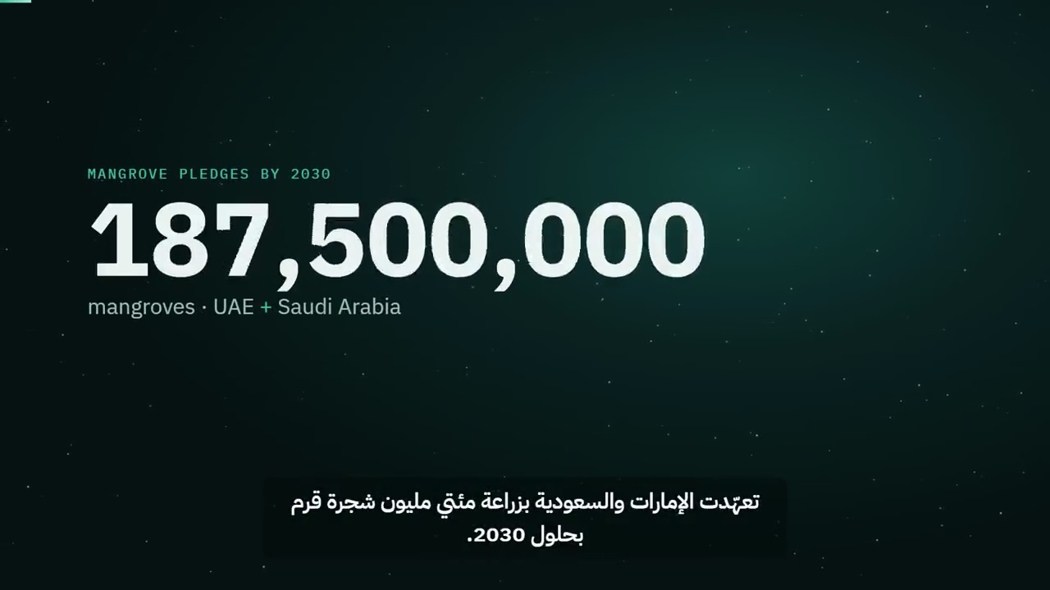
The 2-minute product demo
BACKUP · FOR QUESTIONS
Notes:
BACKUP - only if a judge asks to see the product again, or the live demo failed.
DO: click the video to play it (sound on, 2 min). Press Esc to leave the slideshow afterwards.
SAY: "Here is the two-minute walkthrough of the product."

